Slide 1
CHAPTER 8
Understanding user requirements

Slide 2
Review chapter 7
Chapter 6: Requirements elicitation.
Planning Req. Elicitation
Req. Elicitation Techniques
Classifying users input
Workshop
Interview
Biz req.
User req.
Biz rules
Focus group
Observation
Questionnaire
Document analysis
Prepare for elicitation
Perform elicitation
Follow up after elicitation
Some cautions about elicitation
Balance stakeholder representation
Functional req.
Quality attributes
….
Define scope appropriately
…

Slide 3

Objectives
Understand two of the most commonly employed techniques for exploring user requirements: use cases and user stories
Student could address all the functional requirements of a project by use case diagram and use case specification.

Slide 4
Contents
Use cases and user stories
The use case approach
Use cases and usage scenarios
Identifying use cases
Exploring use cases
Validating use cases
Use cases and functional requirements
Use case traps to avoid
Benefits of usage-centric requirements

Slide 5
Use cases and user stories
A use case describes a sequence of interactions between a system and an external actor that results in the actor being able to achieve some outcome of value.
The names of use cases are always written in the form of a verb followed by an object.
Select strong, descriptive names to make it evident from the name that the use case will deliver something valuable for some user.
Users and actors.

Slide 6
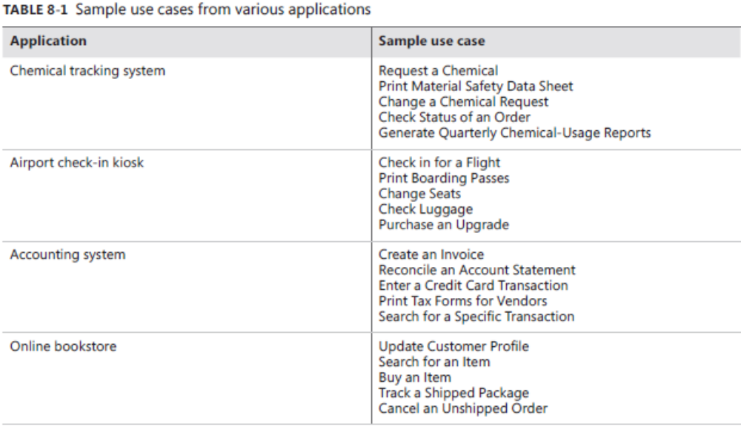
Use cases and user stories

Slide 7
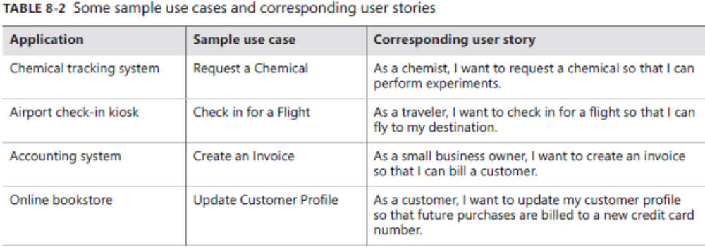
Use cases and user stories
As used on agile project, a user story is a “short, simple description of a feature told from the perspective of the person who desires the new capability, usually a user or customer of the system.”
User stories are often written by “As a <type of user>, I want <some goal” so that <some reason>.

Slide 8
The use case approach
Use case describes a sequence of interactions between a system and an external actor that results in some outcome that provides value to the actor. An actor is a person (or another SW system) that interacts with the system to perform a use case.
Questions to consider
  What will the actor use the system for?
  Will the actor create, store, change, remove, or read data in the system?
  Will the actor need to inform the system about external events or changes?
  Will the actor need to be informed about certain occurrences in the system?
Provide a brief description that elaborates the intent of the use case.
Program Vacation Setting
Actor(s): Homeowner/programmer
Description: Homeowner/programmer sets lighting and alarm options for an extended stay away from home.
Notes:
Homeowner/programmer sets lighting and alarm options for an extended stay away from home: Chủ nhà / lập trình viên thiết lập các tùy chọn chiếu sáng và báo động cho một lần xa nhà.

Slide 9
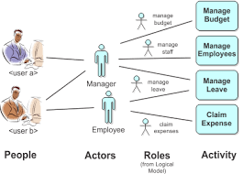
Users and Actors
Users:
  A human user has a collection of hats available, each label with the name of an actor that the system will recognize as participating in certain use cases.
Actors
  When the user want to perform a certain action with the system, he puts on the appropriate hat. The system will recognize that person as the labeled actor when he launches whatever use case he’s interested in performing.
Notes:
- The system will recognize that person as the labeled actor when he launches whatever use case he’s interested in performing: Hệ thống sẽ nhận ra người đó là diễn viên được dán nhãn khi anh ta khởi chạy bất kỳ trường hợp sử dụng nào mà anh ấy thích biểu diễn.

Slide 10
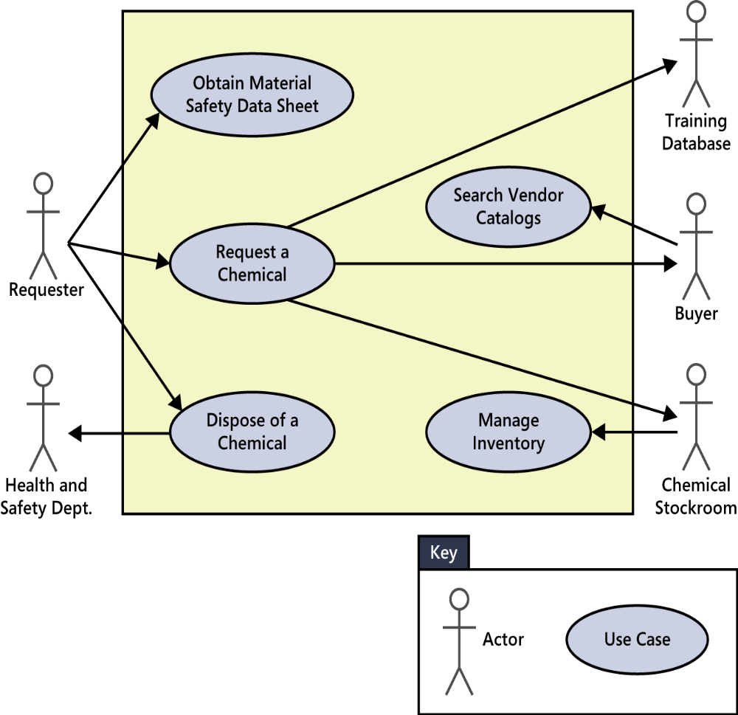
Use Case Diagrams
Use case diagrams provide a high-level visual representation of the user requirements.
Arrows from an actor connect to the use cases.
An arrow from an actor to a use case indicates that he is the primary actor for the use case.
The primary actor initiates the use case and derives (lấy) the main value from it. An arrow goes from a use case to a secondary actor, who participates somehow in the successful execution of the use case.
The arrows in the use case diagrams simply indicate the connections between actors and use cases in which they participate.
Notes:
- The primary actor initiates the use case and derives the main value from it. An arrow goes from a use case to a secondary actor, who participates somehow in the successful execution of the use case.: Tác nhân chính khởi tạo trường hợp sử dụng và lấy giá trị chính từ nó. Một mũi tên đi từ trường hợp sử dụng đến một tác nhân thứ cấp, người tham gia bằng cách nào đó thực hiện thành công trường hợp sử dụng.

Slide 11
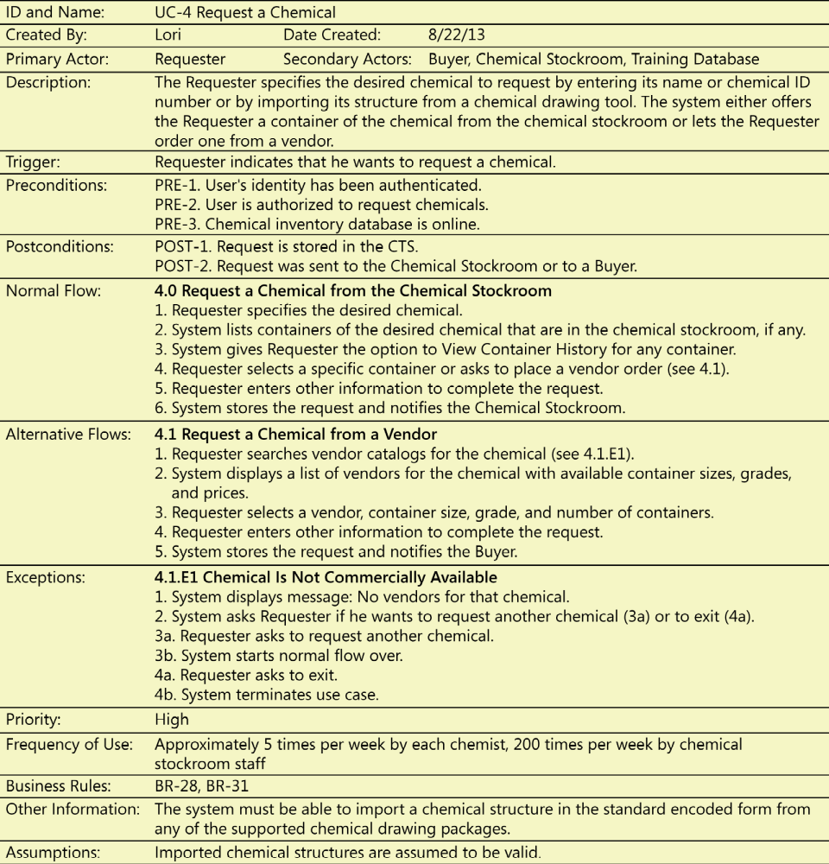
Use cases and usage scenarios
Use case describes a discrete, standalone activity that an actor can perform to achieve some outcome of value.
A use case might encompass a number of related activities having a common goal.
A scenario is a description of a single instance of usage of the system.
Notes:
- Encompass (v): chứa đựng / bao quanh

Slide 12
Use Case Anatomy (mổ xẻ)
Name – Unique and descriptive.
Actors – List all actors that interact with this use case.
Descriptions describe the purpose of the use case.
Trigger initiates execution of the use case.
Pre-conditions – conditions that must be present in order for a use case to start
Post-condition – state of the system after a use case has run its course
Flow of events – Normal flow and Alternate flows
Notes:
- Anatomy (n): mổ xẻ, phân tích

Slide 13
Use Case Anatomy
Normal flow of events is also called the main flow, primary flow, basic flow, normal course, primary scenario,… It’s written as a numbered list of steps, indicating which entity – the system or a specific actor – performs each step.
Alternative flow or secondary flow deliver the same biz outcome as the normal flow but represents less common or lower-priority variations in the specifics of the task or how it is accomplished.
Exception: conditions that have the potential to prevent a use case from succeeding are called exceptions. Exceptions describe anticipated error conditions that could occur during execution of the use case and how they are to be handled. In some cases, the user can recover, but in some other cases, the use must terminate the execution without reaching its success conditions.
Notes:
- Anatomy (n): mổ xẻ, phân tích

Slide 14
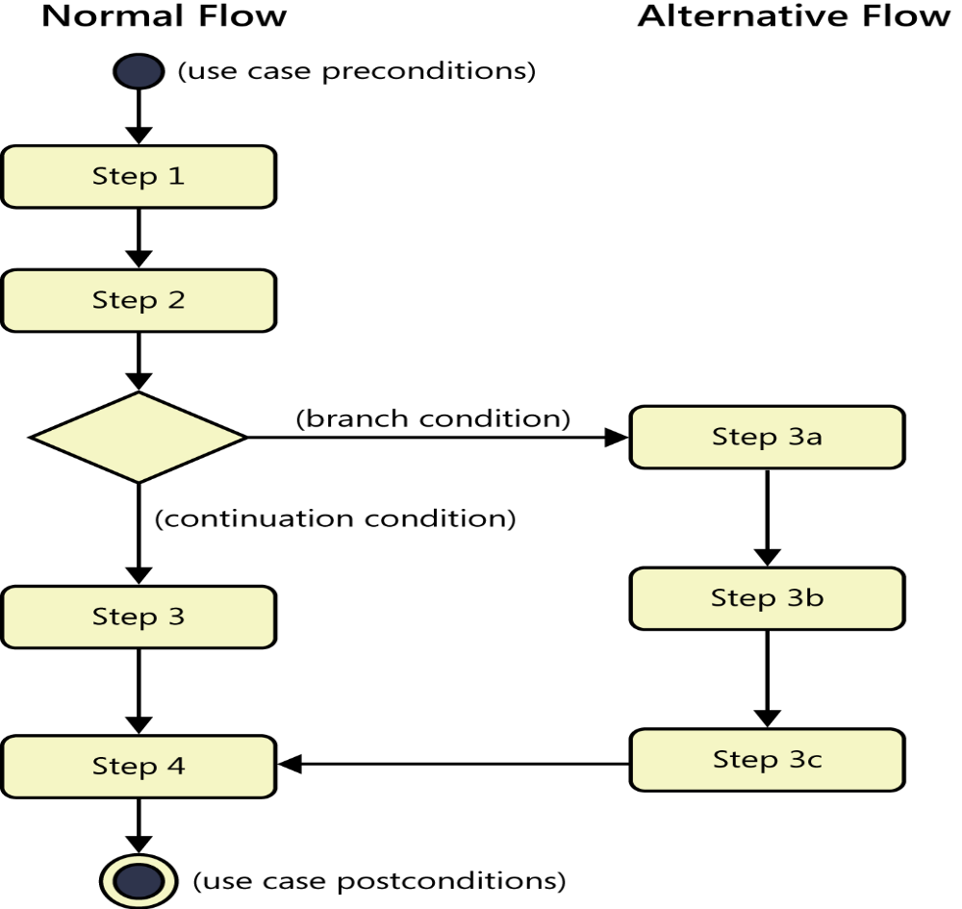
Use Case Anatomy
FIGURE 8-4 An activity diagram illustrating the step sequence in the normal and alternative flows of a use case.
Notes:
- Anatomy (n): mổ xẻ, phân tích

Slide 15
Use cases and usage scenarios
Exploring use cases: Identify the actors → Estimate the frequency of using system → Define the preconditions/postconditions → The resulting sequence of actor actions and system responses became the flow of events → BA captures (nắm được) the actor actions and their corresponding system responses (phản ứng) on sticky notes in the meeting/workshop to discuss about use cases.
Validating use cases: 1 day or 2 after each workshop, the BA send the use cases and functional requirements to the workshop participants to review. These informal reviews reveal many errors: undiscovered alternative flows, new exceptions, incorrect functional requirements,… The mental relaxation (thư giãn tinh thần) that comes after a day or 2 away allows people to examine their earlier work from a fresh perspective (quan điểm mới).
Notes:
Exploring use cases: Khám phá các trường hợp sử dụng
The mental relaxation that comes after a day or 2 away allows people to examine their earlier work from a fresh perspective: Thư giãn tinh thần đến sau một hoặc 2 ngày cho phép mọi người kiểm tra công việc trước đó của họ từ một quan điểm mới

Slide 16
Use cases and usage scenarios
Use cases and functional requirements: Big different!
  Use cases only: Use cases describe the user’s perspective, looking at the externally visible of the system. They don’t contain all the information that a developer need to write the SW.
  a functional requirement defines a function of a system or its component, where a function is described as a specification of behavior between outputs and inputs.
Use cases and tests: If you write both detailed use cases specifications and functional requirements, you might notice some duplication, particularly around the normal flow. You also have to write the acceptance tests to determine if the system properly handles the basic behavior of the use case, alternative success paths, and the various things that could go wrong.
Notes:
Exploring use cases: Khám phá các trường hợp sử dụng
Many functional requirements fall right out of the dialog steps between the actor and the system: Nhiều yêu cầu chức năng rơi ra khỏi các bước hộp thoại giữa tác nhân và hệ thống.

Slide 17
Use cases and usage scenarios
Use case traps to avoid: There many ways to go astray (chệch hướng) when applying the use case approach:
  Too many use cases: You’ll typically have many more use cases than business requirements and features, but many more functional requirements than use cases.
  Highly complex use cases: If you review a use case with 4 dense (dày đặc) pages of dialog steps, with a lot of embedded logic and branching conditions, it’s incomprehensible.
  Including design in the use case: Use cases should focus on what the users need to accomplish with the system’s help, not on how the screen will look.
  Including data definitions in the use cases: Some use case authors include definitions of the pertinent data elements right in the use case specification. This makes it difficult for people to find the information because it isn’t obvious which use case contains each data definition.
  Use cases that users don’t understand: If users can not relate a use case to their biz processes or goals, there’s a problem.
Notes:
Astray (adv): chệch hướng
You’ll typically have many more use cases than business requirements and features, but many more functional requirements than use cases: Thông thường bạn sẽ có nhiều trường hợp sử dụng hơn các yêu cầu và tính năng kinh doanh, nhưng nhiều yêu cầu chức năng hơn các trường hợp sử dụng
Dense (adj): rất nặng / dày đặc / đông đúc / rậm rạp
Too many use cases: You’ll typically have many more use cases than business requirements and features, but many more functional requirements than use cases. But if there are too many use cases, you can not write them at the appropriate level of abstraction.
Highly complex use cases: If you review a use case with 4 dense pages of dialog steps, with a lot of embedded logic and branching conditions, it’s incomprehensible. In this case, you need to select one success path through the use case and call that the normal flow. Use alternative flows for other logic branches that lead to success, and use exceptions to handle branches that lead to failure. You might have many alternatives, but each one will be short and easy to understand.

Slide 18
Use cases and usage scenarios
Benefits of usage-centric requirements: The usage-centric approach leads to functionality that will allow the user to perform certain known tasks. That helps prevents “orphan functionality” (chức năng mồ côi) that seems like a good idea but that no one uses because it doesn’t relate directly to user goals.
A use case or user story could be of high priority for several reasons:
  It describes part of a core biz process that the system enables.
  Many users will use it frequently.
  A favored user class requested it.
  It’s required for regulatory compliance.
  Other system functions depend on its presence.
Notes:
Benefits of usage-centric requirements: Lợi ích của yêu cầu trung tâm sử dụng
Orphan (adj): mồ côi, đứng 1 mình

Slide 19
Assignment 1: Use cases
Every group lists all use cases of your project for every primary actor.
Each member chooses one use case and describes in details for chosen use case. This means that if your group has 4 members, your group need to describe 4 use cases in the file.
Team leader send me list of team members and the name of use cases that they will do. If a member in the team doesn’t his/her use case, will receive ZERO for this assignment.
Template is in the attach file.
Deadline: 20:00 – 23/02/2020

Slide 20
Review chapter 8
Chapter 8: Understanding user Requirements.
The user case approach
Use case & Use story
Use case & usage scenarios
User story
User case
Users
Actors
User case diagram
Sample of user case
Exploring use case
Validating use case
Use case & Functional Req.
Use case & tests
Use case traps

Slide 21

Notes:
- pay-off (n): chi trả

