Slide 1
CHAPTER 9
Playing by the rules

Slide 2
Review chapter 8
Chapter 8: Understanding user Requirements.
The user case approach
Use case & Use story
Use case & usage scenarios
User story
User case
Users
Actors
User case diagram
Sample of user case
Exploring use case
Validating use case
Use case & Functional Req.
Use case & tests
Use case traps

Slide 3
Objectives
After finish this chapter, student should understand the influence of business rule on many type of software requirements.
Student could identify at least one of each business rule type from the taxonomy in Figure 9-1 for student’s project.
Set up a traceability matrix to indicate which functional requirements enforce each business rule that student identified.
Identify the rationale behind each functional requirements to discover other, implicit business rules.
Notes:
Taxonomy (n): sự phân loại, phép phân loại
Traceability (n): sự truy tìm nguồn gốc
Identify the rationale behind each functional requirements to discover other, implicit business rules: Xác định lý do đằng sau mỗi yêu cầu chức năng để khám phá các quy tắc kinh doanh khác, ngầm định.

Slide 4
Contents
A business rules taxonomy
Documenting business rules
Discovering business rules
Business rules and requirements
Tying everything together

Slide 5
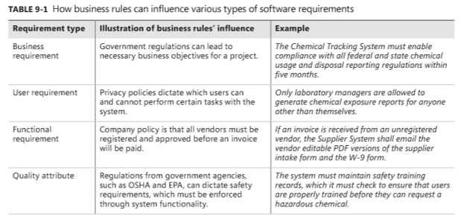
Business rules overview
Biz rules often enforced through manual implementation of policies and procedures. In many cases, SW applications also need to enforce these rules.

Slide 6
Differences bw biz rules, biz processes, and biz requirements
People sometimes confuse biz rules with biz processes or biz requirements.
Biz requirement states desirable outcome or a high-level objective of the organization that builds or procures a SW solution.
Biz process describes a series of activities that transform inputs into outputs to achieve a specific result.
Biz rules influence biz processes by establishing vocabulary, imposing restriction, triggering actions, and governing (điều chỉnh) how computations are carried out.
Notes:
- Biz rules influence biz processes by establishing vocabulary, imposing restriction, triggering actions, and governing how computations are carried out: Các quy tắc kinh doanh ảnh hưởng đến các quy trình kinh doanh bằng cách thiết lập vốn từ vựng, áp đặt các hạn chế, kích hoạt các hành động và điều chỉnh cách tính toán được thực hiện

Slide 7
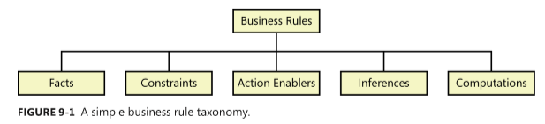
A business rules taxonomy
Definition for biz rules from perspectives of both the biz and its information systems:
  From the business perspective: “A biz rule is guidance that there is an obligation concerning conduct, action, practice, or procedure within a particular activity or sphere (lĩnh vực).”
  From the information system perspective: “A biz rule is a statement that defines or constrains some aspect of the biz. It is intended to assert (nhằm khẳng định) biz structure or to control or influence the behavior of the biz.”
A simple business rule taxonomy: 5 types of rules.
Notes:
Having undocumented business rules known only to certain experts results in a knowledge vacuum when those experts leave the organization: Có các quy tắc kinh doanh không được ghi lại chỉ được biết đến bởi một số chuyên gia dẫn đến khoảng trống kiến thức khi những chuyên gia đó rời khỏi tổ chức.
Sphere (n): lĩnh vực hoạt dộng, phạm vi, tầm ảnh hưởng
A biz rule is guidance that there is an obligation concerning conduct, action, practice, or procedure within a particular activity or sphere: Một quy tắc kinh doanh là hướng dẫn rằng có một nghĩa vụ liên quan đến hành vi, hành động, thực hành hoặc thủ tục trong một hoạt động hoặc lĩnh vực cụ thể.
A biz rule is a statement that defines or constrains some aspect of the biz. It is intended to assert biz structure or to control or influence the behavior of the biz: Quy tắc kinh doanh là một tuyên bố xác định hoặc ràng buộc một số khía cạnh của kinh doanh. Nó nhằm mục đích khẳng định cấu trúc kinh doanh hoặc để kiểm soát hoặc ảnh hưởng đến hành vi kinh doanh.

Slide 8
A business rules taxonomy
Facts are simply statements that are true about the biz at a specific point in time. Exs:
  Every chemical container has a unique bar code identifier.
  Every order has a shipping charge.
Constraints are statements that restrict the actions that the system or its users are allowed to perform. Exs:
  Organizational policies: A loan applicant who is less than 18 years old must have a parent or a legal guardian as cosigner on the loan; A library patron may have a maximum of 10 items on hold at any time.
  Government regulations: All SW applications must comply with government regulations for usage by visually impaired persons (d9o61i vo71i người khiếm thị); Airline pilots must receive at least 8 continuous hours of rest in every 24-hour period….
  Industry standards: Web applications may not contain any HTML tags or attributes that are deprecated according to the HTML 5 standard.
Notes:
Co-signer (n): Người cùng đứng tên
Loan (n): khoản vay
Patron (n): Khách hàng thân thiết
Impair (v): làm hư hỏng
All SW applications must comply with government regulations for usage by visually impaired persons: Tất cả các ứng dụng phần mềm phải tuân thủ các quy định của chính phủ đối với người khiếm thị sử dụng
Web applications may not contain any HTML tags or attributes that are deprecated according to the HTML 5 standard. Các ứng dụng web có thể không chứa bất kỳ thẻ HTML hoặc thuộc tính nào không được dùng theo tiêu chuẩn HTML 5.

Slide 9
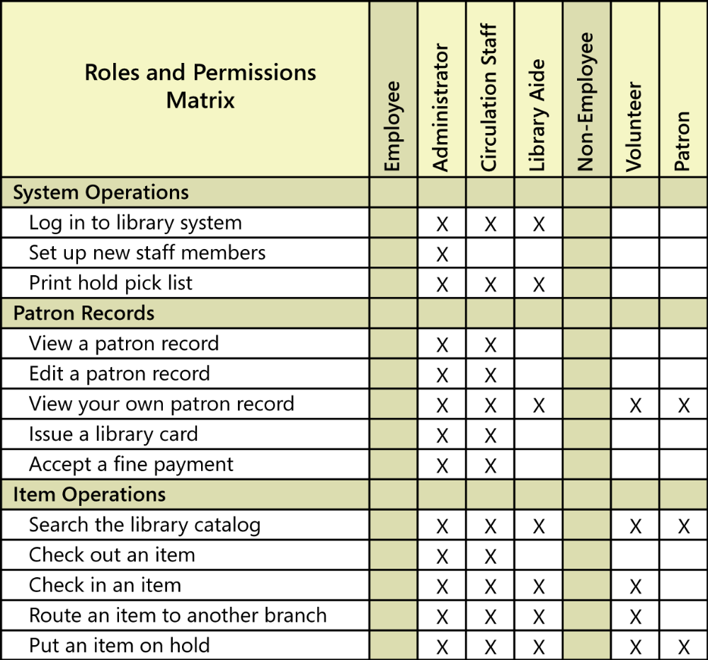
A business rules taxonomy
Constraining business rules sometimes can be represented in a roles and permissions matrix.

Slide 10
A business rules taxonomy
Action enablers: A rule that triggers some activity if specific conditions are true is an action enabler. Exs:
  If the chemical stockroom has containers of a requested chemical in stock, then offer existing containers to the requester.
  If the expiration date for the chemical container has been reached, then notify the person who currently possesses that container.
  After a customer places a book into the shopping cart, display related books that other customers also bought when they bought this one. (enhance the commercial success).
Inferences (sự luận ra): Sometime called inferred knowledge, or a derived fact, an inference creates a new fact from other facts. Inferences are written in the “if/then” pattern also, but the “then” clause simply provides a piece of knowledge, not an action to be taken. Exs:
  If payment is not received within 30 calendar days after it is due, then the account is delinquent (xem như ko trả đúng kỳ hạn).
  If the vendor cannot ship an ordered item within 5 days of receiving the order, then the item is considered back-ordered.
Notes:
Delinquent (adj): Không trả đúng kỳ hạn (nợ, thuế,…)

Slide 11
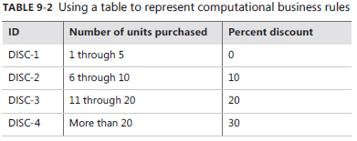
A business rules taxonomy
Computations: transform existing data into new data by using specific mathematical formulas or algorithms. Many computations follow rules that are external to the enterprise, such as income tax withholding formulas (tạm giữ thuế TNCN). Exs:
  The domestic ground shipping charge for an order that weighs more than two pounds is $4.75 plus 12 cents per ounce or fraction thereof.
  The unit price is reduced by 10% for orders of 6-10 units, by 20% for orders of 11-20 units, and 30% for orders of more than 20 units.
Notes:
Delinquent (adj): Không trả đúng kỳ hạn (nợ, thuế,…)
The domestic ground shipping charge for an order that weighs more than two pounds is $4.75 plus 12 cents per ounce or fraction thereof.: Phí vận chuyển mặt đất trong nước cho một đơn hàng nặng hơn hai pound là 4,75 đô la cộng với 12 xu mỗi ounce hoặc một phần của chúng.

Slide 12
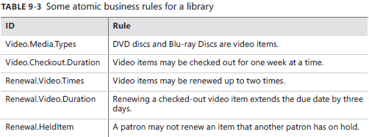
Atomic business rules
The composite biz rules can be hard to understand and maintain. It’s better to write your biz rules at the atomic level. This keep your rules short and simple. It also facilitates reusing the rules, modifying them, and combining them in various ways.
Notes:
Video items may be checked out for one week at a time. Các mục video có thể được kiểm tra một tuần một lần.
Video items may be renewed up to two times. Các mục video có thể được gia hạn tối đa hai lần.
Renewing a checked-out video item extends the due date by three days. Gia hạn một mục video đã kiểm tra kéo dài ngày đáo hạn thêm ba ngày.

Slide 13
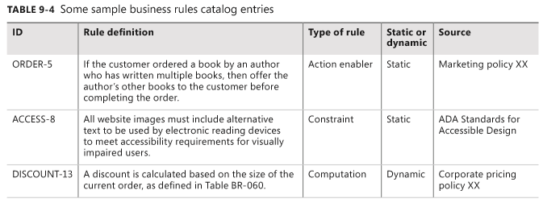
Documenting business rules
Because biz rules can influence multiple applications, organizations should manage their rules as enterprise-level assets. A simple biz rules catalog is necessary.
If you’re using a requirements management tool, you can store biz rules as a requirements type, provided they are accessible to all of your SW projects.
Large organizations should establish a database of biz rules.

Slide 14
Discovering business rules
There are some ways to look for biz rules:
“Common knowledge” from the organization, often collected from individuals who have worked with the business for a long time and know the details of how it operates.
Legacy systems (hệ thống kế thừa) that embed business rules in their requirements and code. This requires reverse-engineering the rationale behind the requirements or code to understand the pertinent (thích hợp) rules. This sometimes yields incomplete knowledge about the business rules.
Business process modeling, which leads the analyst to look for rules that can affect each process step: constraints, triggering events, computational rules, and relevant facts.
Notes:
- Pertinent (adj): đúng chỗ, thích hợp

Slide 15
Discovering business rules
Analysis of existing documentation, including requirements specifications from earlier projects, regulations, industry standards, corporate policy documents, contracts, and business plans.
Analysis of data, such as the various states that a data object can have and the conditions under which a user or a system event can change the object’s state.
Compliance departments in companies building systems subject to regulation.

Slide 16
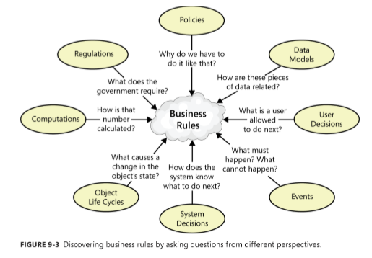
Discovering business rules

Slide 17
Business rules and requirements
After identifying and documenting business rules, determine which ones must be implemented in the software.
Business rules and their corresponding functional requirements sometimes look a lot alike. However, the rules are external statements of policy that must be enforced in software, thereby driving system functionality.
Every BA must decide which rules pertain to (liên quan tới) his application, which ones must be enforced in the software, and how to enforce them.
Notes:
thereby driving system functionality.: có liên quan đến chức năng hệ thống
Pertain to (v): liên quan đến

Slide 18
Tying everything together
To prevent redundancy, don’t duplicate rules from your business rules catalog in the requirements documentation.
Instead, refer back to specific rules as being the source of certain functionality or algorithms.
You can define the links between a functional requirement and its parent business rules in several ways-
  If you are using a requirements management tool, create a requirement attribute called “Origin” and indicate the rules as being the origin of derived functional requirements.
  Define traceability links between functional requirements and the connected business rules in a requirements traceability matrix or a requirements mapping matrix.
  If the business rules and requirements are stored in word processing or spreadsheet files, define hyperlinks from business rule ID references in the requirements back to the descriptions of the business rules stored elsewhere. Be aware that hyperlinks are prone to (dễ) breaking if the location of the rules collection changes.
Notes:
- Prone (adj): ngả về, thiên về → be prone to: dễ

Slide 19
Review chapter 9
Chapter 9: Playing by the rules.
Biz rules taxonomy
Biz rules overview
Atomic biz rules
Biz process
Biz Req.
Facts
Constraints
Action enablers
Biz rules
Inferences
computations
Document biz rules
Discovering biz rules
Common knowledge
Legacy systems
Biz process modeling
Analysis document
Analysis data

Slide 20

Notes:
- pay-off (n): chi trả

