Slide 1
CHAPTER 21
Enhancement and replacement projects

Slide 2
Review chapter 20
Chapter 20 – Agile projects
Agile dev. approach
Waterfall model
What is agile dev. approach
Essential aspects of agile dev. approach
What is waterfall model?
Its advantages
Its disadvantages
Its advantages
Its disadvantages
Customer involvement
Documentation detail
Transitioning to agile: Now what?
The backlog and prioritization
Timing
Epics, user stories, and features
Expect change

Slide 3
Objectives
Exploring some suggestions to practice the enhancement and replacement projects.
After finish this chapter, student should know what and how they have to do in enhancement and replacement projects.

Slide 4
Contents
What is enhancement and replacement project?
Expected challenges.
Requirements techniques when there is an existing system.
Prioritizing by using business objectives.
When old requirements don’t exist.
Encouraging new system adoption.
Can we iterate?

Slide 5
What is enhancement and replacement project?
An enhancement project is one in which new capabilities are added to an existing system. Enhancement projects might also involve correcting defects, adding new reports, and modifying functionality to comply with revised business rules or needs.
A replacement (or reengineering) project replaces an existing application with a new custom-built system, a commercial off-the-shelf (COTS) system (làm sẵn để bán), or a hybrid of those.

Slide 6
Expected challenges
The presence of an existing system leads to common challenges that both enhancement and replacement projects will face, including the following:
  The changes made could degrade (giảm) the performance to which users are accustomed (đã quen).
  Little or no requirements documentation might be available for the existing system.
  Users who are familiar with how the system works today might not like the changes they are about to encounter (sắp gặp phải).
  You might unknowingly break (vô tình phá vỡ) or omit (bỏ qua) functionality that is vital to some stakeholder group.
  Stakeholders might take this opportunity to request new functionality that seems like a good idea but isn’t really needed to meet the business objectives.

Slide 7
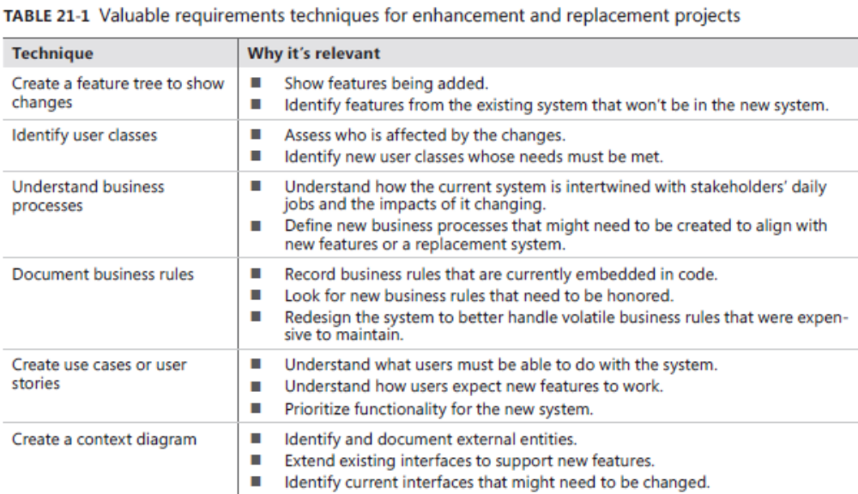
Requirements techniques when there is an existing system
Notes:
Look for new business rules that need to be honored: Tìm kiếm các quy tắc kinh doanh mới cần được tôn vinh

Slide 8
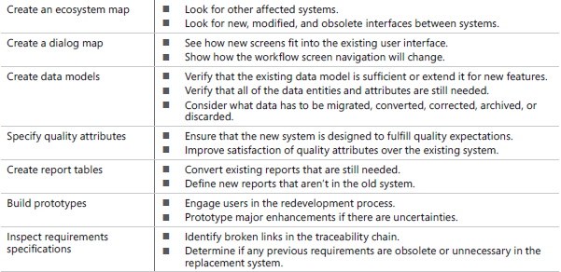
Requirements techniques when there is an existing system

Slide 9
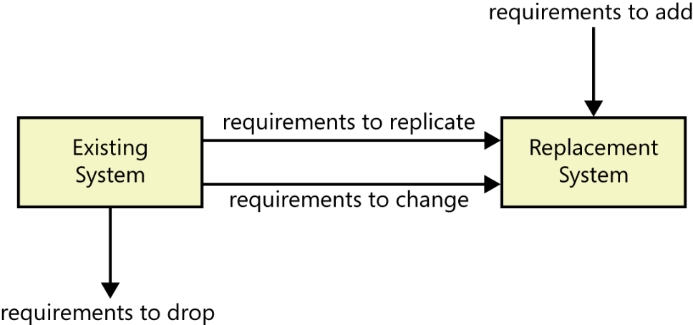
Prioritizing by using business objectives
Mind the gap:
  A gap analysis is a comparison of functionality between an existing system and a desired new system.
  A gap analysis can be expressed in different ways, including use cases, user stories, or features. When enhancing an existing system, perform a gap analysis to make sure you understand why it isn’t currently meeting your business objectives.
  Gap analysis for a replacement project entails (thể hiện) understanding existing functionality and discovering the desired new functionality (see Figure 21-1). Identify user requirements for the existing system that stakeholders want to have re-implemented in the new system. Also, elicit new user requirements that the existing system does not address.

Slide 10
Prioritizing by using business objectives
Maintaining performance levels:
  Existing systems set user expectations for performance and throughput (thông lượng). Stakeholders almost always have key performance indicators (KPIs) for existing processes that they will want to maintain in the new system.
  Unless you explicitly plan to maintain them, performance levels can be compromised (có thể bị tổn hại) as (khi) systems are enhanced. Stuffing (nhồi thêm) new functionality into an existing system might slow it down.
  For replacement systems, prioritize the KPIs that are most important to maintain. Look for the business processes that trace to the most important KPIs and the requirements that enable those business processes; these are the requirements to implement first.

Slide 11
When old requirements don’t exist
In the absence of reliable documentation, teams might reverse-engineer (thiết kế ngược) an understanding of what the system does from the user interfaces, code, and database. We think of this as “software archaeology. (khảo cổ học)”.
If you’re replacing an old system, you have an opportunity to document the requirements for the new one and to keep the requirements up to date with what you learn throughout the project.
Which requirements should you specify?
  Rarely do you need to document the entire existing system. Focus detailed requirements efforts on the changes needed to meet the business objectives.
  if you’re replacing a system, start by documenting the areas prioritized as most important to achieve the business objectives or those that pose the highest implementation risk.
  Level of details: One of the biggest challenges is determining the appropriate level of detail at which to document requirements gleaned from (lượm lặt từ) the existing system.
  Trace data:
    Requirements trace data for existing systems will help the enhancement developer determine which components she might have to modify because of a change in a specific requirement.
    When you’re replacing a system, the existing system would have a full set of functional requirements such that you could establish traceability between the old and new systems to avoid overlooking any requirements.

Slide 12
When old requirements don’t exist
How to discover the requirements of an existing system:
  In enhancement and replacement projects, even if you don’t have existing documentation, you do have a system to work from to discover the relevant requirements. During enhancement projects, consider drawing a dialog map for the new screens you have to add, showing the navigation connections to and from existing display elements.
  In replacement system projects, you need to understand all of the desired functionality, just as (giống như) you do on any new development project. Study the user interface of the existing system to identify candidate functionality for the new system. Examine existing system interfaces to determine what data is exchanged between systems today.
  The models can help you to discover requirements. Swimlane diagrams can describe how users do their jobs with the system today. Context diagrams, data flow diagrams, and entity-relationship diagrams are also useful…..

Slide 13
Encouraging new system adoption
Why we do this?
  The new system will make users’ jobs easier, and maybe improve the productivity of organization.
What are disadvantages?
  Users might fear that the new system will disrupt (phá vỡ) their normal operations while they learn how to use it.
  Users might even be afraid of losing their jobs if the system automates tasks they perform manually today.
How to do this?
  To mitigate the risk of user resistance, you first need to understand the business objectives and the user requirements.
  During elicitation, focus on the benefits the new system or each feature will provide to the users. Help them understand the value of the proposed change to the organization as a whole.
  When you are migrating from an existing system, transition requirements are also important. Transition requirements describe the capabilities that the whole solution—not just the software application—must have to enable moving from the existing system to the new system. They can encompass data conversions, user training, organizational and business process changes, and the need to run both old and new systems in parallel for a period of time.
Notes:
- Encouraging new system adoption: Khuyến khích thích nghi hệ thống mới

Slide 14
Review chapter 21
Chapter 21 – Enhancement and replacement projects
Requirements techniques
What is enhancement and replacement project
Prioritizing by using biz objectives
Enhancement projects
Replacement projects
Mind the gap
When old reqs. don’t exist
Maintaining performance levels
Which reqs. should you specify?
How to discover the reqs. of an existing system

Slide 15
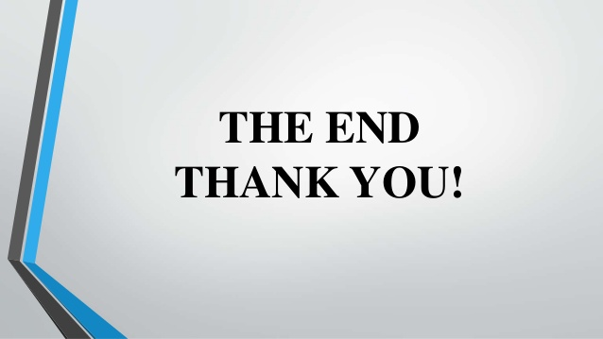
Notes:
- pay-off (n): chi trả

