Slide 1
CHAPTER 22
Packaged solution projects

Slide 2
Review chapter 21
Chapter 21 – Enhancement and replacement projects
Requirements techniques
What is enhancement and replacement project
Prioritizing by using biz objectives
Enhancement projects
Replacement projects
Mind the gap
When old reqs. don’t exist
Maintaining performance levels
Which reqs. should you specify?
How to discover the reqs. of an existing system

Slide 3

Objectives
Student should understand what is packaged solution project and how to get requirements for this project.

Slide 4

Content
What is packaged solution project?
Requirements for selecting packaged solutions.

Slide 5
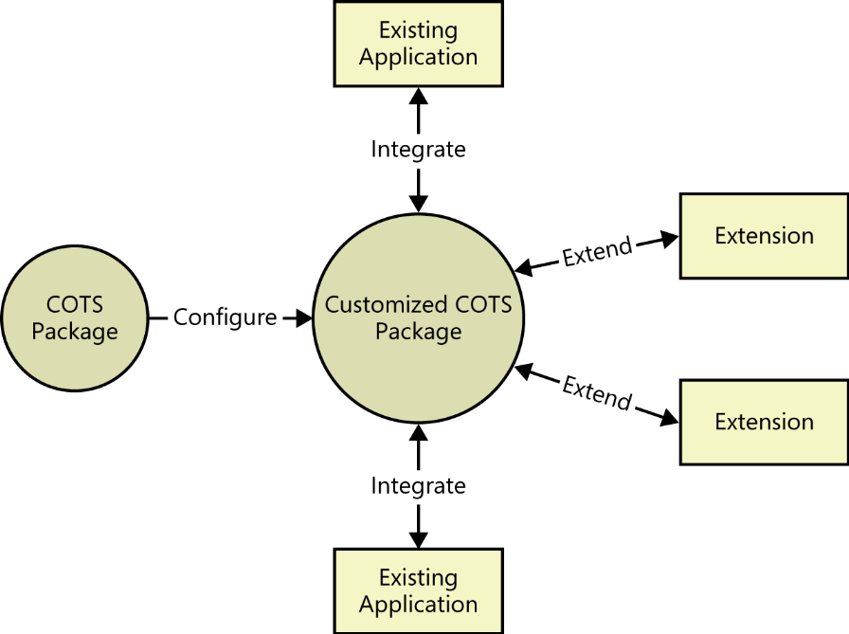
Packaged solutions
Some organizations acquire and adapt purchased packaged solutions (also called commercial off-the-shelf, or COTS, products) to meet their software needs, instead of building new systems from scratch (từ đầu).
Software as a service (SaaS), or cloud, solutions are becoming increasingly available to meet software needs as well.
Whether (cho dù) you’re purchasing a package as part or all of the solution for a new project or implementing a solution in the cloud, you still need requirements.
COTS packages typically need to be configured, integrated, and extended to work in the target environment.
Some COTS products can be deployed out of the box with no additional work needed to make them usable.
However, most of them require some customization for creating integrations to other systems, and/or developing extensions to provide additional functionality that is not included in the COTS package.

Slide 6
Requirements for selecting packaged solutions
COTS packages offer the acquiring organization less flexibility to meet requirements. You need to know which requested capabilities aren’t negotiable and which you can adjust to fit within the package’s constraints. The only way to choose the right packaged solution is to understand the business activities the package must let the users perform.
When you select the packaged solution, you need to pay attention to the following factors:
  Developing user requirements:
    Any package you choose must let users accomplish their task objectives, although different packaged solutions will do so in different ways. The majority of your requirements efforts for COTS acquisition should be focused at the user requirements level. Use cases and user stories work well for this purpose.
    It can also be helpful to list the features you need from the packaged solution. Identify the desired product features from an understanding of what users need to achieve with the solution and the business processes the package must enable.

Slide 7
Requirements for selecting packaged solutions
  Considering business rules:
    Your requirements exploration should identify pertinent business rules to which the COTS product must conform. Can you configure the package to comply with your corporate policies, industry standards, and relevant regulations?
    Some packages incorporate widely applicable business rules, such as income tax withholding (khấu trừ) computations or printed tax forms. Do you trust that these are implemented correctly? Will the package vendor provide you with timely software updates when those rules and computations change? Will they charge you for the updates? If the product implements any intrinsic business rules that don’t apply to you, can you disable, modify, or work around them?
  Identifying data needs:
    You might need to define the data structures required to satisfy your user requirements and business rules, particularly if the new solution must be integrated into an ecosystem of existing applications.
    Specify the reports that the COTS product must generate. Does it generate mandated reports in the correct formats? Can you design new reports of your own to integrate with those that the vendor supplied?....

Slide 8
Requirements for selecting packaged solutions
  Defining quality requirements: For packaged solutions, explore at least the following attributes:
    Performance What maximum response times are acceptable for specific operations? Can the package handle the anticipated load (tải dự kiến) of concurrent users and transaction throughput? (thông lượng giao dịch)...
    Usability Is the interface similar to what the users experience in other applications already? How easily can your users learn to use the new package? …
    Modifiability How hard will it be for your developers to modify or extend the package to meet your specific needs?...
    Interoperability How easily can you integrate the package with your other enterprise applications? Does it use standard data interchange formats?...
    Integrity Does the package safeguard data from loss, corruption, or unauthorized access?
    Security Does the package permit control over which users are allowed to access the system or use specific functions? …

Slide 9
Requirements for selecting packaged solutions
  Evaluating solutions: To selecting the packaged solutions, you need to identify some evaluation criteria used in COTS software selection process:
    Step 1: Weight your requirements on a scale of 1 to 10 to distinguish their importance.
    Step 2: Rate each candidate package as to how well it satisfies each requirement. Use a rating of 1 for full satisfaction, 0.5 for partial satisfaction, and 0 for no coverage.
    Step 3: Calculate the score for each candidate (request for proposal (RFP) – Thư đấu thầu) based on the weight you gave each factor, to see which products appear to best fit your needs.
    Step 4: Evaluate product cost, vendor experience and viability (khả năng làm được), vendor support for the product, external interfaces that will enable extension and integration, and compliance with any technology requirements or constraints for your environment. Cost will be a selection factor, but evaluate the candidates initially without considering their cost.

Slide 10
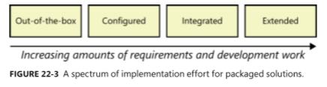
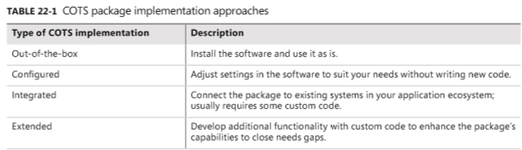
Requirements for implementing packaged solutions
After you decide to implement a selected packaged solution, there is still more requirements work to do. The spectrum (dãy) of effort required to make a packaged solution useful ranges from using the package as is, right out of the box, to performing considerable requirements specification and software development for extensions.

Slide 11
Requirements for implementing packaged solutions
Configuration requirements:
  Sometimes you can use a package just as it comes from the vendor. More often, you’ll need to adjust various configuration parameters in the package to better meet your needs.
  Configuration requirements are essential to most successful COTS implementations.
  Consider the full set of business rules when you are configuring the system.
Integration requirements:
  Unless the packaged solution is used in a standalone mode, you’ll need to integrate it into your application environment.
  Precisely specify the requirements for interchanging data and services between the package and other components in your environment.
Extension requirements:
  One common goal of COTS implementations is to minimize customizations to the solution.
  In most COTS projects, though, there will be gaps between what the organization needs and what the package delivers.
  If you are extending the COTS solution, you’ll need to fully specify the requirements for those new capabilities just as you would for any new product development.

Slide 12
Requirements for implementing packaged solutions
Data requirements:
  Begin with the data requirements used in the selection process. Map data entities and attributes from your existing data dictionary to the COTS entities and attributes.
  As with (giống như) functional gaps, you’ll need to decide how to handle data gaps, typically by adding attributes or repurposing (tái sử dụng) an existing data structure in the COTS solution.
Business process changes:
  COTS packages are usually selected because implementing and maintaining them is expected to be less expensive than building custom software. Organizations need to be prepared to adapt their business processes to the package’s workflow capabilities and limitations.
  In fact, a COTS solution that can be fully configured to meet your existing processes is likely (có thể) to be expensive and complex.

Slide 13
Common challenges with packaged solutions
The following are common challenges that you might encounter when selecting or implementing a packaged solution:
  Too many candidates: Many solutions on the market that meet your needs at first glance. Select a short list of criteria to narrow the candidate list to a few top choices for a more refined evaluation.
  Too many evaluation criteria: Use business objectives to help select the most important requirements as criteria. If you narrow the candidate package choices down to only a few, you can evaluate them against a long list of criteria.
  Vendor misrepresents package capabilities: In the typical packaged software purchasing process, the vendor sales staff sells their solution to the customer organization’s decision makers, and then engages a technical implementation team to provide in-depth knowledge about the product.
  Incorrect solution expectations: Sometimes a solution looks great during vendor demos, but it doesn’t work like you expect after installation. To avoid this, during the selection process, have the vendor demonstrate your actual use cases so you can see how well the solution matches your expectations.
  Users reject the solution: To avoid this, engage users in the selection process or early in the implementation to make sure their needs are clearly understood.

Slide 14
Review chapter 22
Chapter 22 – Packaged solutions projects
Reqs. for selecting packaged solutions
Packaged solutions
Reqs. for implementing packaged solutions
Configuration requirements
Developing user requirements
Considering business rules
Identifying data needs
Defining quality requirements
Evaluating solutions
Integration requirements
Extension requirements
Data requirements
Business process changes
Challenges with packaged solutions
Too many candidates
Too many evaluation criteria
Vendor misrepresents package capabilities
Incorrect solution expectations
Users reject the solution

Slide 15


