Slide 1
CHAPTER 23
Outsourced projects

Slide 2
Content
What is outsourced project?
Appropriate levels of requirements detail
Acquirer-supplier interactions
Change management
Acceptance criteria

Slide 3
What is an Outsourced Project?
An outsourced project is a business arrangement in which a company delegates certain tasks, operations, or services to an external third-party vendor or service provider. This arrangement allows the company to focus on its core competencies while the external partner handles the specialized work, often at a lower cost or with greater expertise. Outsourced projects can vary in scope and complexity and can include areas such as software development, customer service, human resources, or manufacturing.
Types of Outsourcing:
Onshore Outsourcing: The service provider is located in the same country as the client.
Nearshore Outsourcing: The provider is in a neighboring or nearby country.
Offshore Outsourcing: The provider is located in a different country, often far away geographically

Slide 4
Benefits and Challenges of Outsourcing
Benefits:
Leverage external expertise: Access to global professionals with specialized skills.
Cost efficiency: Lower labor costs in different countries compared to hiring in-house.
Challenges:
Communication barriers: Time zone, language, and cultural differences can cause misunderstandings.
Expectation mismatch: The final product may not meet initial expectations without proper guidance.
Recommendation:
Invest in clear communication and use collaboration tools to reduce misunderstandings.

Slide 5
Appropriate Levels of Requirements Detail
In managing a project, it’s essential to define requirements at various levels of detail to guide the development process effectively. The level of detail required varies depending on the nature and complexity of the project, as well as the phase of the project lifecycle.
Different levels of requirements detail:
High-level requirements: General statements that outline what the solution should achieve, without going into specifics.
Detailed requirements: Specific statements that describe the functionality, behavior, or constraints of the solution.
Importance:
Ensures alignment between business goals and technical implementation.
Reduces misunderstandings and ambiguity.
Provides a roadmap for development teams.

Slide 6
Benefits of Detailed Requirements
Advantages:
Minimizes risk: Detailed requirements lower the chances of miscommunication between the acquirer and supplier.
Ensures quality: Well-defined expectations lead to products that meet business needs, especially in offshore projects.
Example:
A U.S. company faced project failure because the offshore development team misunderstood requirements, forcing them to bring the project back in-house.

Slide 7
3. Acquirer-Supplier Interactions
In a project where external suppliers are involved, effective interaction between the acquirer (the buyer or client) and the supplier (the service provider) is crucial for success. These interactions ensure that both parties understand each other’s needs, capabilities, and constraints.
Key Aspects:
Communication: Clear communication channels are essential for sharing expectations, updates, and resolving issues.
Collaboration: Joint problem-solving and collaborative decision-making contribute to project success.
Trust and Relationship Building: Long-term partnerships often benefit from building mutual trust and a strong working relationship.
Challenges:
Misalignment: Differences in priorities and objectives can affect project outcomes.
Cultural Differences: Varying cultural perspectives can lead to misunderstandings.
Conflict Resolution: Mechanisms must be in place to address disputes swiftly.

Slide 8
Acquirer-Supplier Interactions
Acquirer-Supplier interactions ensure that both parties are aligned throughout the project. Key points include:
  Formal communication: Establish clear touchpoints to review requirements and progress.
  Training: Train the supplier team on your company’s domain to ensure they understand the project.
Recommendations:
Use collaboration tools for peer reviews and incremental development to correct issues early.

Slide 9
Challenges in Acquirer-Supplier Interactions
Challenges:
Cultural differences: Offshore teams may hesitate to admit confusion or mistakes.
Language barriers: Differences in language can cause literal interpretations of requirements.
Example:
One project failed because an offshore team followed requirements too literally, missing key nuances.

Slide 10
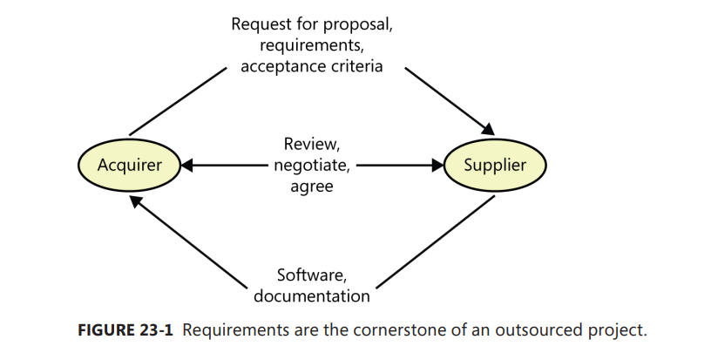
Diagram of Acquirer-Supplier Interactions

Slide 11
Change Management ?
Change Management is the process of managing changes that occur throughout the software development life cycle.
In modern development environments where requirements and conditions are constantly changing, good change management is one of the factors that ensures a project does not get out of control.

Slide 12
Change management process
Change Request:
Stakeholders propose changes through a common system.
Impact Analysis:
Evaluate the impact of the change on time, cost, and product quality.
Decision and Approval:
The decision to accept the change is made by those with authority, such as the project manager or customer.
Implementation and Update:
If the change is accepted, it is implemented and updated in the requirements document and the project schedule.

Slide 13
What is Acceptance Criteria ?
Acceptance Criteria is a set of conditions that a product must meet in order to be accepted.
It helps to clearly determine whether the final product has been completed as originally expected.
This is the basis for evaluating quality and deciding whether to pay the supplier or not.

Slide 14
Why do we need Acceptance Criteria?
Development Orientation:
According to Stephen Covey: “Begin with the end in mind” (Covey, 2004), defining acceptance criteria in advance helps us understand the end goal at the beginning of the project.
Minimize disputes:
Clear acceptance criteria reduce the risk of disputes between the customer and the supplier over whether the product meets the requirements.
Risk Management:
If the acceptance criteria are not met, it must be clear who is responsible and who will pay for product modifications

Slide 15
Q&A
1. What is a primary benefit of outsourcing a project to a third-party vendor?
A. Full control over project resources
B. Access to specialized expertise and cost savings
C. Increased project complexity
D. Full ownership of the project
Correct Answer: B. Access to specialized expertise and cost savings

Slide 16
Q&A
1. Which of the following is a key aspect of Acquirer-Supplier Interactions?
Sole reliance on written communication
Lack of collaboration between parties
Joint problem-solving and relationship building
Unilateral decision-making by the supplier
Correct Answer: C. Joint problem-solving and relationship building

Slide 17

Notes:
- pay-off (n): chi trả

