Slide 1
Chapter 27
Requirements management practices

Slide 2
Review chapter 22
Chapter 22 – Packaged solutions projects
Reqs. for selecting packaged solutions
Packaged solutions
Reqs. for implementing packaged solutions
Configuration requirements
Developing user requirements
Considering business rules
Identifying data needs
Defining quality requirements
Evaluating solutions
Integration requirements
Extension requirements
Data requirements
Business process changes
Challenges with packaged solutions
Too many candidates
Too many evaluation criteria
Vendor misrepresents package capabilities
Incorrect solution expectations
Users reject the solution

Slide 3

Objectives
Addresses some principles and practices of requirements management.
Student should enhance that effective management and communication among the project participants take an important role in having great requirements.
Student should only understand basic concepts. The more detail of every process will be clarified in the next chapters.

Slide 4

Contents
Requirements management process
Requirement attributes
Tracking requirements status
Resolving requirements issues
Common types of requirements issues
Measuring requirements effort
Managing requirements on agile projects

Slide 5
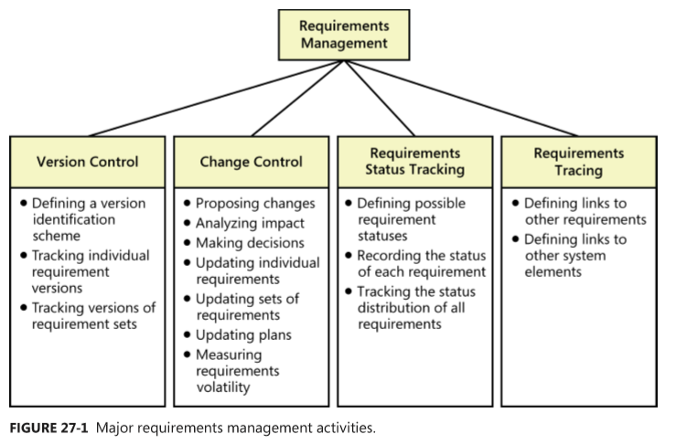
Requirements management process
Requirements management includes all activities that maintain the integrity, accuracy, and currency (Sự phổ biến) of requirements agreements throughout the project.

Slide 6
Requirements baseline
Requirements development involves activities to elicit, analyze, specify, and validate a software project’s requirements.
Requirements development deliverables include business requirements, user requirements, functional and nonfunctional requirements, a data dictionary, and various analysis models.
After they are reviewed and approved, any defined subset of these items constitutes a requirements baseline.
A requirements baseline is a set of requirements that stakeholders have agreed to, often defining the contents of a specific planned release or development iteration.
Subsequent changes can be made only through the project’s defined change control procedure.

Slide 7
Requirements version control
Version control—uniquely identifying different versions of an item—applies at the level of both individual requirements and requirements sets, most commonly represented in the form of documents.
Begin version control as soon as you draft a requirement or a document so you can retain a history of changes made.
Every version of the requirements must be uniquely identified. Every team member must be able to access the current version of the requirements.
Changes must be clearly documented and communicated (truyền đạt) to everyone affected.
To minimize confusion and miscommunication, permit only designated individuals to update the requirements, and make sure that the version identifier changes whenever an update is made.
Each circulated (lưu hành) version of a requirements document should include a revision history that identifies the changes made, the date of each change, the individual who made the change, and the reason for each change.

Slide 8
Requirement attributes
Think of each requirement as an object with properties that distinguish it from other requirements.
In addition to (ngoài) its textual description, each requirement should have supporting pieces of information or attributes associated with it. These attributes establish a context and background for each requirement.
Following is a list of potential requirement attributes to consider:
  Date the requirement was created.
  Current version number of the requirement.
  Author who wrote the requirement.
  Priority.
  Status.
  Origin or source of the requirement.
  Rationale behind the requirement.
  Release number or iteration to which the requirement is allocated.
  Stakeholder to contact with questions or to make decisions about proposed changes.
  Validation method to be used or acceptance criteria.

Slide 9
Tracking requirements status
Like nearly everyone, software developers are sometimes overly optimistic when they report how much of a task is complete.
Tracking status means comparing where you really are at a particular time against (so với) the expectation of what “complete” means for this development cycle.
Next slide shows you the suggested requirement statuses.

Slide 10
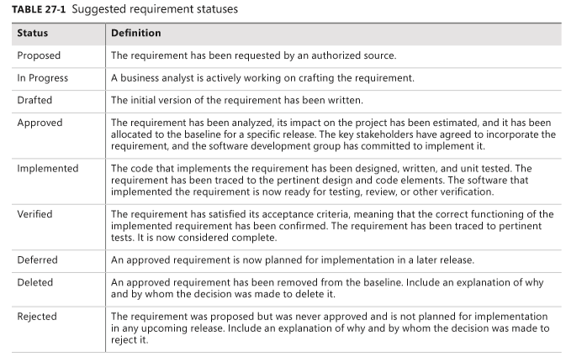
Tracking requirements status
Notes:
The requirement has been requested by an authorized source.: Yêu cầu đã được yêu cầu bởi một nguồn có thẩm quyền.

Slide 11
Resolving requirements issues
Numerous questions, decisions, and issues related to requirements will arise during the course of a project.
Potential issues include items flagged as TBD, pending decisions, information that is needed, and conflicts awaiting resolution. Issues from multiple requirements reviews are collected so that no issue ever gets lost.
Some of the benefits of using an issue-tracking tool are:
  The project manager can easily see the current status of all issues.
  A single owner can be assigned to each issue.
  The history of discussion around an issue can be retained.
  The team can begin development earlier with a known set of open issues rather than having to wait until the SRS is complete.

Slide 12
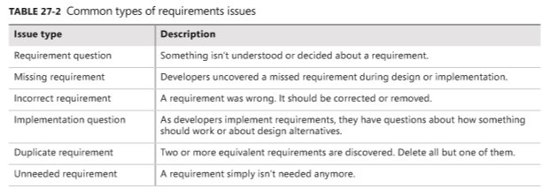
Common types of requirements issues
Nearly (gần như) all of the defects logged early in a project are related to issues in the requirements, such as asking for clarification on a requirement, scope decisions, questions about development feasibility, and to-do items on the requirements themselves.
All stakeholders can log questions as they review the requirements. Table 27-2 lists several common types of requirements issues that can arise.

Slide 13
Measuring requirements effort
As with requirements development, your project plan should include tasks and resources for the requirements management activities described in this chapter.
Record the number of hours spent on requirements development activities such as the following:
  Planning requirements-related activities for the project.
  Holding workshops and interviews, analyzing documents, and performing other elicitation activities.
  Writing requirements specifications, creating analysis models, and prioritizing requirements.
  Creating and evaluating prototypes intended to assist with requirements development.
  Reviewing requirements and performing other validation activities.

Slide 14
Measuring requirements effort
Count the effort devoted to the following activities as requirements management effort:
  Configuring a requirements management tool for your project.
  Submitting requirements changes and proposing new requirements.
  Evaluating proposed changes, including performing impact analysis and making decisions.
  Updating the requirements repository.
  Communicating requirements changes to affected stakeholders.
  Tracking and reporting requirements status.
  Creating requirements trace information.

Slide 15
Managing requirements on agile projects
Agile projects accommodate (điều tiết) change by building the product through a series of development iterations and managing a dynamic product backlog of work remaining to be done.
Some agile teams, particularly large or distributed teams, use an agile project management tool to track the status of an iteration and the stories allocated to it. The stories and their associated acceptance criteria and acceptance tests might all be placed in a product backlog or user story–management tool.
Story status can be monitored by using statuses:
  In backlog (the story is not yet allocated to an iteration)
  Defined (details of the story were discussed and understood, and acceptance tests were written)
  In progress (the story is being implemented)
  Completed (the story is fully implemented)
  Accepted (acceptance tests were passed)
  Blocked (the developer is unable to proceed until something else is resolved)

Slide 16
Review chapter 27
Chapter 22 – Requirements management practices
Requirements baseline
Reqs. management process
Reqs. Attributes
Reqs. version control
Version control
Change control
Reqs. Status tracking
Reqs. tracking
Tracking reqs. Status
Resolving reqs. Issues
Measuring reqs. Effort
Managing reqs. on
agile projects

Slide 17

Notes:
- pay-off (n): chi trả

