Slide 1
Chapter 29
Links in the requirements chain

Slide 2
Review chapter 28
Chapter 28 – Change happens
Manage scope creep
Why manage changes?
Change control policy
CCB – Change Control Board
Change control process
CCB composition
CCB charter
Change control tools
Purpose & scope
Roles & responsibilities
Change request states
Entry criteria
Tasks
Exit criteria
CC status reporting
Measuring change activity
Change impact analysis
CC on Agile project

Slide 3

Objectives
Addressing the subject of requirements tracing (or traceability).
Student knows that the requirements trace information documents the dependencies and logical links between individual requirements and other system elements.
Student understands that tracing information facilitates impact analysis to identify all the works related to implementation of requirement change.

Slide 4

Contents
Tracing requirements.
Motivations (sự thúc đẩy) for tracing requirements.
The requirements traceability matrix.
A requirements tracing procedure.

Slide 5
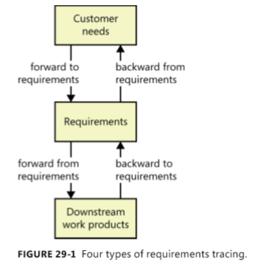
Tracing requirements
Why tracing requirements? →Trace links allow you to follow the life of a requirement both forward and backward, from origin through implementation.
Types of requirements tracing: Forward to requirements, forward from requirements, backward to requirements and backward from requirements.

Slide 6
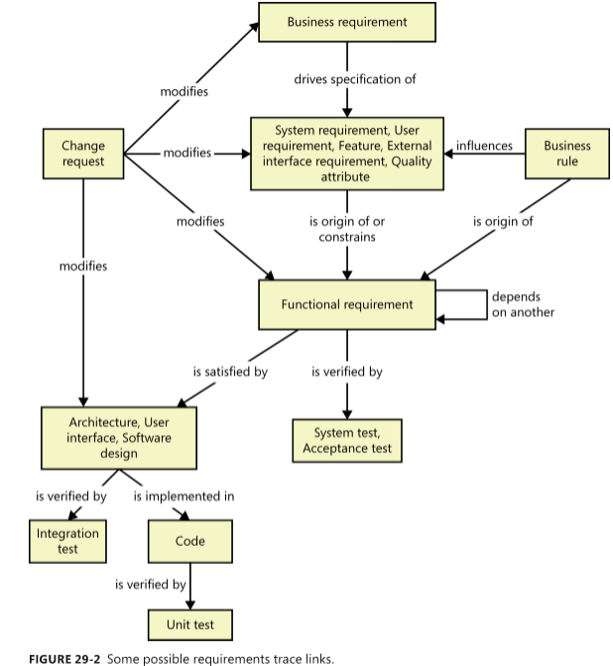
Tracing requirements
There are many kinds of traceability relationships that can be defined on a project. Of course, you don’t need to define and manage all these trace link types.
Maybe you only need to trace system tests back to functional requirements or user requirements.

Slide 7
Motivations for tracing requirements
At an organization level, implementing requirements tracing can improve the quality of your products, reduce maintenance costs, and facilitate reuse.
Following are some potential benefits of implementing requirements tracing:
  Finding missing requirements: Look for business requirements that don’t trace to any user requirements, and user requirements that don’t trace to any functional requirements.
  Finding unnecessary requirements: Look for any functional requirements that don’t trace back to user or business requirements and therefore might not be needed.
  Certification and compliance: You can use trace information to demonstrate that all requirements were implemented—although that doesn’t confirm that they were implemented correctly! Trace information demonstrates that requirements demanded for regulatory compliance have been included and addressed (giải quyết).
  Change impact analysis: Without trace information, there’s a good chance that you’ll overlook a system element that would be affected if you add, delete, or modify a particular requirement.
Notes:
You can use trace information when certifying a safety-critical product, to demonstrate that all requirements were implemented—although that doesn’t confirm that they were implemented correctly! : Bạn có thể sử dụng thông tin theo dõi khi xác nhận sản phẩm quan trọng về an toàn, để chứng minh rằng tất cả các yêu cầu đã được triển khai, mặc dù điều đó không xác nhận rằng chúng đã được thực hiện đúng!

Slide 8
Motivations for tracing requirements
  Maintenance: Reliable trace information facilitates your ability to make changes correctly and completely during maintenance. When corporate policies or government regulations change, software systems often must be updated.
  Project tracking: If you record the trace data during development, you’ll have an accurate record of the implementation status of planned functionality.
  Reengineering: You can list the functions in an existing system you’re replacing and trace them to where they are addressed in the new system’s requirements and software components.
  Reuse: Trace information facilitates (tạo điều kiện) the reuse of product components by identifying packages of related requirements, designs, code, and tests.
  Testing: When a test fails, the links between tests, requirements, and code point developers toward likely areas to examine for the defect.

Slide 9
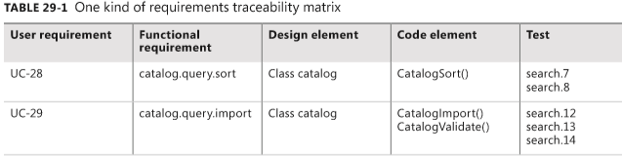
The requirements traceability matrix
The most common way to represent the links between requirements and other system elements is in a requirements traceability matrix, also called a requirements trace matrix or a traceability table.
Table 29-1 shows how each functional requirement is linked backward to a specific use case and forward to one or more design, code, and test elements.
A design element can be something like an architectural component, a table in a relational data model, or an object class.
Code references can be class methods, stored procedures, source code file names, or modules within a source file. Including more trace detail takes more work, but it gives you the precise locations of the related software elements.

Slide 10
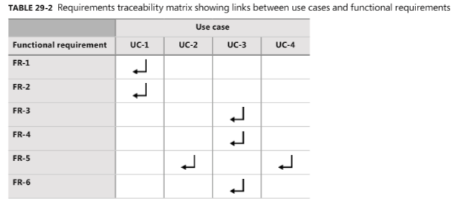
The requirements traceability matrix
Table 29-2 illustrates a two-way traceability matrix. Most cells in the matrix are empty. Each cell at the intersection of two linked components contains a symbol to indicate the connection.
Table 29-2 uses an arrow to indicate that a certain functional requirement is traced from a particular use case. For instance, FR-2 is traced from UC-1, and FR-5 is traced from both UC-2 and UC-4. This indicates that the functional requirement FR-5 is reused across two use cases, UC-2 and UC-4.
One-to-one One design element is implemented in one code module.
One-to-many One functional requirement is verified by multiple tests.
Many-to-many Each use case leads to multiple functional requirements, and certain functional requirements are common to several use cases.

Slide 11
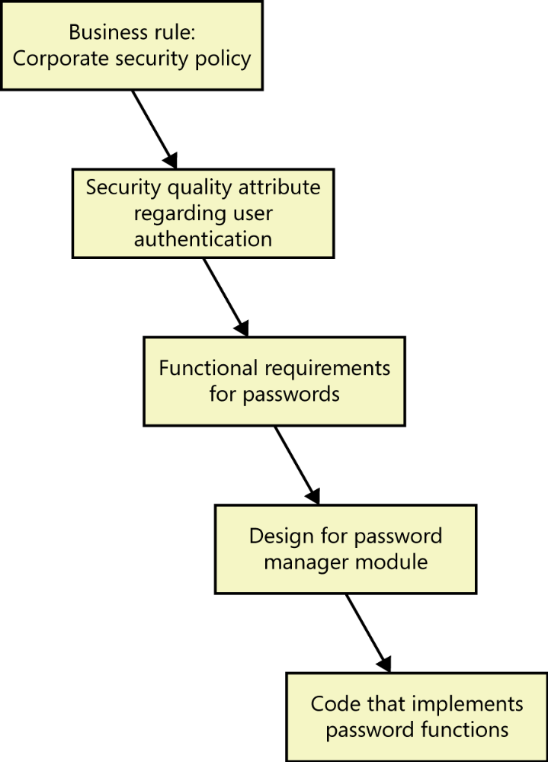
Traceability chain involving nonfunctional requirements
Nonfunctional requirements such as quality attributes often do not trace directly into code.
A portability requirement could restrict (hạn chế) the language features that the programmer uses but might not result in specific code segments that enable portability.
Other quality attributes are indeed (thực sự) implemented in code.
Security requirements for user authentication lead to derived functional requirements that might be implemented through passwords or biometrics functionality. In those cases, you can trace the corresponding functional requirements backward to their parent nonfunctional requirement and forward into downstream deliverables as usual.
FIGURE 29-3 Sample traceability chain for requirements dealing with application security.
Notes:
A portability requirement could restrict (hạn chế) the language features that the programmer uses but might not result in specific code segments that enable portability.: Yêu cầu về tính di động có thể hạn chế các tính năng ngôn ngữ mà lập trình viên sử dụng nhưng có thể không dẫn đến các phân đoạn mã cụ thể cho phép tính di động.

Slide 12
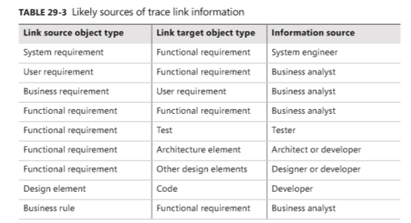
Trace link information
Table 29-3 identifies some typical sources of knowledge about links between various types of source and target objects.
Determine the roles and individuals who should supply each type of trace information for your project.
Notes:
- Link source object type: Liên kết loại đối tượng nguồn

Slide 13
A requirements tracing procedure
Consider following this sequence of steps when you begin to implement requirements tracing on a specific project:
  Educate the team and your management about the concepts and importance of requirements tracing, your objectives for this activity, where the trace data is stored, and the techniques for defining the links. Ask all participants to commit to their responsibilities.
  Select the link relationships you want to define (xác định) from the possibilities shown in Figure 29-2. Don’t try to do all of these at once! You’ll be overwhelmed.
  Choose the type of traceability matrix you want to use: the single-matrix style shown in Table 29-1 or several matrices like the one illustrated in Table 29-2.
  Identify the parts of the product for which you want to maintain traceability information. Start with the critical core functions, the high-risk portions, or the portions that you expect will undergo (trải qua) the most maintenance and evolution over the product’s life.

Slide 14
A requirements tracing procedure
Consider following this sequence of steps when you begin to implement requirements tracing on a specific project:
  Identify the individuals who will supply each type of link information and the person (most likely a BA) who will coordinate the tracing activities and manage the data.
  Modify your development procedures to remind developers to update the links after implementing a requirement or an approved change.
  Define the labeling conventions you will use to give each system element a unique identifier so that the elements can be linked together.
  As development proceeds (khi phát triển SP), have each participant provide the requested trace information as they complete small bodies of work.
  Audit the trace information periodically to make sure it’s being kept current. If a requirement is reported as implemented and verified, but its trace data is incomplete or inaccurate, your requirements tracing process isn’t working as intended.

Slide 15
Review chapter 29
Chapter 29 – Links in the requirements chain
Tracing requirements
Finding missing requirements
Motivations for tracing requirements
Finding unnecessary requirements
Change impact analysis
Maintenance
The reqs. traceability matrix
Certification and compliance
Traceability chain involving nonfunctional reqs
Trace link information
A req tracing procedure
Project tracking
Reengineering
Reuse
Testing

Slide 16

Notes:
- pay-off (n): chi trả

