Slide 1
Chapter 31
Improving your requirements processes

Slide 2
Review chapter 30
Chapter 30 – Tools for reqs. engineering
Requirements development tools
Requirements management tools
RM tool capabilities
Selecting and implementing a reqs tool
Benefits of using an RM tool
Manage versions and changes
Elicitation tools
Prototyping tools
Modeling tools
Store requirements attributes
Facilitate impact analysis
Identify missing and extraneous reqs
Track reqs status
Control access
Communicate with stakeholders
Reuse reqs
Track issue status
Generate tailored subsets
Selecting a tool
Setting up the tool and processes
Facilitating user adoption

Slide 3

Objectives
Student could understand how requirements relate to various other project processes and stakeholders.
Student enhance some basic concepts about software process improvement and a suggested process improvement cycle.
Student enhance a list several useful requirements “process assets” that your organization should have available.

Slide 4
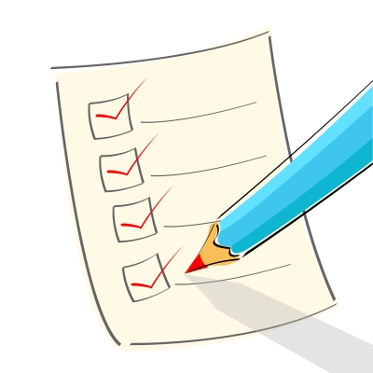
Contents
How requirements relate to other project processes.
Requirements and various stakeholder groups.
Gaining commitment to change.

Slide 5
Why you need to improve your requirements processes?
The ultimate objective of process improvement is to reduce the cost of creating and maintaining software, thereby increasing the value delivered by projects. Ways to accomplish this include:
  Correcting problems encountered on previous projects that arose from process shortcomings (thiếu sót).
  Anticipating and preventing problems that you might encounter on future projects.
  Adopting practices that are more efficient and effective than those currently being used.

Slide 6
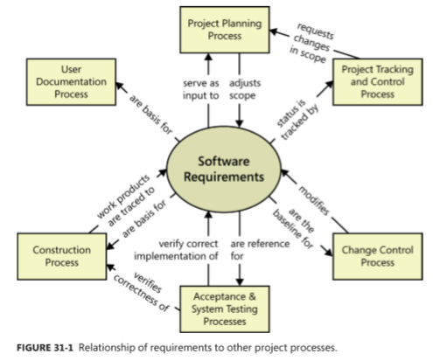
How requirements relate to other project processes
Requirements lie at the heart of every well-run software project, supporting and enabling the other technical and management activities.
Changes that you make in your requirements development and management approaches will affect these other project processes, and vice versa.
This picture illustrates some connections between requirements and other project processes.

Slide 7
How requirements relate to other project processes
Project planning:
  Requirements serve as the foundation of the project planning process. The planners select an appropriate software development life cycle and create resource and schedule estimates based on the requirements.
  Project planning might indicate that it’s not possible to deliver the entire desired feature set within the available bounds of resources and time.
Project tracking & control:
  Project tracking includes monitoring the project’s status so the project manager can see whether construction and verification are proceeding as intended.
  If they are not, management, customers, or other stakeholders might need to request scope modification through the planning process.
Change control:
  After a set of requirements has been baselined, all subsequent changes and additions should be made through a defined change control process.
  Requirements changes modify the backlog of remaining work to be done and the priorities of the work items in the backlog.

Slide 8
How requirements relate to other project processes
Acceptance & system testing:
  User requirements and functional requirements are essential inputs to acceptance testing and system testing, respectively.
  If the expected behavior of the software under various conditions isn’t clearly specified, the testers will be hard-pressed (khó có thể) to verify that all planned functionality has been implemented as intended.
Construction:
  Requirements are the basis for the design and implementation work, and they tie together the various construction work products.
  Use design reviews to ensure that the designs correctly address all of the requirements.
  Unit testing can determine whether the code satisfies the design specifications and the pertinent requirements.
User documentation:
  User documentation has to respond to the final changes in user interface displays and the features that got dropped or added at the last minute.

Slide 9
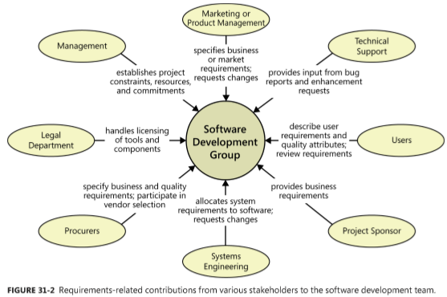
Requirements and various stakeholder groups
If you’re the business analyst or project manager, explain to stakeholders in each area the information and participation you need from them if the product development effort is to succeed.

Slide 10
Gaining commitment to change
When a software organization changes its requirements processes, the interactions it has with other stakeholders change as well.
People don’t like to be forced out of their comfort zone, so there are some resistance from them to the process changes you propose. Understand the origins of the resistance so you can both respect it and defuse it (xoa dịu nó).
Following are some forms of resistance that you might encounter:
  People who are already too busy to get their project work done don’t think they have time to invest in adopting better practices.
  A change control process might be viewed as a barrier thrown up by development to make it harder to get changes made.
  Some developers and managers view writing and reviewing requirements as bureaucratic time-wasters (kẻ lãng phí tgian quan liêu) that delay the “real work” of coding.

Slide 11
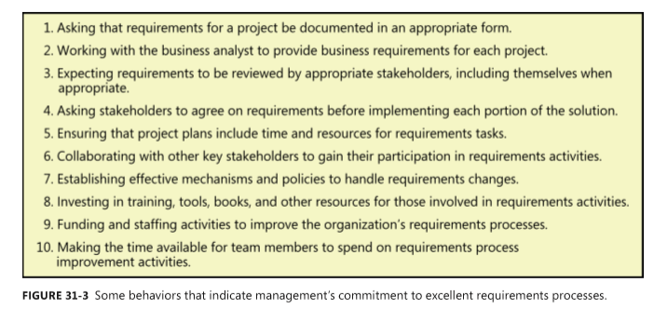
Gaining commitment to change
We’ve often heard business analysts say that they can’t make some process change in their organization without “management support.”.
Too often, management support translates merely (đơn thuần) into permission to do something different. But as an intelligent professional, you don’t need management’s permission to work in the best way you know how: that’s your job.
Figure 31-3 lists 10 signs that your organization’s management is truly committed to excellent requirements processes.

Slide 12
Fundamentals of software process improvement
The following principles of software process improvement:
Process improvement should be evolutionary and continuous: Instead of aiming for perfection, develop a few improved templates and procedures and get started with implementation. Adjust your approaches as the team gains experience with the new techniques.
People and organizations change only when they have an incentive (khích lệ) to do so: The strongest incentive for change is pain (nổi đau) - real pain people have experienced on previous projects.
  The project missed deadlines because requirements were more extensive than expected.
  Developers worked a lot of overtime because of misunderstood or ambiguous requirements.
  System test effort was wasted because the testers didn’t understand what the product was supposed to do.
  The right functionality was present, but users were dissatisfied because of sluggish (chậm chạp) performance, poor usability, or other quality shortcomings.
  The organization experienced high maintenance costs because customers requested many enhancements that could have been identified during requirements elicitation.
  Requirement changes weren’t implemented appropriately during the course of the project, so the delivered solution did not meet the customer needs.
  Edits to requirements were lost or overwritten because multiple BAs were working on them concurrently without a version control process.
  Customers were not available to clarify and flesh out requirements.

Slide 13
Fundamentals of software process improvement
The following principles of software process improvement:
Process changes should be goal-oriented: Before you begin the journey to superior processes, make sure you know your objectives. Do you want to reduce the amount of work that is redone because of requirements problems? Do you want to overlook fewer requirements during implementation? Do you want to cut unneeded features sooner?
Treat your improvement activities as mini-projects: Perform the planning, tracking, measurement, and reporting that you’d do for any project, scaled for the size of the improvement project. Write a simple action plan for each improvement area you tackle (giải quyết).

Slide 14
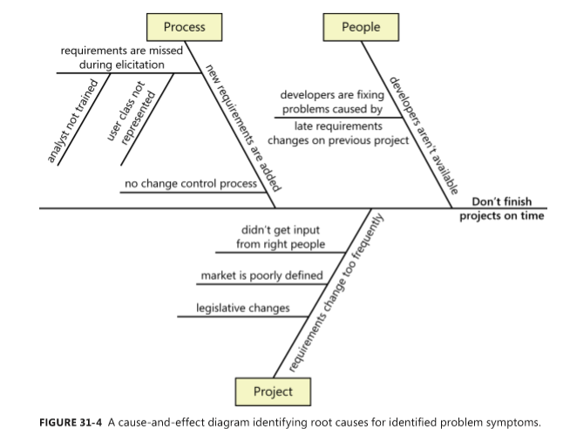
Root cause analysis
It’s important to focus your limited time and budget for process improvement efforts where they will do the most good. If you can identify the causes of any process shortcomings you’ve experienced, you can have chances to improvement opportunities.
Root cause analysis seeks to identify the underlying (cơ bản) factors that contribute to an observed problem, distinguishing symptoms from their causes.
Root cause analysis involves asking “why” the problem exists several times in succession, each time probing (điều tra) for the reason that underlies (nằm ở dưới) the answer to the previous “why” question.

Slide 15
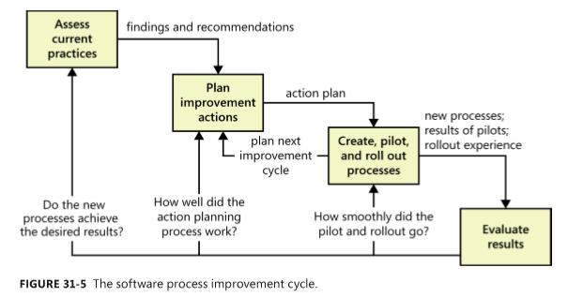
The process improvement cycle
This cycle helps you to improve your processes.

Slide 16
The process improvement cycle
Access current practices:
  Step 1 of any improvement activity is to assess the practices currently being used to identify their strengths and shortcomings. The assessment lays the foundation for selecting the changes you should make.
Plan improvement actions:
  Tactical action plans target specific improvement areas, such as the ways you elicit or prioritize requirements.
  Each action plan should identify measurable improvement goals, the participants, and the individual action items that must be completed to implement the plan.
  A plan for requirements management improvements that included these action items:
    Draft a requirements change control process.
    Review and revise the change control process.
    Pilot the change control process with Project A.
    Revise the change control process based on feedback from the pilot.
    Evaluate problem-tracking tools, and select one to support the change control process.
    Procure the problem-tracking tool, and customize it to support the change control process.
    Roll out (giới thiệu) the new change control process and tool to the organization.

Slide 17
The process improvement cycle
Create, pilot, and roll out processes:
  Many approaches that seem like a good idea in the abstract (về mặt lý thuyết) turn out (hóa ra) to be less effective than anticipated (dự đoán). Therefore, pilot most of the new procedures or templates you create on a small scale before implementing them for real.
  Keep the following suggestions in mind for your process pilots:
    Select pilot participants who will give the new approaches a fair try and provide helpful feedback.
    Quantify the criteria the team will use to evaluate the pilot’s results.
    Identify the stakeholders who need to be informed about the pilot.
    Consider piloting portions of the new processes on different projects. This engages (thu hút) more people in trying new approaches, which increases awareness, feedback, and buy-in.
    As part of the evaluation, ask pilot participants how they would feel if they had to go back to their former ways of working.

Slide 18
The process improvement cycle
Evaluate results:
  The final step of a process improvement cycle is to evaluate the activities performed and the results achieved.
  This evaluation will help the team do an even better job on future improvement activities. Assess how smoothly the pilots ran. How effective were they in resolving the uncertainties about the new processes? Would you change anything the next time you conduct a process pilot?
  A critical step is to assess whether the new processes are yielding (mang lại) the desired results. Some new practices deliver visible improvements quickly, but others take time to demonstrate their full value.

Slide 19
Requirements engineering process assets
High-performance projects have effective processes for all of the requirements engineering components: elicitation, analysis, specification, validation, and management.
To facilitate the performance (thực hiện) of these processes, every organization needs a collection of requirements process assets.
A process encompasses the actions you take and the deliverables you produce; process assets help the team members perform processes consistently and effectively.
These process assets will help those involved in the project understand the steps they should follow and the work products they’re expected to create.
Next slide shows you the types of process assets.

Slide 20
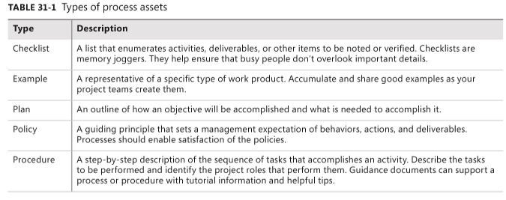
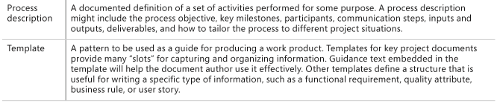
Requirements engineering process assets

Slide 21
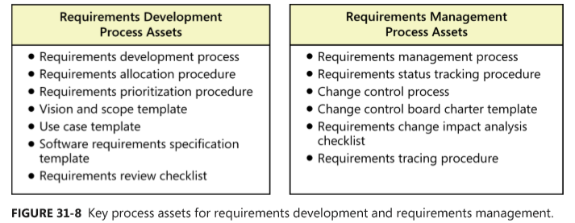
Requirements engineering process assets
Figure 31-8 identifies some valuable process assets for requirements engineering.
Store these items in a shared process assets library for ease of access and ready availability, and establish mechanisms for improving them with experience.
Many of the process assets in Figure 31-8 are available with the companion content for this book.

Slide 22
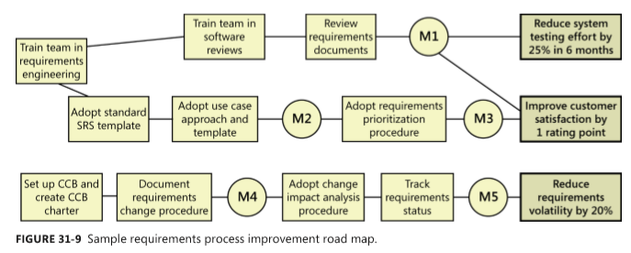
Creating a requirements process improvement road map
The process improvement road map sequences improvement actions to yield the greatest and quickest benefits with the smallest investment.
Figure 31-9 illustrates one organization’s road map for improving its requirements processes.
Implement each threaded set of improvement activities from left to right. After you’ve created a road map, give ownership of each milestone to an individual, who can then write an action plan for achieving that milestone. Then turn those action plans into actions!
Milestones
The desired biz goals
The major improvement activities

Slide 23
Review chapter 31
Chapter 31 – Improving your requirements processes
How requirements relate to other project processes
Reqs and various stakeholder groups
Project planning process
Project tracking & control process
Change control process
Gaining commitment to change
Fundamentals of software process improvement
Root cause analysis
Acceptance & system testing process
Construction process
User documentation process
The process improvement cycle
Access current practices
Plan improvement actions
Create, pilot, and roll out processes
Evaluate results
Requirements engineering process assets
requirements process improvement road map

Slide 24

Notes:
- pay-off (n): chi trả

