Slide 1


Election 2024
DATA ANALYSIS
Professor Yanis Petros

Slide 2
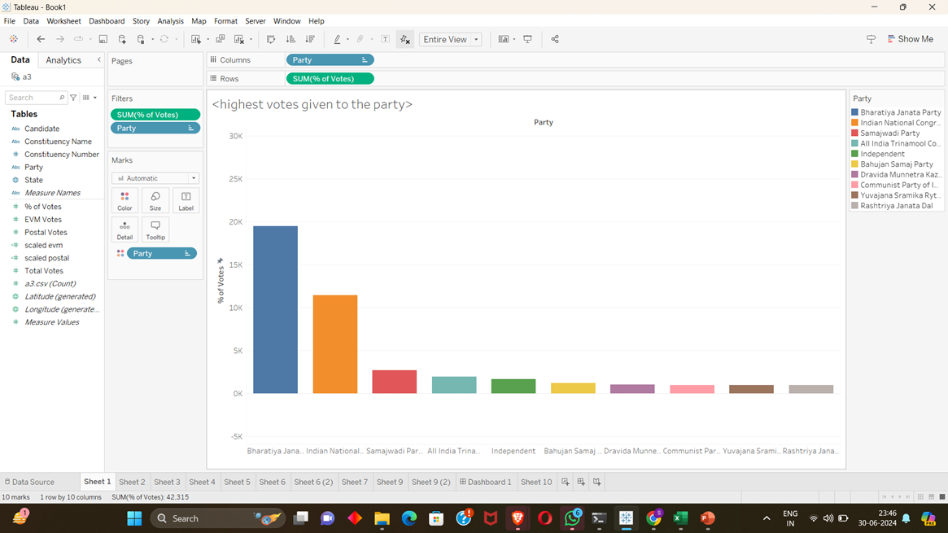
HIGHEST VOTES OF TOP 10 PARTY
This is the distribution of the votes to each party in descending order

Slide 3
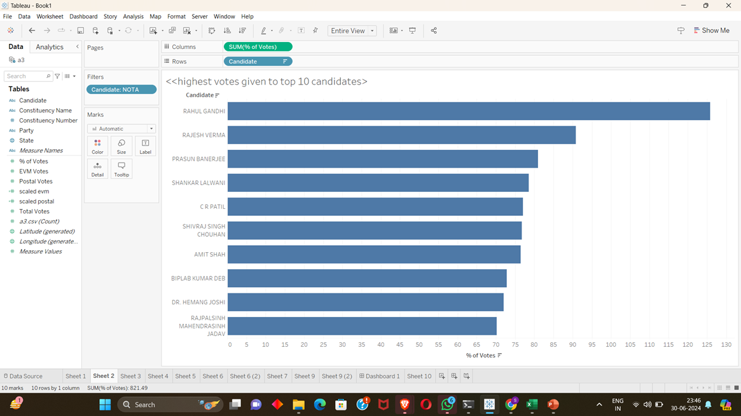


HIGHEST VOTES OF TOP 10 CANDIDATES
This is the distribution of the votes to each candidate in descending order.
03

Slide 4
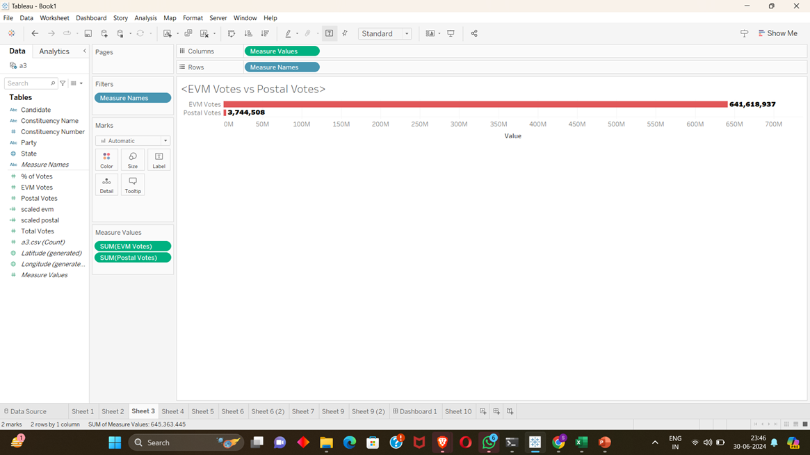

EVM VOTES VS POSTAL VOTES
This is the comparison of EVM votes and the Postal votes ,as the areas where voting booths cannot be installed will undergo the postal votes
04

Slide 5
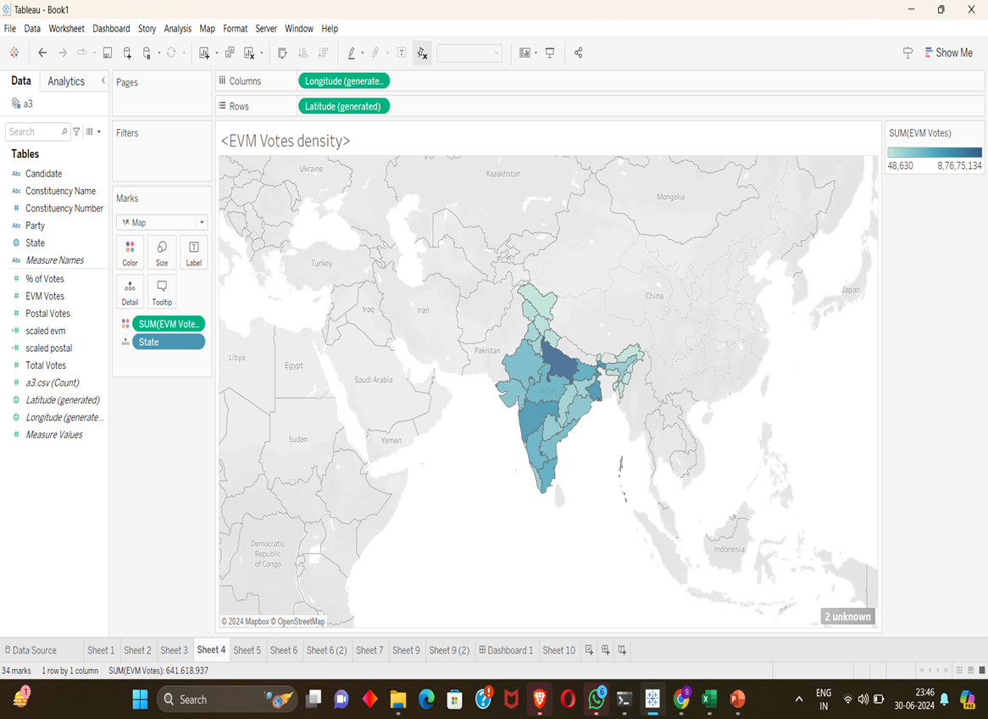
EVM VOTES DENSITY
The density at which the EVM votes are given according to the states are represented here the darker region represents the dense, the lighter area represents the sparse
05

Slide 6
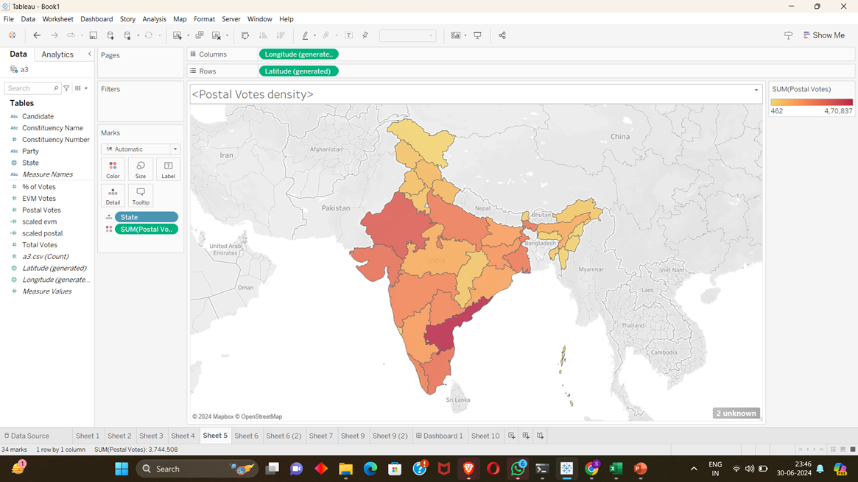
POSTAL VOTES DENSITY
The density at which the Postal votes are given according to the states are represented here the darker region represents the dense, the lighter area represents the sparse
06

Slide 7
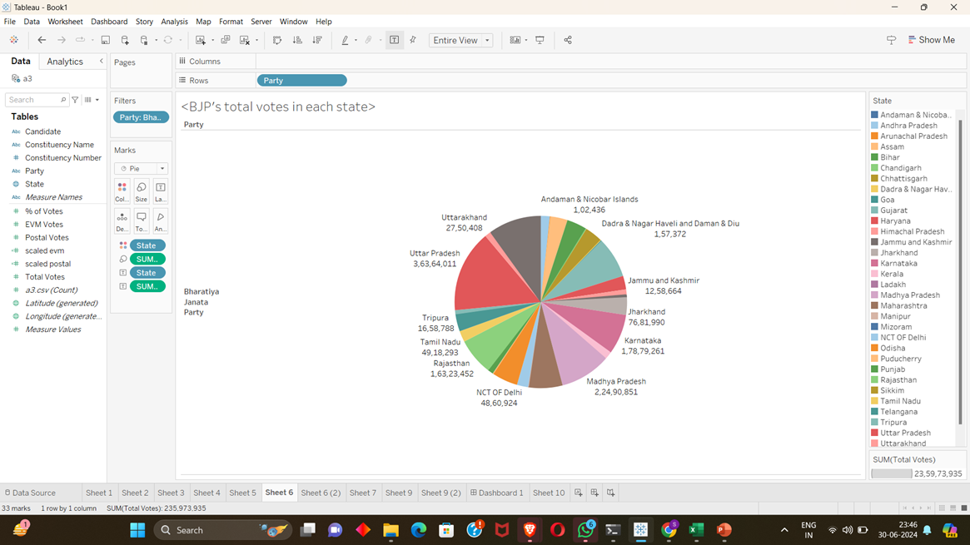
BJP TOTAL VOTES IN EACH STATE
07

Slide 8
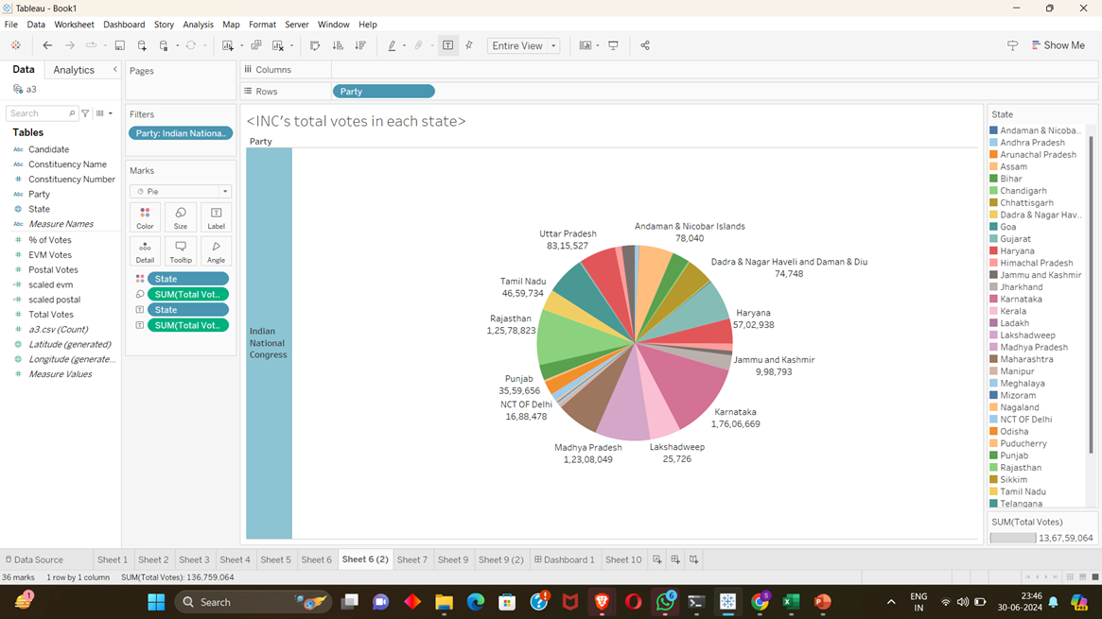

INC’S TOTAL VOTES IN EACH STATES
08

Slide 9
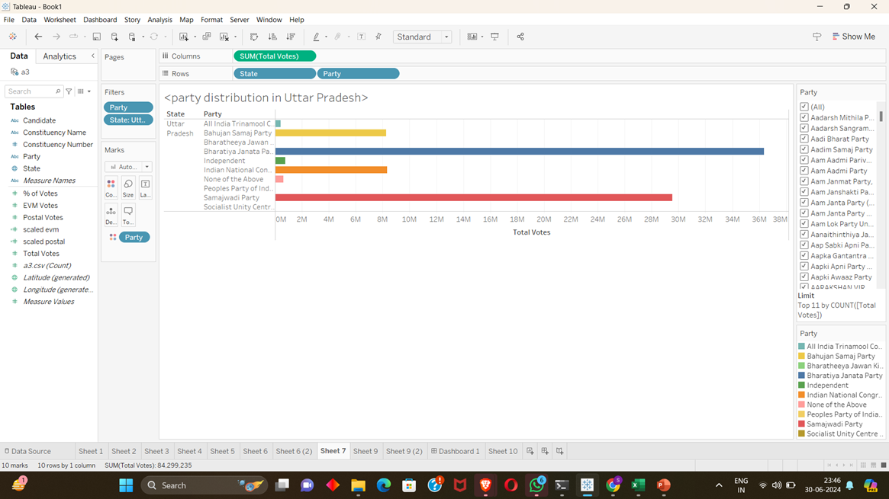
PARTY DISTRIBUTION IN UP
09

Slide 10
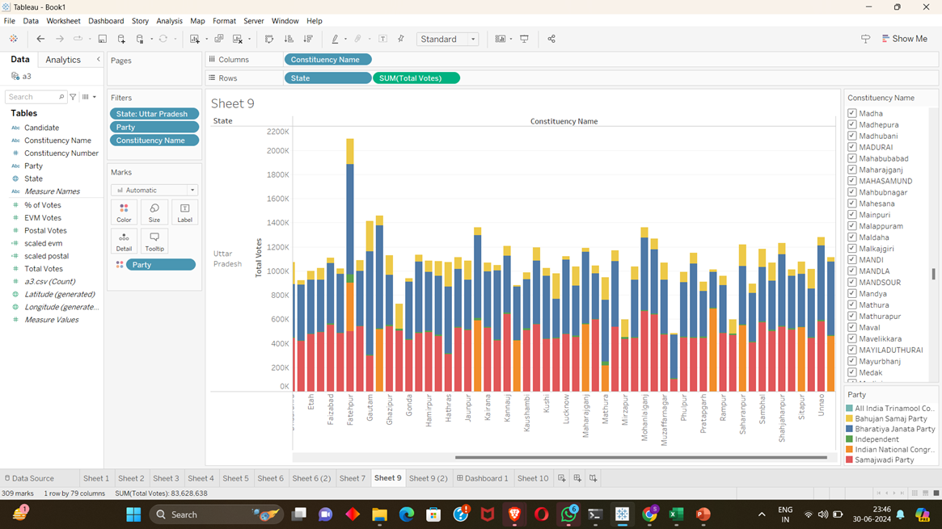
PARTY DISTRIBUTION IN UP ACCORDING TO CONSITUENCY
It is the representation of UP as bases on its constituency, here we can see that Samajwadi party is having a good hold.
10

Slide 11
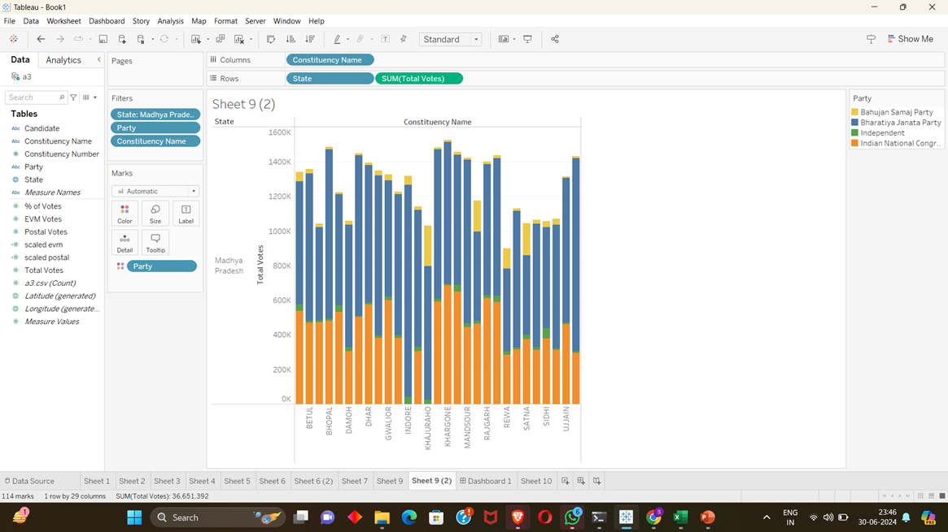
PARTY DISTRIBUTION IN MP ACCORDING TO CONSTITUENCY
This is the representation of Madhya Pradesh’s constituency wise.
Here we can see that in Indore there is only BJP as it was because the many voters has voted to NOTA.

Slide 12
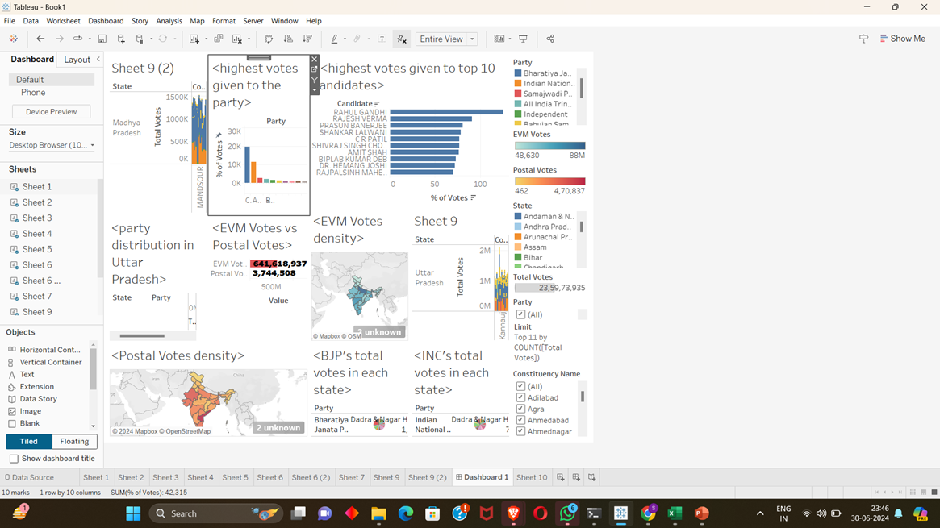
ALL IN ONE DASHBOARD

Slide 13
THANK YOU
ARYAN KUMAR
RA2111026010192

