Slide 1

Exception
Occurred

Slide 2


Stack 2

Slide 3

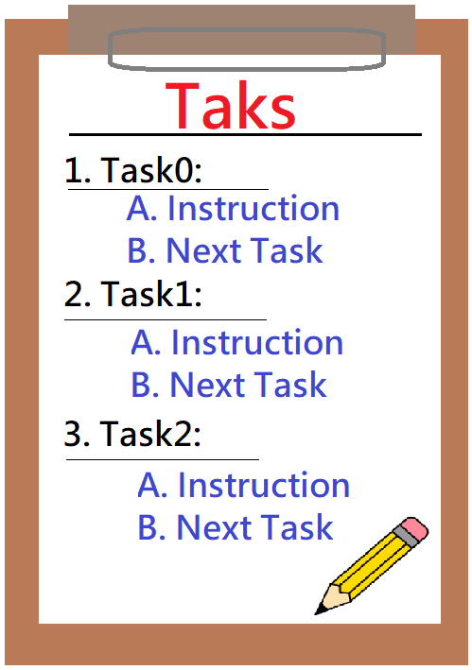







Registers
Stack
Task
Context Switch
Exception
Thread Control
Block

Slide 4
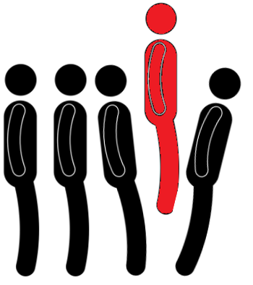

Slide 6
