Slide 1
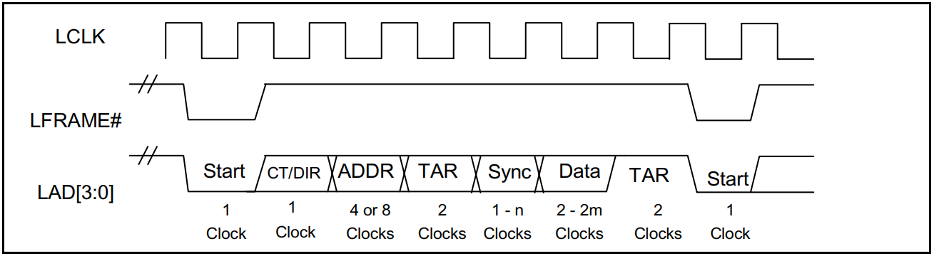
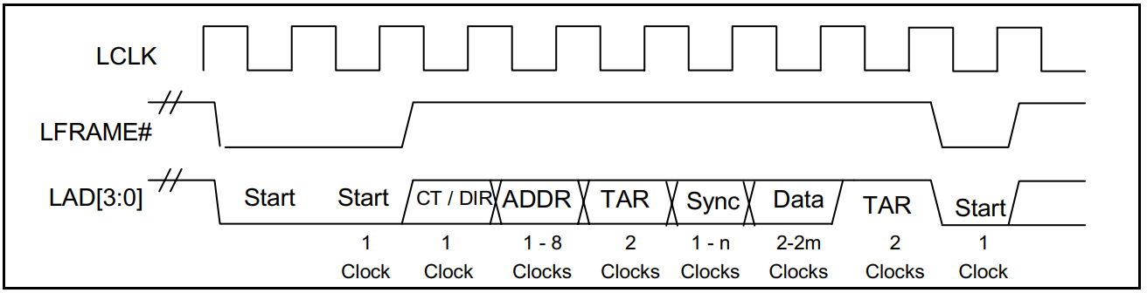

Slide 2
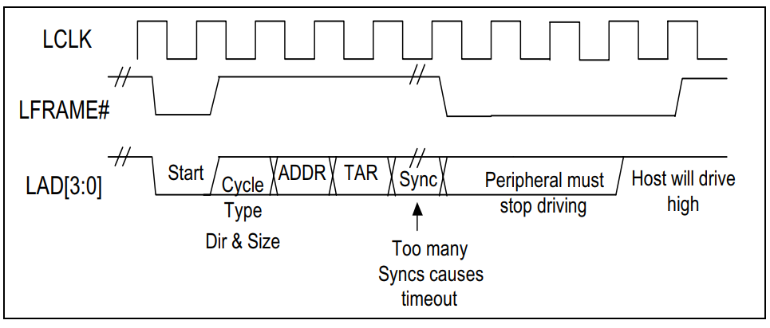

Slide 3
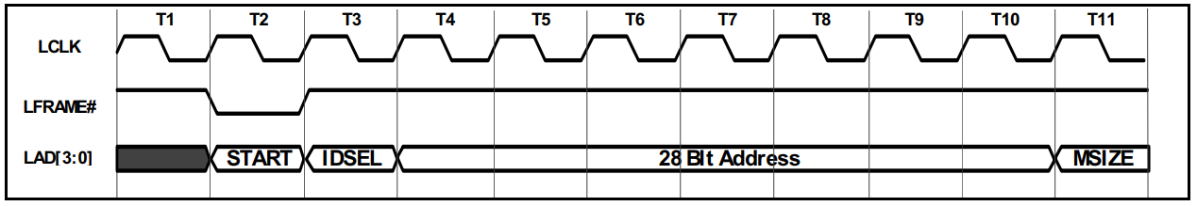
Firmware Memory Cycle Preamble

Slide 4
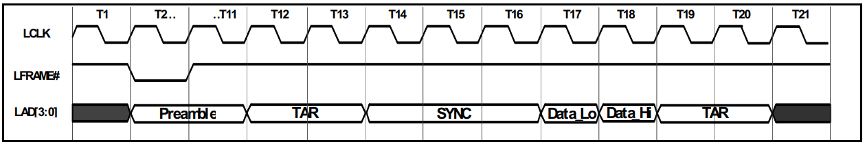
Firmware Memory Cycle Single Byte Read

Slide 5
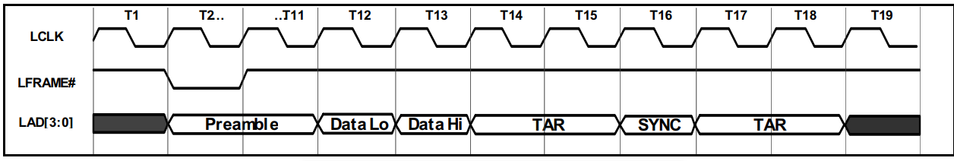
Firmware Memory Cycle Single Byte Write

Slide 6
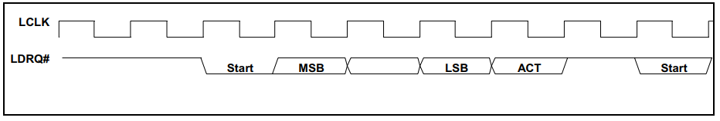
DMA Request Assertion through LDRQ#

Slide 7
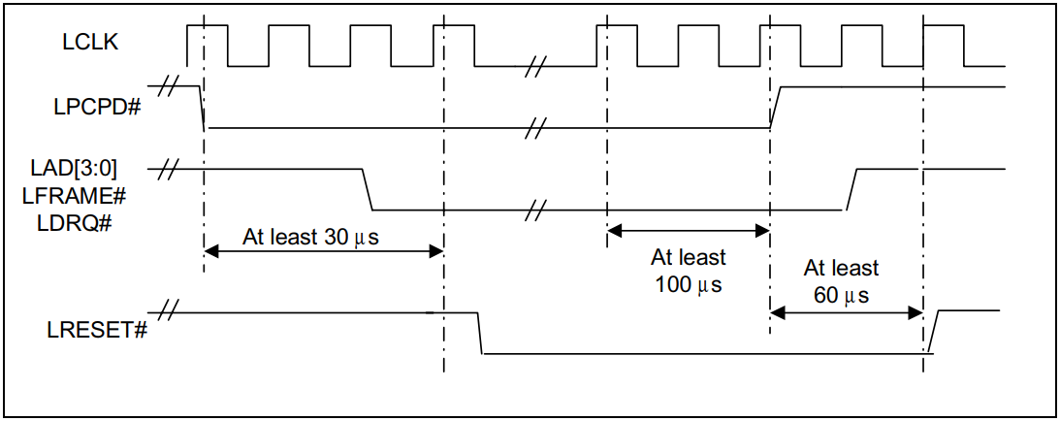
Timing for Entering and Exiting the Power Down State

