Slide 1
ITE 8512
Speaker: WY

Slide 2
What’s the EC ?
Embedded Controller comes form ACPI structure
Host is communicated EC by LPC interface. The I/O port are 60/64 and 62/66
EC integrated ps2 device, keyboard matrix, battery charger, fan control, power sequence, hot key function, backlight, CPU thermal sensor, system power consumption,etc.

Slide 3
System Structure
NB
SB
LPC
EC
PS/2 KB/MS
MATRIX
FAN Control
Charger
Flash ROM
Power
Sequence….

Slide 4
Keyboard Controller Overview
Host System
LPC/Firmware Hub
ITE KBC
HIF
18 Scan Out (Column)
Scan Matrix
Keyboard
Scan
PS/2
3 PS/2 Devices
8 Scan In (Row)
I2C
SMBus
3 SMBus Devices

Slide 5
EC Feature
ITE EC
PS/2 KB/MS
MATRIX
ACPI
Power management
SMBus
UART / CIR
ADC/DAC
PWM
Share BIOS
KBS Monitor

Slide 6
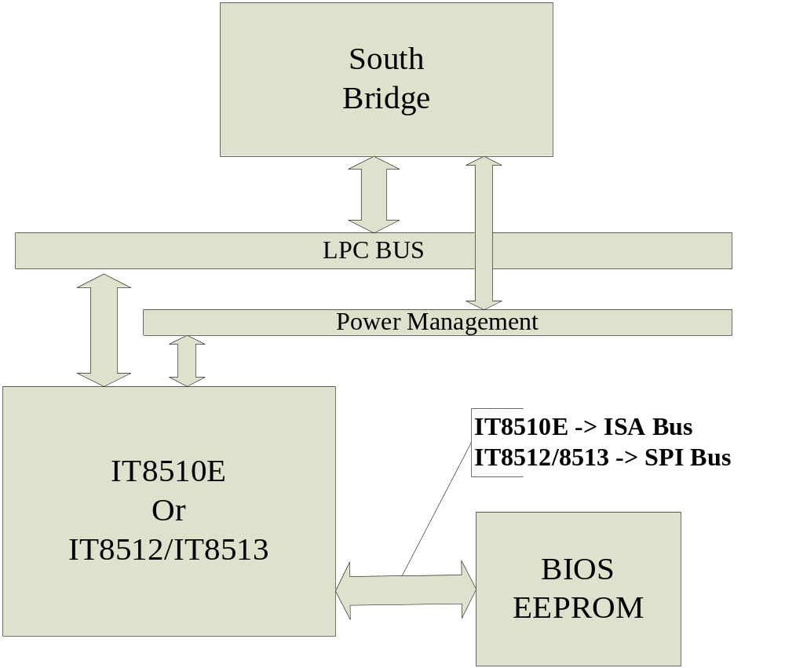
EC Position

Slide 7
Share BIOS Architecture
Max : 16M
64K~16M Byte
BIOS ROM Zone
KBC ROM Zone
KBC ROM Zone
64K
Max :16M-64K Byte
0
64K Byte
Full space 16M Byte

Slide 8
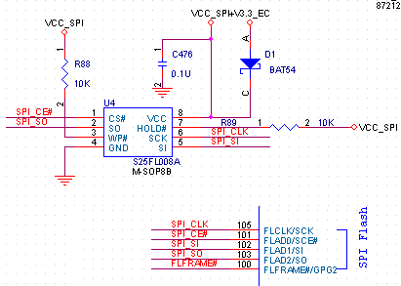
BIOS&EC Code Position

Slide 9
Features
IBM AT & PS/2 8042-Compitable Host Interfaces
Support all standard Host Commands
ACPI Embedded Controller Interface
ACPI System Management Bus Interface
PS/2 Devices
Scan Matrix Keyboard
OEM Customization

Slide 10
Features – Host Interface
Host Interfaces
  Primary Host Interface (0x60, 0x64)
    HIF1 – 8042 Command Interface
  Secondary Host Interface (0x62, 0x66)
    HIF2 – Logical HIF – ACPI Command Interface
    HIF3 – Logical HIF – SMI Access
  Third Host Interface (0x68,0x6C)
IBM AT & PS/2 8042-Compatible
  Standard KBC Commands – 0x64 port
  Standard KBD Commands - 0x60 port
  Standard AUX Commands – 0x64 port D4 command

Slide 11
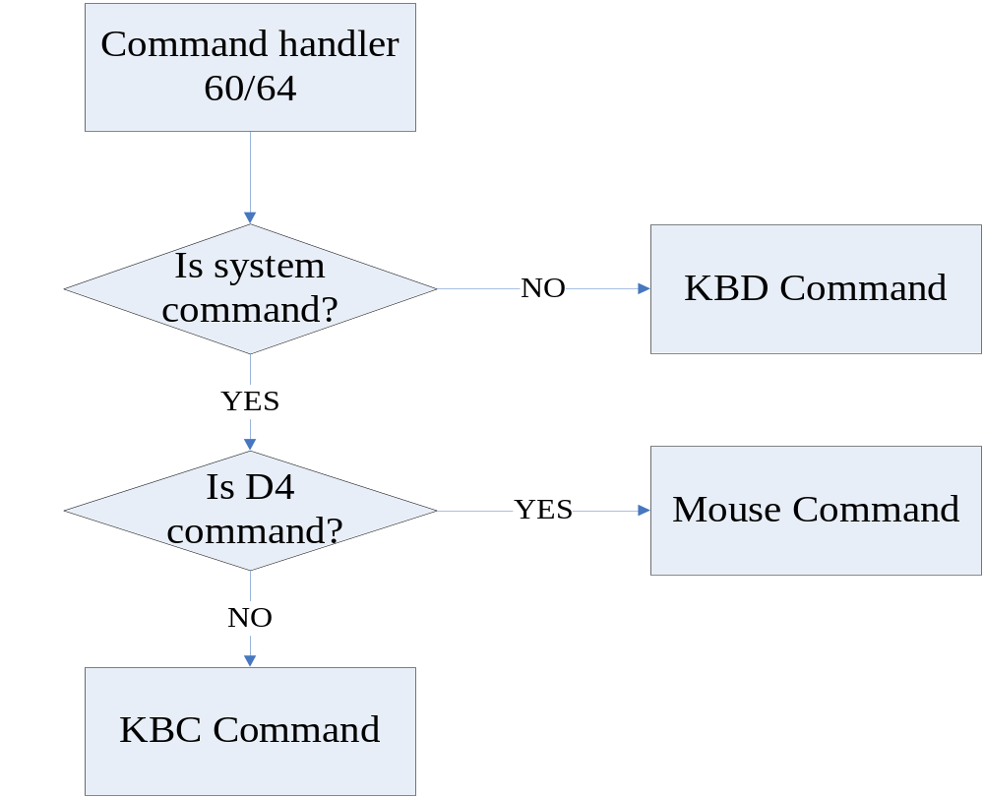
Command Handler

Slide 12
Keyboard Controller Status Register 64h
Bit
Description
7
Parity Error
6
Timeout Error
5
Auxiliary Output Buffer Full
4
Inhibit Switch
3
Command/Data
2
System Flag
1
Input Buffer Full ( IBF )
0
Output Buffer Full (OBF)

Slide 13
Features – Standard KBC Commands
Standard 64 command list
Write / Read Keyboard Controller Command Byte (60h / 20h)
The KCCB resides in 8042 RAM location 20h, Address 20h defined in the IBM 8042 programming specification.
IBM standard command set, use command 20h to read the KCCB and command 60h to write KCCB.
  Default:
    0x65 – PS/2 Mouse Not Present
    0x47 – PS/2 Mouse Present
Controller Command Byte:
  Bit[7] - Reserved
  Bit[6] - Keyboard Translate
  Bit[5] - Disable Auxiliary Device
  Bit[4] - Disable Keyboard
  Bit[3] - Reserved
  Bit[2] - System Flag
  Bit[1] - Enable Auxiliary Interrupt
  Bit[0] - Enable Keyboard Interrupt

Slide 14
Features – Standard KBC Commands
Output Buffer Write Commands:
  Write Keyboard Output Buffer (D2h)
  Write Auxiliary Device Output Buffer (D3h)
Write to Auxiliary Device Command (D4h)
  Write to PS2 Device
Pulse Output Port Commands:
  Pulse Both Reset and Gate A20 (FCh)
  Pulse Gate A20 (FDh)
  Pulse System Reset (FEh)

Slide 15
Features – Standard KBD Commands
Standard KBD 60 command list
Set / Reset Status Indicators Command (EDh)
Echo Command (EEh)
Select Alternate Scan Codes Command (F0h)
Read Id Command (F2h)
Set Typematic Rate/Delay Command (F3h)
Enable Command (F4h)
Default Disable Command (F5h)
Set Default Command (F6h)
Set Keys Commands (F7h-FDh)
Resend Command (FEh)
Reset Command (FFh)

Slide 16
Features – Standard AUX Commands
Standard PS2 64_D4 command list
Reset Scaling (E6h)
Set Scaling to 2:1 (E7h)
Set Resolution (E8h)
Status Request (E9h)
Set Stream Mode (EAh)
Read Data (EBh)
Read / Set Wrap Mode (ECh /EEh)
Set Remote Mode (F0h)
Read Device Type (F2h)
Set Sampling Rate (F3h)
Enable / Disable Auxiliary Device (F4h / F5h)
Set Default (F6h)
Reset Auxiliary Device (FFh)

Slide 17
Features – Commands
Extended Controller Commands
  Specific Functionalities
    Access Legacy EC Space
    Sample A/D Channel
    Turn On/Off LED’s
    Access Configuration Table
    Etc.

Slide 18
Features – ACPI Interface
Embedded Controller Interface(0x62/0x66)
ACPI fully support
Command Set
0x80-Read EC space
0x81-Write EC space
0x82-Burst Enable
0x83-Burst Disable
0x84-Query SCI event

Slide 19
Features – PS/2 Devices
Three PS/2 Ports
One internal ps2 mouse & two external ps2 device(one keyboard +one mouse)
  Port 1 & Port 2 – Keyboard & Pointing Devices
  Port 3 – Touchpad Devices (Internal)
Active PS/2 Multiplexing
Hot-plug
if Ext.aux device is also attached, send command to it but do not pass Ext. response to the system.

Slide 20
Features – Scan Matrix
All Standard Notebook PC Keys
Easy Customization
  Download OEM Scan Table in RAM
  Update Scan Table in ROM

Slide 21
Features – OEM Customization
OEM-Definable Hotkeys
-Hotkey, Quick button
OEM-Definable SMI / SCI Events
-Battery event, System Beep, Thermel throttle event, etc…

Slide 22
Firmware Architecture

Slide 23
Firmware – ROM Image
KBC.ROM---64K
0x0000
Crisis
Recovery
0x1000
Main
Core
Configuration
Tables
Scan
Tables
OEM function
0xFFFF

Slide 24
EC Flowchart
Top-Level Flow Diagram
Power Up
Initialization
Idle
Interrupt
Runtime Service

Slide 25
Firmware - Initialization
Power Up
Power Up
Crisis?
No
Initialization
Idle
Yes
Normal
Initialization
Crisis
Initialization
Idle
Crisis
Recovery

Slide 26
Firmware - Idle
Disable Interrupts
Initialization
Idle
No
Standby
Yes
Standby
Setup
Enable
Interrupts
Idle
(SLEEP)

Slide 27
Firmware – Runtime Service
Interrupt
Idle
Check Service
Interrupt
Runtime Service
Do Service
Yes
More Service
No
Idle

Slide 28
How To Enter Power Down Mode
1. Check condition for enter power-down mode
2. Disable module (reduce leak current)
3. Change all gpio pin function ( if need ) (reduce leak current)
4. Set wake-up pin function
5. Set wake-up source
6. Set interrupt source
7. Enter power-down mode→Deep sleep→IRQ event
8. Set gpio pin to original funtion
9 .Enable module
10. Restore all gpio pin function ( if need )
11. Return to main_loop

Slide 29
Upper Loop
KBC-centric:1 byte output buffer, wait forever for the System to read kbd/mouse.
Poll all other interrupts expect ps/2(KBC/EC Host commands, External pin, Smbus, etc)
PS2 device inactive

Slide 30
Lower Loop
Wait for interrupt (sleep, Idle, wait……)
Ps2 devices active.
1ms Timer-periodic switch to Upper Loop
Each Interrupt switch to Upper Loop

Slide 31
Interrupts Sources
Internal:
1.Timer interrupt (for 1ms timer..)
External:
1.IRQ pin(WUxx)
2.SMBus interrupt(for receive data)
3.Peripheral interrupt(for PS2 device data in)
4.Data buffer interrupt (for IBF,IBF1 and IBF2)
5.Keyboard interrupt(for internal keypressed)

Slide 32
ITE8512 Memory Introduction
ITE8512 Memory Mapping
  There are different commands for these memory area.
FFFF
~
0000
ROM
RAM
FFF
~
000
Ram
00~FF
Internal
External
External

Slide 33
Code Structure
Build Environment
Source Code Directories
Source Code Overview

Slide 34
Code Structure – Build Environment
Windows XP – DOS Command prompt
Tools
  Keil C51 Tools
    Assembler - ax51.exe (v2.13)
    Compiler – c51.exe (v7.20)
    Linker - lx51.exe (v3.64)
  Misc. Tools
    h2b.exe
    replace.exe

Slide 35
Code Structure – Directories
CORE
  CORE_ACPI.C
  CORE_HOSTIF.C
  CORE_INIT.C
  CORE_DATA.C
  CORE_FLASH.C
  CORE_IRQ.C
  CORE_MAIN.C
  CORE_PS2.C
  CORE_SCAN.C
  CORE_PORT6064.C
  CORE_TIMERS.C
  CORE_CIR.C
  CORE_CHIPREGS.C
OEM– Default OEM Project
  OEM_BATTERY.C
  OEM_LED.C
  OEM_FAN.C
  OEM_SCANTABS.C
  OEM_GPIO.C
  OEM_MAIN.C
TOOLS
  Nmaker15.exe hex2bin.exe

Slide 36
Code Structure – Build
Set Environment
  KeilC51
Customize Build EC code
  Iteec.mak → iteec.bin
  Iteec_bb.mak → iteec_bb.bin
bb_iteec.bin = iteec_bb.bin + iteec.bin
Set Build EC Firmware
    MAKEAll.bat

Slide 37
Source Code – CORE
Reset Entry Point
  Startup.a51
Crisis Recovery
  CORE\Core_bblock.c
Hardware Dependant
  Chip Registers
  Interrupt Handlers
  Hardware Control Routines
Variable Data Types
  CORE\ TYPES.H

Slide 38
Source Code – Core_IRQ.C
On-CHIP peripherals
System interrupt table
Interrupt Handler
  Timers (1mS & 150µS)
  Host Interfaces
  PS/2 Ports
  I2C
  Etc.

Slide 39
Source Code – Core_BBlock.C
CORE
Crisis Command Handler
  Standard KBC/KBD/AUX Commands – Crisis Mode
  Flash Commands
  GPIO setting

Slide 40
Source Code – Core_ini.C
CORE
Initialization
  Registers
  Timers (1mS Timer & 150µS Timer)
  Host Interface
  Devices
Hook to OEM

Slide 41
Source Code – Core_MAIN.C
CORE
Normal Code Entry
Main Routine
  Idle Loop
  Service Routines
    Service Flags

Slide 42
(Source Code – Core_MAIN.C)
16 Service Routines:
  service_unlock - Unlock device transmission
  service_pci – Primary Host Interface (0x60, 0x64)
  service_aux_port - Send byte from auxiliary port to Host
  service_1mS – 1 millisecond service
  service_scan – Scan Matrix
  service_send - Send byte from scanner keyboard
  service_pci2 - Secondary Host Interface (0x62, 0x66)
  service_pci3 - Third Host Interface
  service_core_7 – Reserved
  service_ext_irq - External IRQ
  service_core_10, service_core_11 – Reserved
  service_chk_aux - Check External mouse existence
  service_OEM_0, service_OEM_1, service_OEM_2 - Reserved

Slide 43
Source Code – Core_port6064.C
CORE
Standard 8042 Commands
  IBM AT & PS/2 8042-Compitable
    Standard KBC Commands
    Standard KBD Commands
    Standard AUX Commands

Slide 44
Source Code – Core_ps2.C
CORE
PS/2 Devices
  Lock/unlock PS/2 device
  Suspend/Resume PS/2 device
  Send/Get data to/From PS/2 device

Slide 45
Source Code – Core_scan.C
CORE
Scan Matrix Keyboard
  8x16 Matrix (Row: 8, Column: 16)
  Ghost Key
  Key Press / Release Debounce

Slide 46
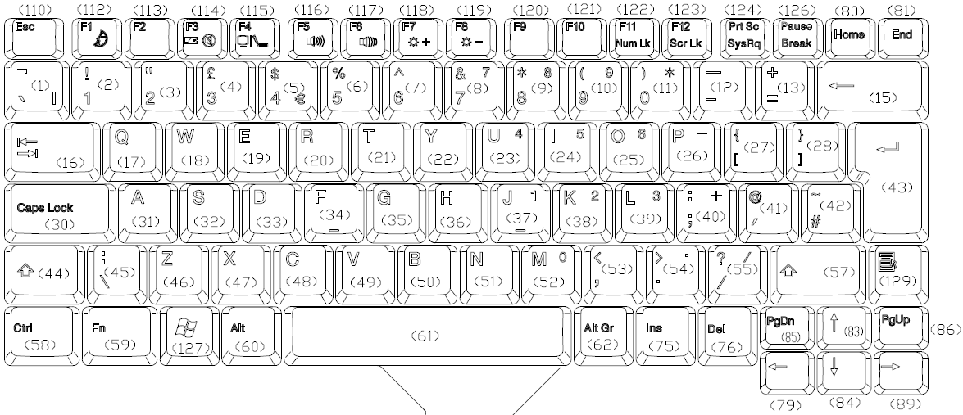
Keyboard Drawing

Slide 47
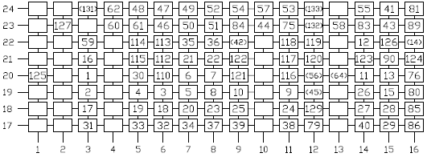
Standard Matrix

Slide 48
(Source Code – PURSCN.C)
Scan Matrix Keyboard
0
1
R - ROW (Scan In)
2
3
4
5
6
7
0
1
2
3
4
5
6
7
8
9
10
11
12
13
14
15
C – Column (Scan Out)

Slide 49
(Source Code – PURSCN.SRC)
Ghost Key – 2 (or more) keys pressed on the same ROW
0
1
R - ROW (Scan In)
2
3
4
5
6
7
0
1
2
3
4
5
6
7
8
9
10
11
12
13
14
15
C – Column (Scan Out)

Slide 50
(Source Code – PURSCN.C)
Key Press / Release Debounce
Break?
Make?
10~15 ms
10~15 ms
Re-check
Re-check

Slide 51
Source Code – Core_XLT.C
CORE
Scan Code Translation
  R/C Input
  Translate to Scan Code
    Store into internal key buffer
    Hotkey

Slide 52
Source Code – Core_ACPI.C
CORE
ACPI Command Handler
SCI Generation
SMBus Protocol Handler
ACPI EC Space Access

Slide 53
Source Code –Core_SMBus
Core_SMB.C
  CORE
  SMBus Protocol
  Read/Write Smbus byte
  Read/Write Smbus Word
  Read/Write Smbus Block

Slide 54
Source Code – Core_DAT.C
CORE
Internal Variables
  BIT
  DATA
External Variables
  IDATA
  XDATA
CHIP \ TYPE.H

Slide 55
BUILD A PROJECT WITH EC CODE
Define GPIO’s
Setting/variables
1. CORE_INIT.C
2. OEM_GPIO.C
Files Modify
Build Matrix table
1. OEM_SCANTABS.C
Files Modify
Set power
sequence
OEMMAIN.C
OEMGPIO.C
OEMGPIO.H
Files Modify
OEM_FAN.C
OEM_BATTERY.C
OEm_FAN.C
OEM_LED.C
:
Build OEM
Function
Files Modify

Slide 56
ITE chip solution

Slide 57
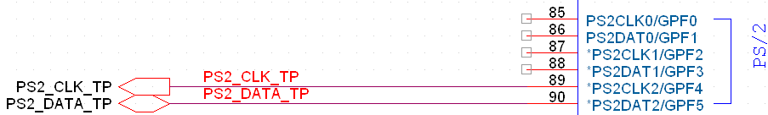
PS/2

Slide 58
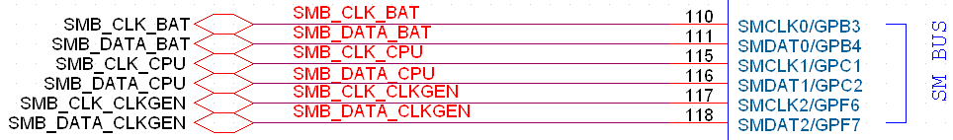
SMBus
SMBus-0 Battery#1, Thermal IC#1
SMBus-1 Battery#2, Thermal IC#2
SMBus-2 System Clock Generator

Slide 59
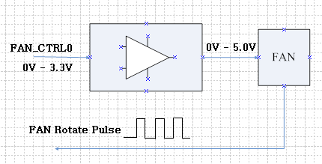
FAN Control

Slide 60



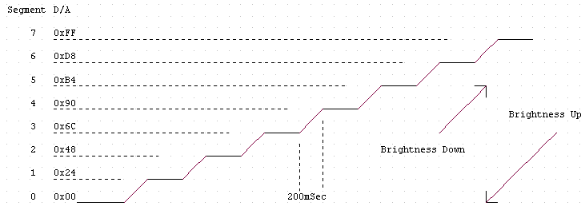
LCD Brightness Control

Slide 61
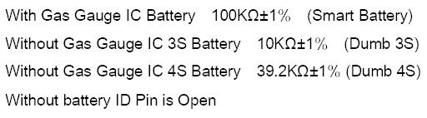
Adapter & Battery
Adapter Status
Battery Detection

Slide 62


Charger Control
Charge On/Off
Charging Current Setting

Slide 63
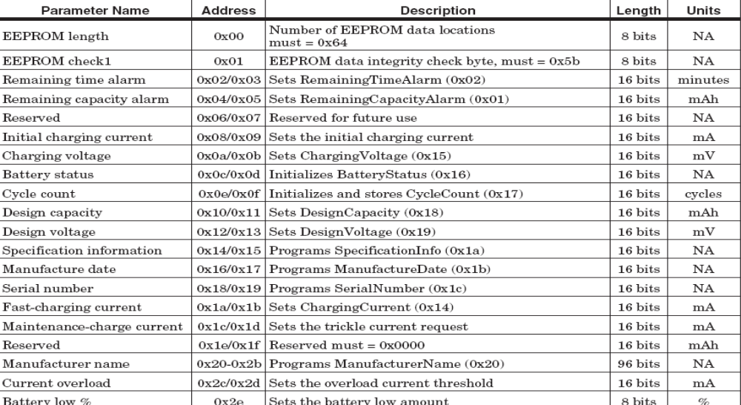
Software Battery GasGauge
Reference Software GasGauge Document
(O2/Texas Instruments)

Slide 64
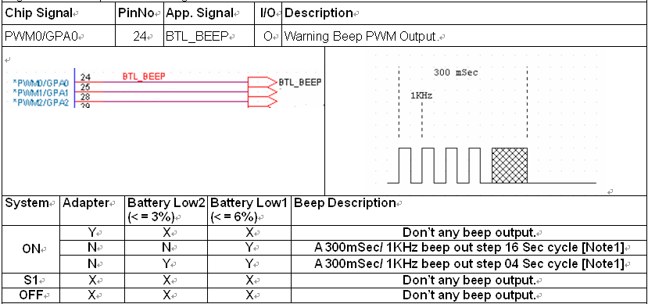
EC Beep PWM (Battery Status Warning)

Slide 65
On Board Programming

Slide 66
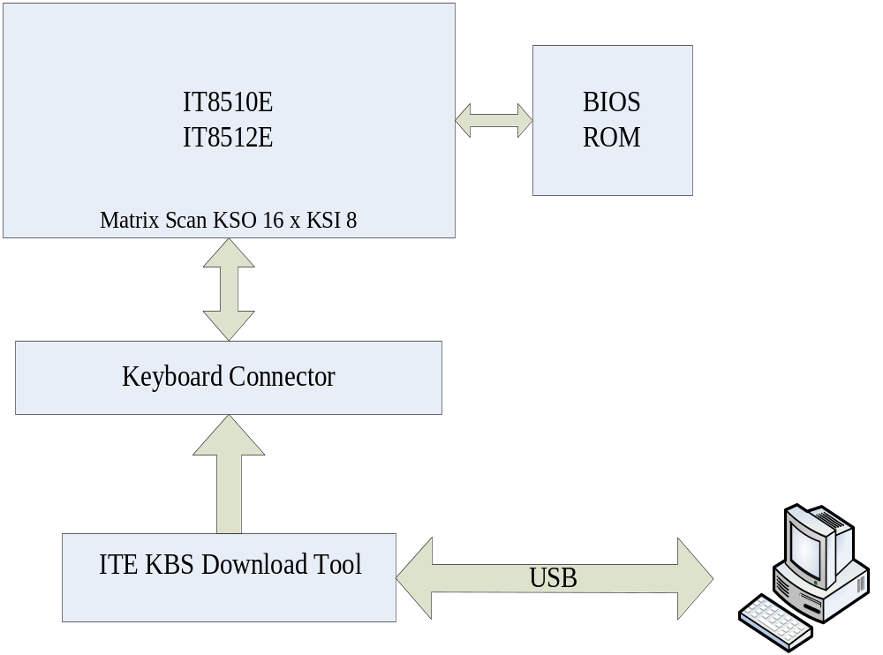

Slide 67
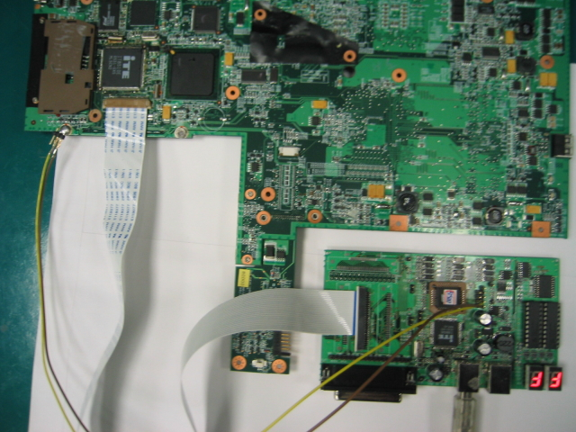
ITE KBS Download Board

Slide 68
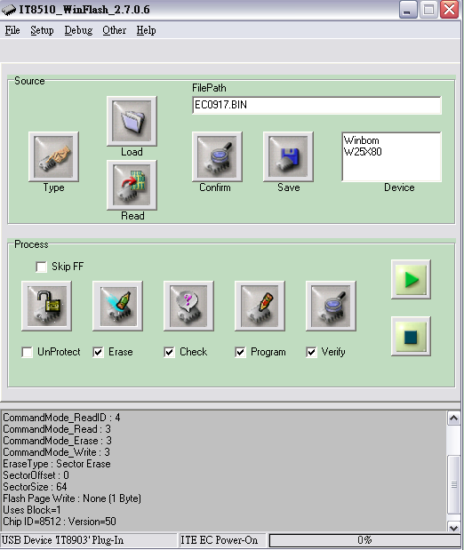
ITE KBS download tool

Slide 69
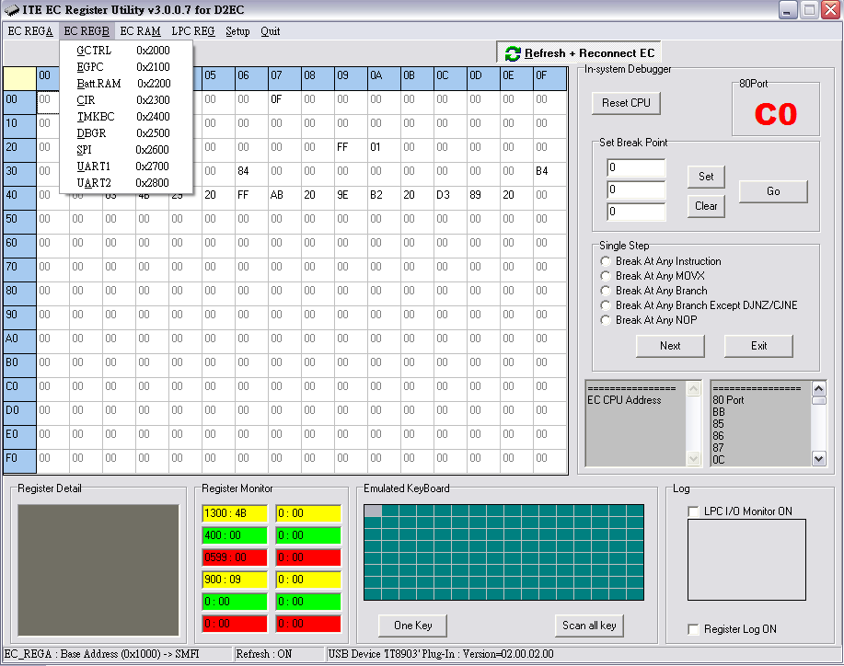
ITE KBS D2EC access RAM

Slide 70
System utility

Slide 71
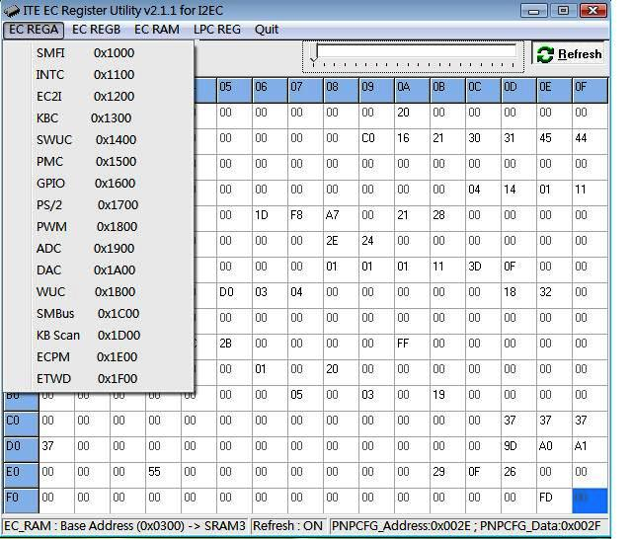
EC Register/Ram access Dos/XP/Vista

Slide 72
Utility- Rom Flash
Flash utility for dos mode
Iteflash.exe
Flash utility for Windows XP/ Vista
Winflash v1.0

Slide 73
Summary
PS2 and keyboard traffic communication
EC要使系统節能，更加省电，增加电池的续航能力，控制良好的散热性能，减少風扇系统的噪音，根据温度，控制CPU风扇的停转。
系統電源管理 -s3/s4/s5 電力調節
充电指示灯、WIFI指示灯、Fn快速鍵功能
背光亮度，聲音控制等。

Slide 74
Q & A
Q & A
Thank you!

