Slide 1
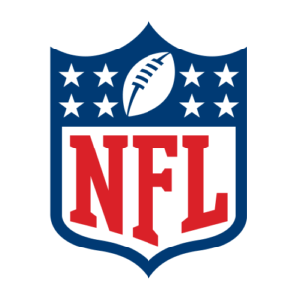
NFL Concussion study
Team group 2
Kelsey brantner
Daniel Carrasco
Joel pangilinan

Slide 2
Why care about head injuries, specifically concussions?
According to the CDC:
Most TBIs(Traumatic Brain Injuries) are concussions or mild TBIs
Even mild TBIs can cause harm to the brain through the damage of brain cells and can change brain chemistry
These changes can impact sleep, thinking, actions, learning, and feelings
https://www.cdc.gov/traumaticbraininjury/concussion/index.html

Slide 3
The Questions
How long were players out? (Determined by examining number of games missed)
How did the injury affect the player’s playtime?
What position gets the most concussions on both offense and defense?
How did the team fare (win or lose?) when they had a player with a head injury?
What team is most prone to concussions?
What team inflicted the most concussions?

Slide 4
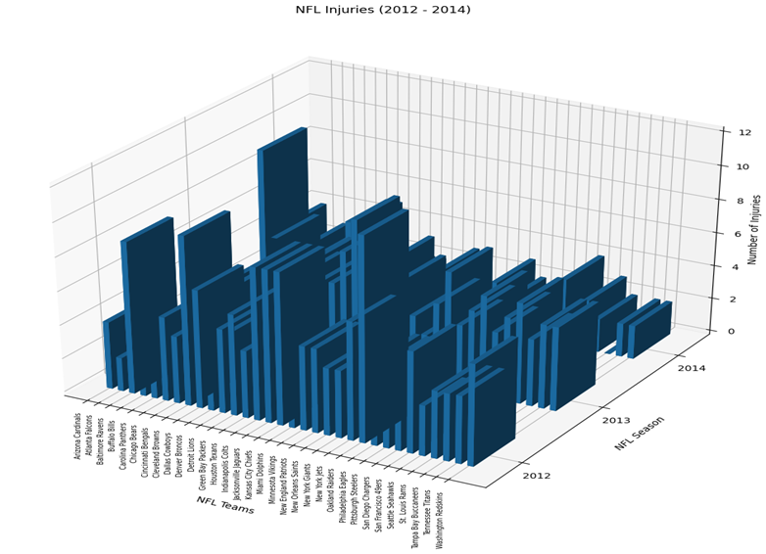
The Data
Spans NFL seasons 2012-2014
325 concussions and head injuries were recorded
All NFL teams were included

Slide 5
Overall Results

Slide 6
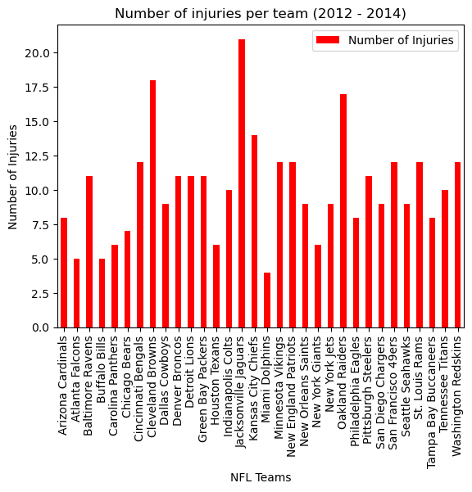
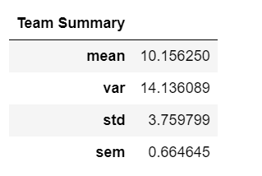
TEAM INJURIES

Slide 7
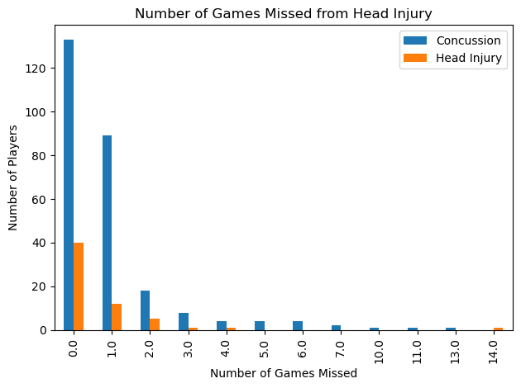
Number of Concussions and Head Injuries
Statistical Test:
Ho: If head injuries impact a player’s ability to participate as much as concussions, then there will not be a difference in mean number of games missed
Independent t-test
pvalue=0.35
No statistically significant difference of mean games missed for head injuries versus concussions

Slide 8
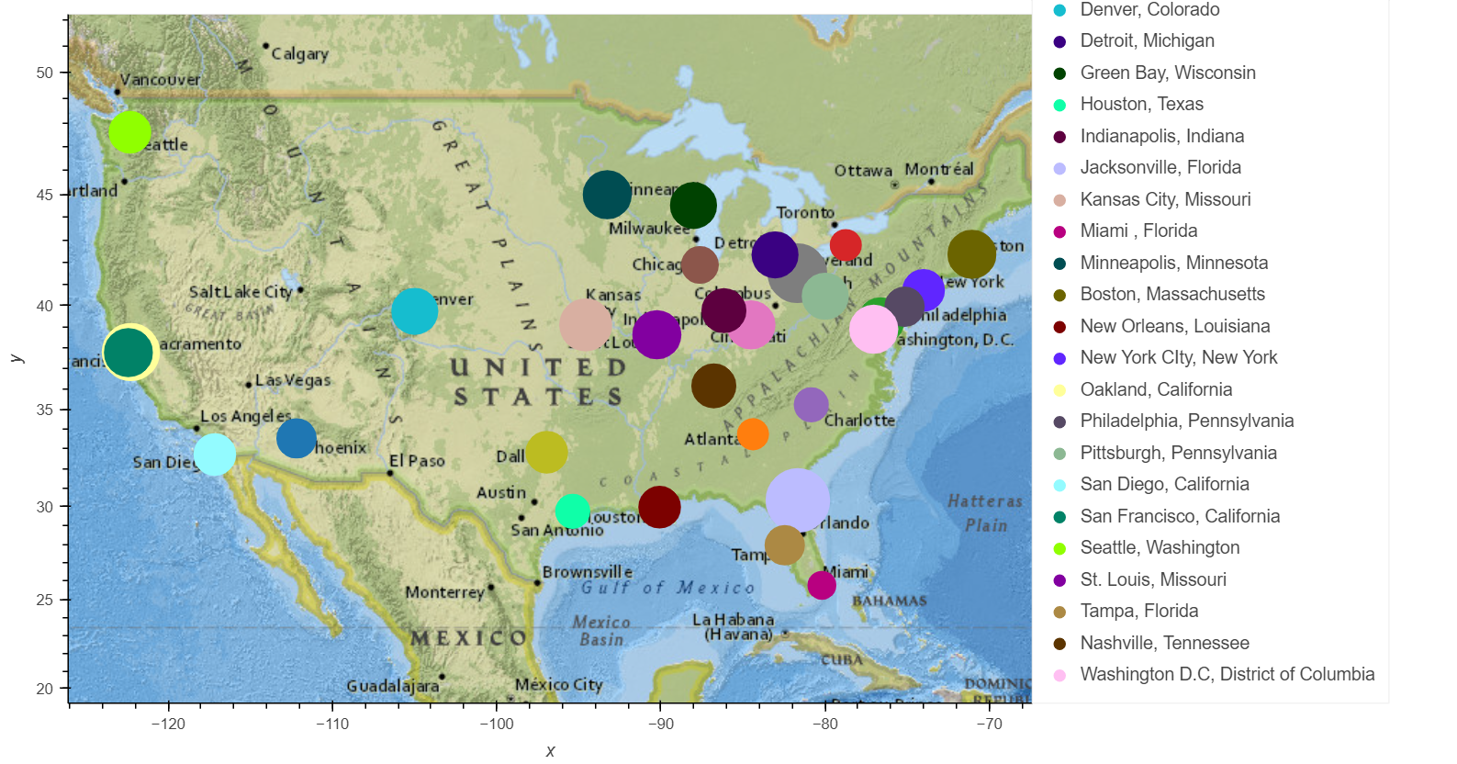
NFL Map by Number of Injuries

Slide 9
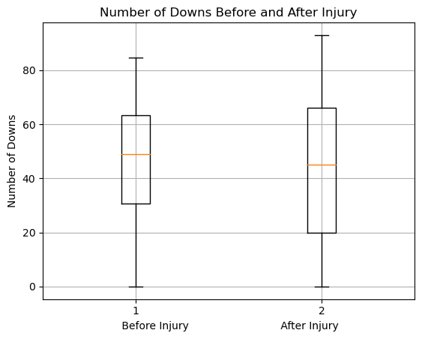
Play Time After Injury
stats.ttest_ind(play_compare['0_x'], play_compare['0_y'], equal_var=False)
Ttest_indResult(statistic=-2.340507171046189, pvalue=0.01958606850646929)

Slide 10
The Break Down
Offense, Defense, and by Year

Slide 11
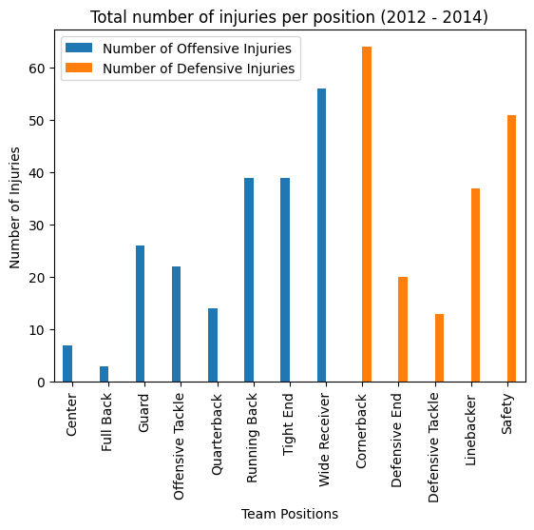
Breakdown on injuries by team (Offense and Defense)
Top positions that is prone to concussion
Cornerback
Wide Receiver
Safety
Running Back
Due to the nature of the game, these positions are likely to have contact

Slide 12
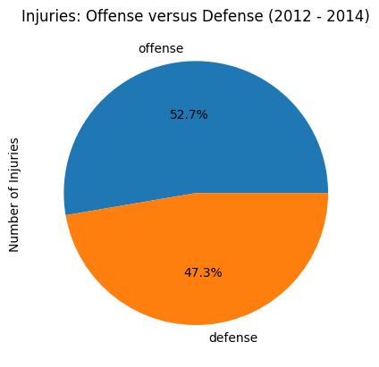
Injury Percentage of Offense and Defense
Offensive players are slightly prone to injury
Wide receivers have their eye on the ball
Running backs are tackled, being hit

Slide 13
stats.ttest_ind(defense_df["Games Missed"], offense_df["Games Missed"], equal_var=False)
Is there a difference on the number of games missed between offense and defense
Ttest_indResult(statistic=-1.7650938173235642, pvalue=0.07849418146862482)
Richard Branson

Slide 14
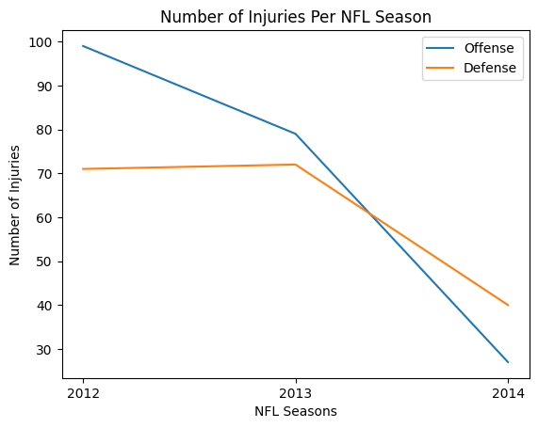
Injury trend from 2012 to 2014 (Offense and Defense)
NFL player safety are given emphasis
NFL Game Day Concussion Diagnosis and Management Protocol in 2011
The protocol is reviewed annually

Slide 15
stats.ttest_ind(injury_per_year_df["Offensive Injuries"], injury_per_year_df["Defensive Injuries"], equal_var=False)
Ttest_indResult(statistic=0.3639356095616046, pvalue=0.7393726990881611)
In [55]:

Slide 16
Daniel’s info here

Slide 17
conclusion
Further Research
Question Answered
How long were players out? (Determined by examining number of games missed)
How did the injury affect the player’s playtime?
Statistically significantly deceases playtime
What position gets the most concussions on both offense and defense?
Offense: Wide Receiver
Defense: Cornerback
How did the team fare (win or lose?) when they had a player with a head injury?
What team is most prone to concussions?
Jacksonville Jaguars
What team inflicted the most concussions?
Increases size of dataset
Original dataset is small
Determine number of players with head injuries
See if there was a NFL change in 2014 that decreased head injuries

Slide 18
references
Dataset:
https://data.world/alice-c/nfl
News articles:
https://www.pbs.org/wgbh/frontline/investigation/the-nfls-concussion-crisis/
NFL protocol on concussions:
https://www.nfl.com/playerhealthandsafety/resources/fact-sheets/nfl-head-neck-and-spine-committee-s-concussion-diagnosis-and-management-protocol
CDC:
https://www.cdc.gov/traumaticbraininjury/concussion/index.html

Slide 19

QUESTIONS

Slide 20
appendix

Slide 21
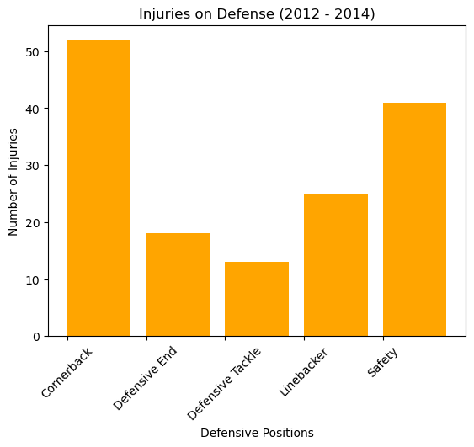
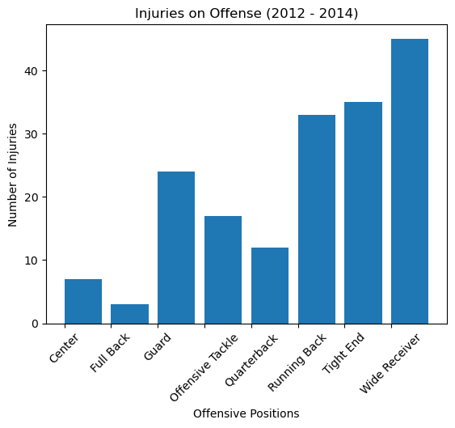
Head Injury/Concussion from 2012 to 2014 by position
Football is a contact sport

Slide 22

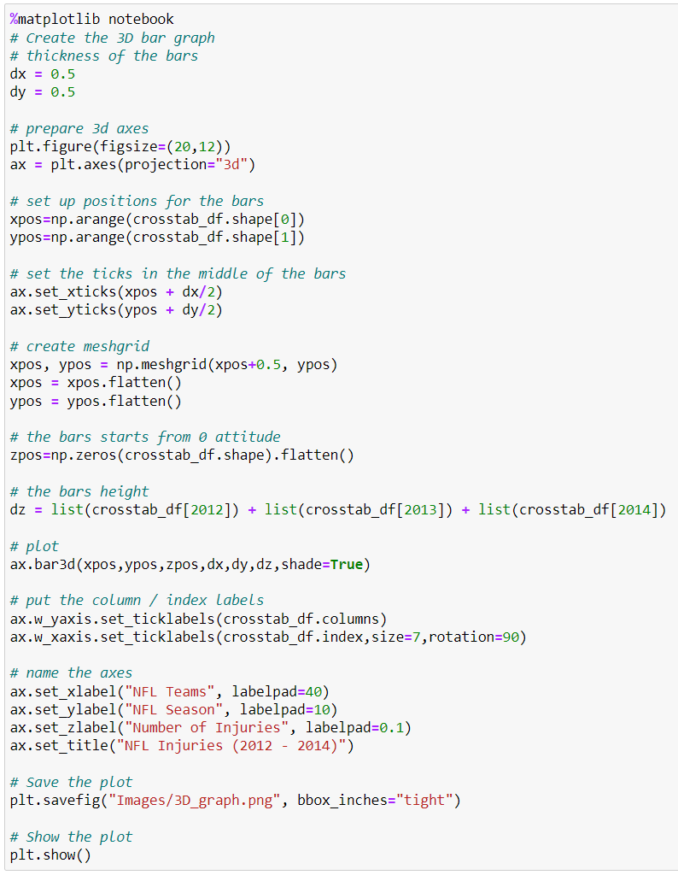
Break down of injuries per team and per year (2012 to 2014)

