Slide 1
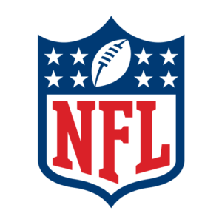
NFL Concussion study
Team group 2
Kelsey brantner
Daniel Carrasco
Joel pangilinan

Slide 2

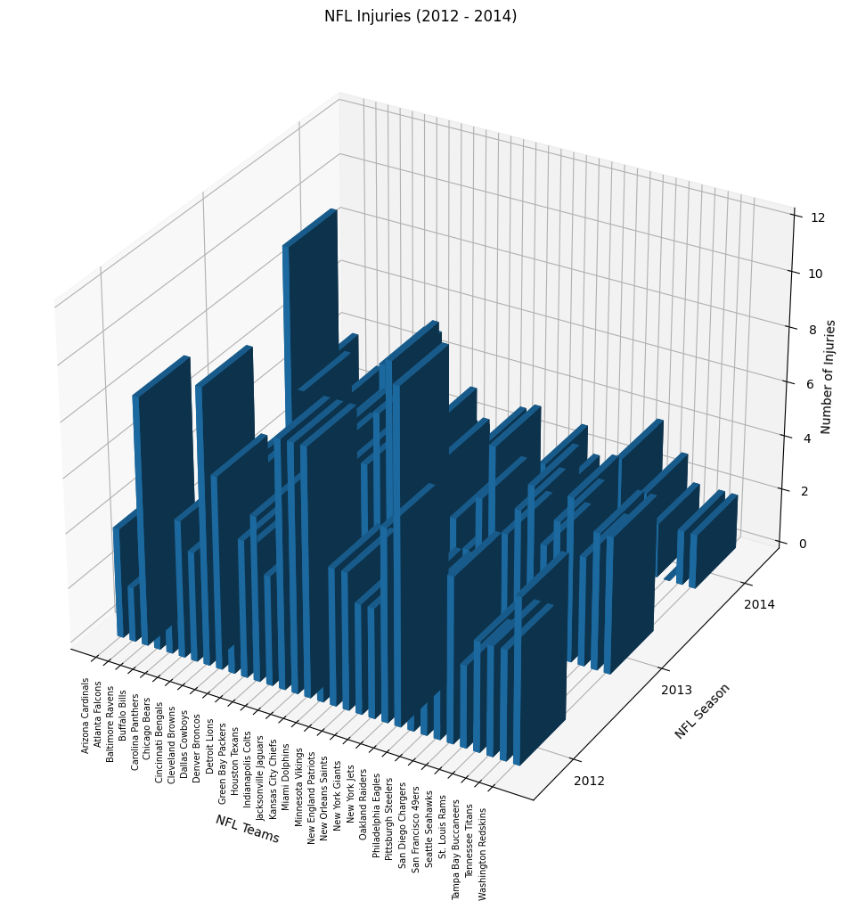
2012 – 2014 nfl head injury/concussion Problem statement
3D rendering of our dataset
Our study
How does a team get affected by a concussed player? Wins vs Losses
In terms of performance, how does a player get affected if he gets injured?
Football is a contact sport
<What else to put?>

Slide 3
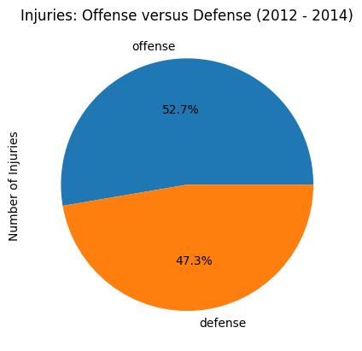
Injury Percentage of Offense and Defense
Offensive players are slightly prone to injury
Wide receivers have their eye on the ball
Running backs are tackled and hit

Slide 4
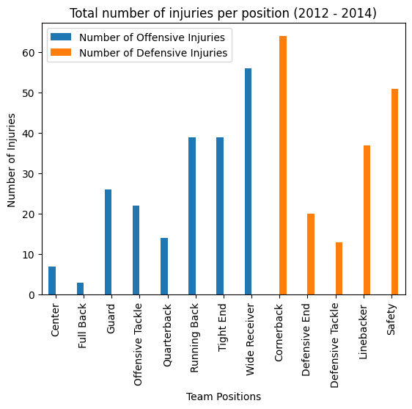
Breakdown on injuries by team (Offense and Defense)
Top positions that is prone to concussion
Cornerback
Wide Receiver
Safety
Running Back
Due to the nature of the game, these positions are likely to have contact

Slide 5
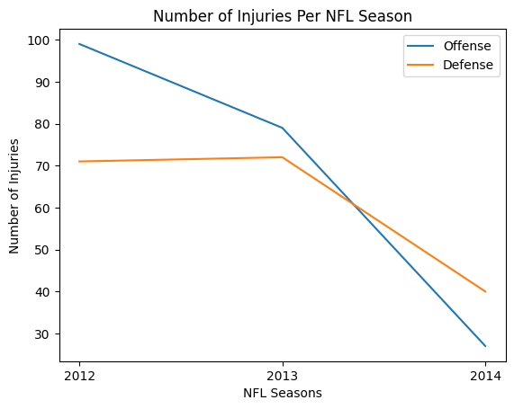
Injury trend from 2012 to 2014 (Offense and Defense)
NFL player safety are given emphasis
NFL Game Day Concussion Diagnosis and Management Protocol in 2011 (https://www.nfl.com/playerhealthandsafety/resources/fact-sheets/nfl-head-neck-and-spine-committee-s-concussion-diagnosis-and-management-protocol)

Slide 6
Daniel’s graphs

Slide 7
Kelsey’s graphs

Slide 8
references
Dataset:
https://data.world/alice-c/nfl
News articles:
https://www.pbs.org/wgbh/frontline/investigation/the-nfls-concussion-crisis/
NFL protocol on concussions:
https://www.nfl.com/playerhealthandsafety/resources/fact-sheets/nfl-head-neck-and-spine-committee-s-concussion-diagnosis-and-management-protocol
GitHub Repository:
https://github.com/DunieCarrasco/nfl_concussion_analysis.git

Slide 9
questions

Slide 10
appendix

Slide 11
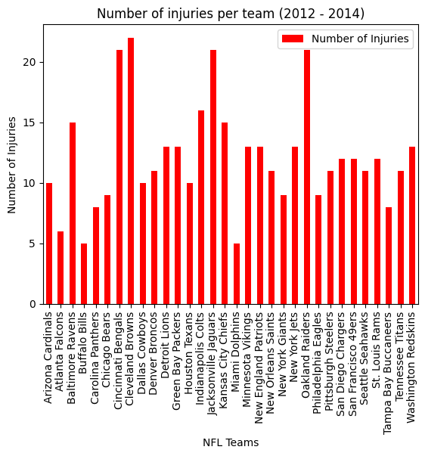
Head Injury/Concussion from 2012 to 2014 by position

