Slide 1
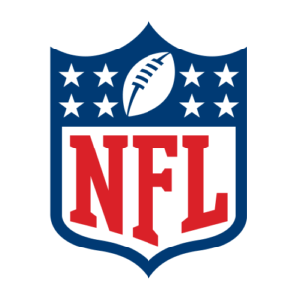
NFL Concussion study
Team group 2
Kelsey brantner
Daniel Carrasco
Joel pangilinan

Slide 2
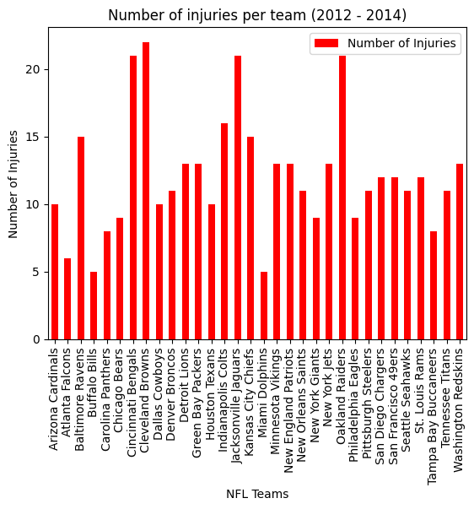
Head Injury/Concussion from 2012 to 2014 by position
Football is a contact sport

Slide 3
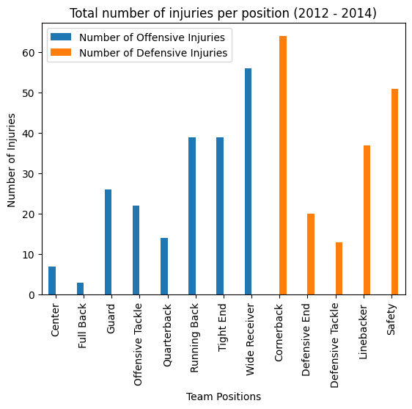
Breakdown on injuries by team (Offense and Defense)
Top positions that is prone to concussion
Cornerback
Wide Receiver
Safety
Running Back
Due to the nature of the game, these positions are likely to have contact

Slide 4
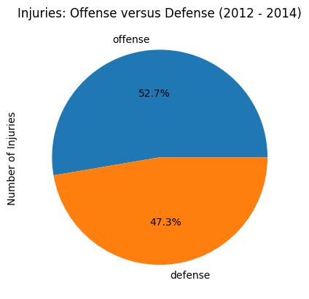
Injury Percentage of Offense and Defense
Offensive players are slightly prone to injury
Wide receivers have their eye on the ball
Running backs are tackled, being hit

Slide 5
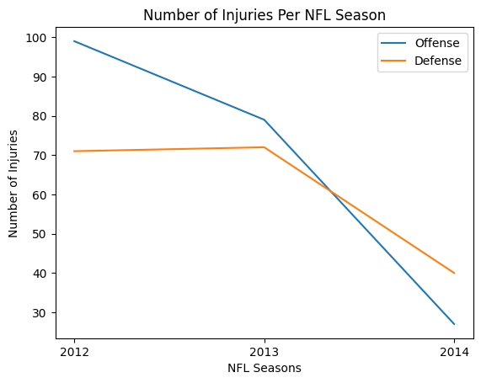
Injury trend from 2012 to 2014 (Offense and Defense)
NFL player safety are given emphasis
NFL Game Day Concussion Diagnosis and Management Protocol in 2011

Slide 6
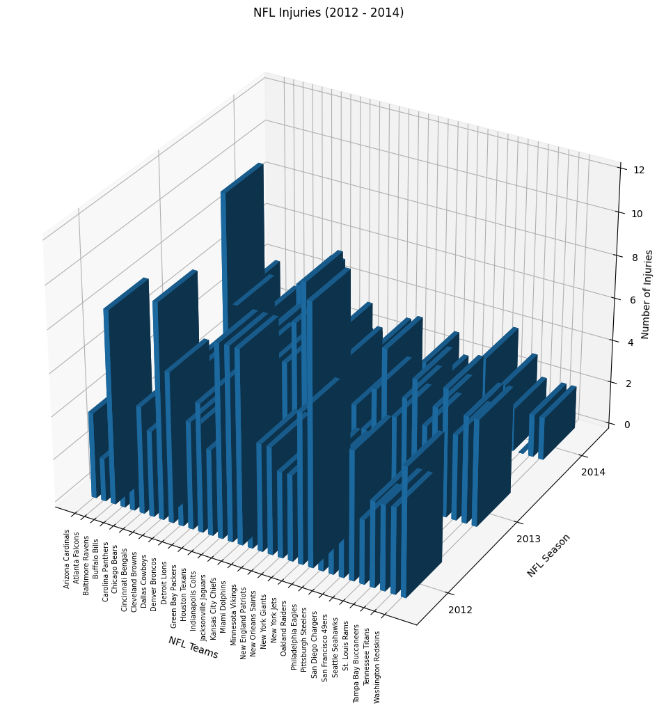
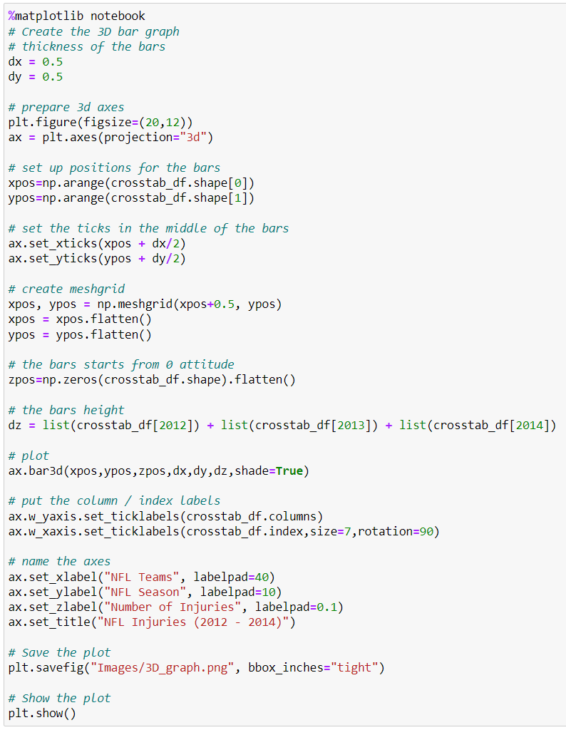
Break down of injuries per team and per year (2012 to 2014)

Slide 7
references
Dataset:
https://data.world/alice-c/nfl
News articles:
https://www.pbs.org/wgbh/frontline/investigation/the-nfls-concussion-crisis/
NFL protocol on concussions:
https://www.nfl.com/playerhealthandsafety/resources/fact-sheets/nfl-head-neck-and-spine-committee-s-concussion-diagnosis-and-management-protocol

Slide 8
appendix

