Slide 1

NFL Concussion study
Team group 2
Kelsey brantner
Daniel Carrasco
Joel pangilinan

Slide 2
The questions
Do Head Injuries or concussions cause players to miss more games?
How long were players out? How did the injury affect the player’s playtime?
What position gets the most concussions on both offense and defense?
Do offensive or defensive players miss more games from injuries?
Do offensive or defensive players have more injuries?
How did the team fare (win or lose?) when they had a player with a head injury?
What team is most prone to concussions?
What team inflicted the most concussions?

Slide 3
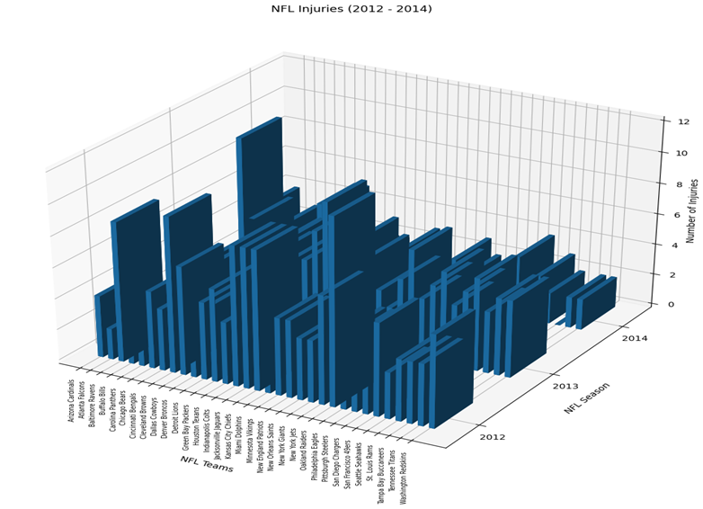
The Data
Spans NFL seasons 2012-2014
325 concussions and head injuries were recorded
All NFL teams were included

Slide 4
Overall Results

Slide 5

NFL Map by Number of Injuries

Slide 6
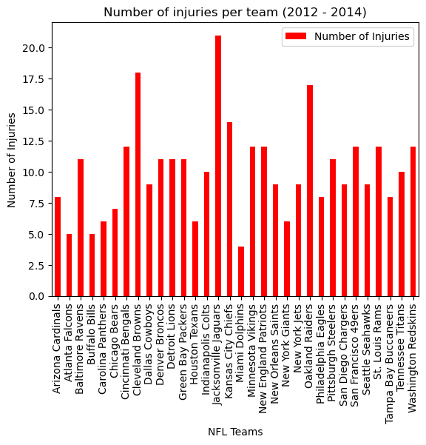
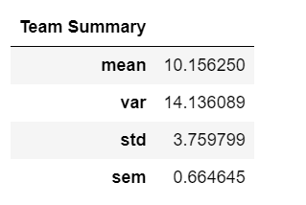
TEAM INJURIES

Slide 7
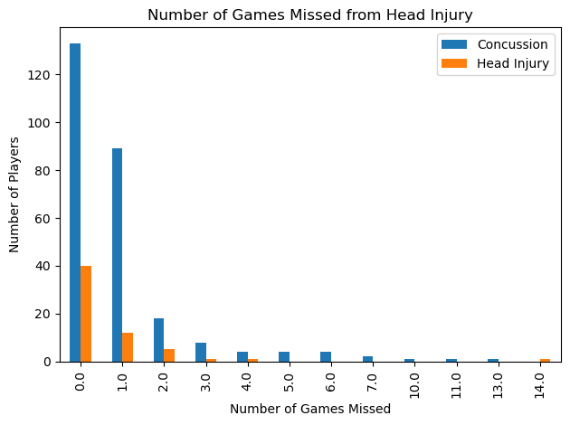
Number of Concussions and Head Injuries

Slide 8
pvalue=0.35 Not Statistically Significant
Do Head Injuries or concussions cause players to miss more games?
Statistical Test:
Ho: If head injuries impact a player’s ability to participate as much as concussions, then there will not be a difference in mean number of games missed
Ha: If head injuries do not impact a player’s ability to participate as much as concussions, then there will be a difference in mean number of games missed
Independent t-test

Slide 9
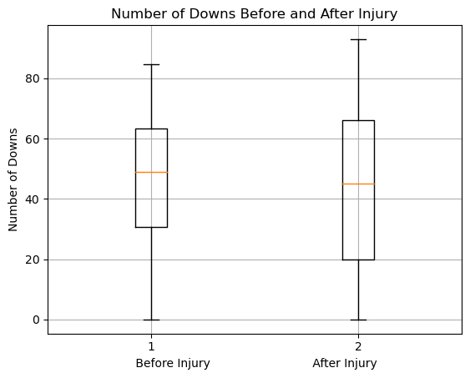
Play Time After Injury
Notes:
stats.ttest_ind(play_compare['0_x'], play_compare['0_y'], equal_var=False)
Ttest_indResult(statistic=-2.340507171046189, pvalue=0.01958606850646929)

Slide 10
pvalue=0.012 Statistically Significant
Do Injuries impact play time?
Statistical Test:
Ho: If head injuries and concussions do not impact a player’s ability to participate, then there will not be a difference in mean number of downs played after injury compared to downs played before injury.
Ha: If head injuries and concussions do impact a player’s ability to participate, then there will be a difference in mean number of downs played after injury compared to downs played before injury.
Independent t-test

Slide 11
The Break Down
Offense, Defense, and by Year

Slide 12
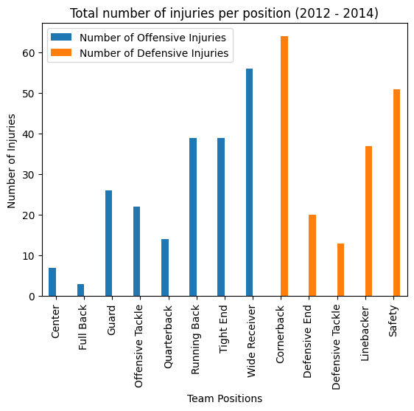
Breakdown on injuries by team (Offense and Defense)
Top positions that is prone to concussion
Cornerback
Wide Receiver
Safety
Running Back
Due to the nature of the game, these positions are likely to have contact

Slide 13
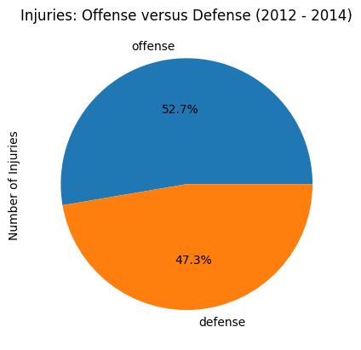
Injury Percentage of Offense and Defense
Offensive players are slightly prone to injury
Wide receivers have their eye on the ball
Running backs are tackled, being hit

Slide 14
Do offensive or defensive players miss more games from injuries?
Statistical Test:
Ho: If being an offensive or defensive player is not related to the number of games missed after injury, then there will not be a difference in mean number of games missed.
Ha: If being an offensive or defensive player is related to the number of games missed after injury,, then there will be a difference in the mean number of games missed.
Independent t-test
pvalue=0.078 Not statistically significant
Notes:
stats.ttest_ind(defense_df["Games Missed"], offense_df["Games Missed"], equal_var=False)

Slide 15
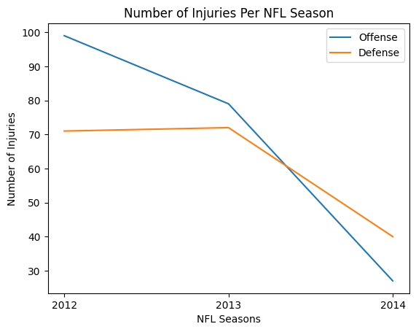
Injury trend from 2012 to 2014 (Offense and Defense)
NFL player safety are given emphasis
NFL Game Day Concussion Diagnosis and Management Protocol in 2011
The protocol is reviewed annually

Slide 16
Do offensive or defensive players have more injuries?
Statistical Test:
Ho: If offensive and defensive players are as susceptible to injury, then there will not be a difference in mean number injuries received over the three seasons of play between offense and defense.
Ha If offensive and defensive players are not as susceptible to injury, then there will be a difference in mean number injuries received over the three seasons of play between offense and defense.
Independent t-test
pvalue=0.74 Not statistically significant
Notes:
stats.ttest_ind(injury_per_year_df["Offensive Injuries"], injury_per_year_df["Defensive Injuries"], equal_var=False)
Ttest_indResult(statistic=0.3639356095616046, pvalue=0.7393726990881611)

Slide 17
Win or Lose?
What happens when a team receives or inflicts an injury?

Slide 18
conclusion
Further Research
Question Answered
How long were players out? (Determined by examining number of games missed)
How did the injury affect the player’s playtime?
Statistically significantly deceases playtime
What position gets the most concussions on both offense and defense?
Offense: Wide Receiver
Defense: Cornerback
How did the team fare (win or lose?) when they had a player with a head injury?
What team is most prone to concussions?
Jacksonville Jaguars
What team inflicted the most concussions?
Increases size of dataset
Original dataset is small
Determine number of players with head injuries
See if there was a NFL change in 2014 that decreased head injuries

Slide 19
references
Dataset:
https://data.world/alice-c/nfl
News articles:
https://www.pbs.org/wgbh/frontline/investigation/the-nfls-concussion-crisis/
NFL protocol on concussions:
https://www.nfl.com/playerhealthandsafety/resources/fact-sheets/nfl-head-neck-and-spine-committee-s-concussion-diagnosis-and-management-protocol
CDC:
https://www.cdc.gov/traumaticbraininjury/concussion/index.html

Slide 20

QUESTIONS

Slide 21
appendix

Slide 22
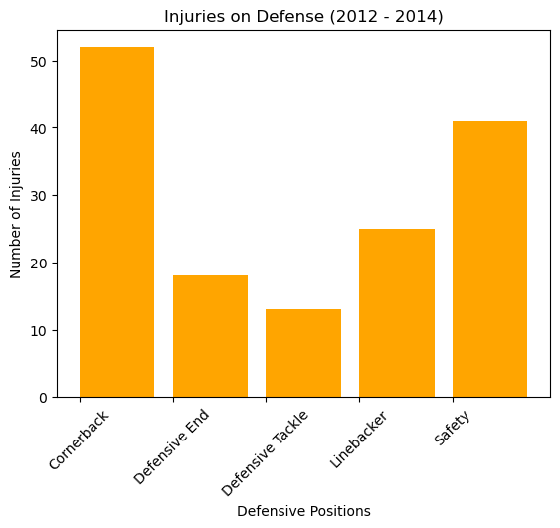
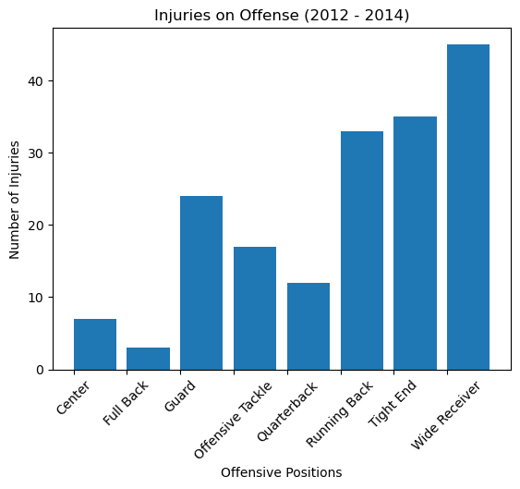
Head Injury/Concussion from 2012 to 2014 by position
Football is a contact sport

Slide 23

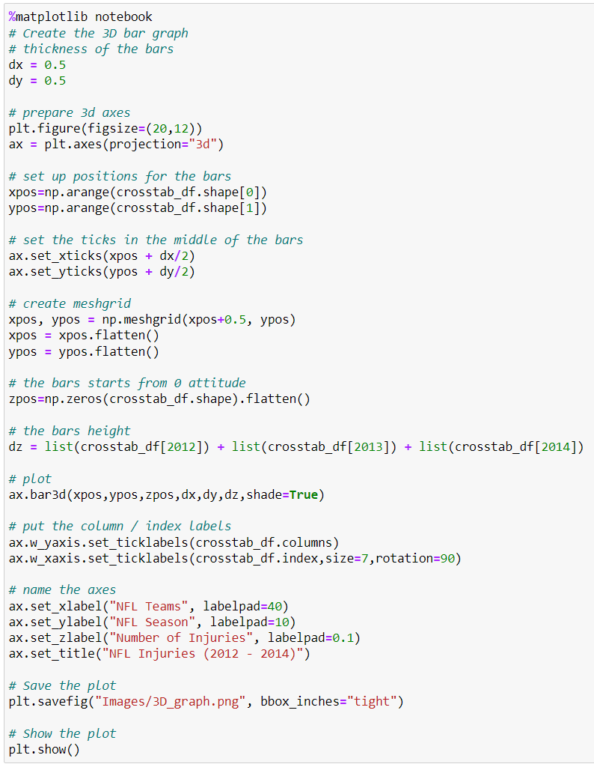
Break down of injuries per team and per year (2012 to 2014)

Slide 24
Why care about head injuries, specifically concussions?
According to the CDC:
Most TBIs(Traumatic Brain Injuries) are concussions or mild TBIs
Even mild TBIs can cause harm to the brain through the damage of brain cells and can change brain chemistry
These changes can impact sleep, thinking, actions, learning, and feelings
https://www.cdc.gov/traumaticbraininjury/concussion/index.html

