Slide 1
Flow matching!

Slide 2
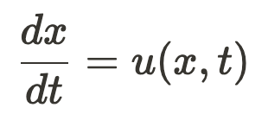

Ordinary Differential Equations (ODEs)
An equation that defines a relationship between 1 or more unknown function(s) and their derivatives
Solution: any form of the unknown function that obeys the ODE

Slide 3
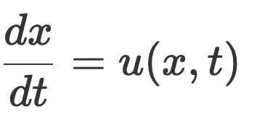
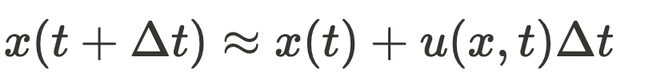
Solving ODE’s
Problem: x(t) frequently has no closed-form solution
Solution: Given an starting point, we approximate x(t) using the ODE
u(x,t) governs how x should be changing over time

Slide 4
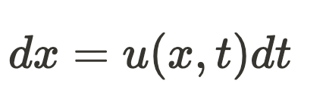
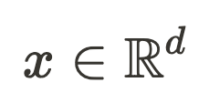
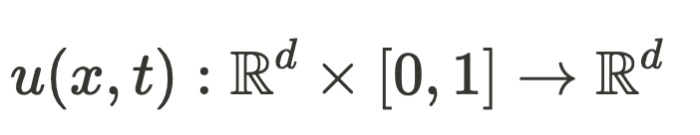
ODEs and vector fields
u(x,t) is a time-varying vector field

Slide 5
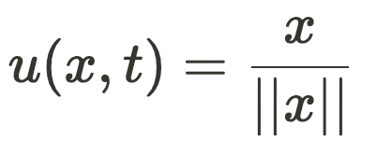
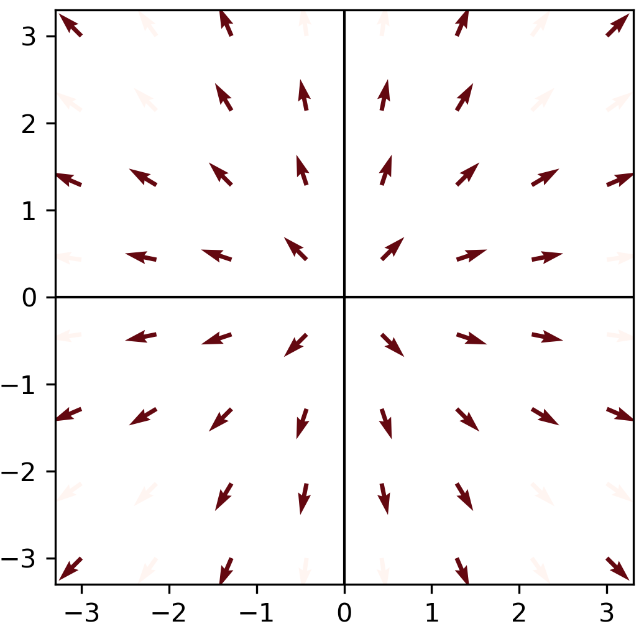
Let’s visualize a 2D vector field

Slide 6
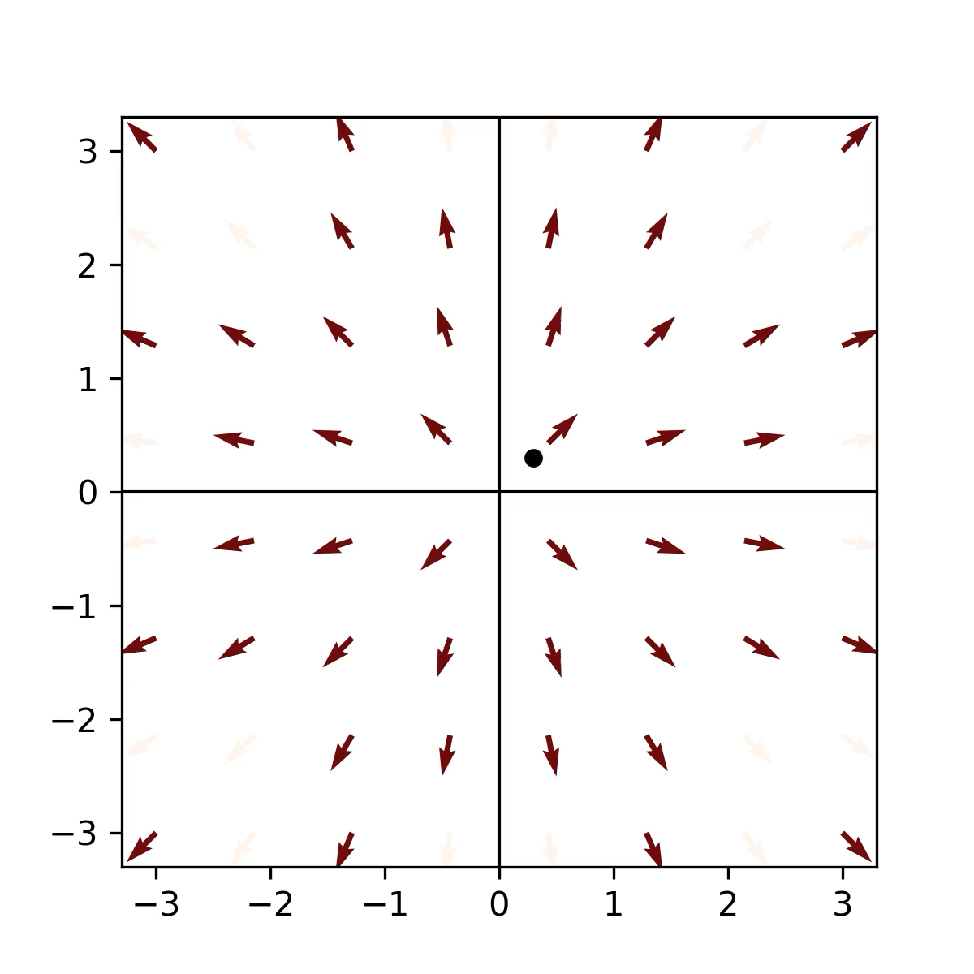
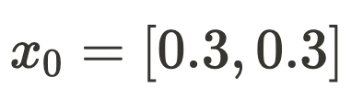
integrate one trajectory on this vector field

Slide 7
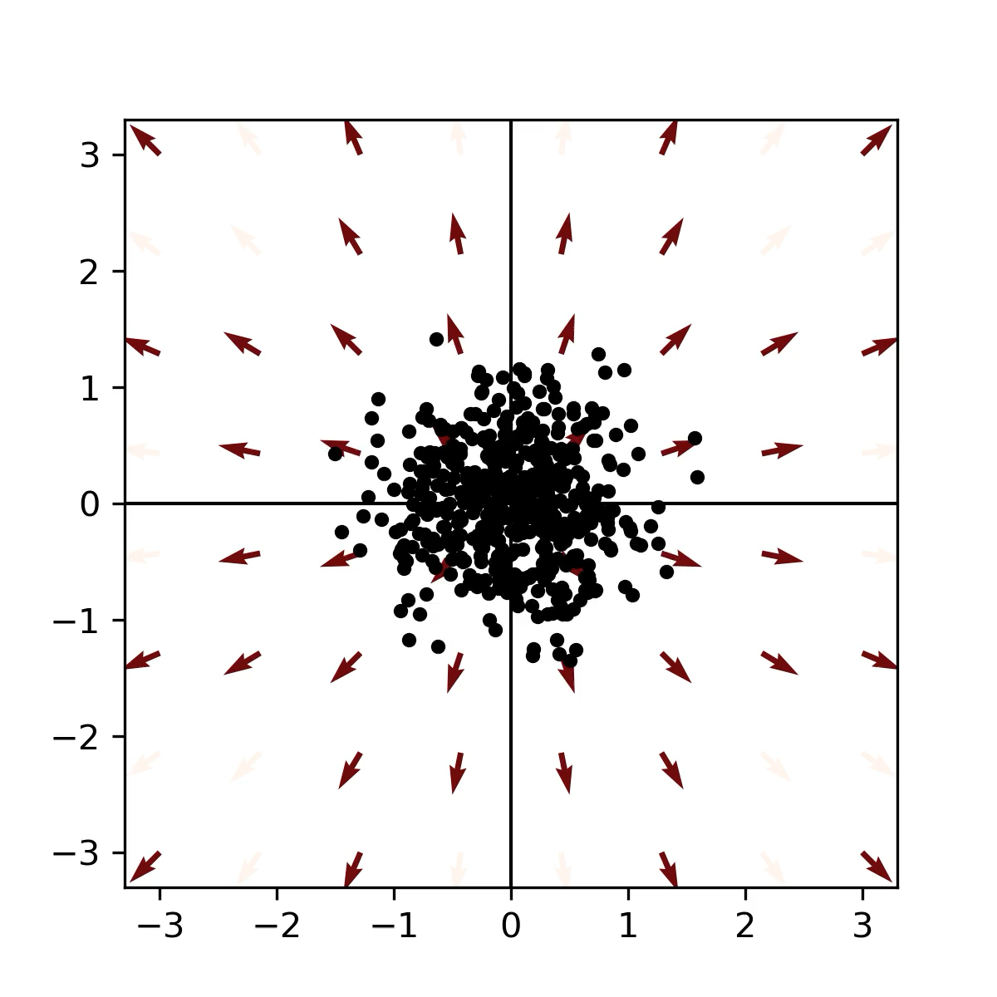
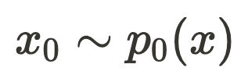
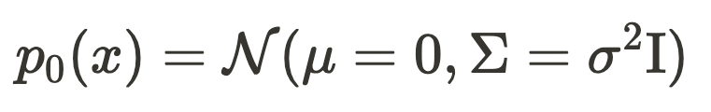
What if our initial positions are drawn from a distribution?

Slide 8
Vector fields can push and change probability distributions

Slide 9
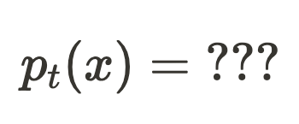
Is there a relationship between the ODE and the time-varying probability distribution that it induces?

Slide 10
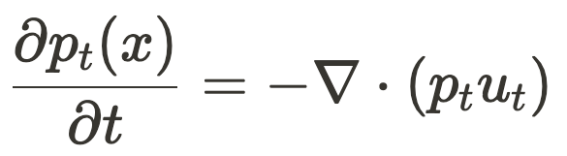
The continuity equation tells us how the probability distribution will evolve over time:
For some (simple) systems, the continuity equation can be solved, giving a closed-form solution for

Slide 11
ODEs with gaussian marginals
If we stipulate that our ODE will produce marginal densities of the form:

