Slide 1
Flow matching!
http://arxiv.org/abs/2302.00482

Slide 2
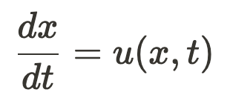

Ordinary Differential Equations (ODEs)
An equation that defines a relationship between 1 or more unknown function(s) and their derivatives
Solution: any form of the unknown function that obeys the ODE

Slide 3
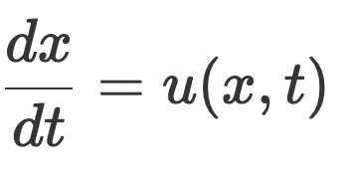
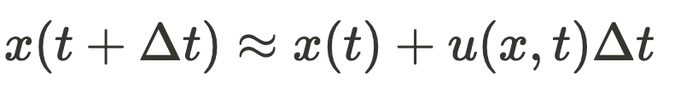
Solving ODE’s
Problem: x(t) frequently has no closed-form solution
Solution: Given an starting point, we approximate x(t) using the ODE
u(x,t) governs how x should be changing over time

Slide 4
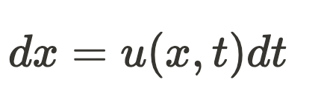
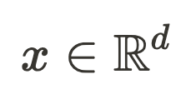
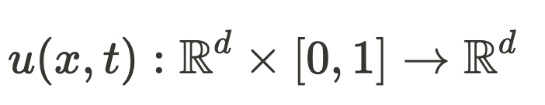
ODEs and vector fields
u(x,t) is a time-varying vector field

Slide 5
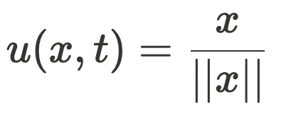
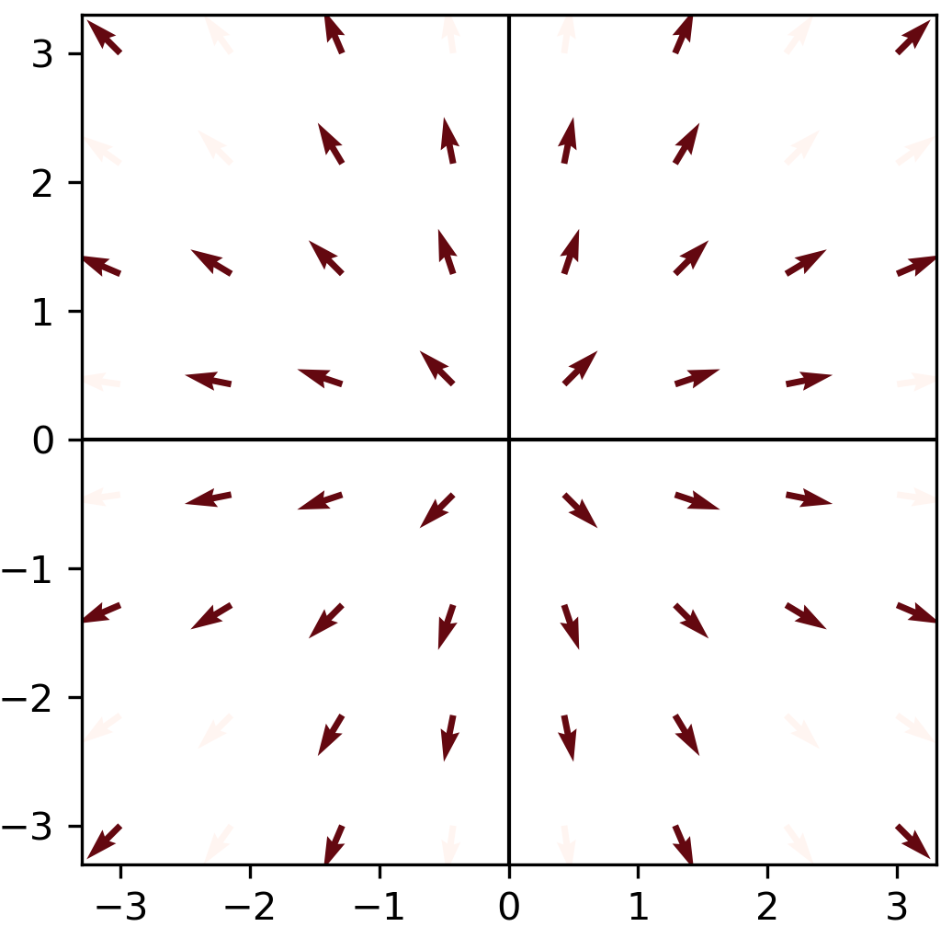
Let’s visualize a 2D vector field

Slide 6
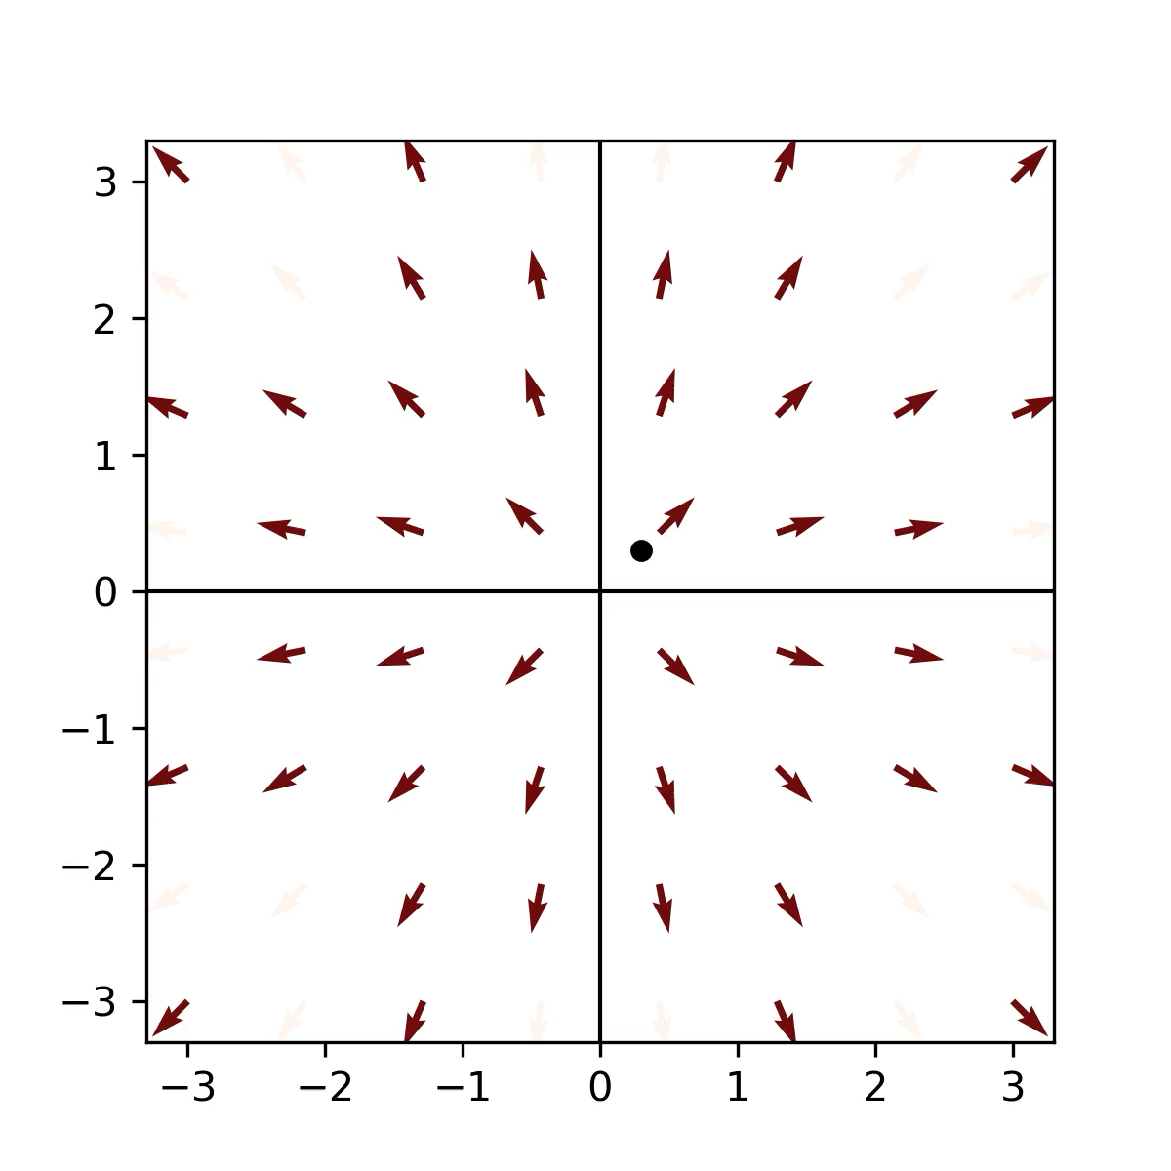
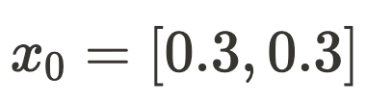
integrate one trajectory on this vector field

Slide 7
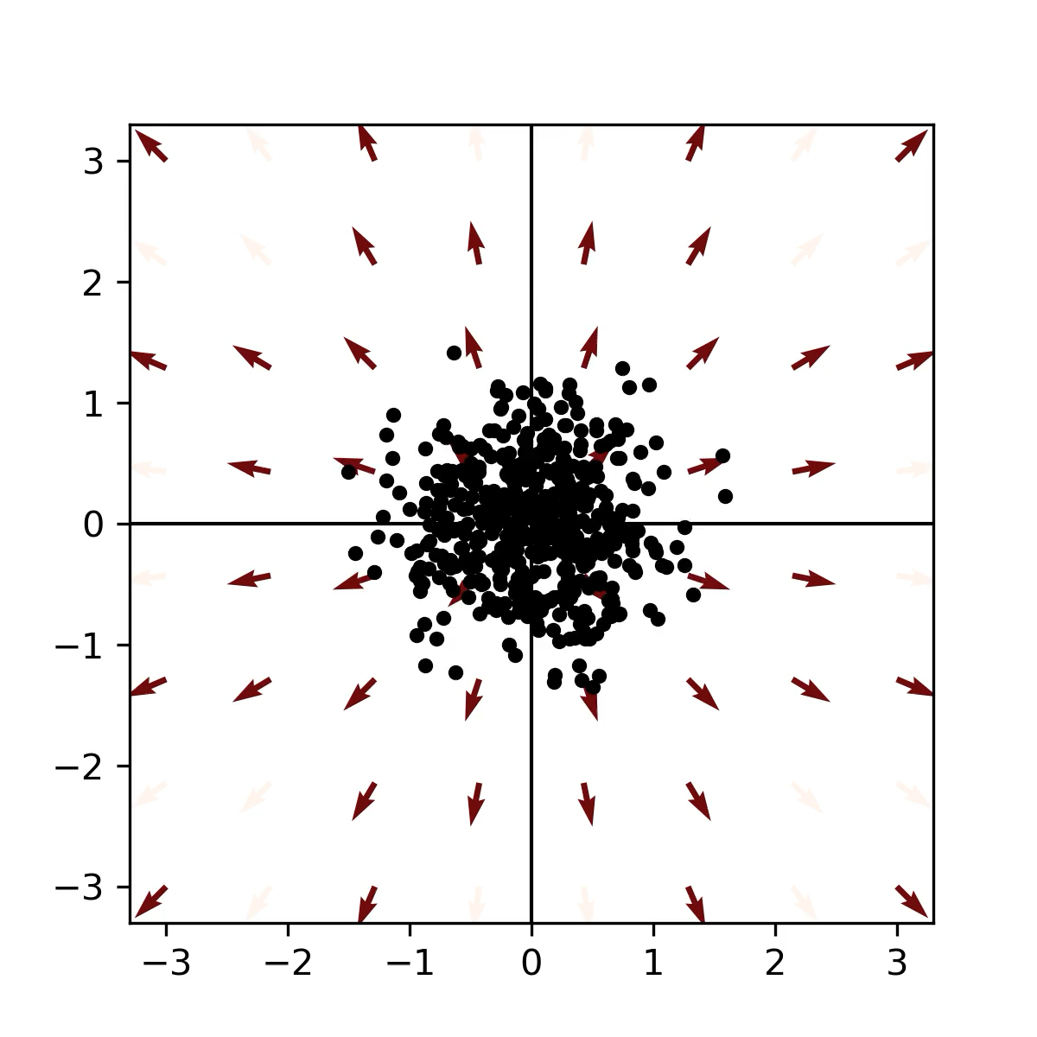
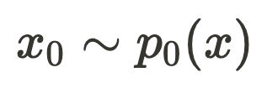
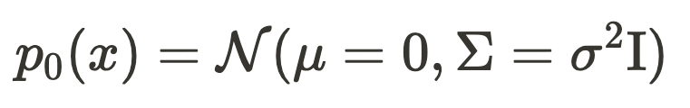
What if our initial positions are drawn from a distribution?

Slide 8
Vector fields can push and change probability distributions

Slide 9
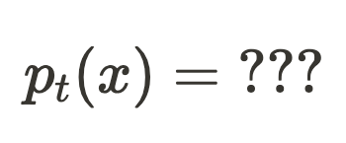
Is there a relationship between the ODE and the time-varying probability distribution that it induces?

Slide 10
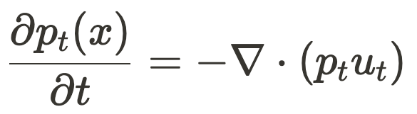
The continuity equation tells us how the probability distribution will evolve over time:
For some (simple) systems, the continuity equation can be solved, giving a closed-form solution for

Slide 11
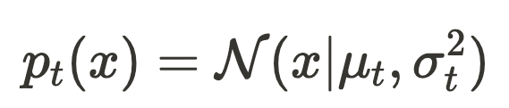
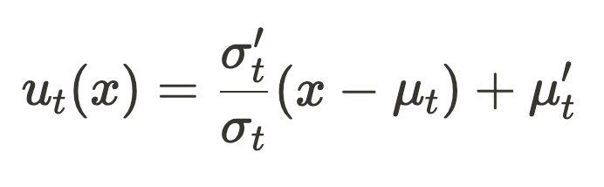
ODEs with gaussian marginals
If we stipulate that our ODE will produce gaussian marginal densities:
We can solve for the unique vector field generating these marginals:

Slide 12
What does this have to do with generative models?

Slide 13
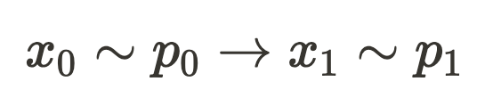
Suppose we want map one distribution into another using ODEs

Slide 14
Suppose we want map one distribution into another using ODEs
If we could do this, would have a generative model

Slide 15
Suppose we want map one distribution into another using ODEs
Lets pretend we have access to the the vector field and marginal density function that map between these distributions at t=0 and t=1
If this were true, we could sample the initial distribution and integrate it with any ODE solver to obtain samples from the target distribution

Slide 16
Regressing to the true vector field
Lets pretend that we have access to these functions, somehow:
We could train a NN to approximate this process by minimizing the following loss:
Problem: for complex terminal distributions . and are intractable

Slide 17


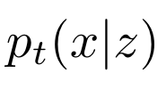

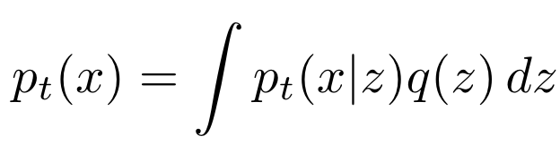
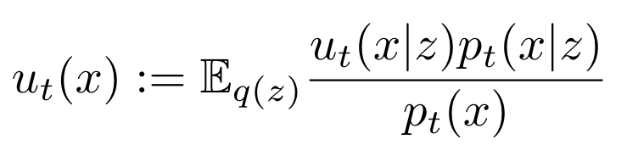
Enter: Conditional Vector Fields & Marginals
Imagine a latent variable z which is correlated with xt
Conditioning on z therefore influences the vector fields and probability paths observed for x
The unconditional probabilities and vector fields can be written as weighted combinations (mixtures) of conditional probabilities/vector fields

Slide 18
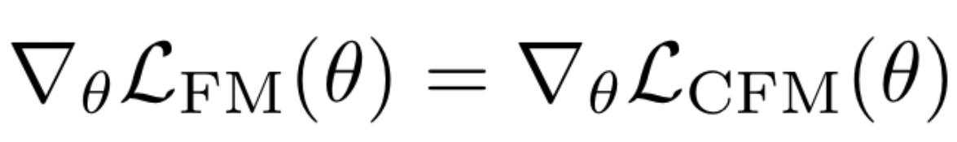
Approximating conditional vector fields is equivalent to approximating marginal vector fields
We can approximate the marginal vector field if these functions are simple/tractable:

Slide 19
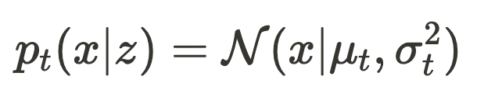
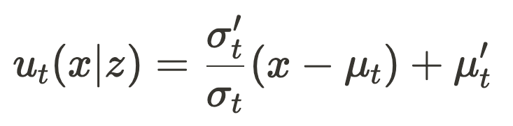
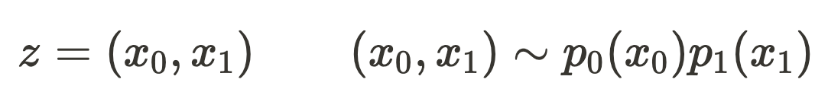
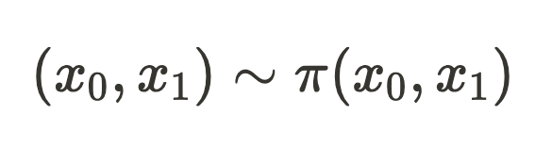
Choosing simple marginal distributions
We choose conditional vector fields to be vector fields with gaussian marginals
We choose our latent variable to be the start and end points of a trajectory:
Instead of sampling x0 and x1 independently, we can compute an optimal alignment:

Slide 20
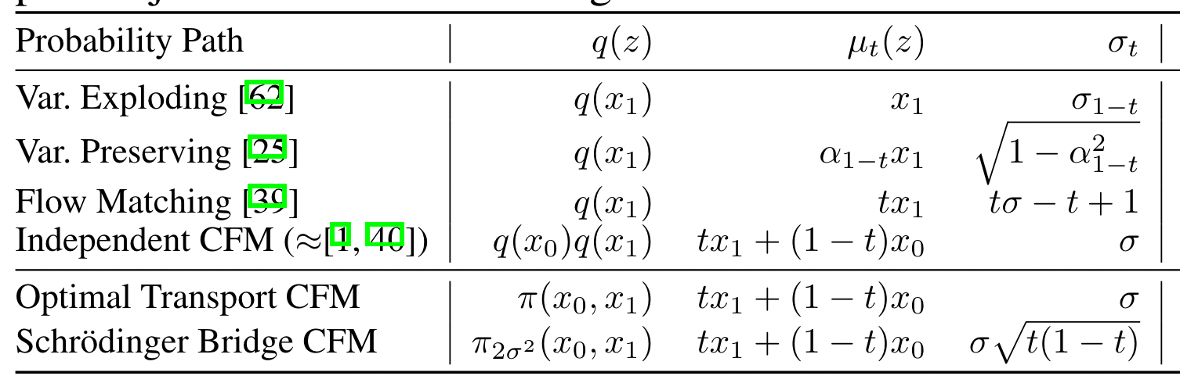

Slide 21
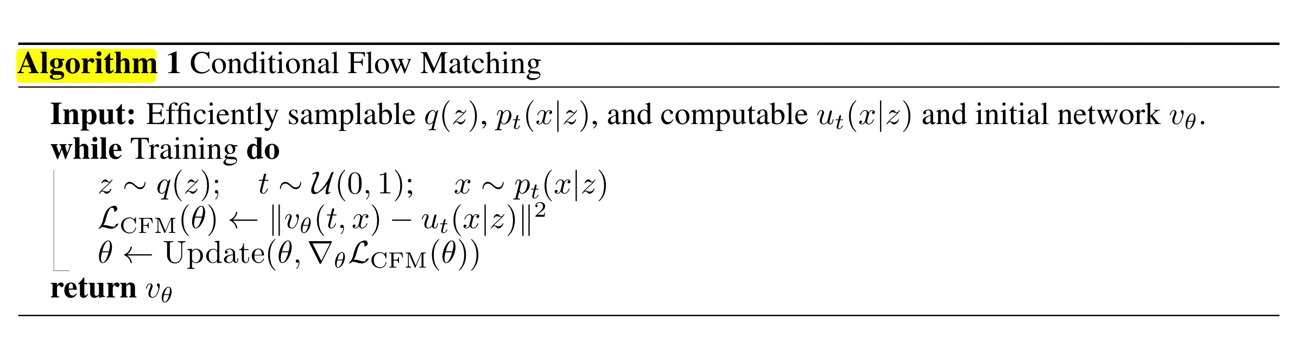
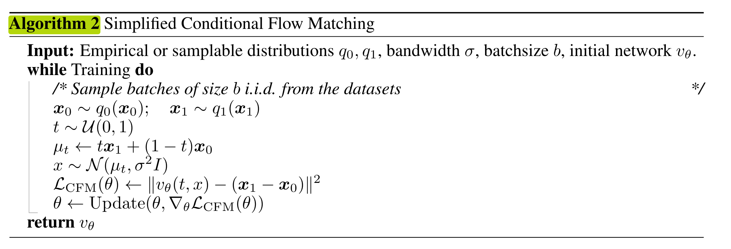

Slide 22
