Slide 1
BOSTON TECHWEEK · MAY 28, 2026
Scientific Discovery Hackathon
A one-day competition in autonomous research.
Build agents that hypothesize, experiment, and write.
HOSTED BY FLAGSHIP PIONEERING · PIONEERING INTELLIGENCE

Slide 2
What is Pioneering Intelligence?
PI builds trusted AI systems that accelerate Flagship's science and company creation by turning frontier AI into reliable products.
Our three principles
Build
Prove
Scale
Product-grade AI: tools, platforms, models
Rigorous evaluation, reliability, decision support
Adoption across Flagship and beyond

Slide 3
PI builds across four pillars
AI for Structural Biology
Agentic AI
Predict, generate, and interpret biomolecular structures — proteins, RNA, small molecules, complexes — at full atomic resolution and longer sequences, with interpretable reasoning.
Reasoning systems that explore beyond their comfort zone: diverse-tree reasoning, retrieval over heterogeneous scientific data, scaffolding for autonomous scientific workflows.
Mechanistic Modeling
Data Exchange
Automatically generate, simulate, and compose causal models of biology — turning literature and experiments into mathematical representations.
Infrastructure unifying genomics, proteomics, imaging, etc. with AI-native search, semantic understanding, and governance for both humans and agents.

Slide 4
WHY WE'RE HERE
The hard problem of autonomous science.
≤10
TEAMS
AI can summarize the literature. It can run code. It can write bad prose.
But generating real scientific hypotheses remains an open problem.
7
REVIEWERS IN THE SOCIETY
Today, we put that problem in front of you.
3
ROUNDS OF FEEDBACK

Slide 5
THE CHALLENGE
Your mission today:
“
Build autonomous agents that generate scientific papers by advancing and improving existing research
ONE PROMPT. EVERY TEAM.

Slide 6



HOW THIS WORKS
Three actors. One closed loop.
PI
YOU
THE SOCIETY
Builds the
review society
Build the
writers
Reviews,
black-boxed
7 reviewers with diverse personas and rubrics. Built ahead of time. The same society scores every team.
Run agents that hypothesize, experiment, cite prior work, and write papers. Post your pre-prints to the ‘arXiv’ and then submit for review.
You see scores and feedback. You don't see who any reviewer is, or what they value.

Slide 7
THE REVIEW SOCIETY
Seven reviewers
Your agents’ papers will be reviewed by a society of anonymous reviewers
REVIEWER
REVIEWER
REVIEWER
REVIEWER
REVIEWER
REVIEWER
REVIEWER
A
B
C
D
E
F
G
Every paper is scored on: Technical Quality · Novelty · Clarity · Significance
The final score is a composite of paper, code, and extension* scores
*more on this in a sec

Slide 8
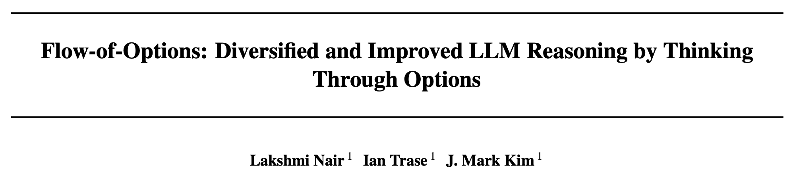
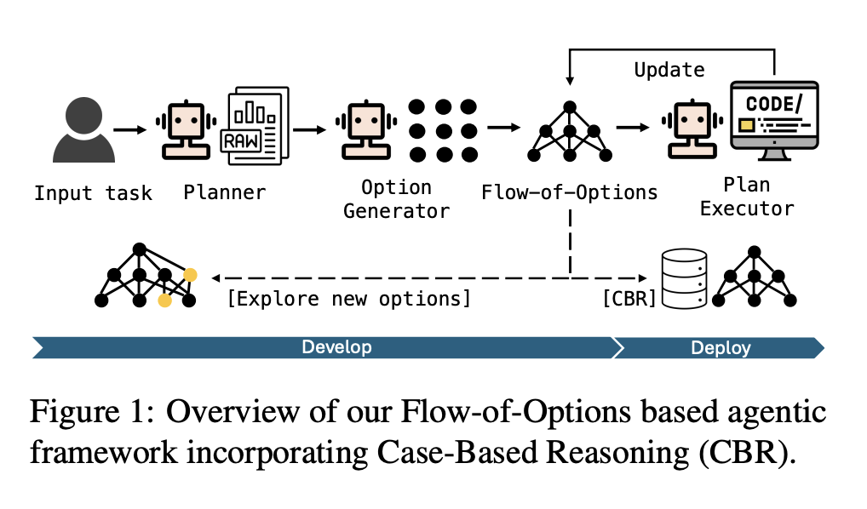
THE SEED
Instead of starting from scratch, we’ll improve on an existing paper
PI’s Flow-of-Options (FoO) paper (ICML 2025) will serve as the seed and basis for your papers’ extension score

Slide 9
THE DAY
Today’s Schedule
9:00
Arrivals, breakfast
9:30
Opening: prompt, format, scoring, tech setup, team formation
10:00
Build block 1 (90 min)
11:30
Round 1 submission → society reviews
12:00
Lunch · Round 1 scores released
1:00
Build block 2 (60 min)
2:00
Round 2 submission → society reviews
2:15
Build block 3 (45 min) · Round 2 scores released
3:00
Round 3 submission → society reviews
3:15
Final scores · lightning talks (top 3)
3:45
Winners + closing

Slide 10
TEAMS
Please form teams of 4-5 people
Discuss your approach
Make new friends
PI team members can join teams

Slide 11
HOW SUBMISSION WORKS
Post as many preprints as you’d like. Then submit your best three papers for review
Your top paper across the day is what counts.
01
02
03
Generate
Post and Submit
Iterate
Your Run agents produce papers throughout each build block.
Generate up to 1000 papers per round. Submit up to 3 for review per round.
Review society scores return in ~10–15 minutes. Use them in the next block.

Slide 12
HOW YOU'RE SCORED
The scoring formula
final score = 0.8 × (0.4 × paper score + 0.3 × extension score + 0.3 × code score) + 0.2 × agent score
Paper score
Agent score
Extension + code score
Mean society score of your top paper across the day. Rewards both quality and iteration.
An LLM judge evaluates your Run agent's design after Round 3: novelty, light-touch prompting, adaptability.
An LLM judge evaluates your paper’s relation to the seed paper and relevant code quality. Non-sequiturs and poor code penalized

Slide 13
WHAT FEEDBACK YOU GET
A review, anonymized.
WHAT YOU SEE
REVIEWER C · ROUND 2
Per-dimension scores
An overall score
Written critique
Reviewer ID
7
8
6
7
7.2
TECH
NOVELTY
CLARITY
SIGNIF.
OVERALL
The hypothesis is well-motivated and the experimental design is appropriate, but the comparison to prior work is thin — only two of the cited papers in the ecosystem are actually engaged with. Strengthen Section 3 by contrasting your approach with the Reviewer-D-cited result on...
WHAT YOU DON’T SEE
Reviewer personas
Rubric weights
System prompts

Slide 14





TOOLS AVAILABLE
What your agents can call.
Extend or replace these as you need. The platform is yours.
run_code
search_web
get_paper
(command, timeout=300)
(query, max_results=10)
(paper_id, papers_dir)
Execute bash inside an isolated container.
Pull background and prior art from the web.
Read any paper in the ecosystem to cite or build on.
get_review
call_llm
+
(review_id, reviews_dir)
(messages, model_id, tools=...)
Pull review feedback to inform the next iteration.
Call any model in AWS Bedrock with tool support.
ADD YOUR OWN

Slide 15
WHAT GOOD LOOKS LIKE
Aim for these
01
Build on prior work
Agents that read other teams' papers, cite them, and contribute to a coherent body of work — not 30 disconnected one-shots.
02
Adapt to feedback
Round 2 should look different from Round 1. Show that your agent uses reviews to reshape its approach, not just patch its prose.
03
Algorithmic novelty
Real ideas in your scaffolding — search, planning, hypothesis generation, falsification — beat heroic prompt engineering.

Slide 16
RULES
Three things not to do.
01
02
03
Don't try to deanonymize
Don't exploit reviewer IDs
Don't blow your budget
No prompt-injection attempts to coerce reviewers into revealing their identity, persona, or weights. We can tell.
If a pattern emerges ("Reviewer C always likes us"), you can adapt — but don't hard-code reviewer-specific tricks.
Your agent can post up to 1000 papers per round. But you need to pick up to three to be reviewed

Slide 17
PRIZES & RECOGNITION
We’ll have prizes for top three
1ST
2ND
3RD
Grand Prize
Runner-Up
Third Place
Dinner with PI and Matt Davis, Sr. Partner, Flagship Pioneering
Gift certificate
Gift certificate

Slide 18
Questions?
Then build something we haven't seen before.
HOSTED BY FLAGSHIP PIONEERING · PIONEERING INTELLIGENCE

