Slide 1



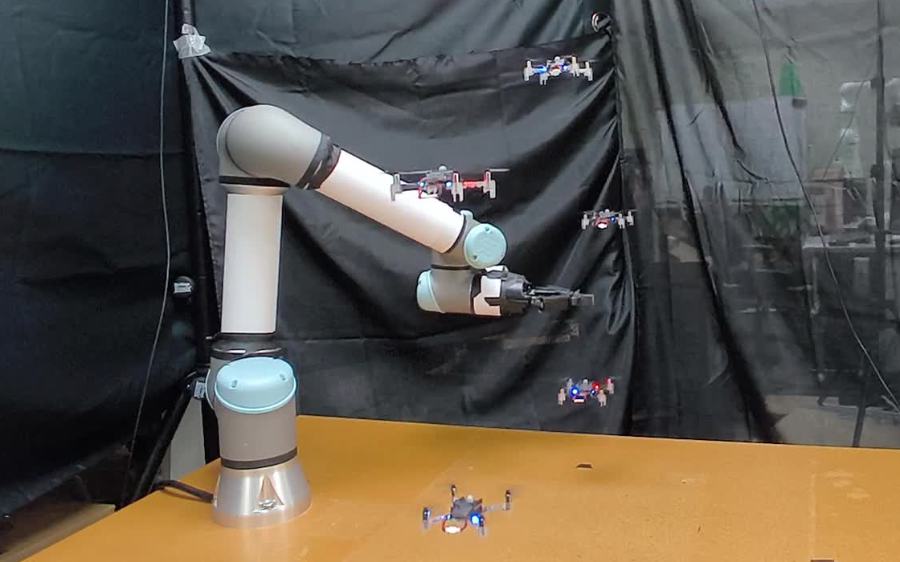
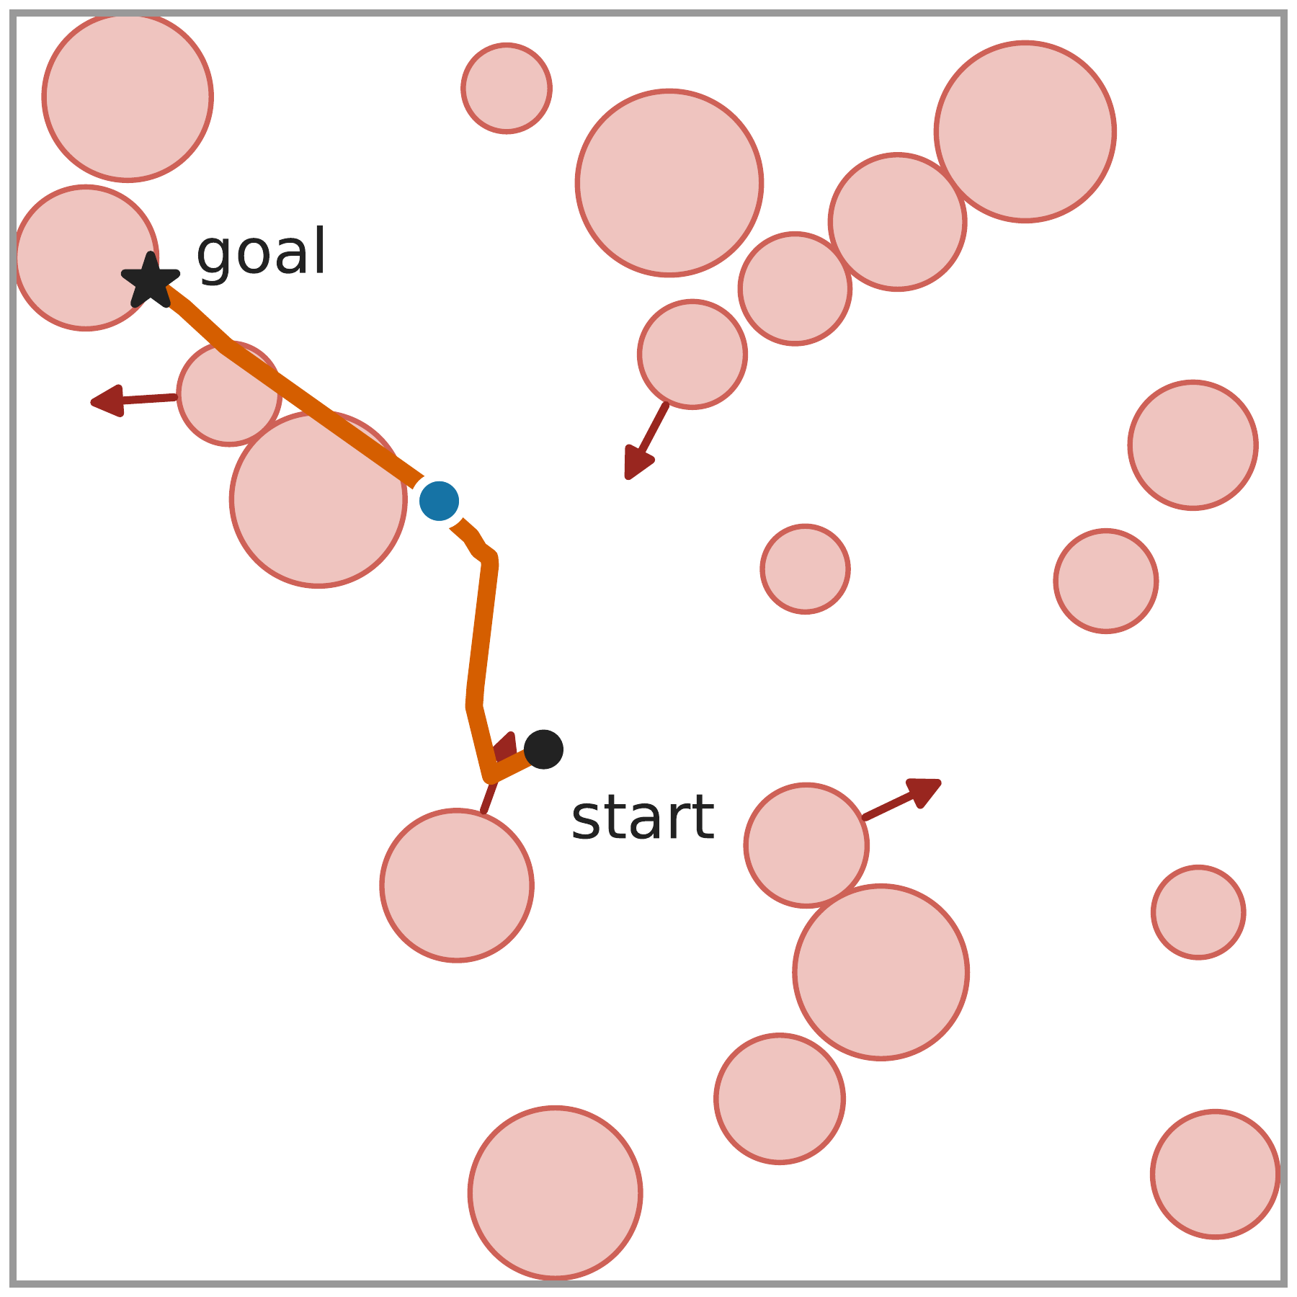
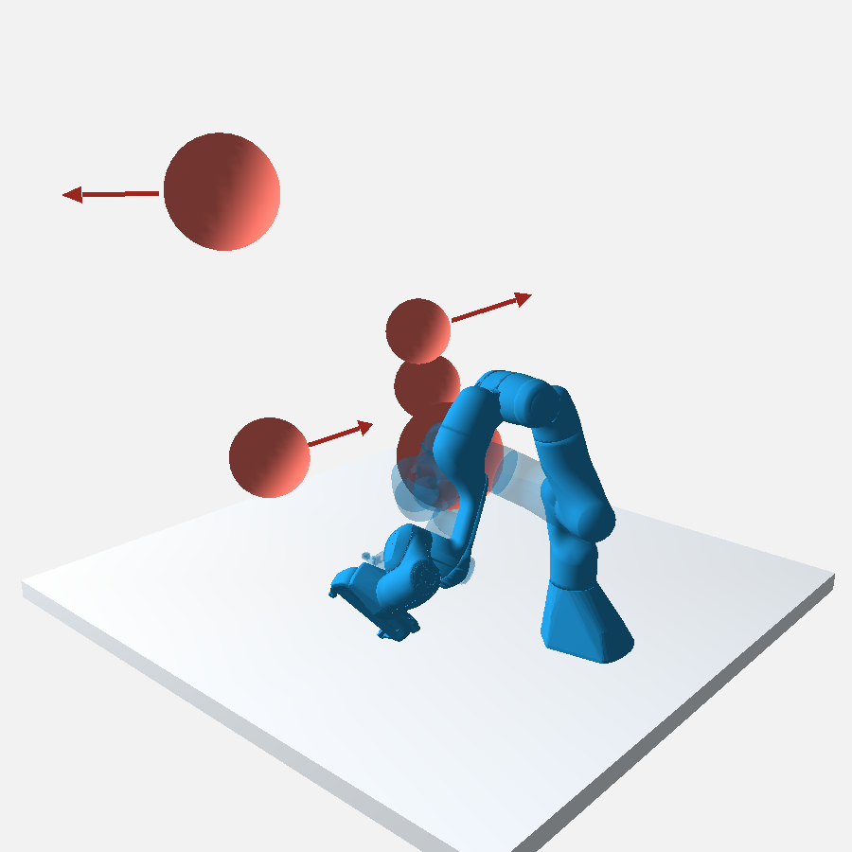
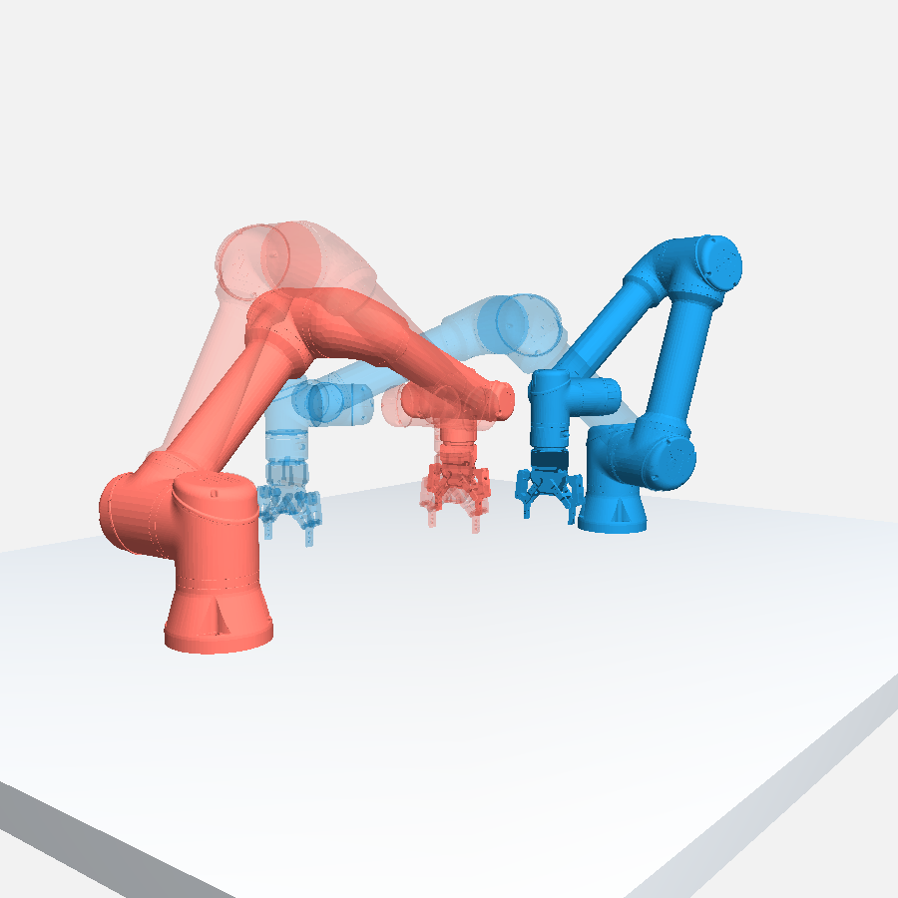
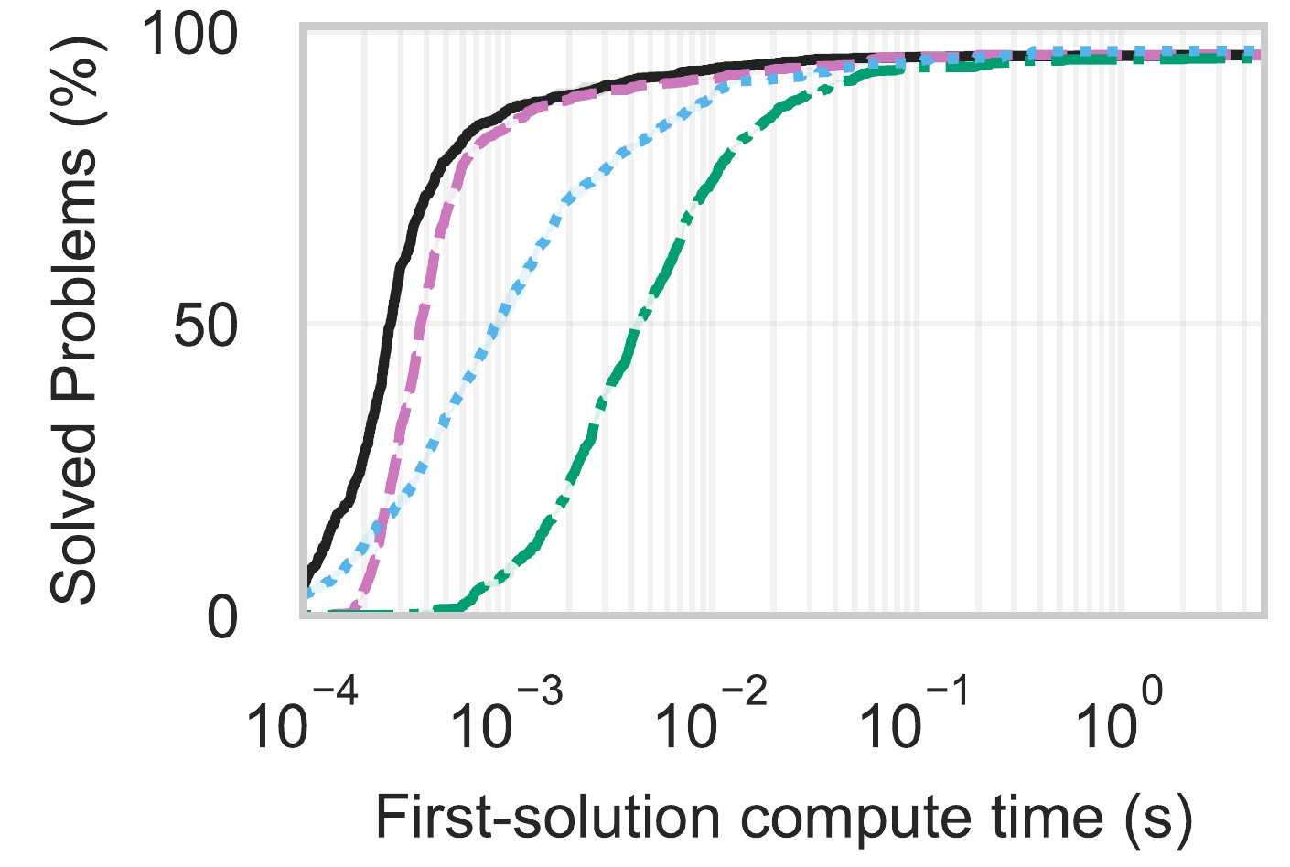
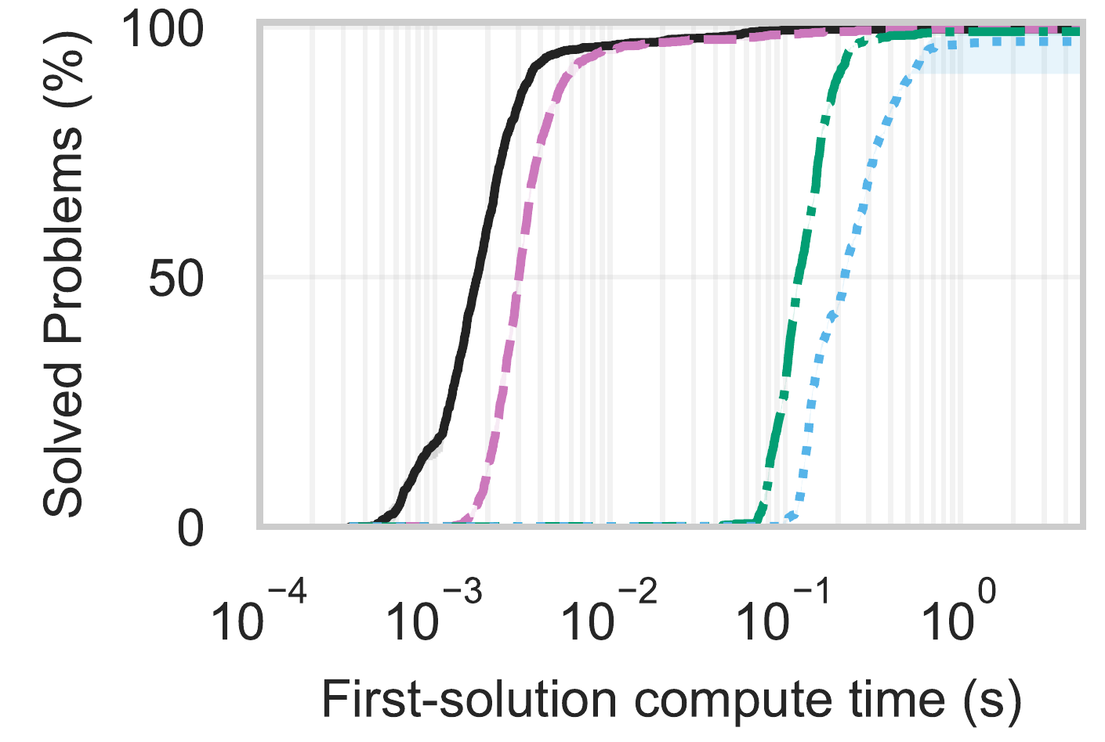
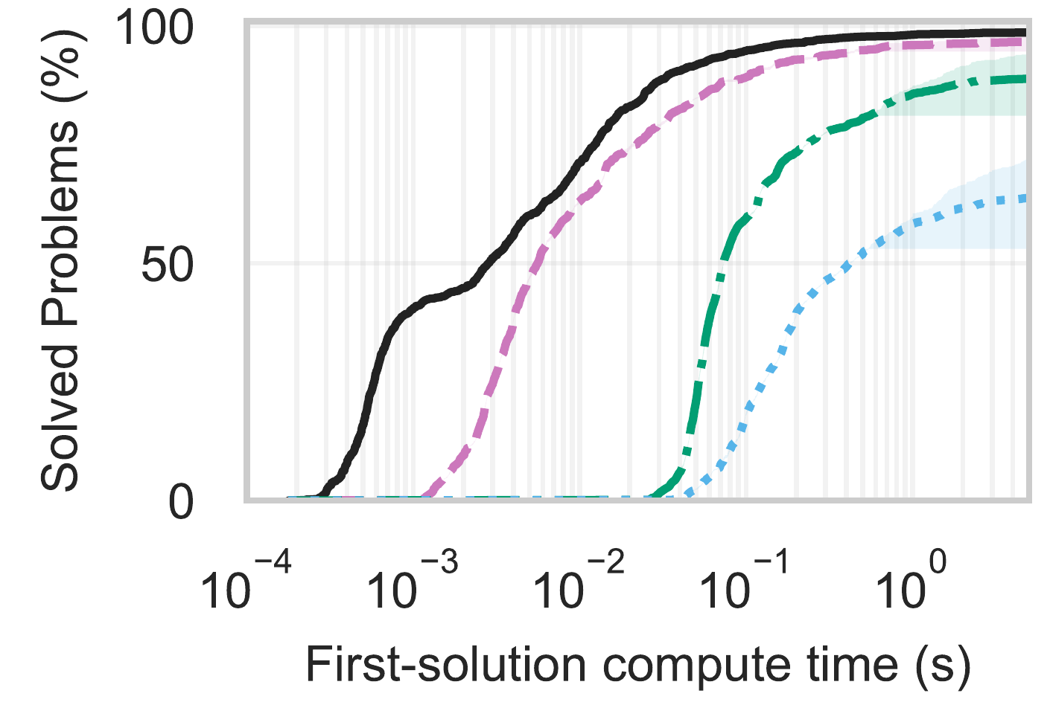
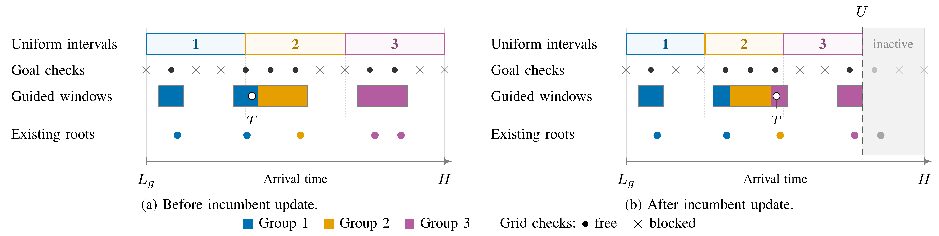
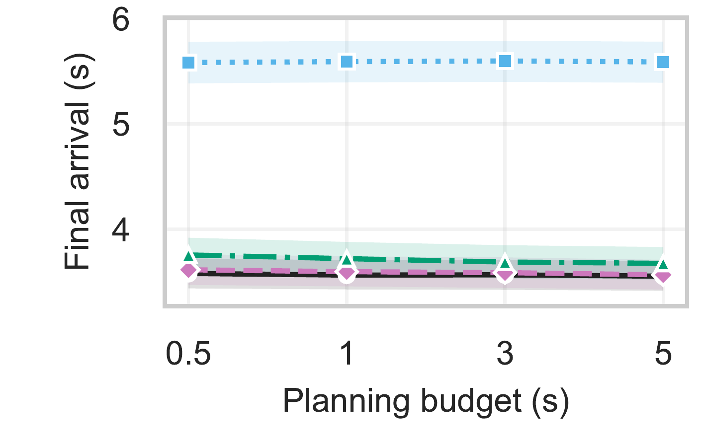
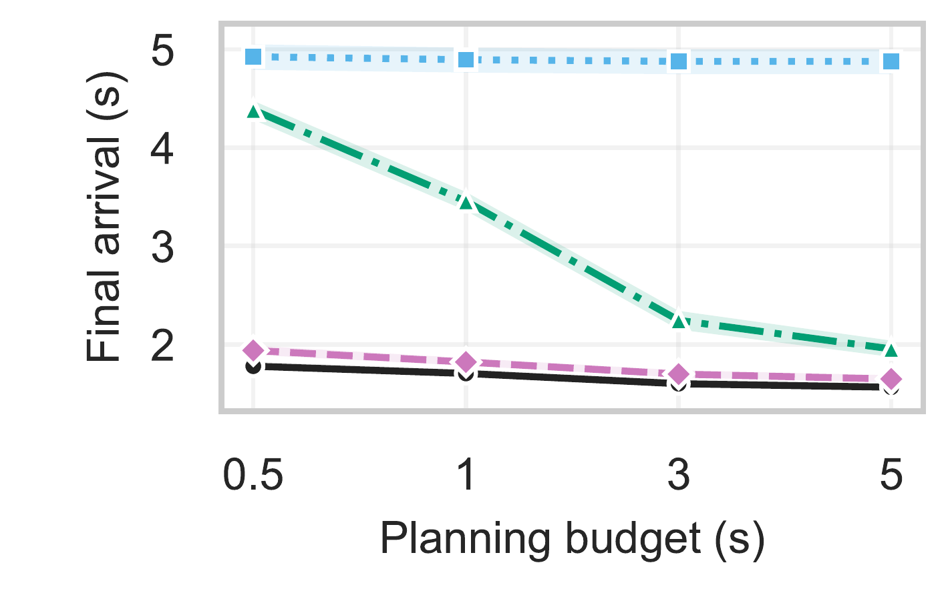
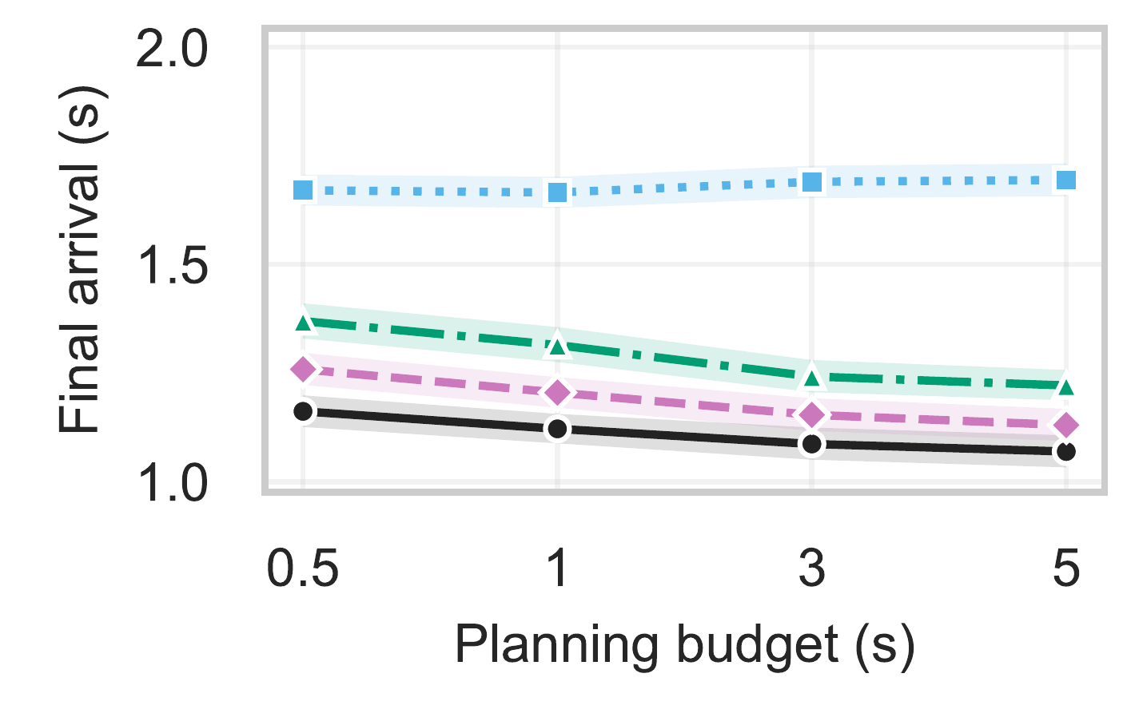
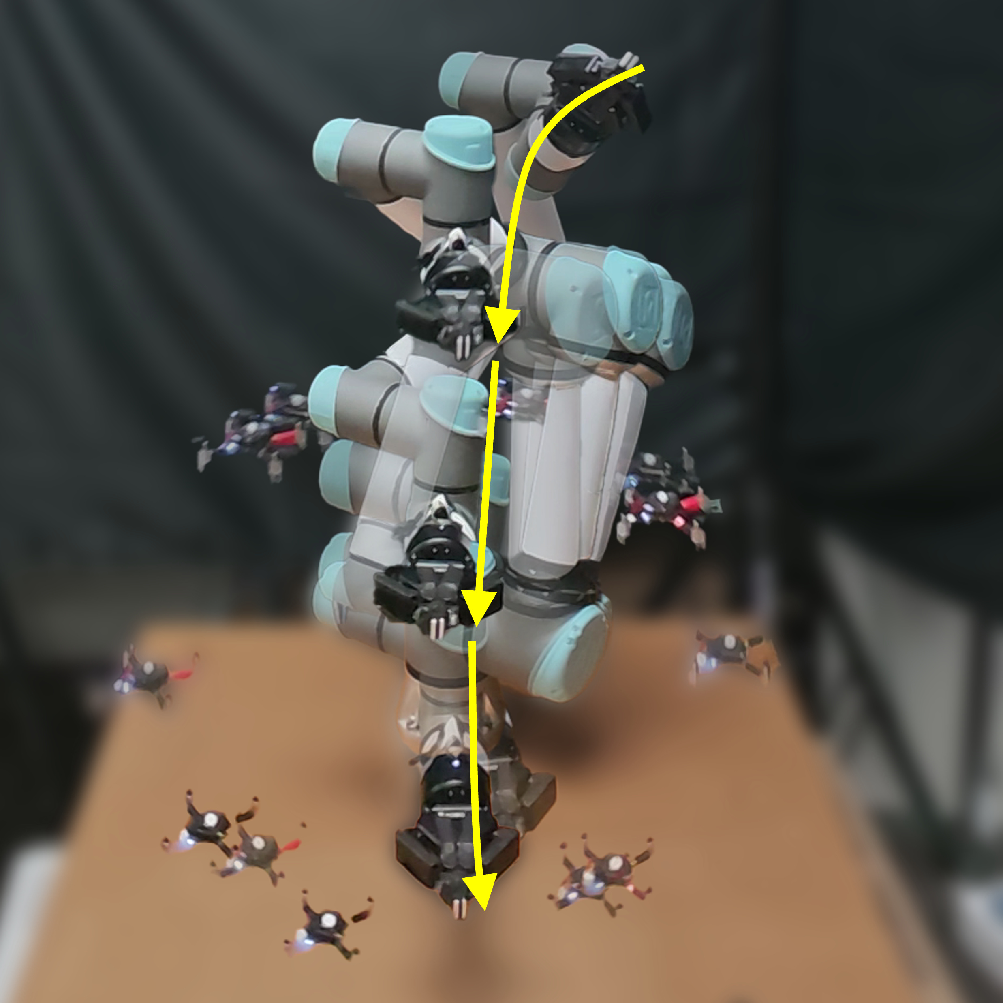
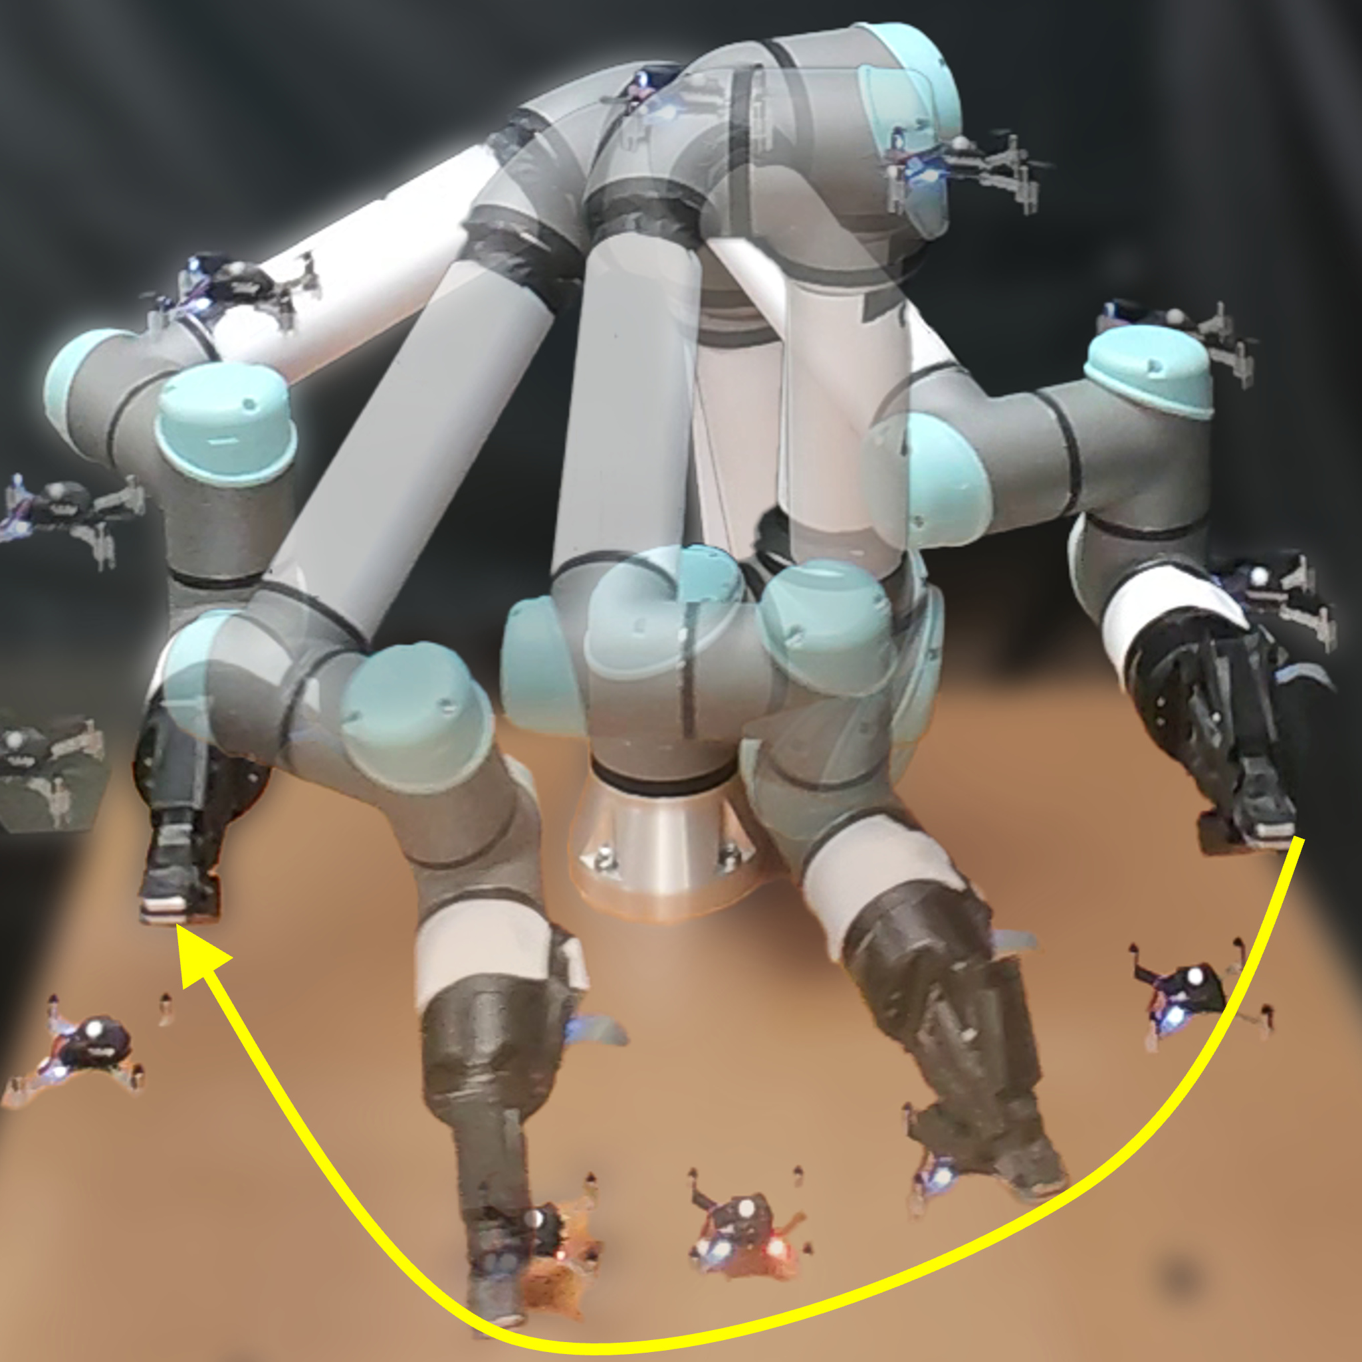
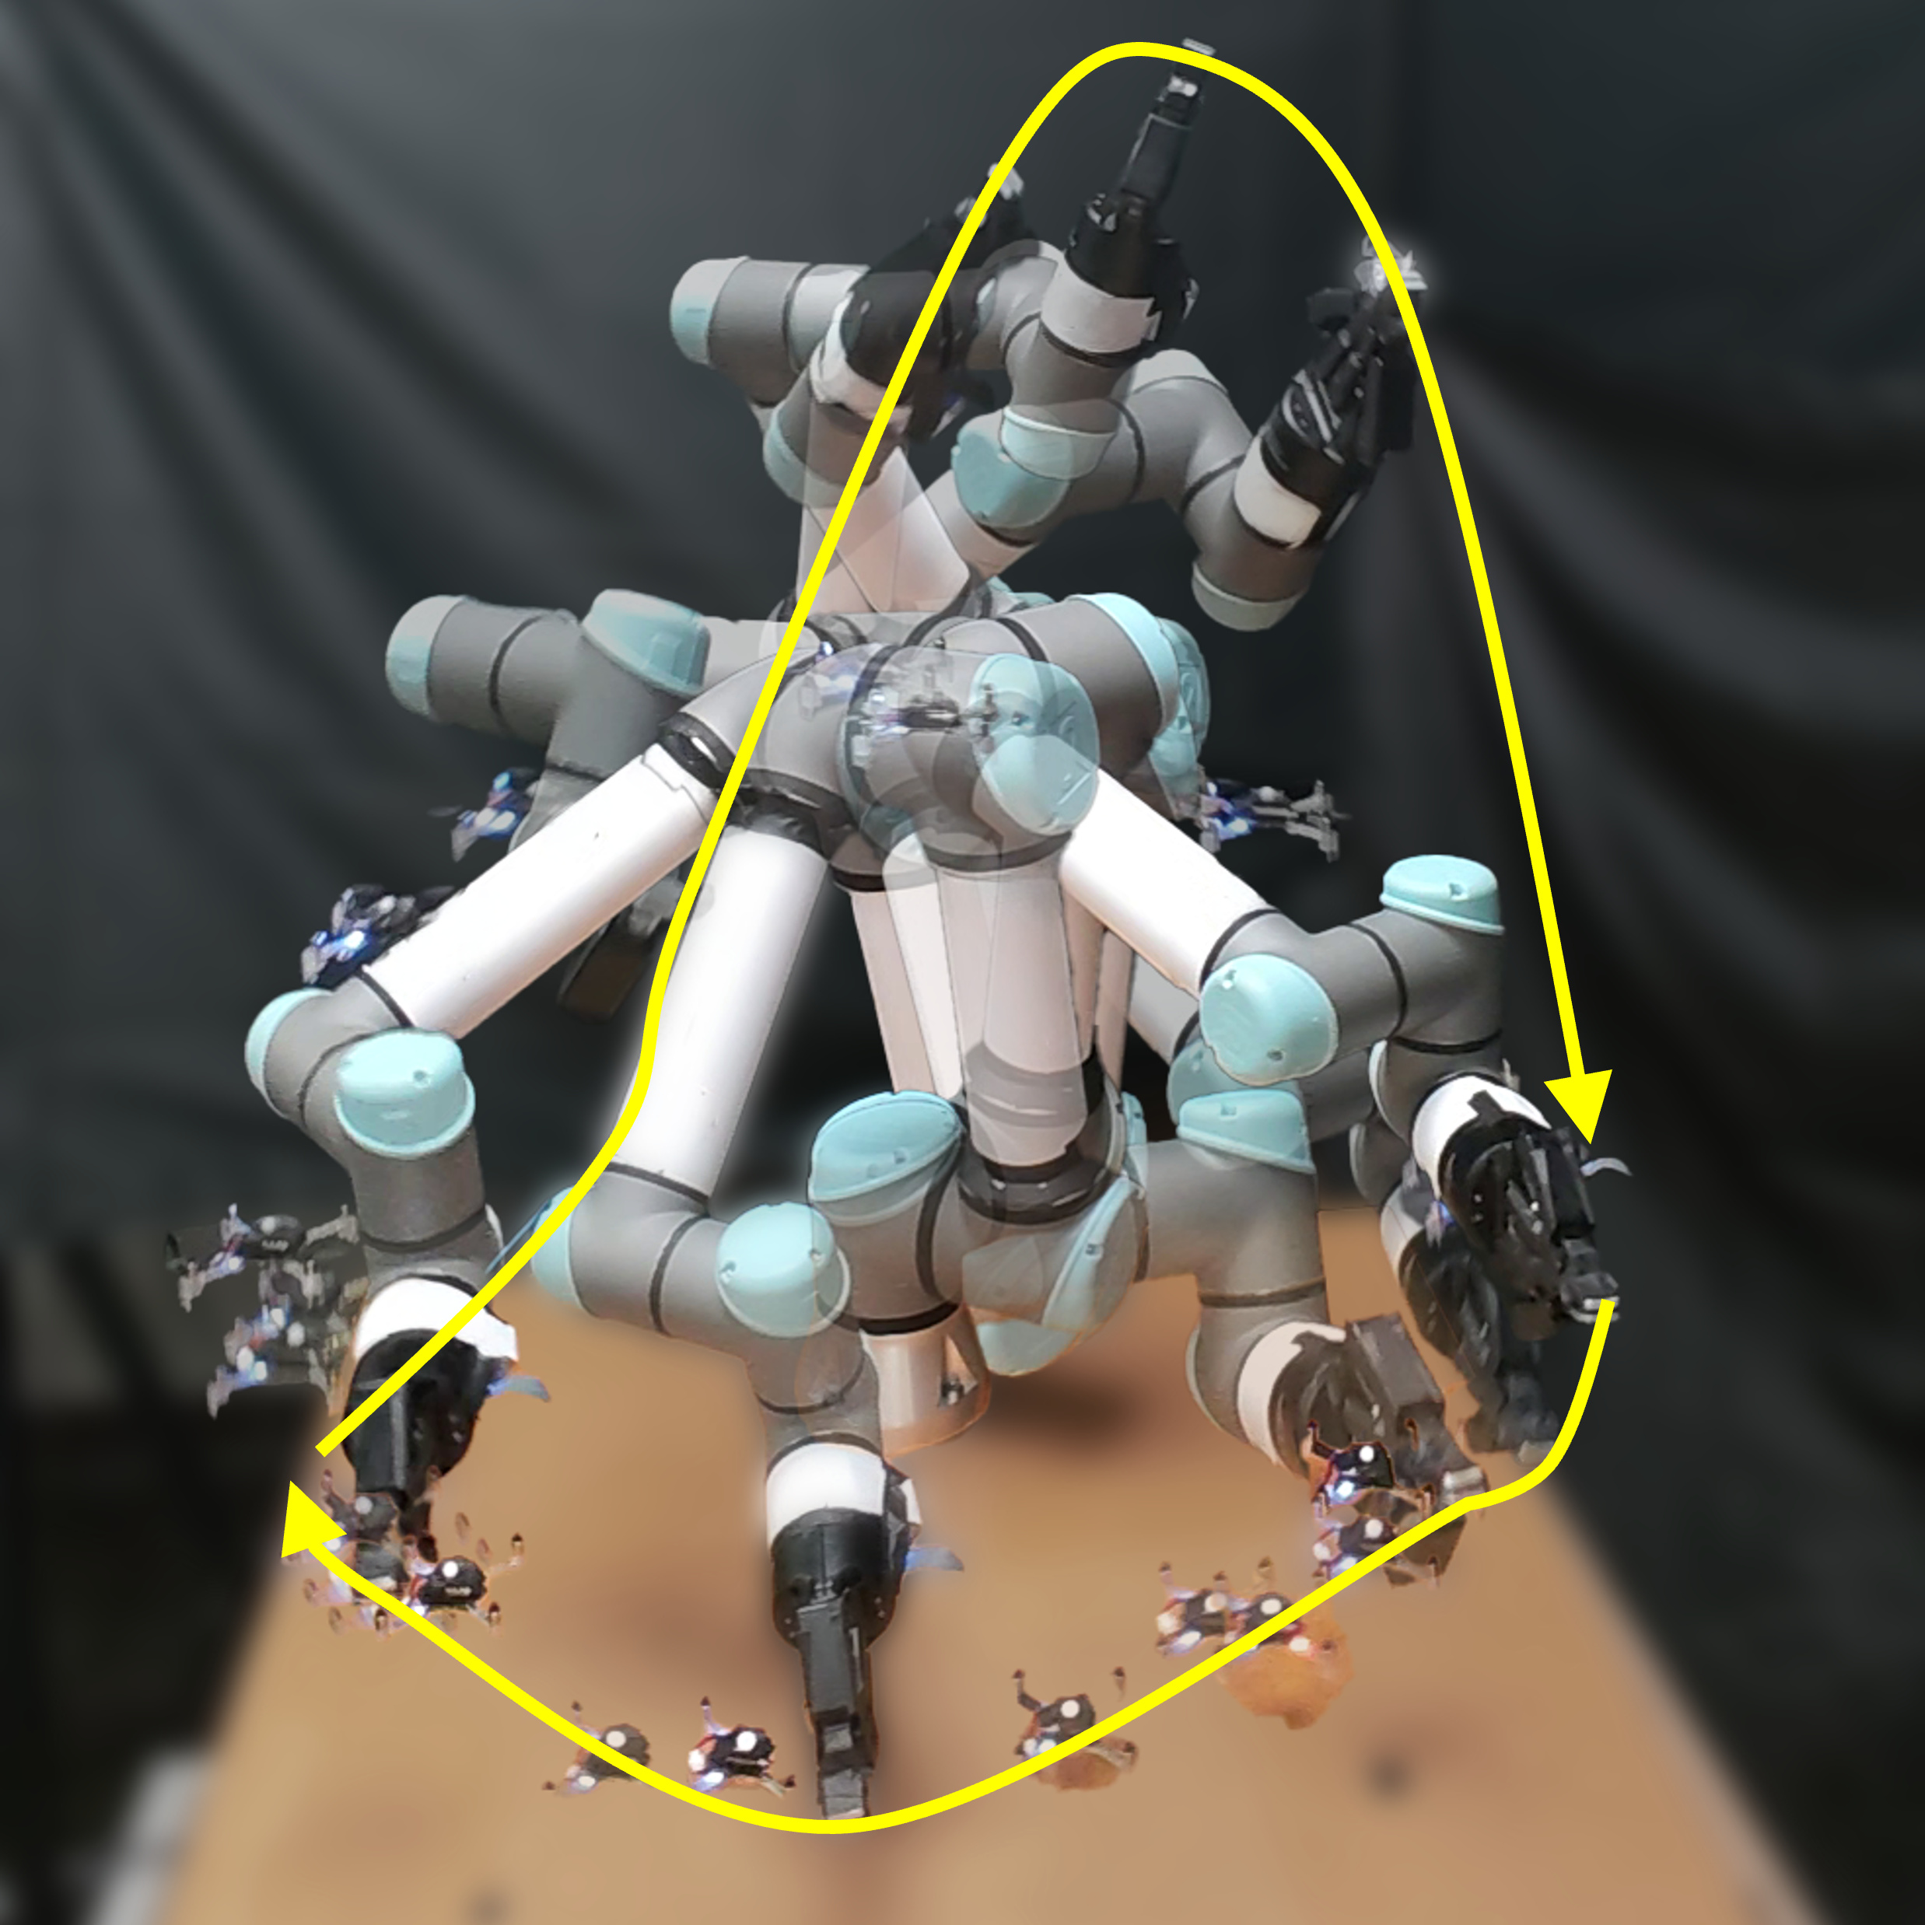
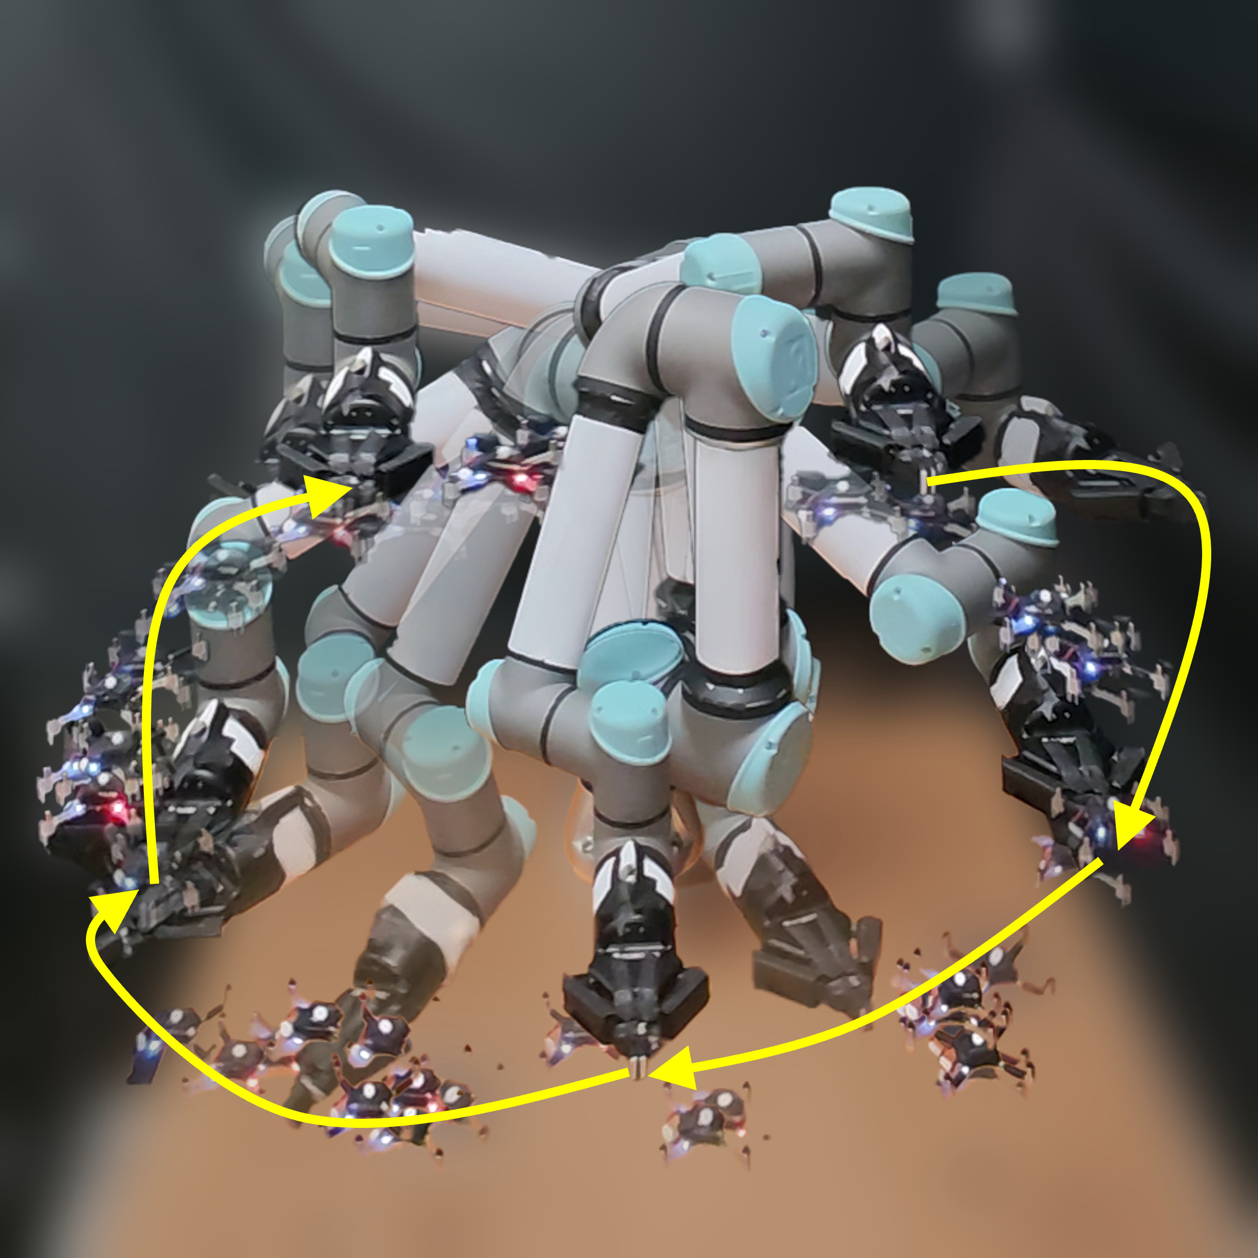
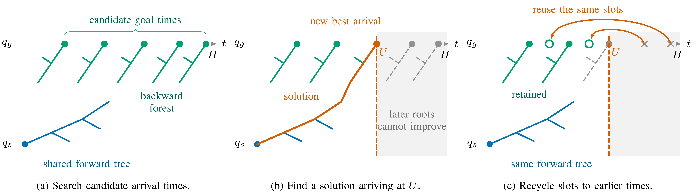
ST-pRRTC: Parallel Space-Time RRT-C with Adaptive Goal-Time Forests
Duo Zhang
Jintong Li
Junshan Huang
Jingjin Yu
Algorithmic
Robotics &
Control Lab
Department of Computer Science, Rutgers, The State University of New Jersey, Piscataway, NJ, USA
Paper & videos
Background & Motivation
Benchmarks: Faster First Solutions, Earlier Arrivals
Obstacle trajectories are known, but the robot’s goal-arrival time is unspecified.
Compute time: ST-pRRTC GPU kernels vs. baseline CPU planning calls.
Final arrival: mean over cases solved by all four methods.
Disc2D (300 cases)
Panda-spheres (300 cases)
Tabletop (962 cases)
Backward trees need both a goal configuration and an arrival time. More candidate times improve coverage but divide the search budget.
Objective: earliest collision-free arrival
ST-pRRTC: Interval Root and Root Recycling
GPU workers grow one shared forward tree and a backward forest from the goal.
Each backward root fixes an arrival time.
Interval root: continuous arrival-time sampling
Uniform sampling preserves coverage. Goal checks guide sampling toward promising times.
We collision-check each new root. A new best arrival U narrows the search range.
Interval root: probabilistic completeness and asymptotic arrival-time optimality
Real-Robot Demonstrations
For a bounded horizon H and positive-clearance paths (single-goal planning).
Root recycling: a fixed set of reusable tree slots
A UR5e executes planned reaches among moving Crazyflie drones. Overlays show successive poses.
After an earlier solution, reuse late tree slots for empty roots at earlier times.
Retain the shared forward tree and earlier backward trees.
2 drones
3 drones, slow
3 drones, fast
5 drones
Top/center/bottom reaching
Left/right reaching
Left/right reaching
Portal poking
Reaching through an opening
Notes:
ST-pRRTC: Parallel Space-Time RRT-C with Adaptive Goal-Time Forests. Authors: Duo Zhang, Jintong Li, Junshan Huang, Jingjin Yu.
Paper: https://arxiv.org/abs/2609.30533 .
Project page and videos: https://duozhangrobotics.github.io/projects/st-prrtc/ .
The method diagrams and benchmark figures come from the paper. Success curves include all scenes and average the 0.5, 1, 3, and 5 second budgets, with shading spanning their minimum and maximum. Final-arrival curves show means and 95% bootstrap intervals over cases solved by all four methods at each budget.
ST-pRRTC reports GPU-kernel execution time. CPU baselines report planning-call time. Scene construction and upload are excluded. Hardware: RTX 4090 and i9-14900KF, with single-threaded CPU baselines.
The interval-root guarantees concern single-goal planning in a bounded horizon. The analysis assumes unlimited sampling and storage, fair scheduling, and sound local collision validation that accepts sufficiently short collision-free motions. Asymptotic arrival-time optimality requires robust trajectories approaching the optimum. Root recycling has no general completeness or arrival-time optimality guarantee.
Robot images are temporal overlays of one physical UR5e and its drones. A synchronized trigger starts the preplanned motions with known obstacle trajectories. These demonstrations do not use online replanning.
The QR code links to the public project page, including the narrated overview and all four demonstrations.

