Slide 1
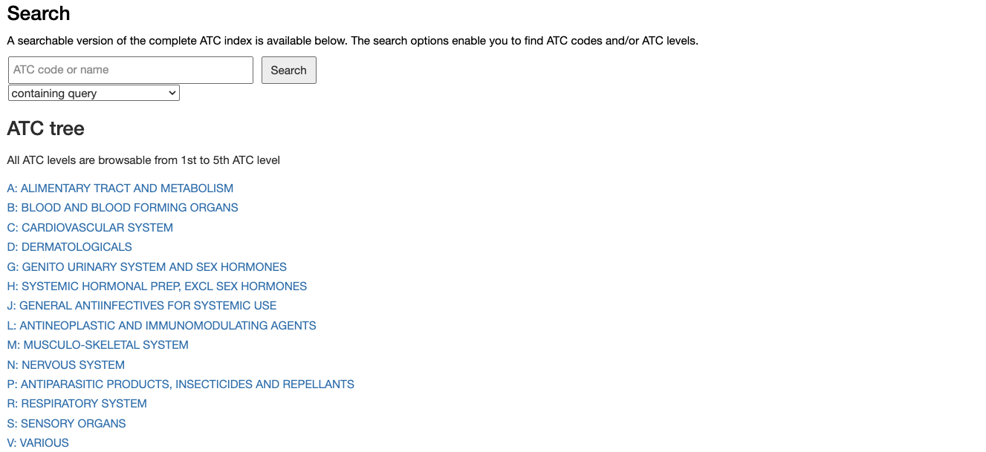
Type an ATC code here and press “Search”
or Click on an Anatomical group

Slide 2
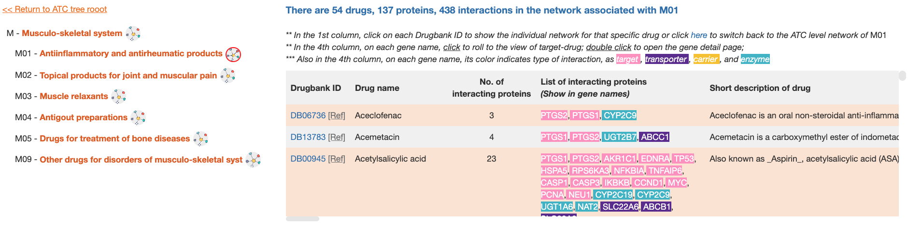
Click on the button to see the detailed drugs, diseases, proteins in the network associated with M01 code

Slide 3
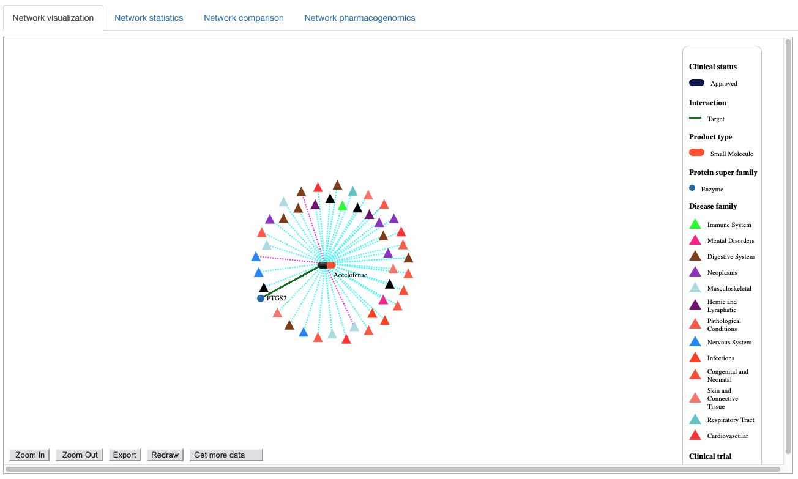
Click or unclick on an legend items to apply or remove filters
Use control buttons to zoom in/out, redraw, see hidden parts of the network or export it to image or csv format file

Slide 4
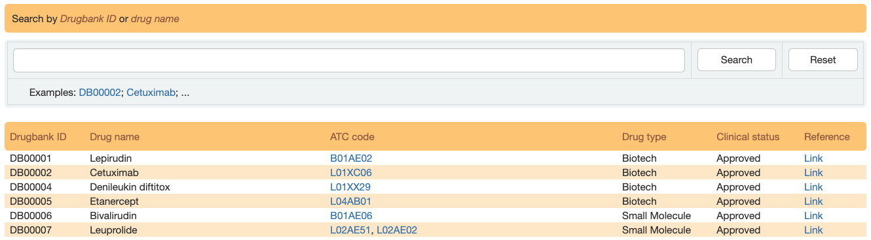
Use this search box to find a drug from its Drugbank ID or name. Autocomplete feature suggests possible matches as the user types.
Click here to see drug information in Drugbank
A drug can have no, one or more than one assigned ATC code. Click here to open the ATC code network for more detailed information

Slide 5
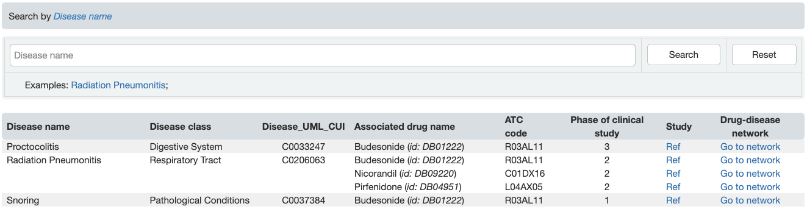
Use this search box to find a disease via its name. Autocomplete feature suggests possible matches as the user types.
Click here to see disease information in clinicaltrials.gov
Click here to open the drug-disease association network for more details

Slide 6
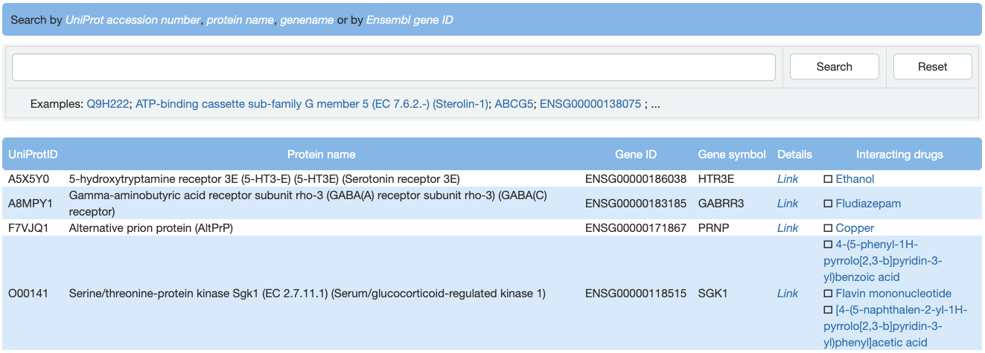
Use this search box to find a protein/gene. Autocomplete feature suggests possible matches as the user types.
Click here to open a detailed page for a protein/gene
Click on any drug to open the drug-protein interaction network for more details

Slide 7
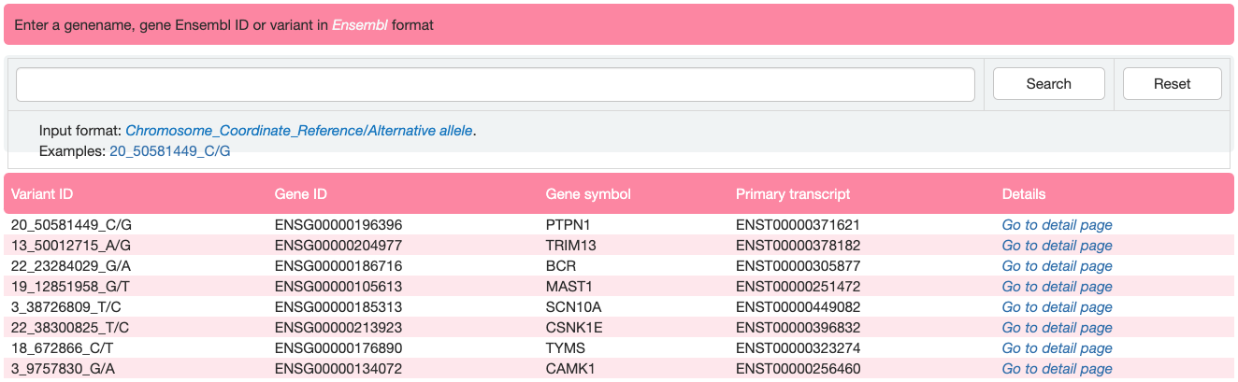
Use this search box to find a single variant. Autocomplete feature suggests possible matches as the user types.
Click here to open a detailed page for a protein/gene where the variant occurs

Slide 8
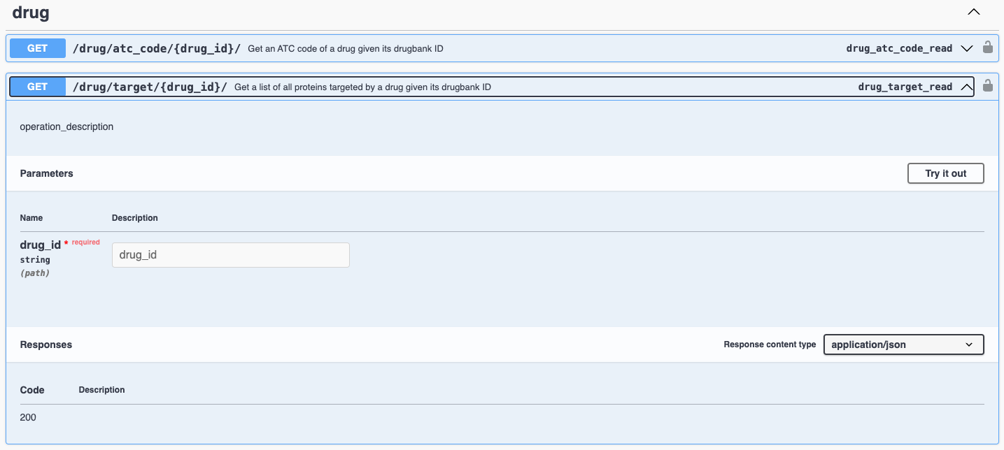
Click here to retrieve data for a single entry
Input entry id here and press “Execute”

Slide 9
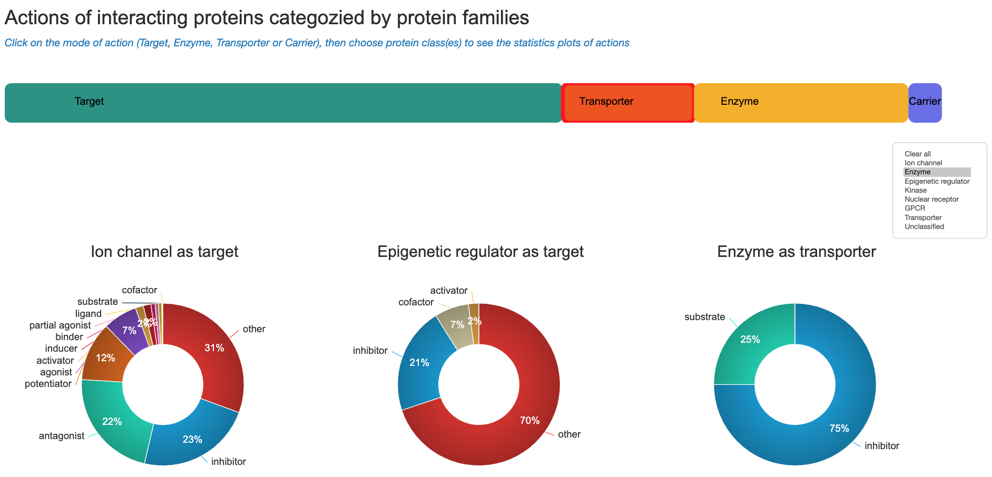
Choose a mode of action
Choose a class/category

