Slide 1
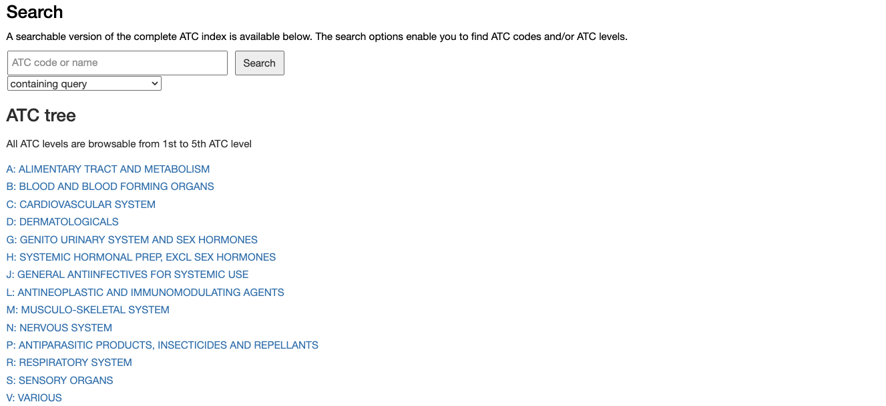
Type an ATC code here and press “Search”
or Click on an Anatomical group

Slide 2
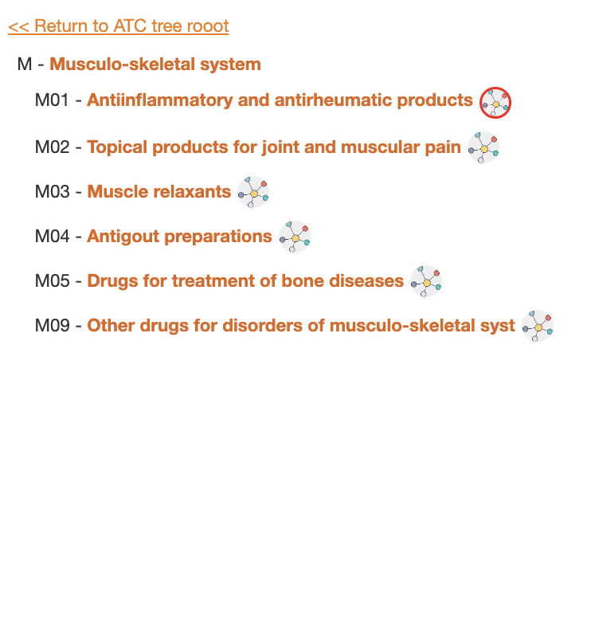
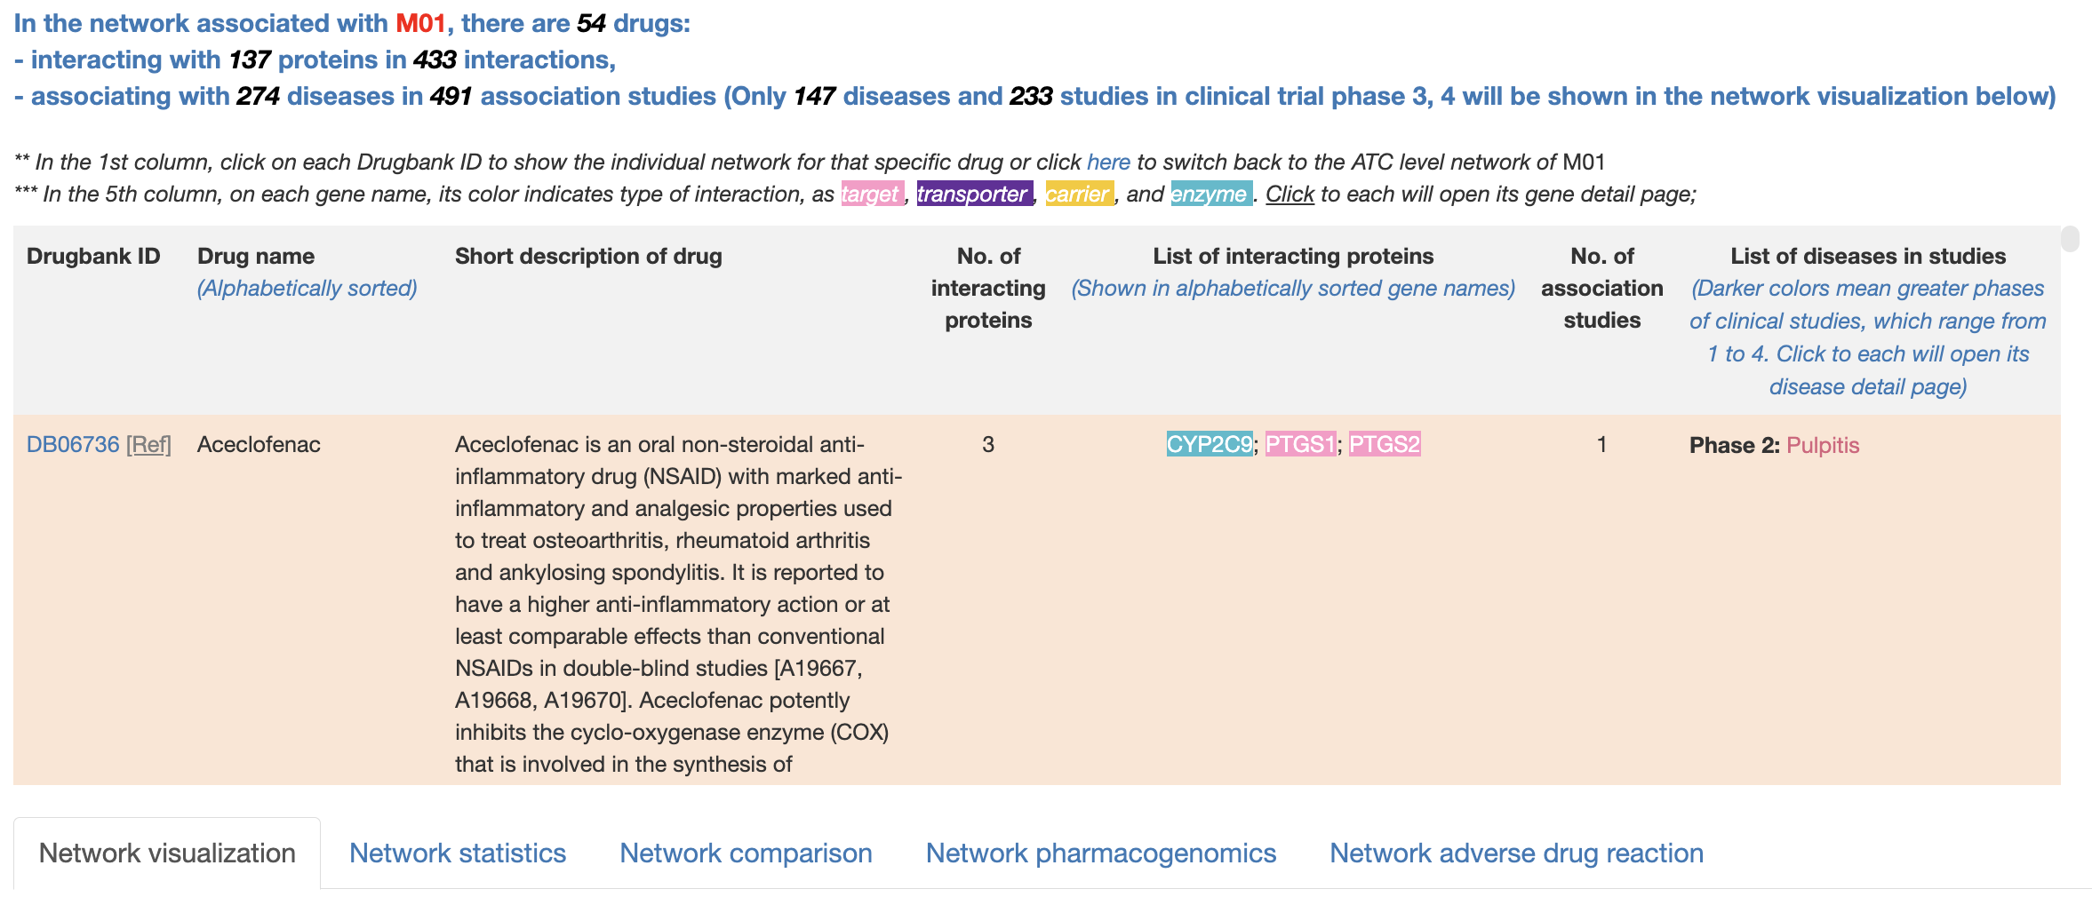
Click on the button to see the detailed drugs, indications, proteins in the network associated with M01 code
Overview table that lists drugs linked to the M01 and its related subcodes
Beneath the table is 5 tabs show different aspect of M01 network with network visualization set as default

Slide 3
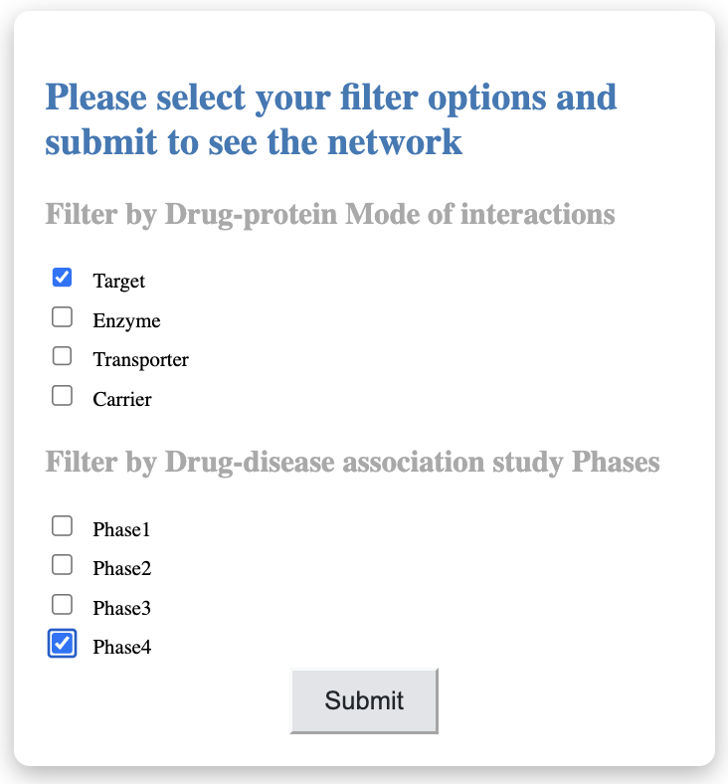
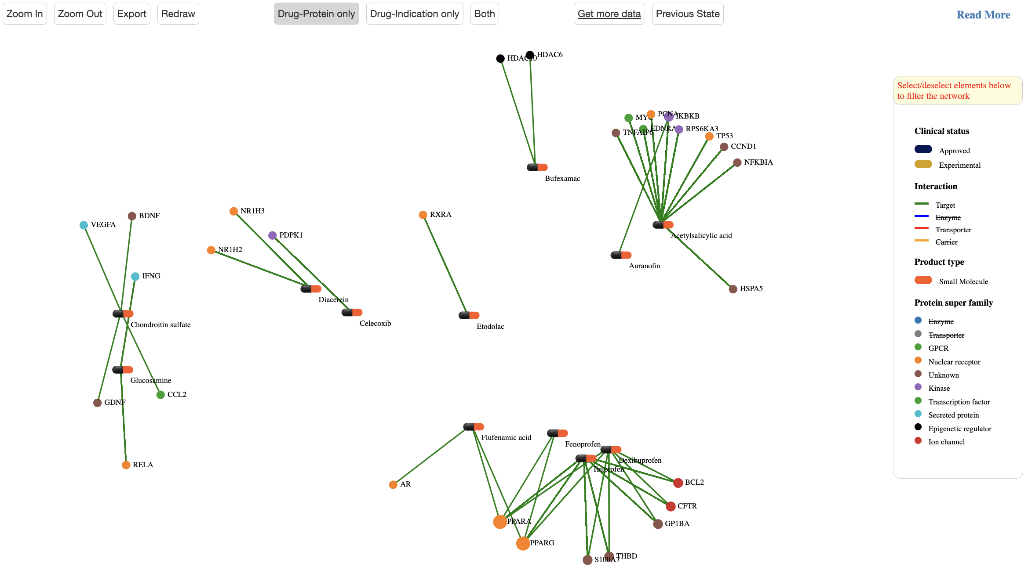
Use control buttons to zoom in/out, redraw or export it to image or csv format file
See parts of the network
Choose filters
Change filters

Slide 4
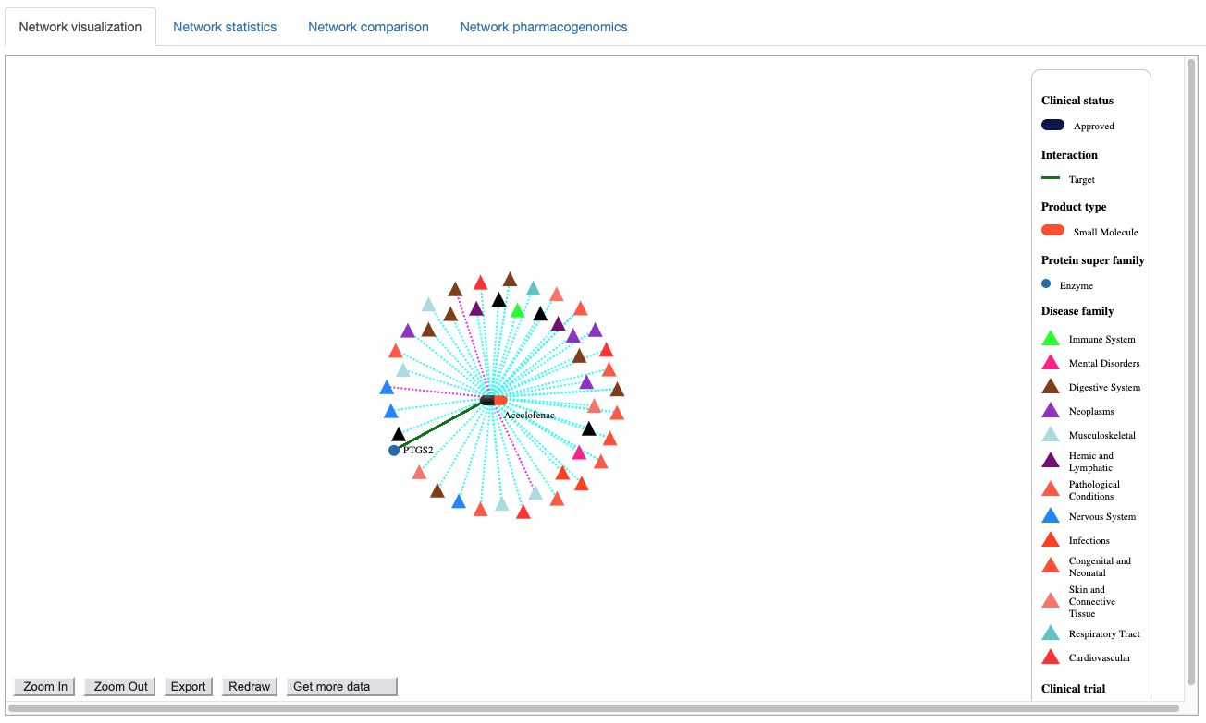
Click or unclick on an legend items to apply or remove filters
Use control buttons to zoom in/out, redraw, see hidden parts of the network or export it to image or csv format file

Slide 5
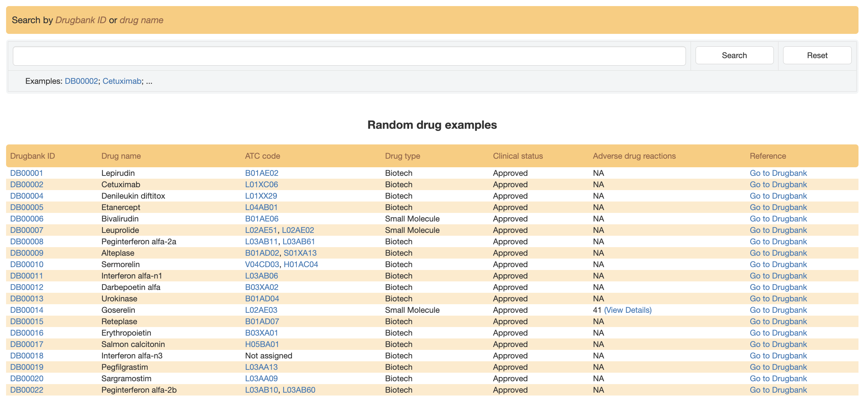
Use this search box to find a drug from its Drugbank ID or name. Autocomplete feature suggests possible matches as the user types.
Click here to see drug information in Drugbank
A drug can have no (not assigned), one or more than one assigned ATC code. Click here to open the ATC code network for more detailed information
Click here to see drug adverse reaction

Slide 6
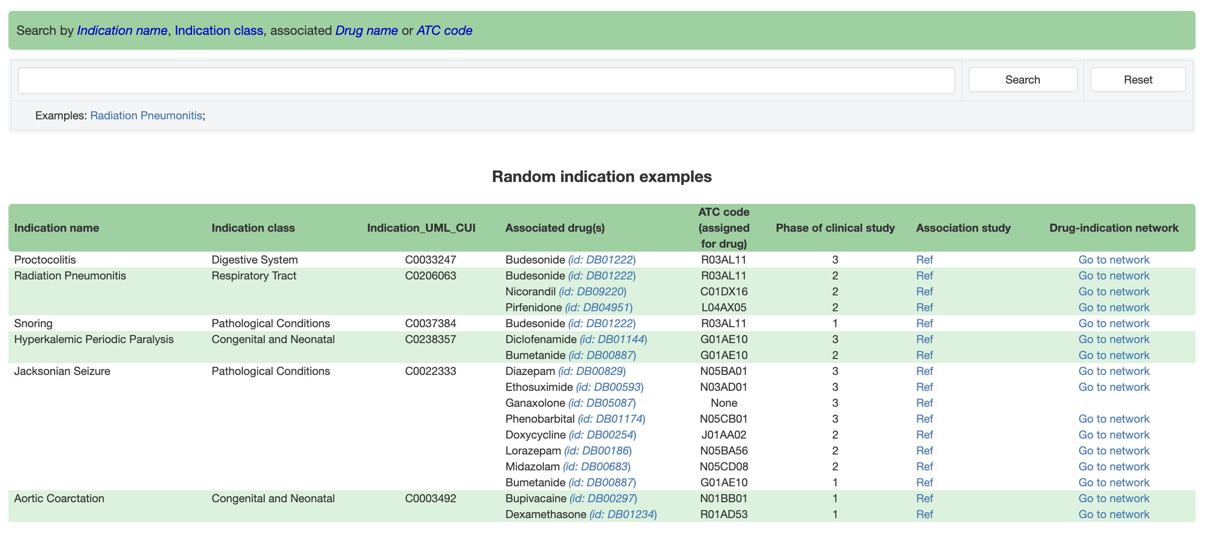
Use this search box to find a disease via its name. Autocomplete feature suggests possible matches as the user types.
Click here to see disease information in clinicaltrials.gov
Click here to open the drug-disease association network for more details

Slide 7
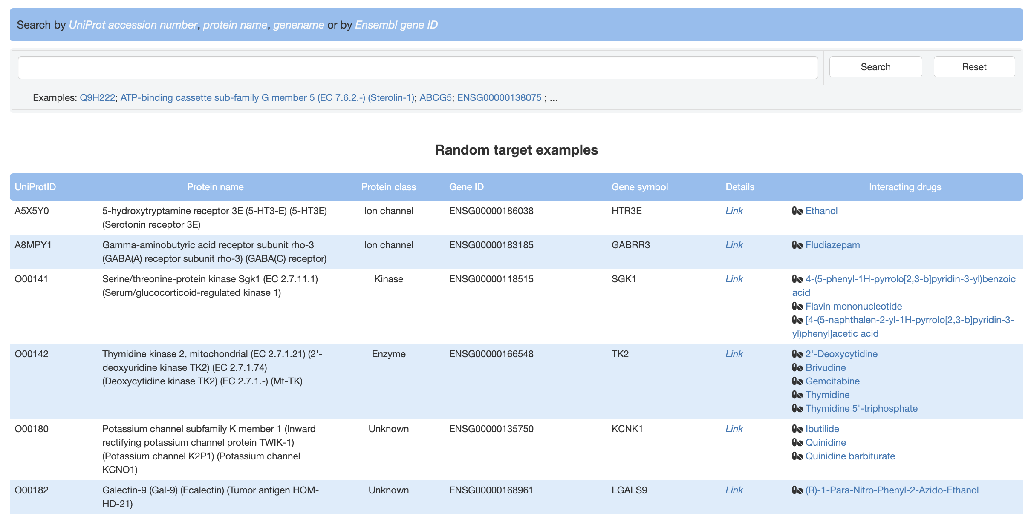
Use this search box to find a protein/gene. Autocomplete feature suggests possible matches as the user types.
Click here to open a detailed page for a protein/gene
Click on any drug to open the drug-protein interaction network for more details

Slide 8
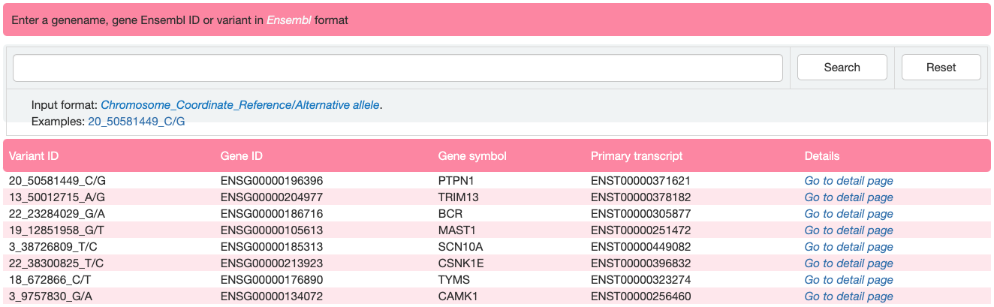
Use this search box to find a single variant. Autocomplete feature suggests possible matches as the user types.
Click here to open a detailed page for a protein/gene where the variant occurs

Slide 9
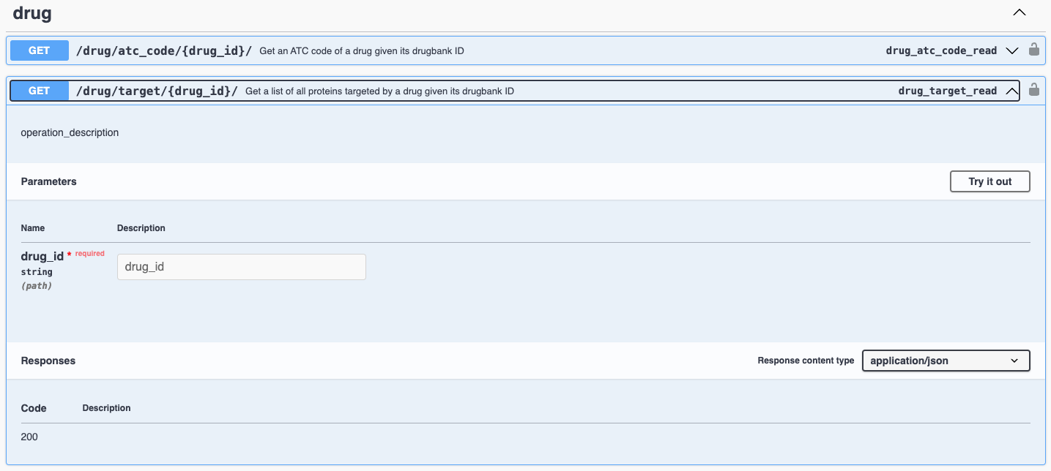
Click here to retrieve data for a single entry
Input entry id here and press “Execute”

Slide 10
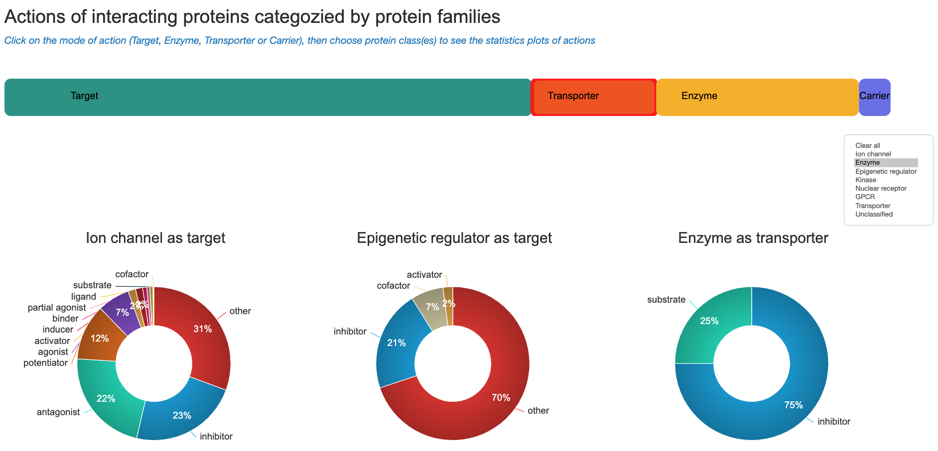
Choose a mode of action
Choose a class/category

