Slide 1

JAVA COURSE
INTRODUCTION

Slide 2
WELCOME!
Welcome to our
JAVA course
from ComIT

Slide 3
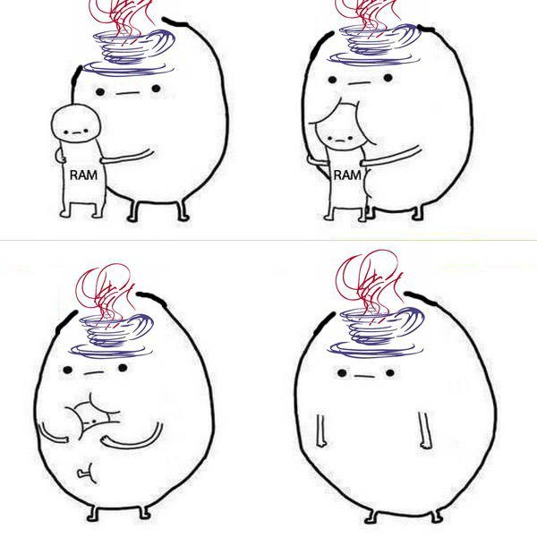

Slide 4
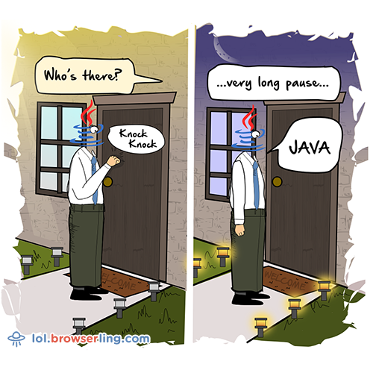

Slide 5
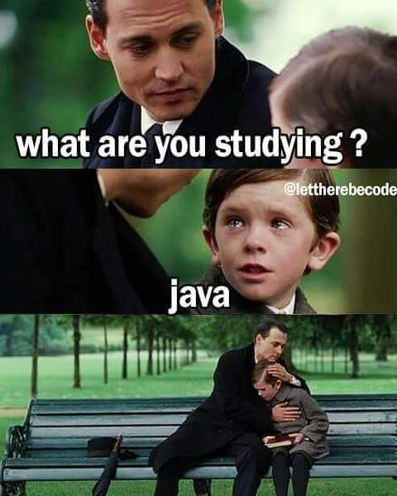

Slide 6
WHO WE ARE
Professor
Days of the course
120hs in class + 20hs of seminars + a lot of practice
Students presentation: name, last name, studies, what are your expectations for the course?

Slide 7
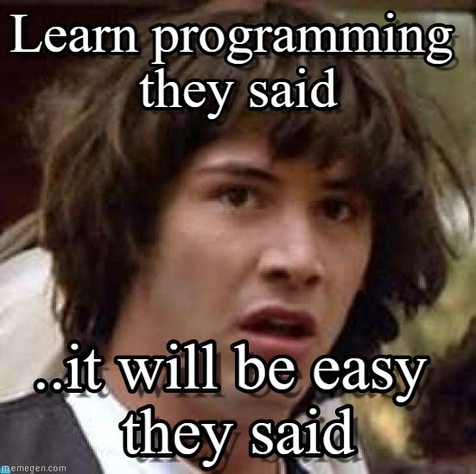

Slide 8
THE GOALS
Train you as trainee/junior Java Devs.
For you to get a job in IT.
For you to develop IT professional’s spirit and mind.
For you to continue your studies after the course and after
you get a job.
To get along all together in classroom and develop a good relationship.

Slide 9


Slide 10
THE CONTENTS
Develop logical skills and basic notions needed to work in IT
Design and program in the Java programming language
Learn the Object Oriented paradigm
Elementary concepts of HTML and CSS
To generate a solid base to continue perfecting yourself in the language and its technologies

Slide 11
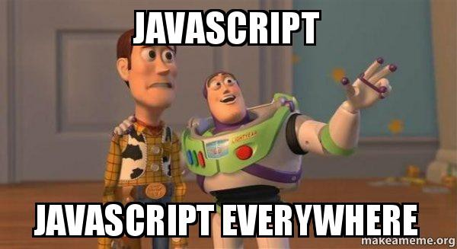

Slide 12
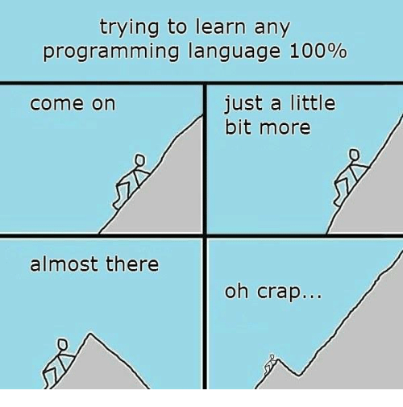

Slide 13
KEYS TO SUCCESS
Listening carefully to all instructions and examples in class
Asking questions if you don’t understand
There are no bad questions!
Participate in classroom discussion
Redo exercises that we do in class in your own time
Please understand that all the topics that we see in the course are interrelated
Do your best to understand what we do in class to do all the exercises from the practice

Slide 14
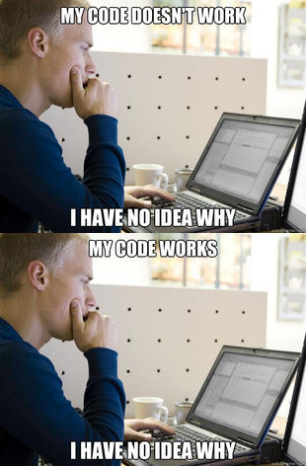

Slide 15
OUR ADVICE
Homework and practice are very important
Practice will help you learn and remember the topics
Share with the other students and don’t hesitate to help them
Helping other students will improve your own knowledge
Try to participate in class
Sharpen concepts and point out mistakes.

Slide 16
OUR ADVICE
The course requires dedication and effort
Do not let the topics frustrate you. Everyone had to start from the beginning at some point.
Learning new topics can be difficult, but anyone can learn this material.
If you don’t like what you’re doing, then you’ll have to make a bigger effort.
Express your experiences and emotions openly
What is working well for you, and what is not working well.

Slide 17
OUR ADVICE
While imitation is a pillar of human learning, at this stage of formation it is of no use
We are going to have to build our own mental constructs and reasonings.

Slide 18
THE END
QUESTIONS?

