Slide 1


irline eservation ystem
A R S
Member: Duong Xuan Binh
Nguyen Tien Dat
Mentor: Dang Kim Thi

Slide 2

01
SUBJECT STATEMENT

Slide 3
WHAT IS ARS?
The Airline Reservation System (ARS) is a software application to assist an airline with transactions related to making ticket reservations, which includes blocking, reserving, canceling and rescheduling tickets.
Function Requirement:
User Account
Registration and creation of user profile
Check availability
Making reservations/Blocking/Confirmation
Confirm ticket
Reschedule ticket
Cancellation
Update Profile
View ticket status
Query flight details

Slide 4

SYSTEM OBJECTIVE
View static pages
Flight status
Query flight
Select flight
Select seat
Block/Buy ticket
Cancel ticket
Booking manage
Display all table
CRUD Flight
GUEST
USER
ADMIN
Only access a limited function
Access all function of the system
Manage and control the system (optional)
Notes:
Từ góc nhìn người học: thực hiện ràng buộc, validate,…
Trình bày sẽ theo 3 luồng này

Slide 5
02
PROJECT LAUNCHING

Slide 6
CORE DEVELOPMENT TECHNOLOGIES
Technique
Template
HTML, CSS, JS, Jquery, AJAX, PHP
Simple template
Framework
Package
Owl carousel, Laravel
Laravel Mail CSS Inliner
Notes:
Tự xây dựng template nên nos trông chưa giống 1 web của hãng hk

Slide 7
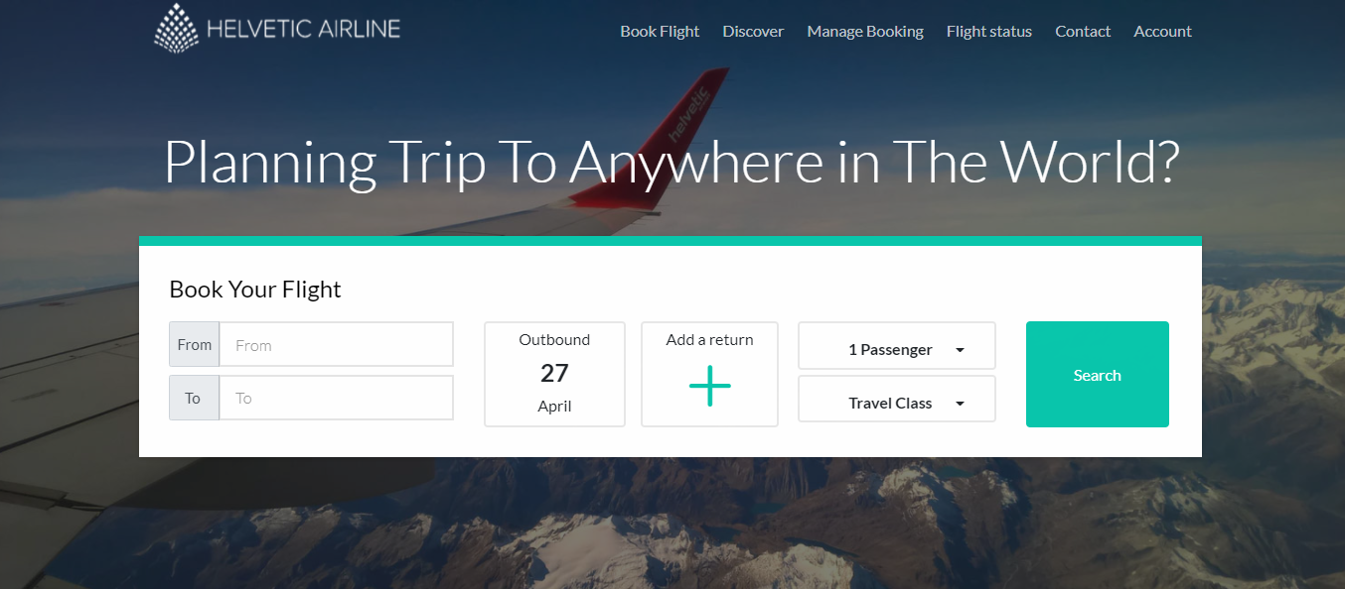
DEMONSTRATION
Click here

Slide 8
THANK YOU

