Slide 1
R help session 03082018
Han Jiang

Slide 2
How to do linear regression
Define the loss function
Find the minimum of loss function
Get model parameters

Slide 3
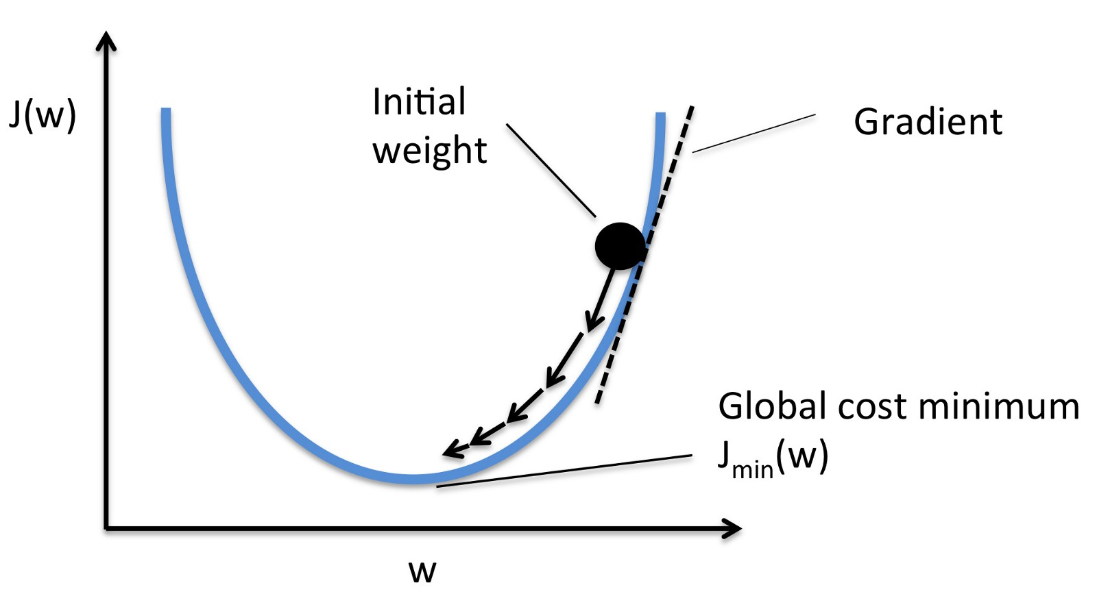
Gradient descent

Slide 4
Intersect
Interaction
Dummy variables

