Slide 1
Requirements Analysis and Design
Student: 521H0220 – Bui Hai Duong
Teacher: Mr. Pham Thai Ky Trung

Slide 2
Summary the slide
Introduction.
Analyze model
Design model

Slide 3
Introduction
This slide represent for the Account Management based on three types of model: Analysis model, Design model and Programming model. The Account Management is the use case with the main function of managing the staff account of the on the website.

Slide 4
Table of contents
01
02
Analysis model
Design model
Analyze a use case.
Design phase of the use case

Slide 5
01
Analyze model

Slide 6
Usecase description
Use case name: | Login
Scenario: | Login to the account
Triggering event: | Admin or staff wants to perform login to their account for work
Brief description: | The login process required admin and staff provide username and password for the use of their account.
Actors: | Admin, Staff
Preconditions: | - The UI is ready for the admin and staff to use. - The username and password is provided.
Postconditions: | The admin or staff member is successfully logged in and has access to their account.

Slide 7
Use case description
Flow of the activities | Actor | System
 | Admin or staff enter the username and password. | System checking the given username and password.
Exception condition | The UI is not available for the admin to use Username or password invalid

Slide 8
Usecase description
Use case name: | Create account
Scenario: | Create account for staff
Triggering event: | When there is a new staff working for the retail store
Brief description: | The admin performs creating a new account if there is a new staff working in their retail store
Actors: | Admin
Preconditions: | - The UI is ready for the admin to use. - There is a new staff working in the store
Postconditions: | - The staff have accessed to the website through the new account for working

Slide 9
Use case description
Flow of the activities | Actor | System
 | Admin performs creating a new account for the staff | Generate account and save it to database
Exception condition | - The UI is not available for the admin to use - There is no new staff working in the store

Slide 10
Usecase description
Use case name: | Check status
Scenario: | Check working status of staff
Triggering event: | When the admin want to check working status of a staff
Brief description: | Admin performs checking the working status of the staff whether they are still a staff or not
Actors: | Admin
Preconditions: | - The UI is ready for the admin to use.
Postconditions: | - The status of the staff has been checked

Slide 11
Use case description
Flow of the activities | Actor | System
 | Admin performs checking the working status of a staff | Find staff and return the checking status result
Exception condition | The UI is not available for the admin to use

Slide 12
Usecase description
Use case name: | Delete account
Scenario: | Delete a staff account
Triggering event: | When a staff no longer working in a store
Brief description: | Admin performs deleting an account of a staff no longer working for their store
Actors: | Admin
Preconditions: | - The UI is ready for the admin and staff to use. - There is a staff no longer working in a store
Postconditions: | - The account of the old staff has no longer available

Slide 13
Use case description
Flow of the activities | Actor | System
 | Admin performs deleting the account of the old staff | Remove the account from the database
Exception condition | - The UI is not available for the admin to use - The staff still working in the store

Slide 14
Usecase description
Use case name: | Update account information
Scenario: | Staff update account information
Triggering event: | Staff want to update the new information for their working account
Brief description: | The staff performs updating their personal information in their working account given by the admin
Actors: | Staff
Preconditions: | - The UI is ready for the admin and staff to use. - The staff need to update the information
Postconditions: | - The information needed to be update has been sent to the admin to be verified.

Slide 15
Use case description
Flow of the activities | Actor | System
 | The staff update their information on the account | Send the verified request for the admin for the updating.
Exception condition | The UI is not available for the admin to use

Slide 16
Usecase description
Use case name: | Verify account information
Scenario: | Verify the updated information account of staff
Triggering event: | The verified request sent to admin
Brief description: | The admin performs verifying the account of the staff if they have some new updated information
Actors: | Admin
Preconditions: | - The UI is ready for the admin and staff to use - The admin received the verified request
Postconditions: | - The staff information had been updated in the account

Slide 17
Use case description
Flow of the activities | Actor | System
 | Admin performs verifying the staff account | Update new information in staff account and save to database
Exception condition | - The UI is not available for the admin to use - The admin haven’t received the request - The updated information is invalid

Slide 18
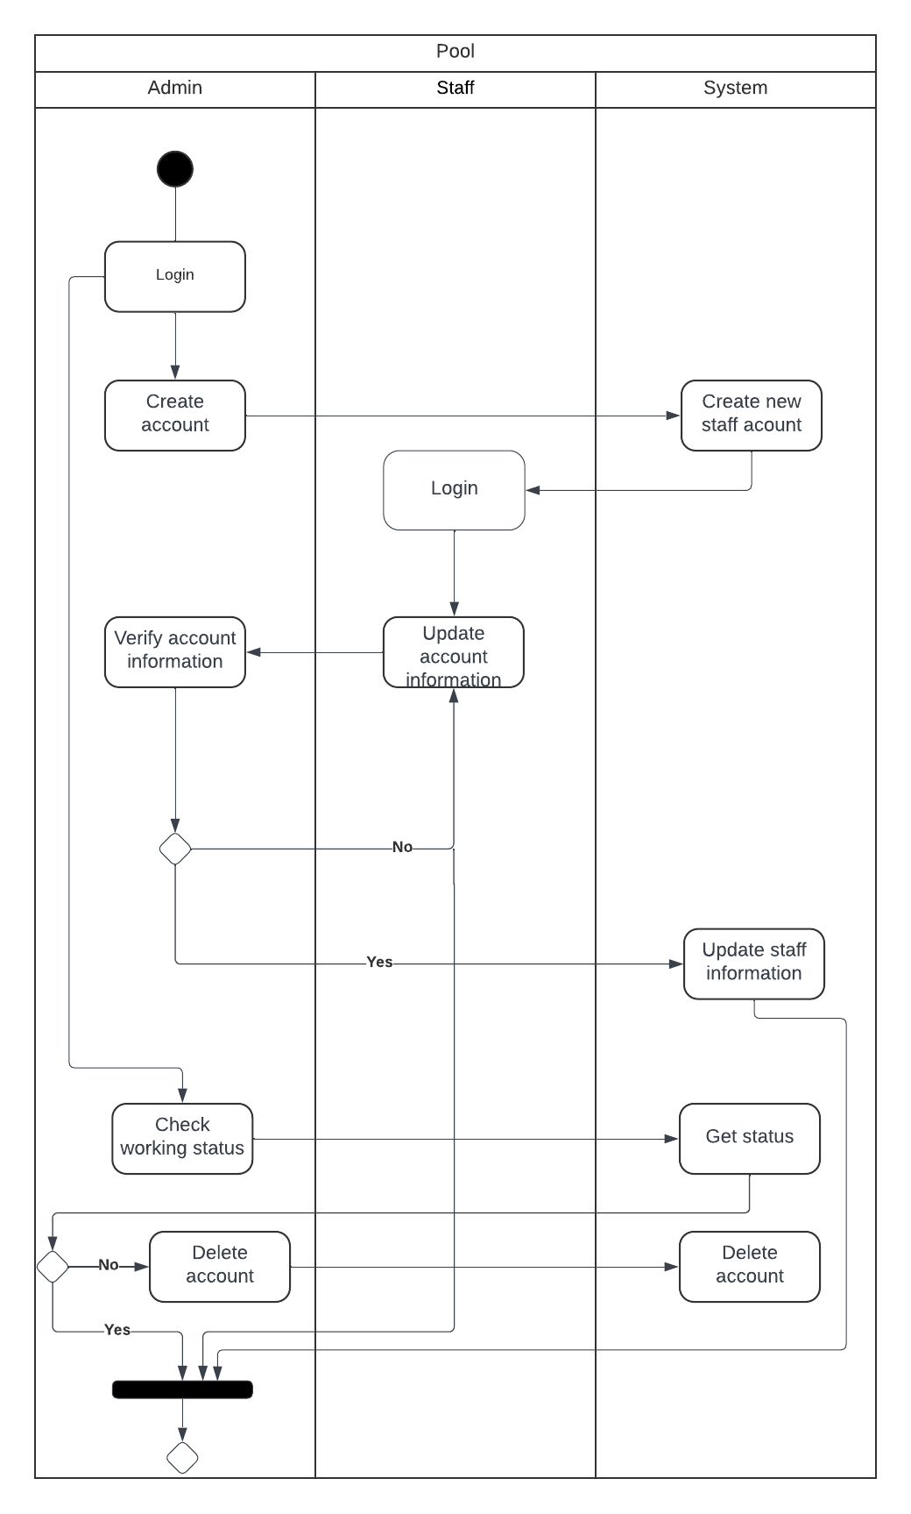
Activity Diagram

Slide 19
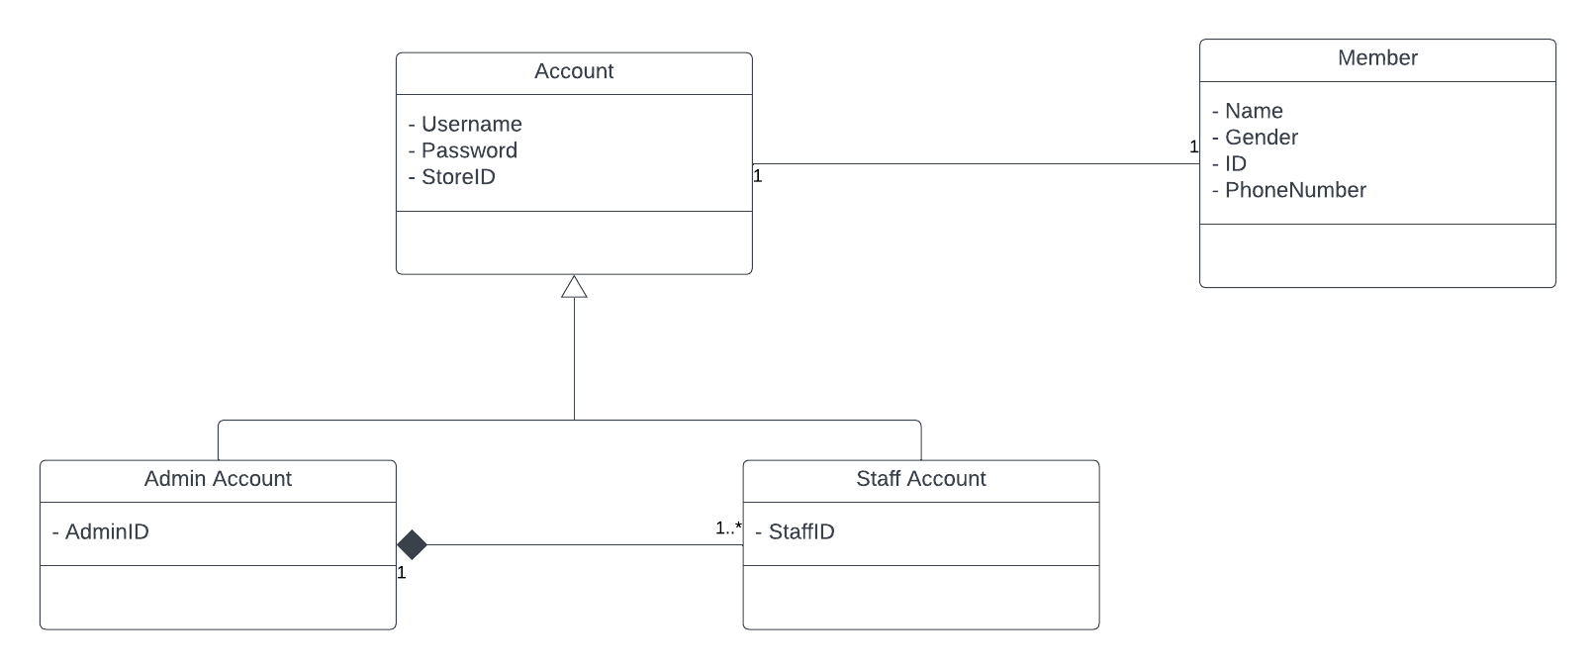
Domain Class Diagram

Slide 20
02
Design model

Slide 21
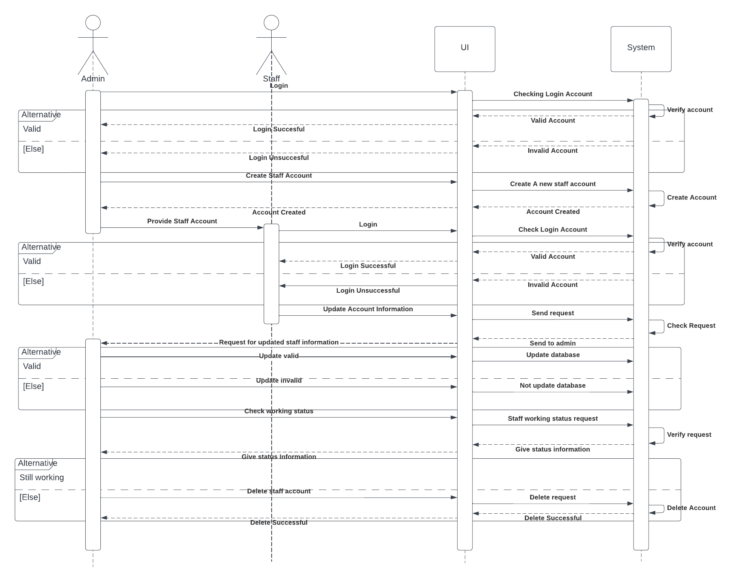
System Sequence Diagram

Slide 22
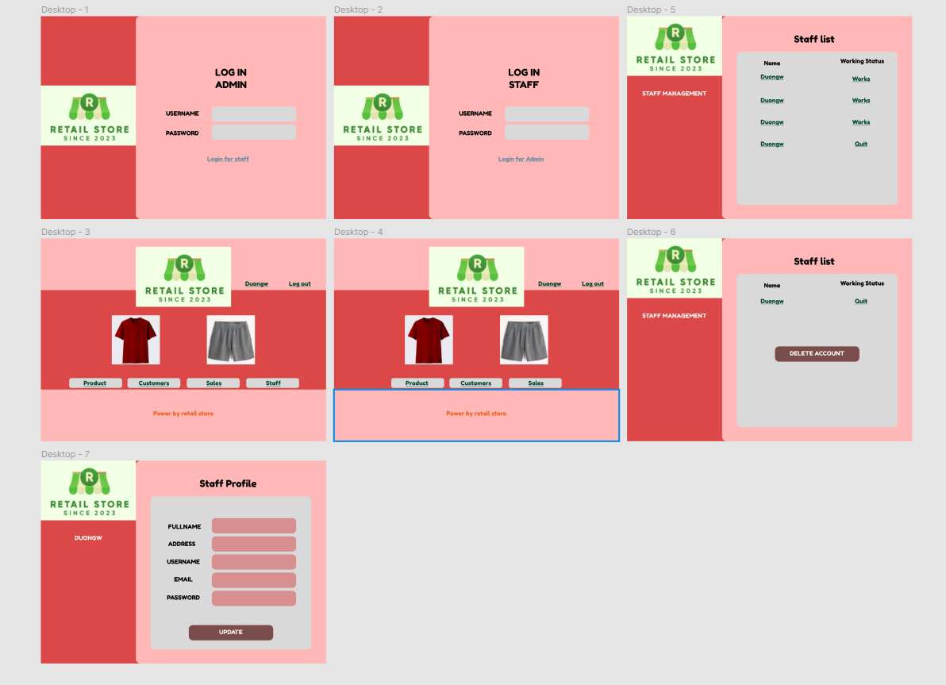
UI DESIGN

Slide 23
THANKS FOR WATCHING

