Slide 1
Secure Data Hiding in Image Using Steganography
CAPSTONE PROJECT
Presented By: Duppally Arun
Student Name : Duppally Arun
College Name & Department : GRIET CSE

Slide 2
OUTLINE
Problem Statement
Technology used
Wow factor
End users
Result
Conclusion
Git-hub Link
Future scope

Slide 3
Problem Statement
"Secure Data Hiding in Images Using Steganography" is a Python-based GUI application that enables users to hide and retrieve secret messages within images using encryption. Users can select an image, enter a secret message with a passcode for encryption, and later decrypt it by providing the correct passcode. The application ensures data confidentiality using pixel manipulation techniques. The GUI, built with tkinter, provides an intuitive interface for seamless encryption and decryption of hidden messages.

Slide 4
Technology used
Python – Core programming language for implementation.
OpenCV (cv2) – For image processing (reading/writing image files).
tkinter – For creating the graphical user interface (GUI).
PIL (Pillow) – For handling and displaying images in tkinter.
NumPy – For efficient image data manipulation.
OS – For handling file operations like opening images
Platforms Supported:
Operating Systems:
Windows, Linux, macOS
Python Version:
Python 3.x (Recommended: Python 3.7 or later)

Slide 5
Wow factors
Modern GUI for Better User Experience
Enhanced Security Features
Image Selection Dialog makes it easier to choose an image.
Automatic Encrypted Image Preview
Cross-Platform Compatibility
More User-Friendly Error Handling

Slide 6
End users
Cybersecurity Professionals & Ethical Hackers
Journalists & Whistleblowers
Government & Intelligence Agencies
Military & Defence
Multi-National Corporations (MNCs)
Banking & Financial Institutions
Healthcare & Medical Industry
Space & Satellite Communication

Slide 7
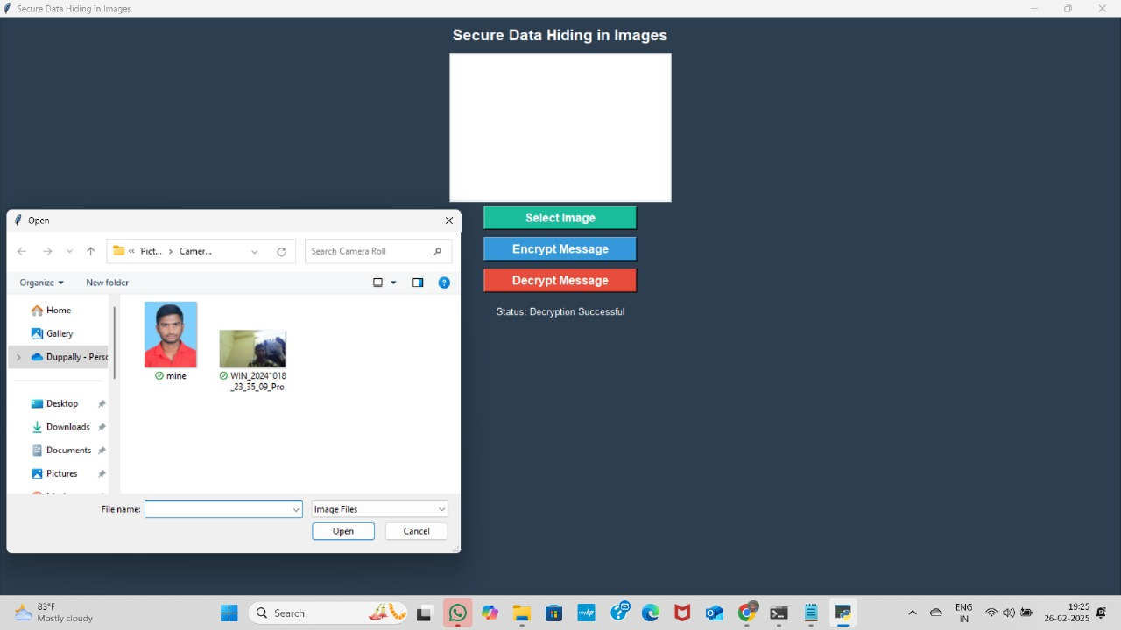
Results

Slide 8
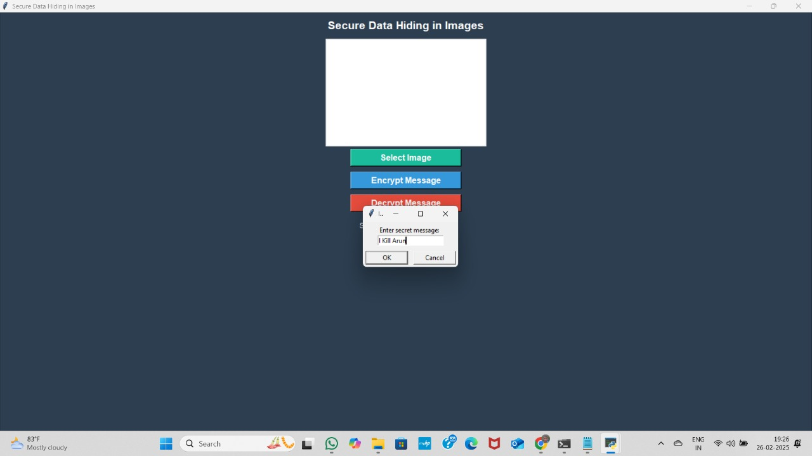

Slide 9


Slide 10
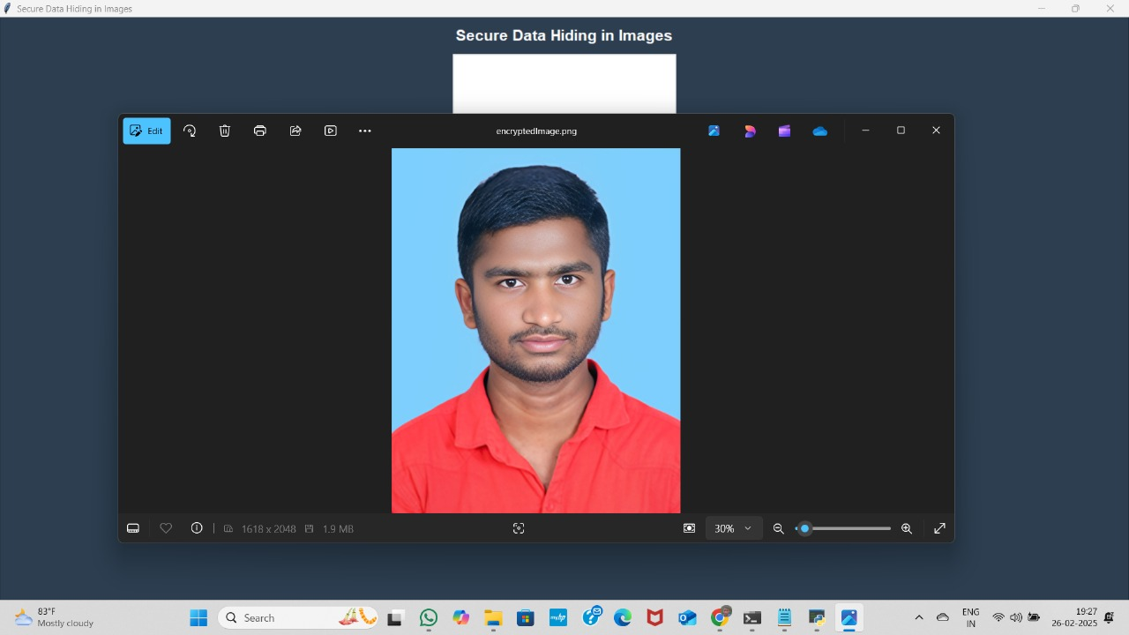

Slide 11
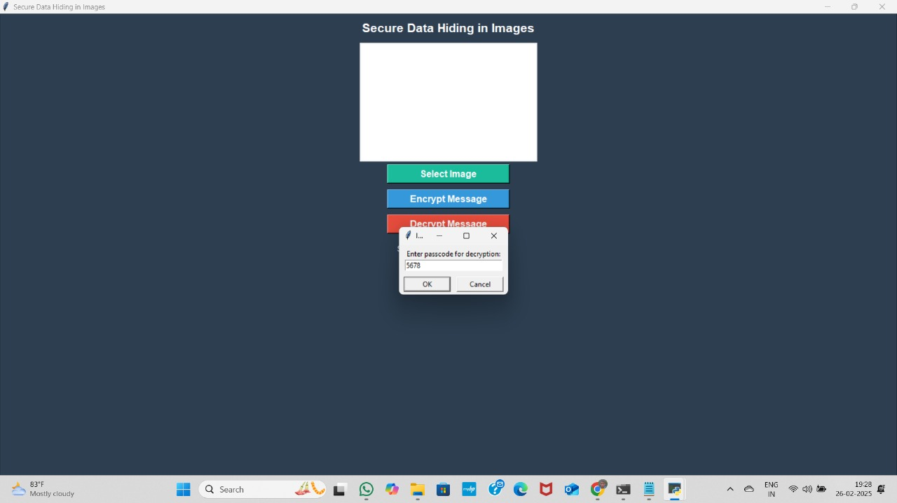

Slide 12
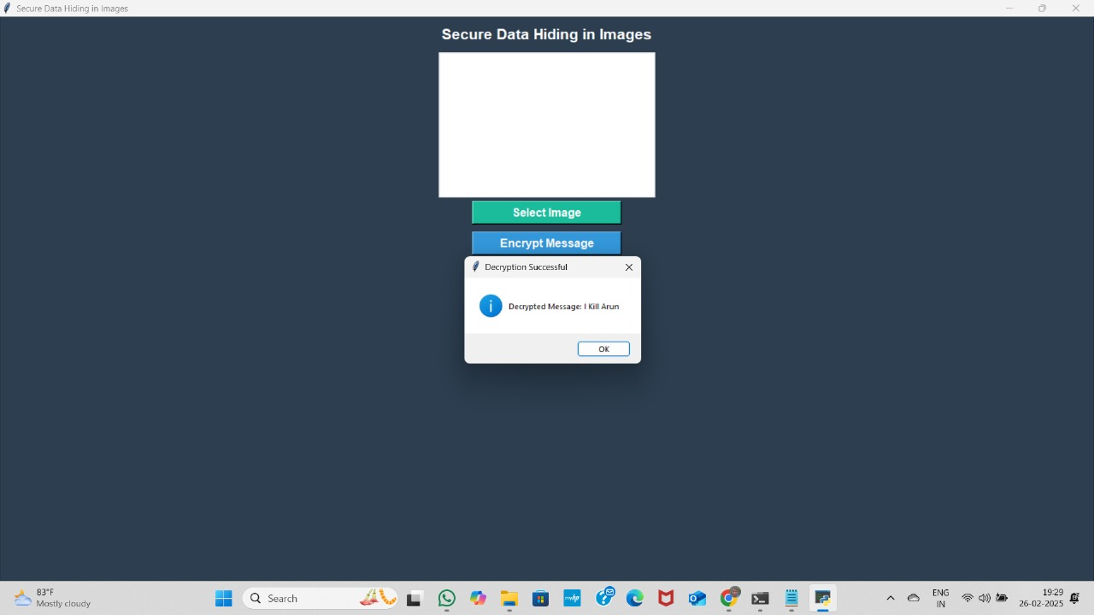

Slide 13
Conclusion
This project provides a secure and undetectable way to hide data within images using steganography.
It ensures confidentiality by requiring a password for encryption and decryption.
The Tkinter-based GUI makes the application user-friendly and accessible.
Useful for military, intelligence, corporate security, journalists, and finance to protect sensitive information.
Unlike traditional encryption, this method keeps messages hidden in plain sight, reducing suspicion.
This solution enhances cybersecurity, privacy, and secure communication across multiple industries.

Slide 14
GitHub Link
https://github.com/DuppallyArun/Stegnography.git

Slide 15
Future scope
Advanced Encryption – Integrating stronger encryption algorithms like AES or RSA can enhance security.
AI-Powered Steganography – Machine learning can optimize data hiding techniques for better efficiency and invisibility.
Multi-Format Support – Expanding beyond images to videos, audio, and PDFs for broader applications.
Cloud & Blockchain Integration – Securely store and retrieve hidden messages using cloud computing or blockchain technology.
Forensic & Cybersecurity Applications – Improving steganalysis methods to detect and prevent malicious data hiding.

Slide 16
THANK YOU

