Slide 1
Saving your Ass-ets through investment diversification
Matthew DupreE
Presented : 5/28/2021

Slide 2
Introduction
To re-think market sector separation using Natural Language Processing (NLP) of earnings call transcripts.
Project Goal:
To provide new sector separations based on company and investor priorities to new investors to assist them in market diversification.
Objectives:
2

Slide 3

Why Invest?
“In the long run, it’s not just how much money you make that will determine your future prosperity. It’s how much of that money you put to work by saving it and investing it.”
- Peter Lynch
3

Slide 4

Methodology
Preliminary Action
Scrape earnings call transcripts from seekingalpha.com
Scrape stock data from stockanalysis.com
Text cleaning
Sector Separation
Tf-idf Vecortizer
NMF
Investment recommendations
4

Slide 5
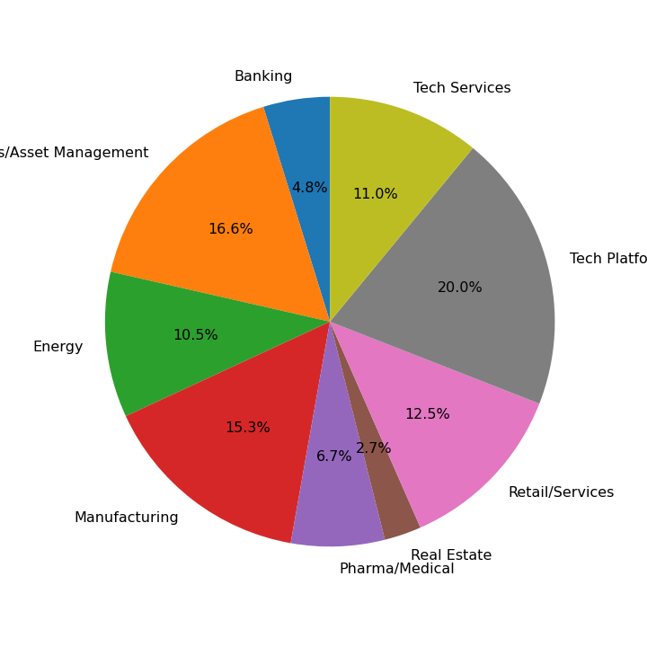


Sector Separation
9 Sectors:
Manufacturing
Pharma/Medical
Banking
Energy
Retail/Services
Real Estate
Tech Services
Business Services
Tech platforms/Entertainment
5

Slide 6
Sectors
Manufacturing
DuPont
Ford
Qualcomm
Pharma/Medical
J&J
Pfizer
AMD
Banking
JP Morgan
Bank of America
‘supply’
‘products’
‘orders’
‘patient’
‘treatment’
‘trial’
‘loan’
‘mortgage’
‘credit’
6

Slide 7
Sectors
Real Estate
American Campus Communities
American Tower Corp
Energy
Exxon
Tesla
Airlines
Retail/Services
TJ Max
Home Depot
UPS
‘tenant’
‘lease’
‘occupancy’
‘gas’
‘energy’
‘production’
‘store’
‘brand’
‘inventory’
7

Slide 8
Sectors
Tech Services
MSFT
IBM
Cisco
Business Services
Paypal
Visa
Charles Schwab
Entertainment/Tech
Apple/Google
Netflix
Gaming
‘cloud’
‘software’
‘security’
‘insurance’
‘client’
‘services’
‘content’
‘streaming’
‘advertising’
8

Slide 9
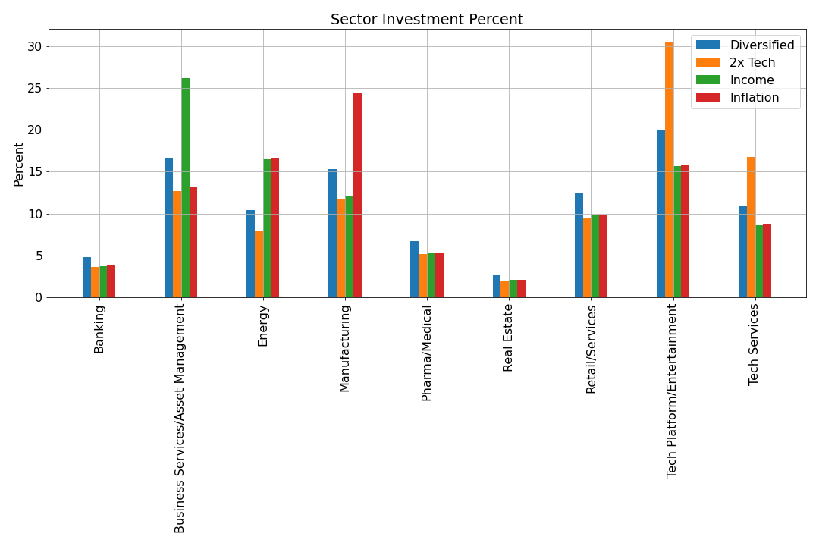
Investment Recommendations
Business Services
9

Slide 10
Future Work
Collect more transcripts per company
Compare sector clusters to real sectors
10

Slide 11
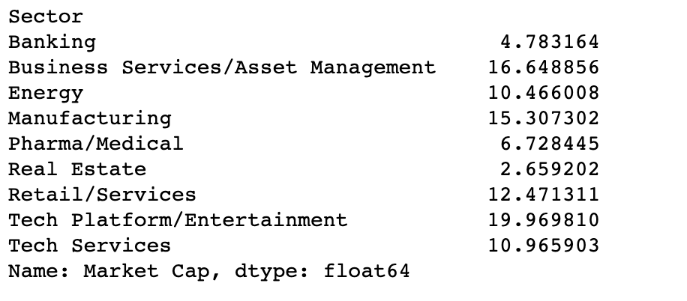
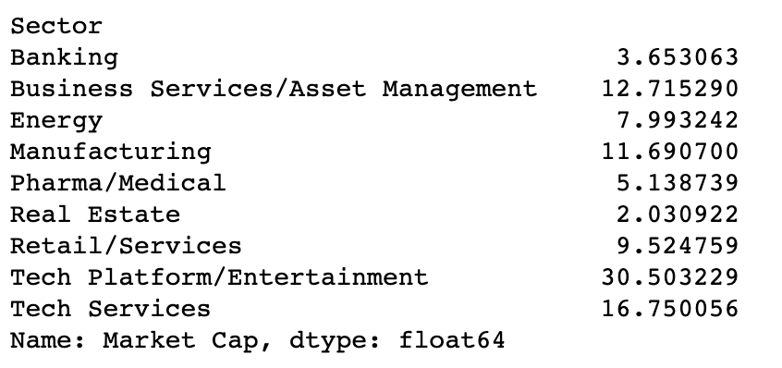
Sectors by Percentage
Diversified
2x Tech

Slide 12
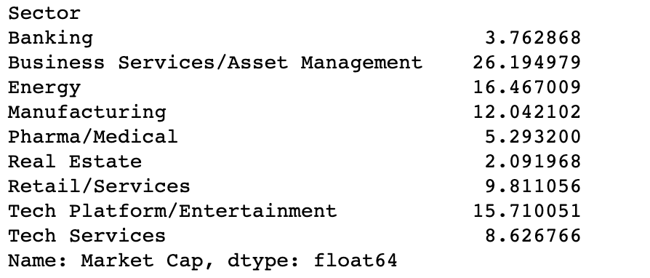
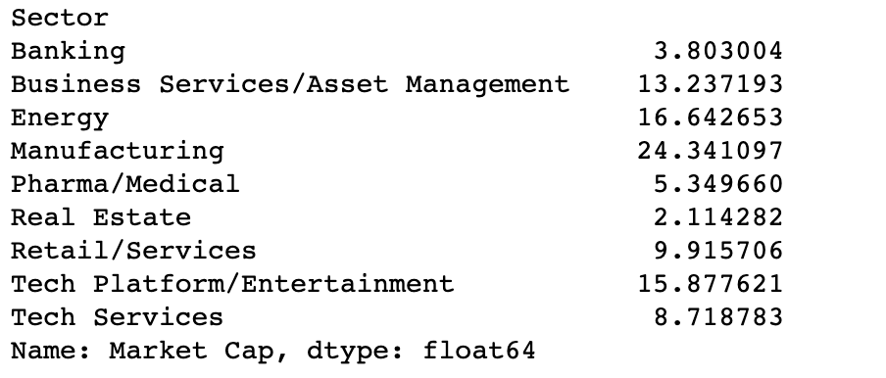
Sectors by Percentage
Income
Inflation

Slide 13
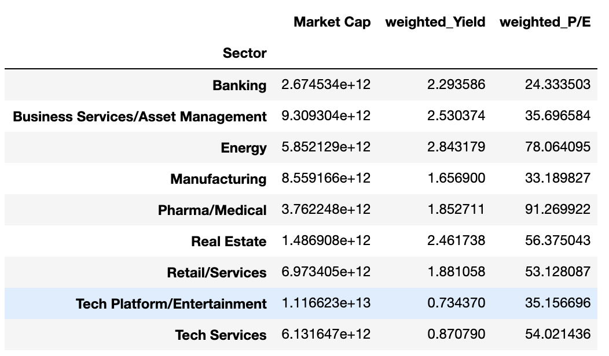
Diversified Yield and P/E

