Slide 1
Rock-Type Classification in Wells
Matthew DupreE
Presented : 5/14/2021

Slide 2
Introduction
To create a model that performs basic rock type classification with minimal user input on new wells.
Project Goal:
To provide a lithological model based on North Sea wells to petroleum geologists looking to perform a lithological investigation for free with minimal effort.
Objectives:
2

Slide 3


Methodology
Preliminary Action
Collect data from Equinor Volve Dataset
Lasio to read petroleum-specific files
EDA and cleaning data
Modeling
KNN, Random Forest, XGBoost
Lithology prediction visualizations
3

Slide 4
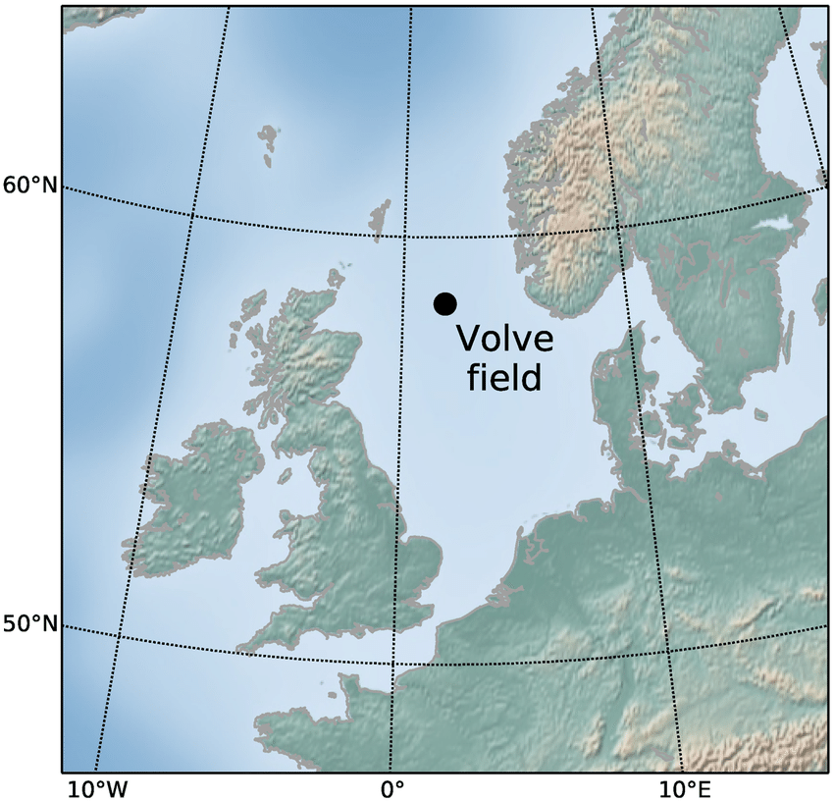
Data Source
Volve field:
Produced 2008-2016
~4 TB of data released
24 wells (3 of which are currently useable with all data present)
4

Slide 5
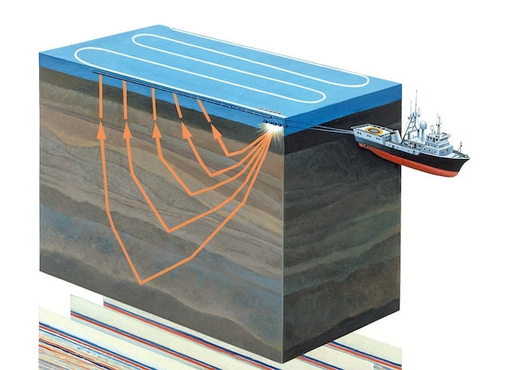
Data Acquisition
Seismic
Logging
5

Slide 6
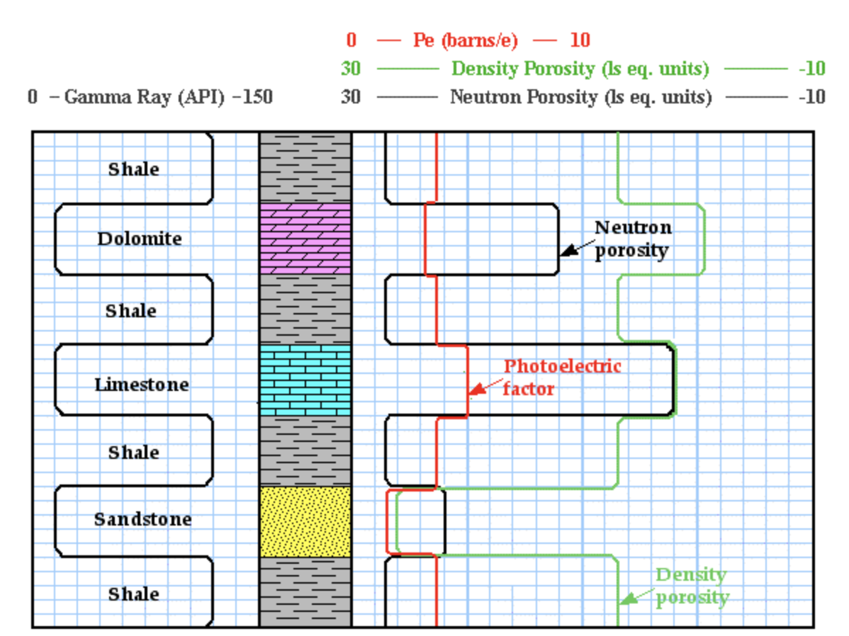
Data Summary
Logging Measurements
Gamma ray (GR): radioactive response
Neutron Porosity (NPHI): pore volume
Bulk Density (RHOB): rock density
Photoelectric (PEF): photo-electric absorption
Sonic Velocity (DT)
Rate of Penetration (ROP)
6

Slide 7
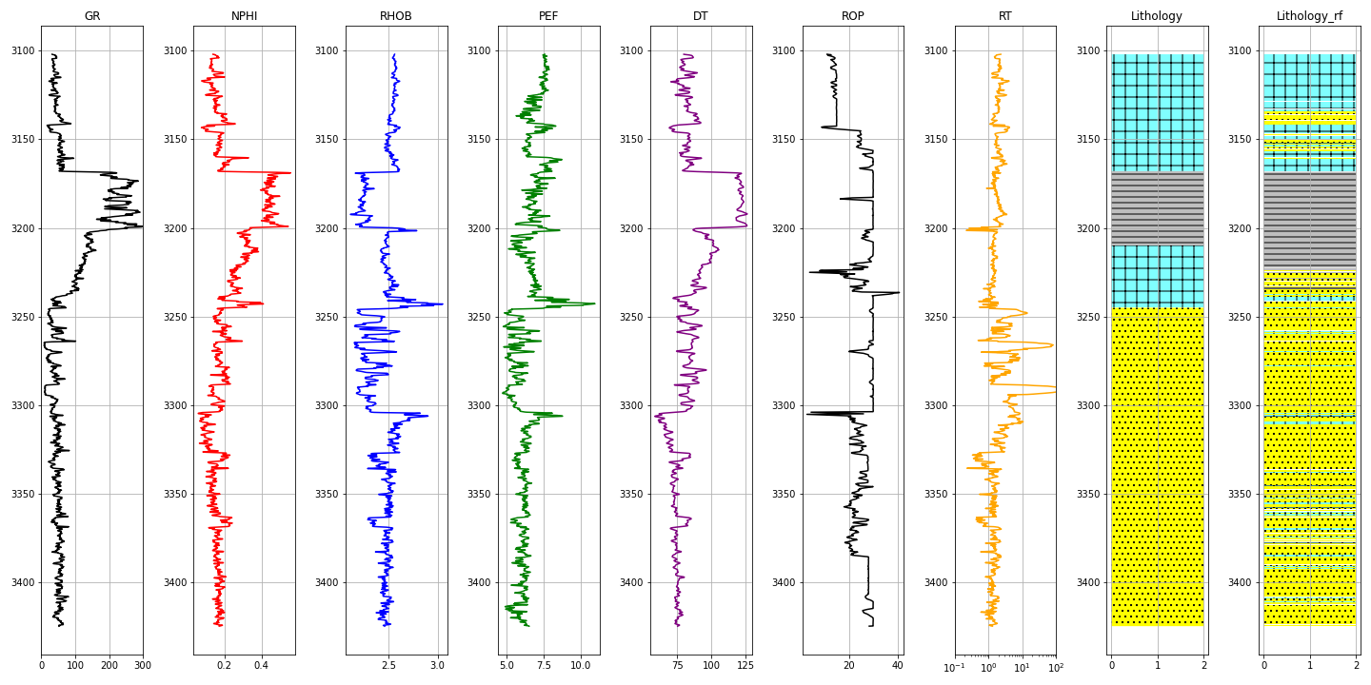
Data Investigation
Limestone
Shale
Depth, m
Sandstone
7

Slide 8
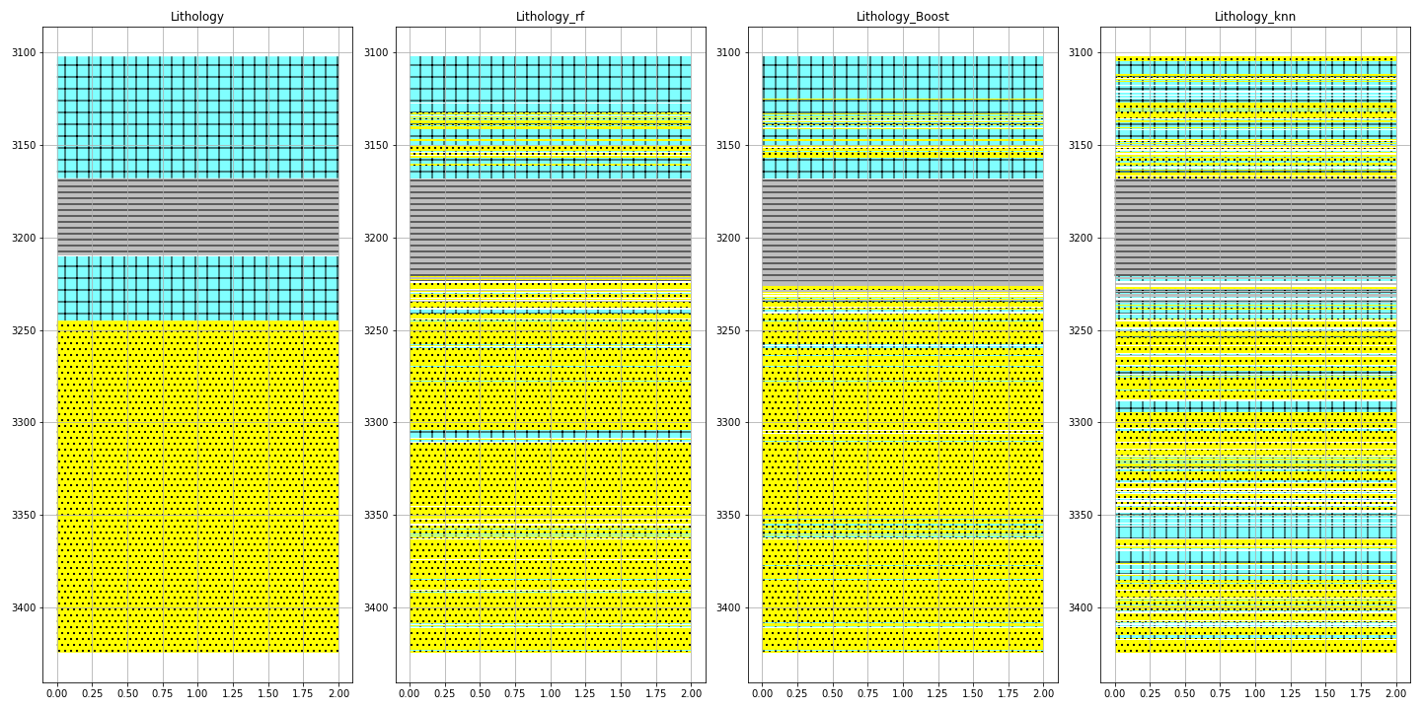
Model Predictions
True
Random Forest
XGBoost
KNN
Depth, m
8
F1 Score: 0.811
F1 Score: 0.825
F1 Score: 0.652

Slide 9
Future Work
Include other well file data such as .DLIS
Another model to classify fluid type
Expand the classification to include other lithologies
9

Slide 10
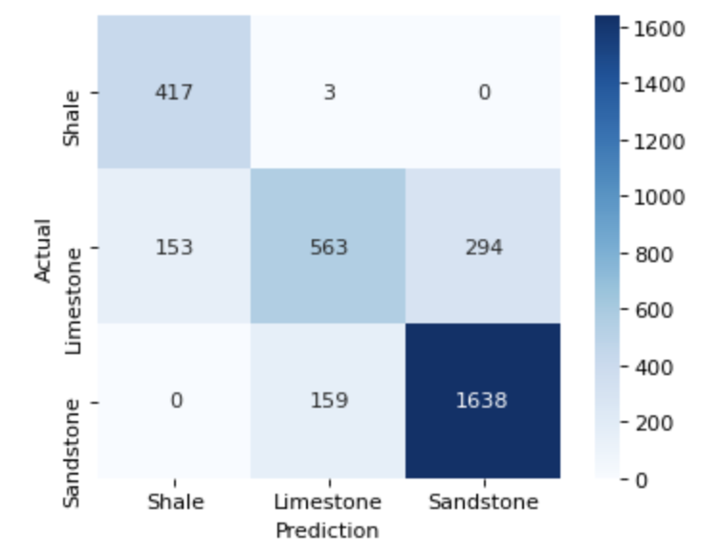
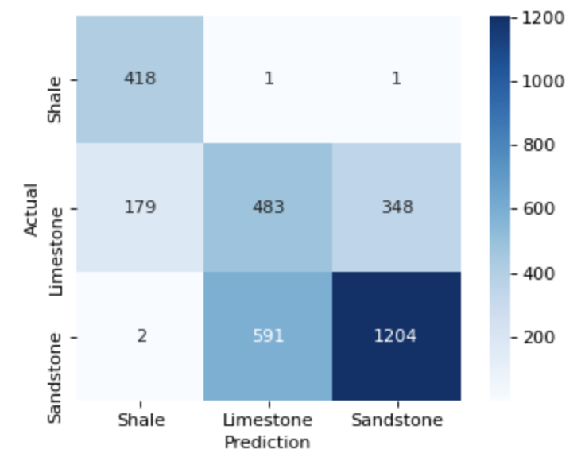
Confusion Matrices
Random Forest Test
KNN Test
10

Slide 11
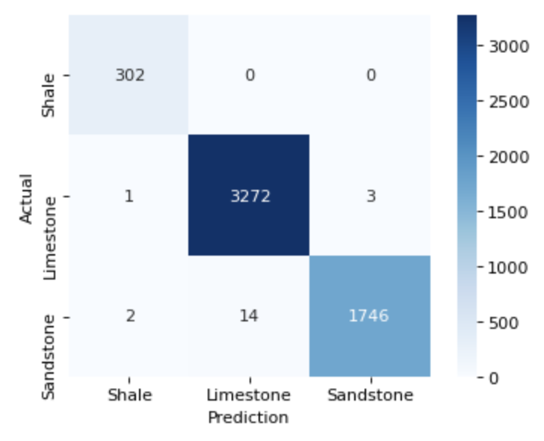
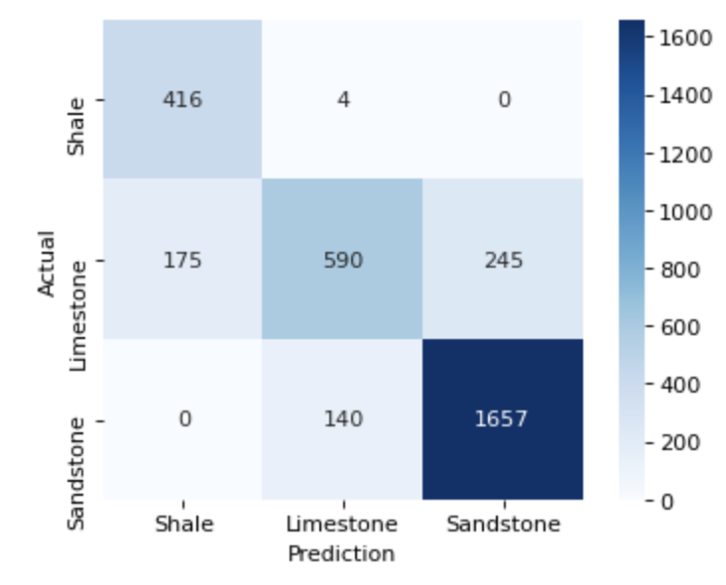
Confusion Matrices
XGBoost Validation
XGBoost Test
11

