Slide 1
Regression on Nonprofit Form 990 Tax-filings
Matthew DupreE
Presented : 4/16/2021

Slide 2
Introduction
To create and optimize a regression model to predict nonprofit executive team compensation in small to medium-sized nonprofits.
Project Goal:
To provide a model to small to medium-sized nonprofit organizations looking to determine salaries for their executive teams.
Objectives:

Slide 3
Methodology
Preliminary Action
Scrape data from Propublica.org
Clean data
Perform exploratory data analysis
Analysis
Linear regression
Polynomial regression
Lasso regression
Random Forest

Slide 4
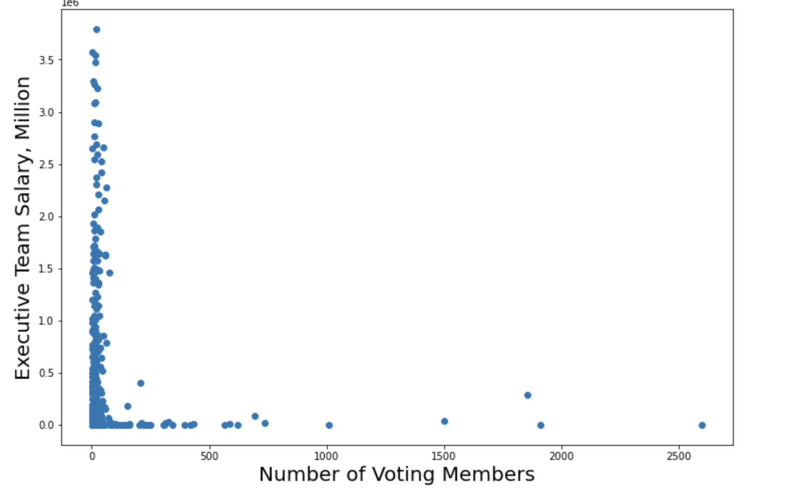
Cleaning the data
4

Slide 5
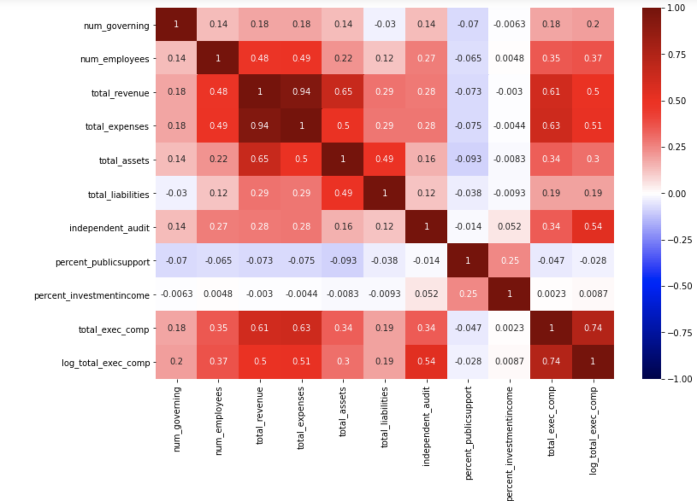
Key feature selection
Key Features:
Num employees
Total revenue
Total assets
Independent Audit

Slide 6
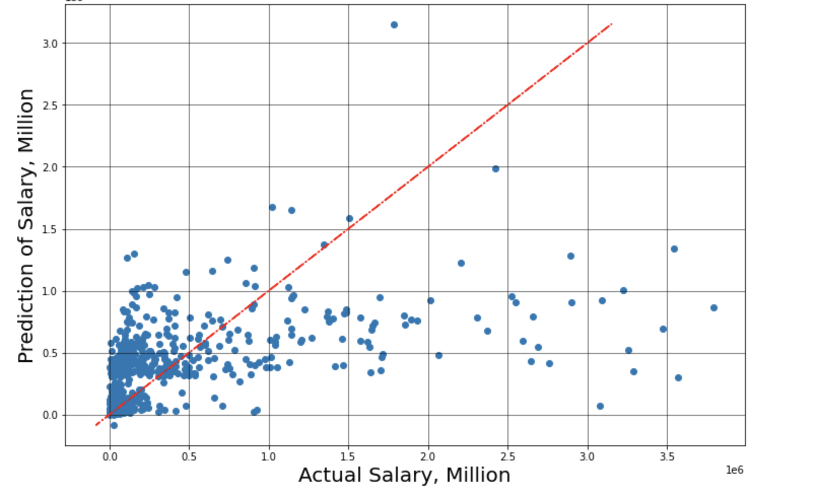
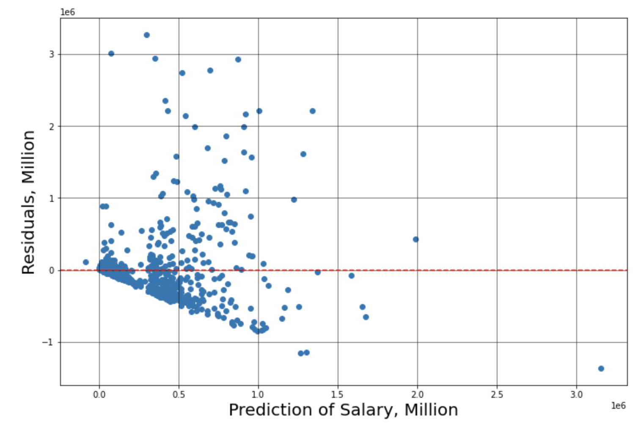
Baseline Model
Train R²: 0.40
Test R²: 0.39

Slide 7
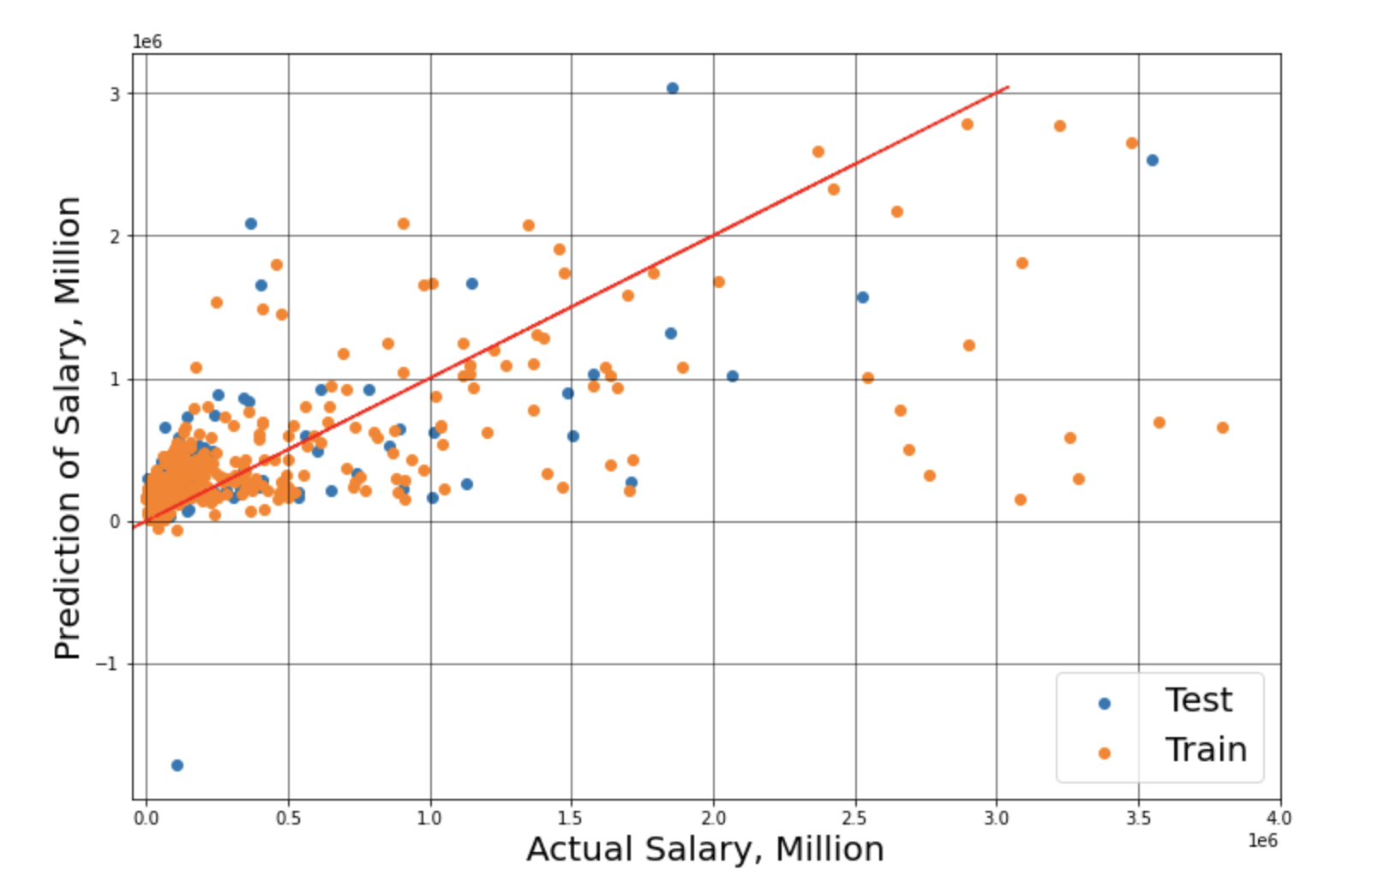
Polynomial Model
Train R²: 0.44
Test R²: 0.38
7

Slide 8
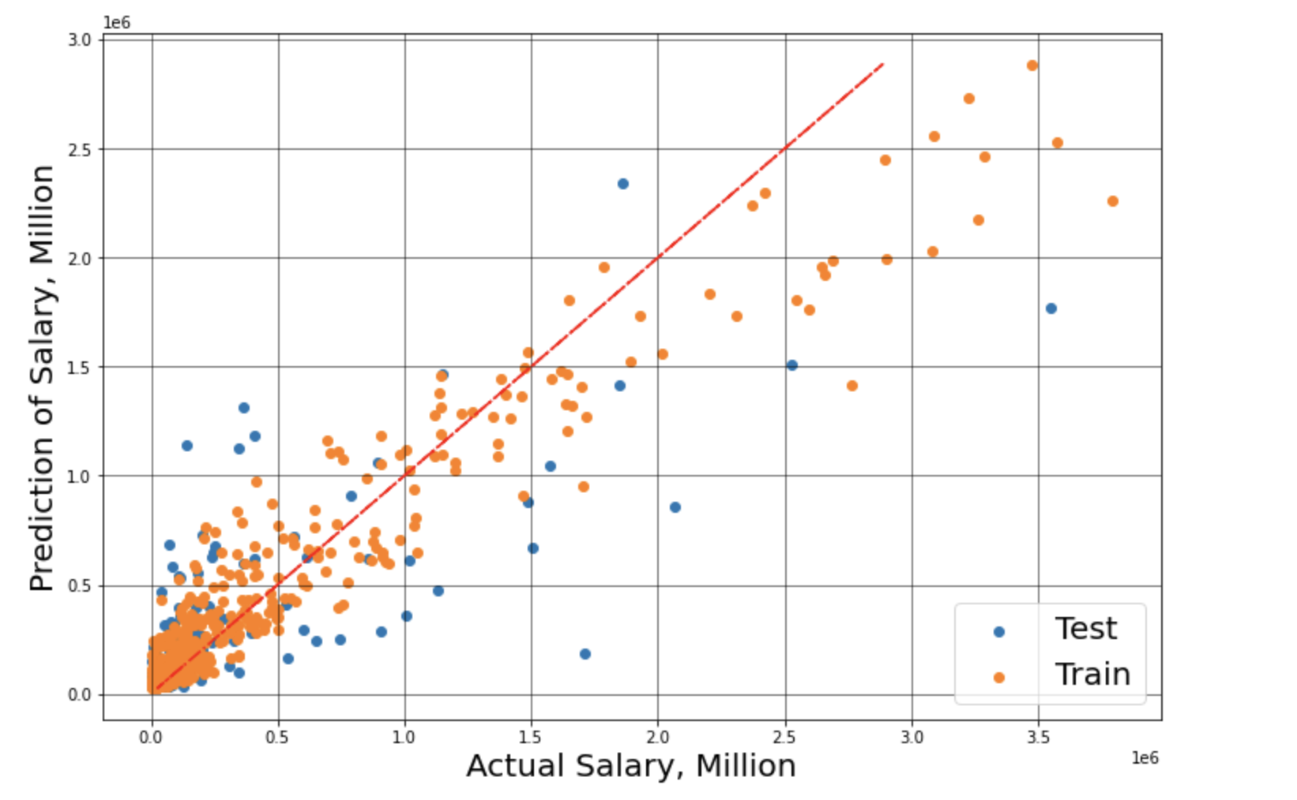
Random Forest
Train R²: 0.89
Test R²: 0.53
8

Slide 9
Results
Baseline -
Train R²: 0.40
Test R²: 0.39
Polynomial -
Train R²: 0.44
Test R²: 0.38
Random Forest -
Train R²: 0.89
Test R²: 0.53

Slide 10
Future Work
Collect more data points and exclude more extreme outliers
Refine random forest model
Preform regression on specific nonprofit types

