Slide 1
Alaska Oilfield pipeline application
Matthew DupreE
Presented : 4/30/2021

Slide 2
Introduction
To create a web application that performs basic oilfield investigation with minimal user input.
Project Goal:
To provide a data pipeline based on Alaskan public data to petroleum engineers and small companies looking to perform an oilfield investigation for free.
Objectives:
2

Slide 3


Methodology
Preliminary Action
Collect data from public Alaskan oilfield database
Use a SQL database
Clean data
Pipeline Outputs
Production: rates, cumulatives, ratios
Production: a setup for forecasting
Injection: rates, cumulatives
3

Slide 4
Pipeline Optimization
Importance:
~1.6 Million data points
~ 7,500 wells
Earliest wells from ~1920
Key Techniques:
SQL querying to minimize data imports
Lazy Evaluation
4

Slide 5
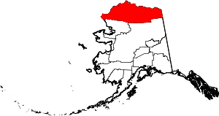
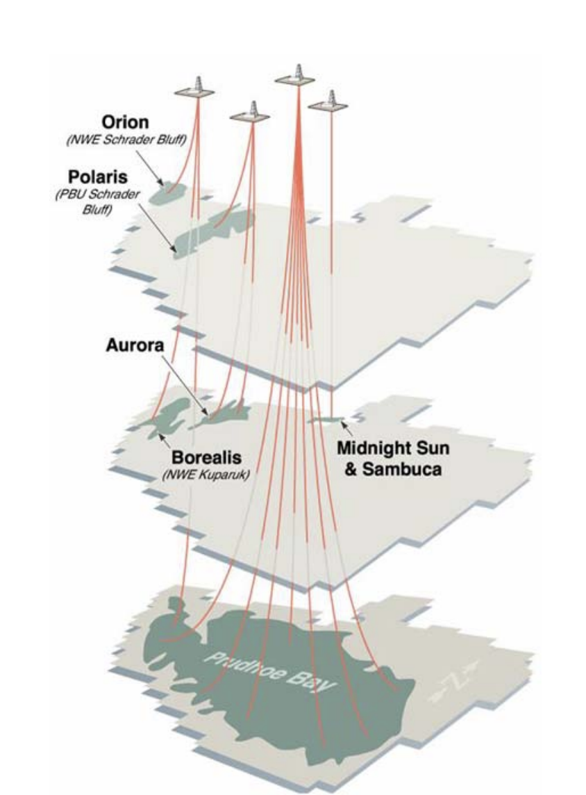
PRUDHOE BAY
Production start: ~1980
OIL: 13.5 billion STB
GAS: 110.8 trillion scf
Water: 14.2 billion STB
5

Slide 6
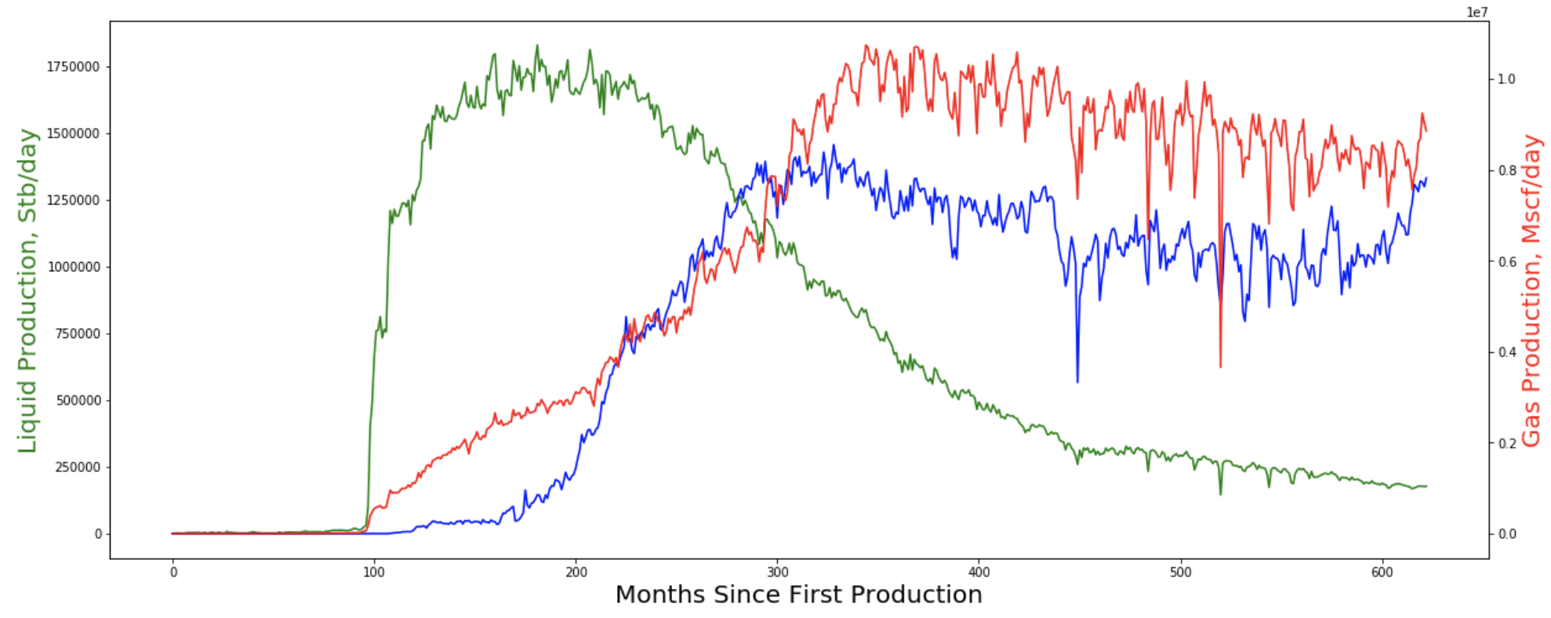
Production Rate
~ 17.5 MMSTB/day
OIL
GAS
WATER
~ 178 MSTB/day
6
OIL: 178 MSTB/day, GAS: 8.8 Bcf/day, WATER: 13.3 MMSTB/day

Slide 7
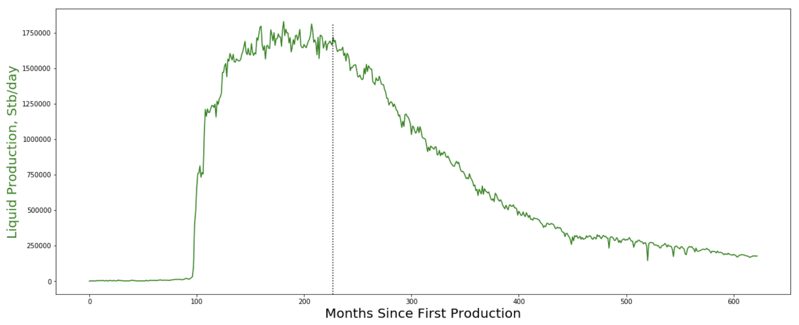
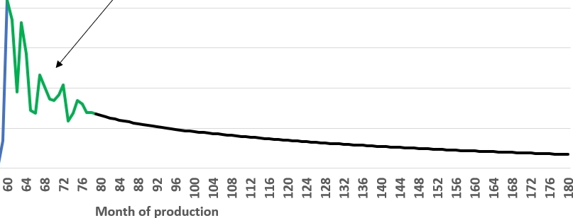
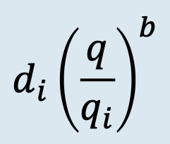
Decline Forecasting
Decline Equation
7

Slide 8
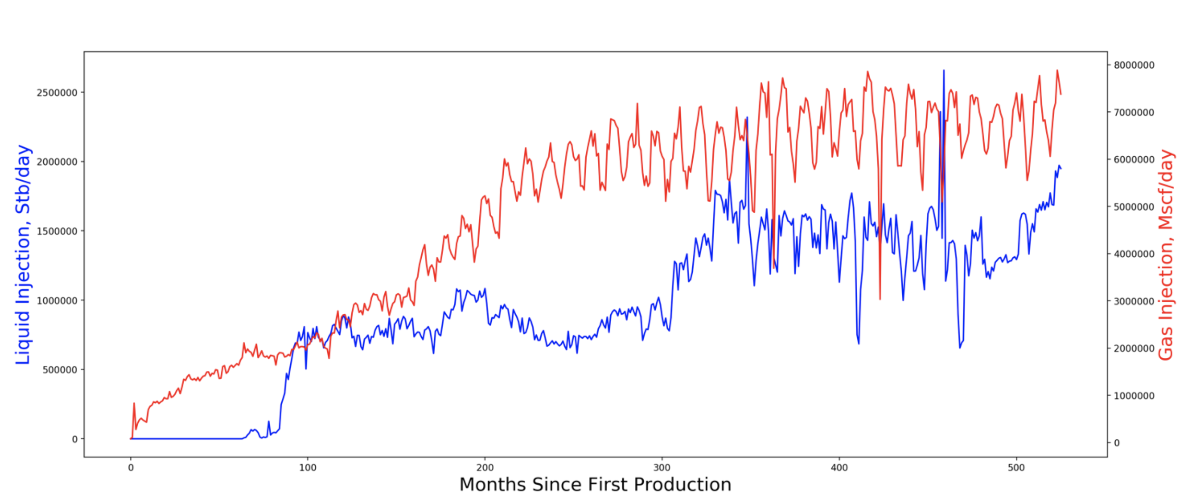
Injection Rate
OIL
GAS
WATER
8
GAS: 7.4 Bcf/day, LIQUIDS: 2 MMSTB/day

Slide 9
Streamlit APPLICATION
Click Here
9

Slide 10
Future Work
Finish decline forecast
Refine Streamlit user interaction
Auto-update SQL database
10

