Slide 1

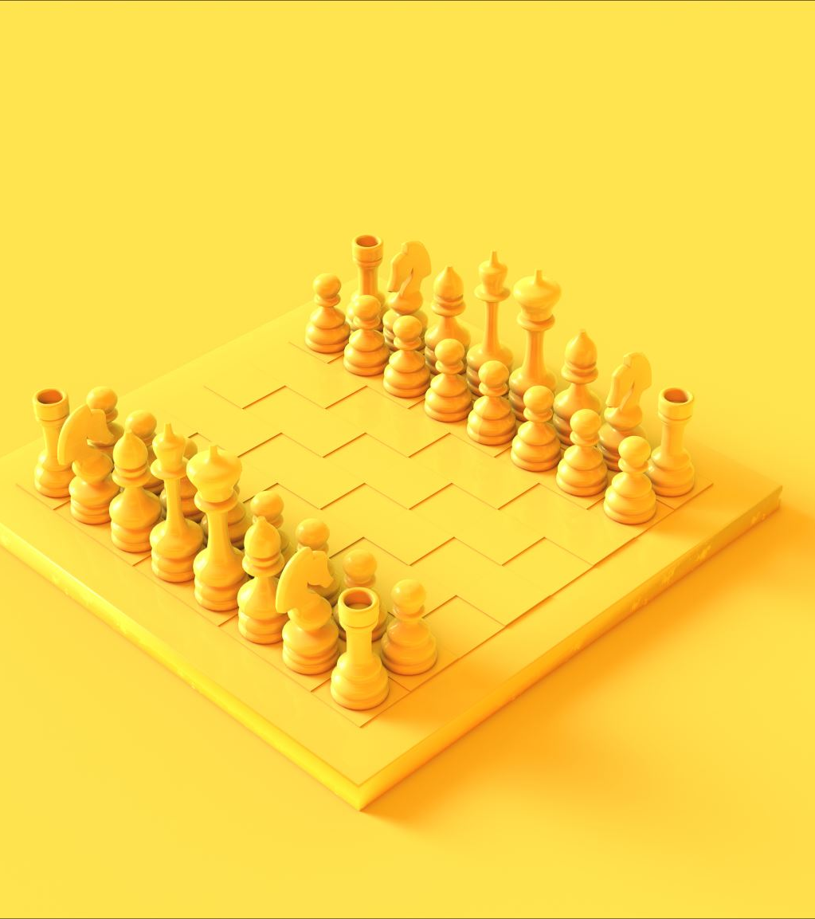
Java Chess Program with Minimax AI Using Graphical User Interface
Mariam swan
24/04/2025

Slide 2
Project goal: To develop a functional chess program in Java
Key Features:
Intelligent computer opponent using the minimax algorithm.
User-friendly graphical interface built with Java Swing.

Slide 3
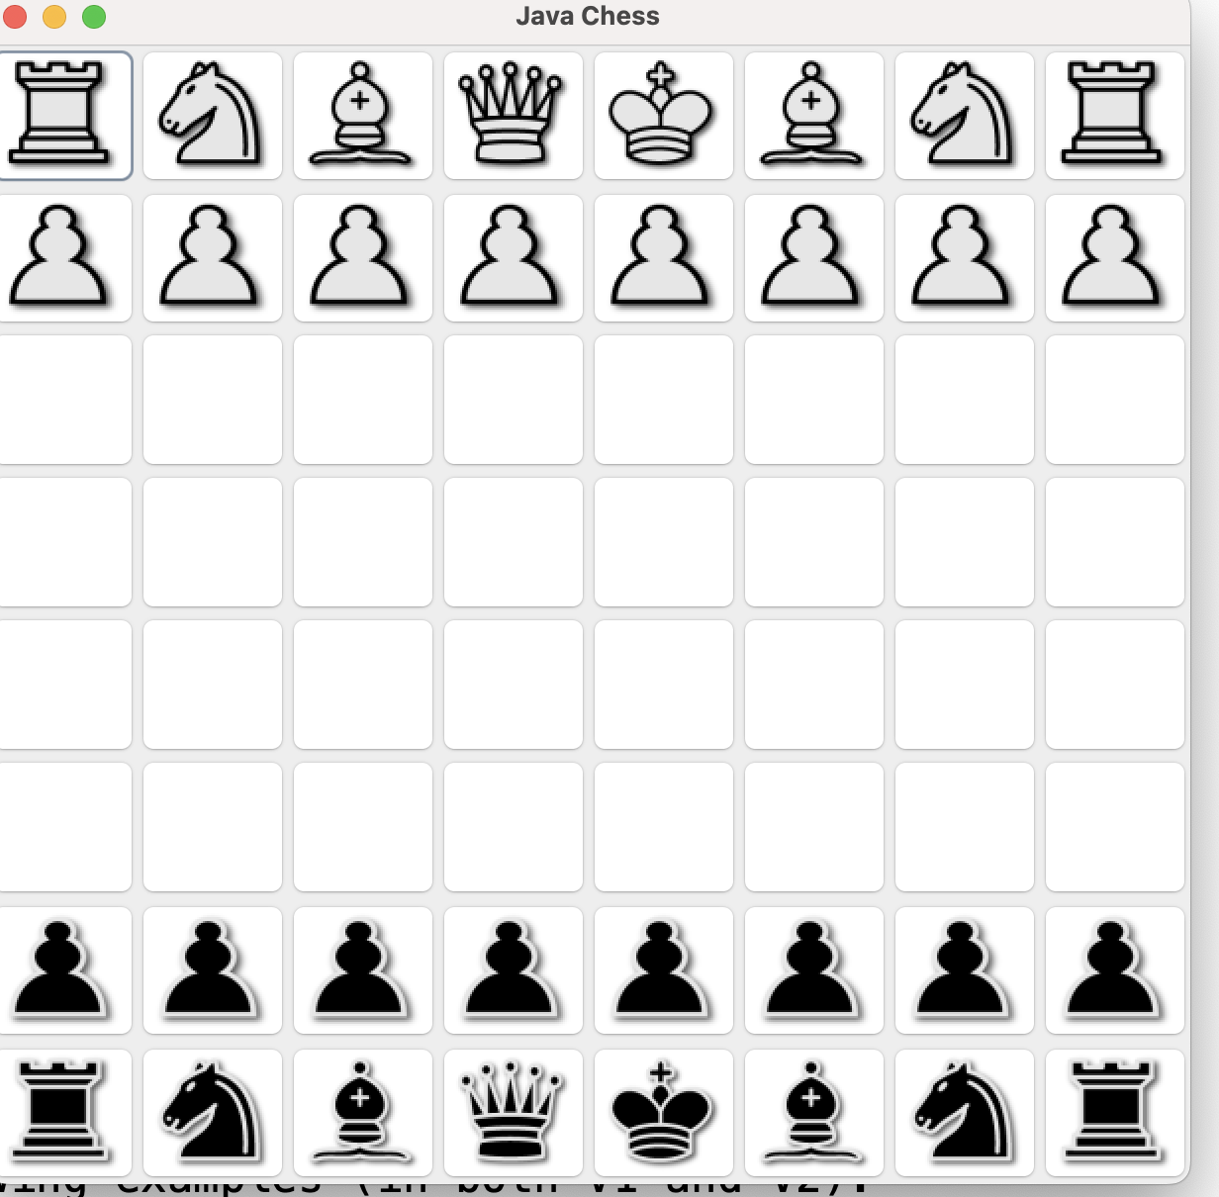
Overview of Chess Rules and Piece Movements
Chess is played on an 8x8 square grid known as a chessboard, with each of the two players controlling 16 pieces at the outset: one king, one queen, two rooks, two knights, two bishops, and eight pawns.

Slide 4
piece moves
King: Can move one square in any direction.
Queen: Capable of moving any number of squares along a row, column, or diagonal.
Rook: Travels any number of squares along a row or column.
Bishop: Diagonally moves over any number of squares.
Knight: Leaps in an 'L' shape, covering two squares in one direction and then one square perpendicular, or vice versa, able to jump over other pieces.
Pawn: Advances forward by one square (or two from its initial position), captures diagonally, and is subject to unique moves like 'en passant' and promotion.

Slide 5
System Architecture
Core Components:
ChessGUI (Graphical User Interface)
GameController (Manages game logic and AI interaction)
ChessAI (Implements the minimax algorithm)
ChessBoard (Represents the game board and state)
Piece Hierarchy (Defines chess pieces and their movements)
Move (Represents a single chess move)

Slide 6
Key Classes - ChessBoard
Represents the 8x8 chessboard using a 2D Piece[][] array.
Responsibilities:
Stores piece locations and types.
Tracks the current player's turn.
Initializes the board.
Retrieves pieces at specific locations.
Moves pieces.
Generates all possible legal moves.
Evaluates the current board state.
Provides a copy() method for AI exploration.

Slide 7
Key Classes - GameController
Intermediary: Connects ChessGUI and game logic.
Holds Instances of: ChessBoard and ChessAI.
Responsibilities:
Receives move requests from ChessGUI.
Validates moves against chess rules.
Updates the ChessBoard.
Switches turns between players.(not implemented yet)
Calls ChessAI to get the computer's move. (currently working on it)

Slide 8
Key Classes - ChessAI
Implements AI for Computer Player: Contains the minimax algorithm.
findBestMove() Method: Initiates the minimax search.
maximize(board, depth): Simulates AI's turn, recursively explores moves to maximize score.
minimize(board, depth): Simulates opponent's turn, recursively explores moves to minimize AI's score.
Search Depth: Determines how many moves ahead the AI considers.

Slide 9
Key Classes - ChessGUI)
Graphical User Interface: Built using Java Swing.
Components:
JFrame (main window)
JPanel with GridLayout (chessboard)
JButton for each square.
ImageIcon to display pieces (loaded from resources/images).
User Interaction: ActionListener handles clicks on squares.
Manages sourceSquare for move selection.
Updates board display using updateBoardUI().
Provides feedback for invalid moves (e.g., JOptionPane).

Slide 10
Algorithm Implementation - Move Generation
getPossibleMoves() Method: Implemented in each concrete Piece subclass.
Logic: Encodes the specific movement rules for each piece type.
Considers: Board state, boundaries, and potential captures.
Examples: Pawn's forward and diagonal moves, Rook's straight-line moves, and Knight's L-shaped moves

Slide 11
Challenges Encountered
Implementing Correct Piece Movement Rules: Especially for complex pieces like Pawn and Knight.
Integrating GUI with Game Logic: Ensuring user actions correctly translate to game state changes.
Resource Management: Correctly loading piece images (classpath issues).
Understanding and Debugging Minimax: Grasping the recursion and ensuring logical AI decisions.

Slide 12
Thank you!

