Slide 1
PHASE 3
DOVELOPMENT PHASE-1
NAME | DURAIARASU E
TEAM ID | 8940
TEAM NAME | Proj­_207146_Team_1
PROJECT NAME | 8301-Air Quality Analysis In Tamil Nadu
SUBMISSION DATE | 26-10-2023

Slide 2
ANALYTICS OBJECTIVES
Data Preprocessing:
1.Data Inspection
2.Data Cleaning
3.Data Transformation
4.Data Splitting
5.Data Normalization
6.Data Validation
7.Data Visualization
8.Data Collection

Slide 3
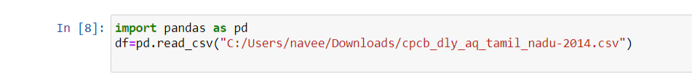
1.Loading Data :
Use pandas.read_csv() to load data
from a CSV file.
Use pandas.read_excel()
for Excel files.

Slide 4
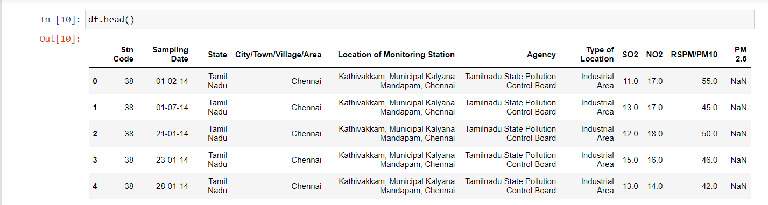
2. Exploring Data:
Use df.head() to view the first few rows of the dataset.

Slide 5
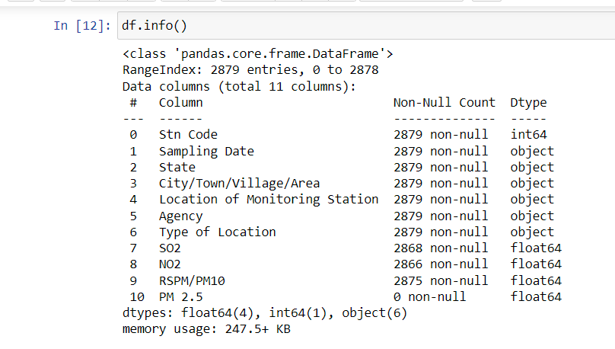
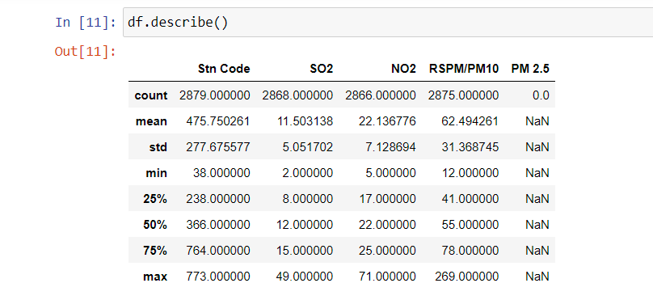
Use df.info() to get information about data types and missing values.
Use df.describe() for summary statistics.python

Slide 6
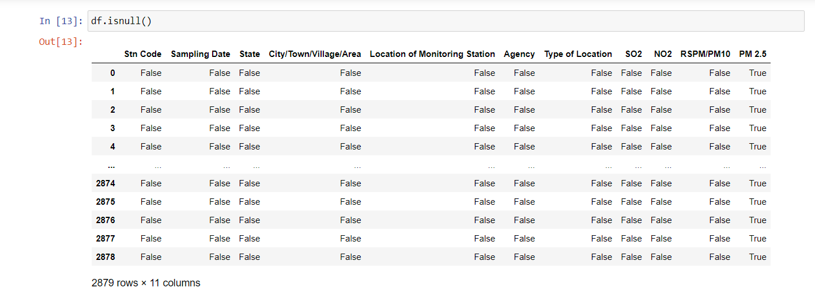
3.Handling Missing Values:
Use df.isnull() to identify missing values.
Use df.fillna() or df.dropna() to handle missing values.

Slide 7
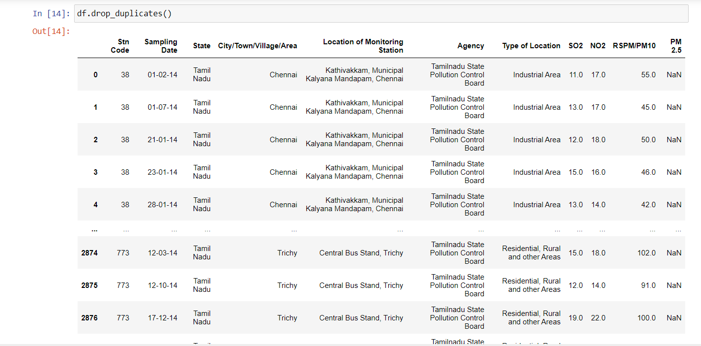
4.Data Cleaning:
Remove duplicate rows with df.drop_duplicates().
Rename columns using df.rename() if necessary.
Convert data types with df.astype().

Slide 8
5.Handling Outliers:
Detect and deal with outliers using statistical methods or visualization.
You can use techniques like zscores or IQR (Interquartile Range).

Slide 9
6.Saving Data:
Save the preprocessed data back to a file if
needed.

Slide 10
IBM COGNOS ANALYTICS

Slide 11
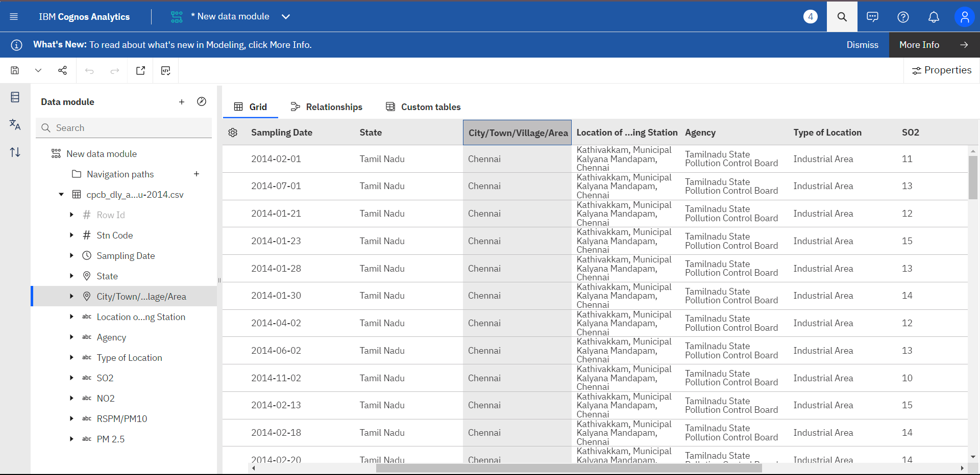
IN COGNOS – DATA LOADING

Slide 12
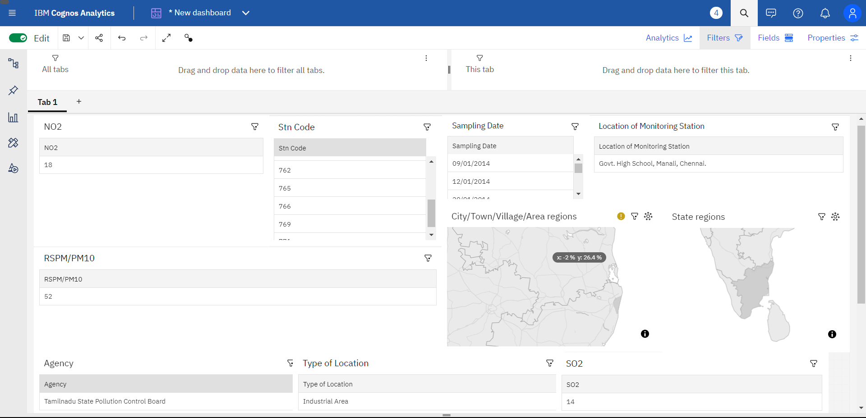
IN COGNOS – AIR QUALITY ANALYSIS DASHBOARD

Slide 13
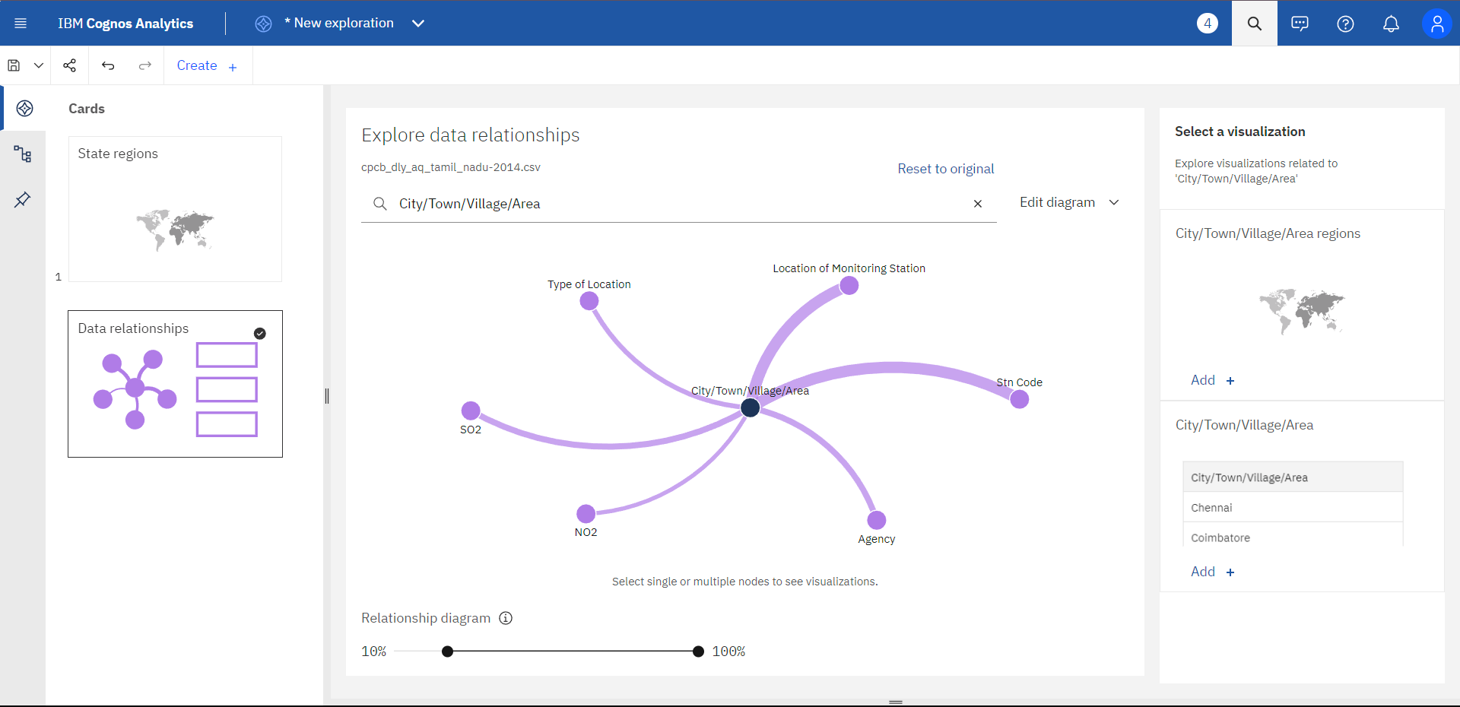
IN COGNOS – DATA RELATIONSHIP

Slide 14
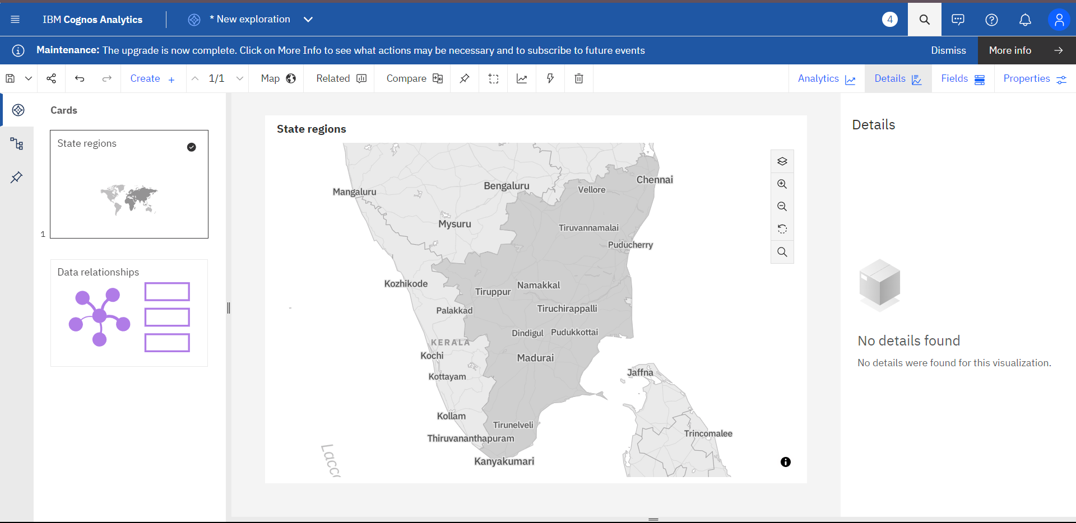
STATE REGIONS BY ANALYSIS

Slide 15
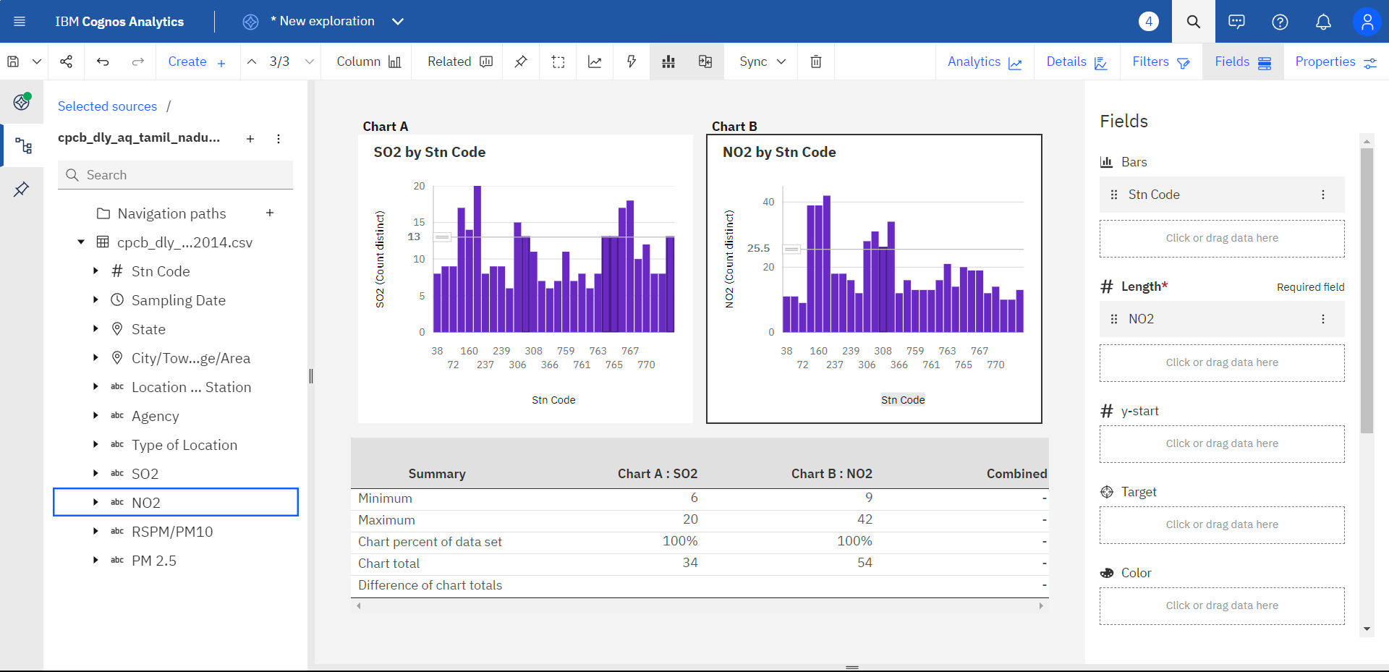
SO2 BBY STN CODE & NO2 BY STN CODE

Slide 16
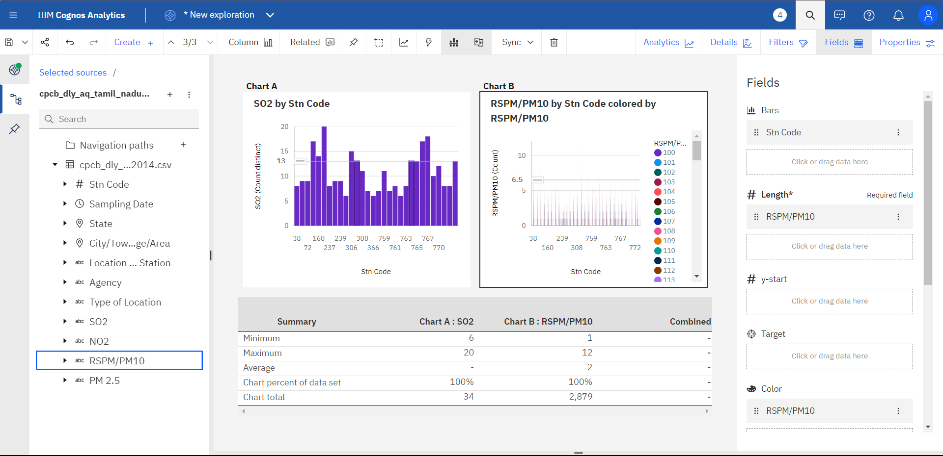
S02 BY STN CODE & RSPM/PM10 BY STN CODE

Slide 17
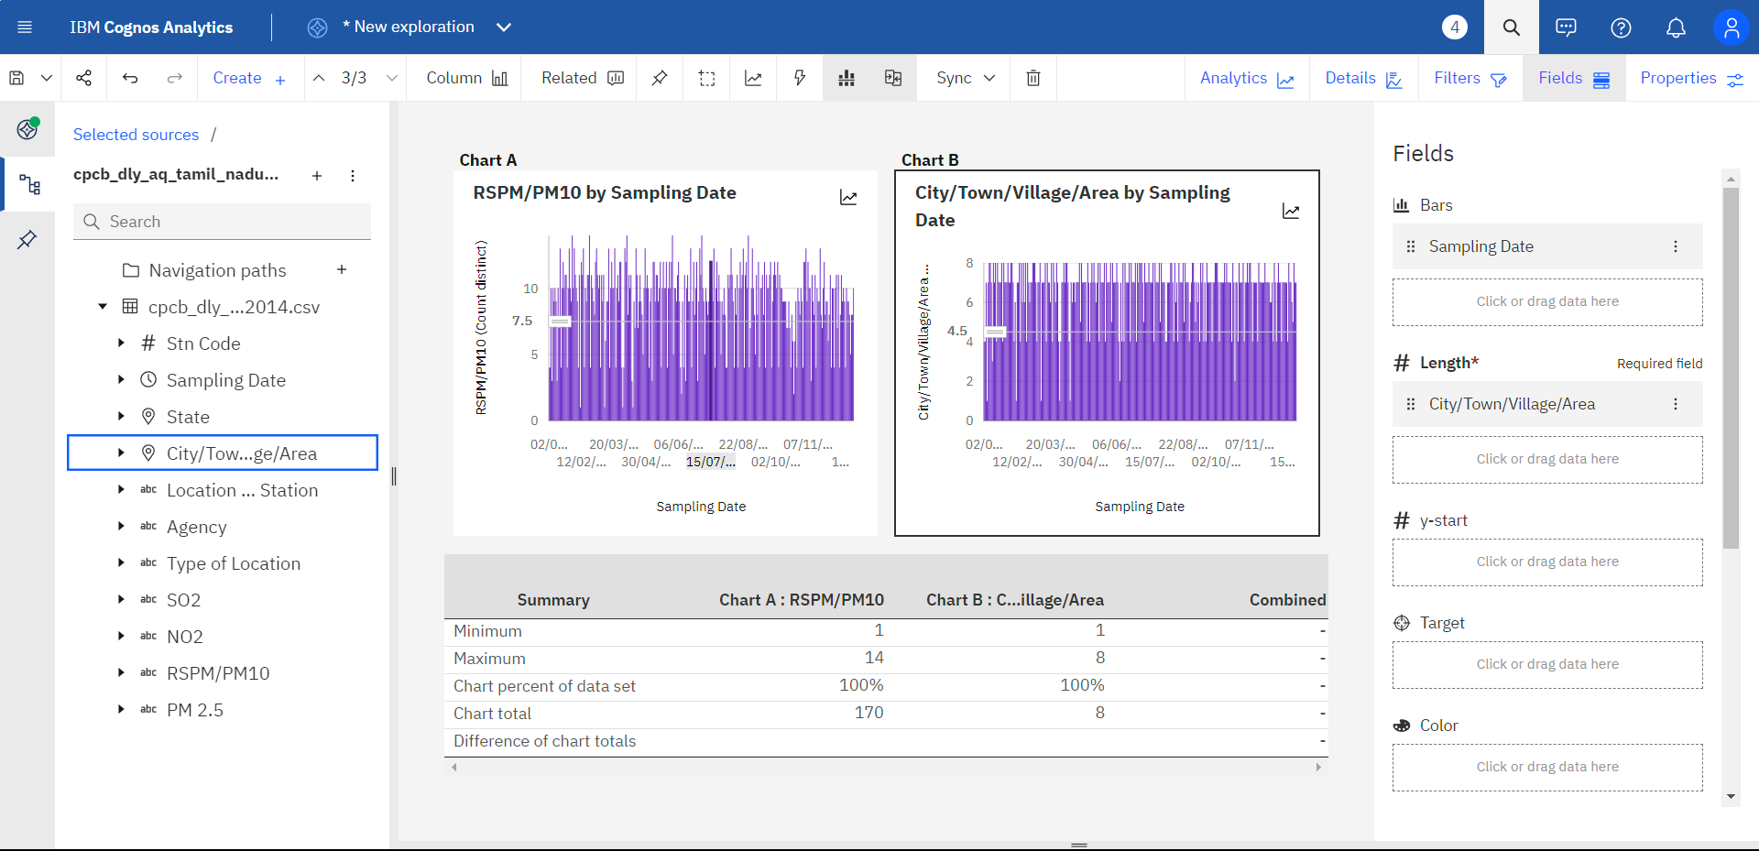
RSPM/PM10 BY SAMPLING DATE & CITY/TOWN/VILLAGE/AREA BY SAMPLING DATE

Slide 18
CONCLUSION
Data preprocessing is a crucial step in preparing data for analysis and machine learning. It involves collecting, inspecting, cleaning, transforming, and organizing data. The main steps include data collection, inspection, cleaning, transformation, splitting, normalization, and validation. It ensures data is ready for analysis and model training, improving the success of data-related projects.

