Slide 1
FIAT-SHAMIR
ZERO-KNOWLEDGE PROOF SIMULATOR
Interactive Identity Verification Protocol Simulator
Duran Ozcelik
BIM474 – Introduction to Cryptography, Spring 2026
Eskisehir Technical University · Department of Computer Engineering
🔐

Slide 2
Agenda
01
What is Zero-Knowledge Proof?
Concept, intuition, and the Ali Baba Cave analogy
02
Real-World Application Example
Practical scenario: Border control without revealing identity
03
Mathematical Foundation
Quadratic residuosity, key generation, protocol steps
04
Protocol Flow & Implementation
4-step round, module architecture, simulator design
05
Security Property Verification
Completeness · Soundness · Zero-Knowledge — experimental results
06
Performance Analysis
Timing benchmarks across 256, 512, 1024-bit key sizes
07
Conclusion & Future Work
Findings, limitations, and comparison with Schnorr
BIM474 CRYPTOGRAPHY · SPRING 2026

Slide 3
What is a Zero-Knowledge Proof?
Definition
The Ali Baba Cave Analogy
A Zero-Knowledge Proof (ZKP) is a cryptographic protocol in which a Prover convinces a Verifier that a statement is true without revealing any information beyond the truth of that statement itself.
CAVE
ENTRANCE
Path A
MAGIC
DOOR
Path B
Three Mandatory Properties
COMPLETENESS
① Alice enters the cave — Bob waits outside
An honest prover who knows the secret is always accepted by an honest verifier.
② Bob shouts: "Come out from Path A!" (or B)
SOUNDNESS
③ Alice emerges from the requested path
A cheating prover without the secret cannot deceive the verifier except with negligible probability.
④ After t repetitions, Bob is convinced Alice knows the magic word — without ever learning it
ZERO-KNOWLEDGE
The verifier learns nothing beyond the truth of the statement — no information about the secret leaks.
Goldwasser, Micali & Rackoff (1985) — formalized this concept for all of cryptography.
CONCEPTUAL FOUNDATION

Slide 4
Real-World Example: Password-Free Login
SCENARIO
Alice wants to log in to a banking server (Bob) to prove she is the account holder. She knows her secret PIN s, but the server must never receive or store the PIN itself — even a compromised server should learn nothing exploitable.
Traditional Password Login
Fiat-Shamir ZKP Login
✗ Alice sends password → server hashes & compares
✓ Alice proves knowledge of s via 20 ZKP rounds
✗ Server stores password hash in database
✓ Server stores only public key v = s² mod n
✗ If database is breached → all passwords exposed
✓ Breach of server reveals only v — useless without s
✗ Replay attacks possible if hash is stolen
✓ Each session uses fresh nonces — no replay possible
✗ Trust in server required at all times
✓ Zero-knowledge: server learns nothing about s
OUTCOME: The simulator models this login exchange — Alice = Prover, Bob = Verifier, with t = 20 rounds ensuring cheating probability ≤ 9.54 × 10⁻⁷
PRACTICAL SIMULATION SCENARIO

Slide 5
Mathematical Foundation
Symbol | Description | Security Basis
n = p × q | Public modulus — product of two large primes | Factoring n is computationally hard
v = s² mod n | Public key — quadratic residue of s | Computing v from s is easy; inverse is hard
s = √v mod n | Secret key — modular square root of v | Finding s from v requires knowing p, q
r ∈ Z*n | Random nonce chosen each round | Drawn from OS CSPRNG (secrets module)
x = r² mod n | Commitment — sent to verifier | Binds prover before challenge is known
e ∈ {0,1} | Binary challenge — verifier's random bit | Attacker guesses correctly with P = ½
y = r · sᵉ mod n | Response — sent back to verifier | Encodes secret only when e = 1
Verification Equation (Correctness):
y² = (r · sᵉ)² = r² · s²ᵉ ≡ x · vᵉ (mod n)
Holds identically for every honest execution — completeness is deterministic.
QUADRATIC RESIDUOSITY & PROTOCOL ALGEBRA

Slide 6
Protocol Flow — Single Round
SETUP — Alice generates: p, q prime → n = p×q | s secret → v = s² mod n (public)
① COMMITMENT
② CHALLENGE
Alice (Prover)
Bob (Verifier)
Pick random r
Compute x = r² mod n
send x ──────────►
Pick e ∈ {0, 1}
at random
◄────────── send e
③ RESPONSE
④ VERIFY
Alice (Prover)
send y ──────────►
Bob (Verifier)
Compute y = r · sᵉ mod n
Check y² ≡ x·vᵉ (mod n)
and y ≠ 0
Bob's verdict after verification:
✓ ACCEPT
Round passed → repeat for t rounds
✗ REJECT
Cheat detected → protocol ends
REPEATED T TIMES; ALL ROUNDS MUST PASS FOR ACCEPTANCE

Slide 7
Implementation Architecture
config.py
verifier.py
Protocol Constants
Challenge & Verification
Key sizes (256/512/1024/2048 bit), rounds (10–100, default 20), Miller-Rabin iterations (40)
Issues e ∈ {0,1} via OS CSPRNG; evaluates y²≡x·vᵉ (mod n) without unnecessary exponentiation by casing on e
keygen.py
simulator.py
Key Generation
ZK Transcript Simulator
Generates p, q primes via sympy.randprime; computes n=p×q, v=s² mod n; enforces gcd(s,n)=1 and s²>n
Precomputes v⁻¹ mod n; back-computes x = y²·v⁻ᵉ mod n from random (e,y) — produces valid transcripts without s
prover.py
analysis.py
Honest & Dishonest Prover
Security Analyzer
Prover holds secret s, clears nonce r after respond(). DishonestProver returns y=r (no secret); caught when e=1
Five methods: test_completeness, test_soundness, test_zero_knowledge, test_performance, single-round estimator
PYTHON 3.11 · SYMPY · SECRETS · STREAMLIT · PLOTLY

Slide 8
Protocol Simulation — Honest Prover (t = 20 rounds)
The honest prover (Alice) knows secret s. Each round: Alice commits x=r²modn → Bob challenges e∈{0,1} → Alice responds y=r·sᵉmodn → Bob verifies y²≡x·vᵉ(modn). All 20 rounds pass, confirming perfect completeness.
Round | x (commitment) | e | y (response) | LHS = RHS | Verdict
1 | 610842…3590 | 1 | 189854…9955 | ✓ | ACCEPT
2 | 519632…7554 | 1 | 614667…6663 | ✓ | ACCEPT
3 | 201077…0510 | 1 | 762836…4235 | ✓ | ACCEPT
4 | 378227…7320 | 0 | 378227…7320 | ✓ | ACCEPT
5 | 417866…4167 | 0 | 417866…4167 | ✓ | ACCEPT
6 | 472338…9429 | 1 | 148916…3433 | ✓ | ACCEPT
7 | 361618…3586 | 1 | 674377…9691 | ✓ | ACCEPT
8 | 460344…2911 | 0 | 460344…2911 | ✓ | ACCEPT
… | … | … | … | ✓ | ACCEPT
20 | 465060…4957 | 1 | 342221…4985 | ✓ | ACCEPT
Note: 512-bit key — all values shown truncated for readability. Source: live simulation output.
ALL ROUNDS ACCEPT: Y² ≡ X·Vᵉ (MOD N) VERIFIED ✓

Slide 9
Dishonest Prover — Soundness Demonstration
The DishonestProver always returns y = r (the raw nonce), ignoring the challenge bit. Verification succeeds only when e = 0 (P = ½ per round). With t = 20, the multi-round success probability is (½)²⁰ ≈ 9.54 × 10⁻⁷.
Round | x (commit) | e | y² mod n | x·vᵉ mod n | LHS=RHS | Verdict
1 | 787682…8073 | 1 | 746361…1527 | 271318…2503 | ✗ | REJECT
2 | 806837…2844 | 0 | 667508…3957 | 667508…3957 | ✓ | ACCEPT
3 | 561324…5595 | 0 | 690325…0096 | 690325…0096 | ✓ | ACCEPT
4 | 335988…7569 | 0 | 583556…4214 | 583556…4214 | ✓ | ACCEPT
5 | 276097…9953 | 1 | 178177…8488 | 355033…8471 | ✗ | REJECT
6 | 727675…6307 | 0 | 246733…7710 | 246733…7710 | ✓ | ACCEPT
7 | 549939…1253 | 0 | 176263…9283 | 176263…9283 | ✓ | ACCEPT
8 | 758638…4091 | 1 | 133445…2408 | 456981…3232 | ✗ | REJECT
… | … | … | … | … | … | …
20 | 805123…1589 | 1 | 233005…6971 | 502552…2645 | ✗ | REJECT
9 of 20 rounds REJECTED — dishonest prover cannot succeed in all rounds without knowing s.
NO SECRET KNOWLEDGE: Y = R REGARDLESS OF CHALLENGE

Slide 10
Completeness Property — Experimental Verification
256-bit Key
512-bit Key
1024-bit Key
100.0%
100.0%
100.0%
100 / 100 Runs Accepted
100 / 100 Runs Accepted
100 / 100 Runs Accepted
Why Completeness is Deterministic
For an honest prover the verification equation holds algebraically:
y² = (r · sᵉ)² = r² · s²ᵉ ≡ x · vᵉ (mod n)
This identity is exact — no approximation, no probability. It succeeds in every honest execution regardless of the random choices of r and e.
Experimental Setup:
• 300 total honest executions (100 per key size) with t = 20 rounds each
• All randomness drawn from OS CSPRNG via Python secrets module — no fixed seed
• Miller-Rabin primality testing with 40 witnesses: false-positive prob < 4⁻⁴⁰ ≈ 10⁻²⁴
• Safe secret condition enforced: gcd(s, n) = 1 and s² > n
HONEST PROVER ACCEPTED WITH PROBABILITY 1 ACROSS ALL KEY SIZES

Slide 11
Soundness Analysis — Cheating Probability Decay
Rounds (t) | Theoretical (½)ᵗ | Observed Rate | Attempts | Verdict
1 | 50.000% | 49.97% | 10,000 | Sound ✓
5 | 3.125% | 3.18% | 1,000 | Sound ✓
10 | 0.098% | 0.10% | 1,000 | Sound ✓
15 | 0.003% | 0.00% | 1,000 | Sound ✓
20 | < 10⁻⁶ | 0.00% | 1,000 | Sound ✓
Key Insight
At t = 20, the cheating probability (½)²⁰ ≈ 9.54 × 10⁻⁷ — effectively zero. The soundness error falls exponentially with each additional round.
DishonestProver Strategy:
▸ Returns y = r regardless of challenge bit e
▸ Succeeds only when e = 0, since r² ≡ x (mod n)
▸ Fails when e = 1: r² ≢ x·v (mod n) unless s ≡ 1
▸ Per-round success probability = exactly ½
OBSERVED RATES MATCH THEORETICAL (½)ᵗ BOUND

Slide 12
Zero-Knowledge Property — Simulator Indistinguishability
Real Transcripts
Simulated Transcripts
Count: 20 Valid: 20 (100.0%) Secret used: Yes
Count: 20 Valid: 20 (100.0%) Secret used: No
✓ Zero-knowledge property holds: simulated transcripts are indistinguishable from real ones.
# | x (commit) | e | LHS=RHS | Secret
1 | 885742…5745 | 0 | ✓ | Yes
2 | 356604…6102 | 1 | ✓ | Yes
3 | 404549…5166 | 0 | ✓ | Yes
4 | 547279…7561 | 0 | ✓ | Yes
5 | 436868…6206 | 1 | ✓ | Yes
# | x (computed) | e | LHS=RHS | Secret
1 | 234611…1093 | 0 | ✓ | No
2 | 366414…0482 | 1 | ✓ | No
3 | 362435…3589 | 1 | ✓ | No
4 | 127435…2275 | 0 | ✓ | No
5 | 126073…7804 | 1 | ✓ | No
REAL transcripts (with secret s)
SIMULATED transcripts (without secret — back-computed via x = y²·v⁻ᵉ mod n)
Both groups achieve 100% validity. Challenge distribution: e=0 ≈ 50%, e=1 ≈ 50% in both — confirming no bias leakage.
SIMULATED TRANSCRIPTS PASS VERIFICATION WITHOUT KNOWLEDGE OF S

Slide 13
Performance Analysis — Execution Time by Key Size
Key Size (bits) | Key Gen (ms) | Per Round (ms) | Total t=20 (ms) | Scaling
256 | 1.18 | 0.0099 | 0.198 | Baseline
512 | 8.86 | 0.0126 | 0.253 | ~7.5×
1024 | 30.00 | 0.0184 | 0.368 | ~25×
2048 | ~350 | ~0.070 | ~1.4 | ~300×
Computational Complexity
Key Generation:
O(k³)
— Miller-Rabin primality testing dominates — cubic in bit-length
Per-Round Execution:
O(k²)
— Dominated by modular squaring — quadratic in bit-length
20-Round Protocol @ 1024-bit:
< 30 ms
— Practical for interactive use on commodity hardware
Advantage over ECC:
Simpler math
— No group parameter selection required — educational transparency
Simulator timing results from live app (Image): 256-bit: 1.18ms, 512-bit: 8.86ms, 1024-bit: 30.00ms key generation — consistent with O(k³) scaling.

Slide 14
Comparative Analysis — Fiat-Shamir vs. Schnorr Protocol
Property | Fiat-Shamir (this project) | Schnorr Protocol
Mathematical Basis | Quadratic Residuosity (QR assumption) | Discrete Logarithm Problem (DLP)
Security Assumption | Integer factorization hardness | DLP hardness in prime-order group
Soundness Error / Round | 1/2 — binary challenge space | 2⁻ᵏ — k-bit challenge (exponentially better)
Rounds for 10⁻⁶ security | t ≥ 20 rounds required | 1 round sufficient (k = 20 bits)
Key / Group Size | 512–3072 bit RSA modulus | 256-bit scalar (Curve25519)
Operations / Round | 2 modular squarings | 1 group exponentiation + 1 multiplication
Group Parameter Setup | None required — n = pq suffices | Careful parameter selection needed
128-bit Security | ~3072-bit RSA modulus (NIST 2030) | 256-bit key (Curve25519)
Educational Transparency | ✓ Extremely clear — basic mod arithmetic | Requires group theory background
Non-Interactive Extension | Fiat-Shamir transform → signatures | Schnorr signatures (EdDSA standard)
Both protocols are honest-verifier zero-knowledge. Fiat-Shamir is preferred for education; Schnorr (EdDSA) is the modern production standard.
EDUCATIONAL TRANSPARENCY VS. EFFICIENCY TRADE-OFF

Slide 15
Conclusion & Future Work
✓ Completeness
✓ Zero-Knowledge
100% acceptance across 300 honest executions (100 per key size at t=20). Deterministic by algebraic identity.
Simulator produces 100% valid transcripts without secret s. Real and simulated transcripts statistically indistinguishable.
✓ Soundness
✓ Performance
Observed cheating rates match (½)ᵗ bound. Zero successes at t=20 over 1,000 trials. Operationally negligible.
20-round protocol completes in <30ms at 1024-bit. Per-round time scales O(k²), key gen scales O(k³).
Duran Ozcelik · BIM474 Cryptography · Spring 2026 · Eskisehir Technical University

Slide 16
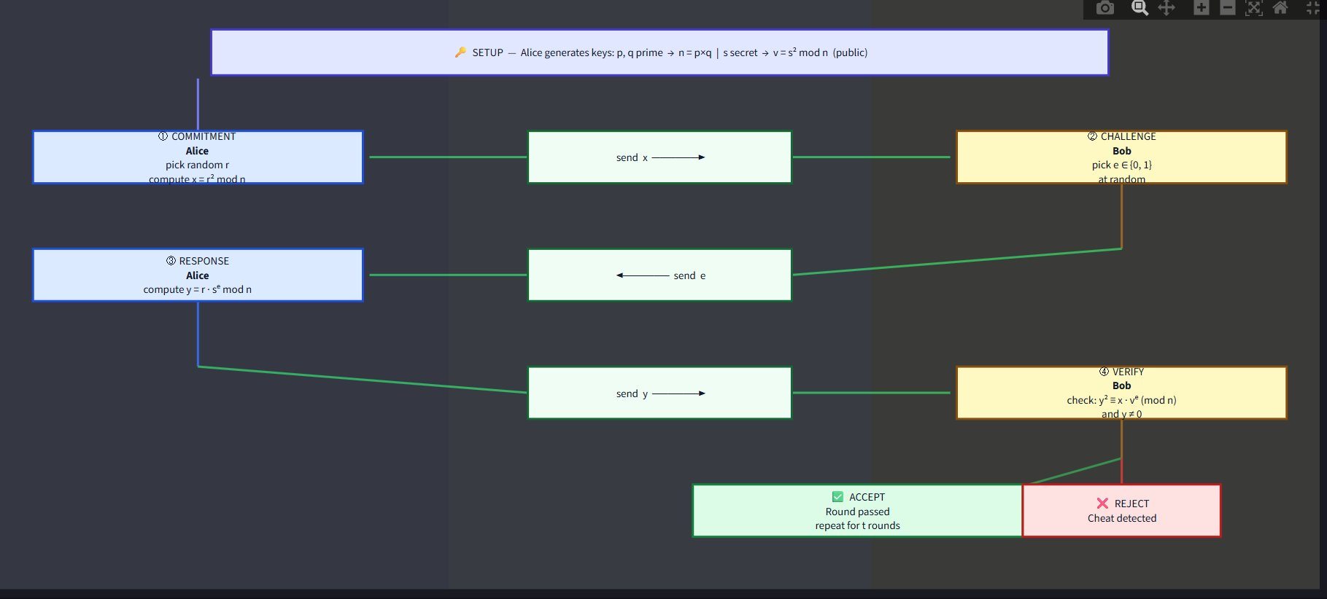
Simulator App — Protocol Flow Diagram
Protocol flow diagram: Alice (prover) ↔ Bob (verifier) — 4-step commit/challenge/respond/verify cycle

Slide 17
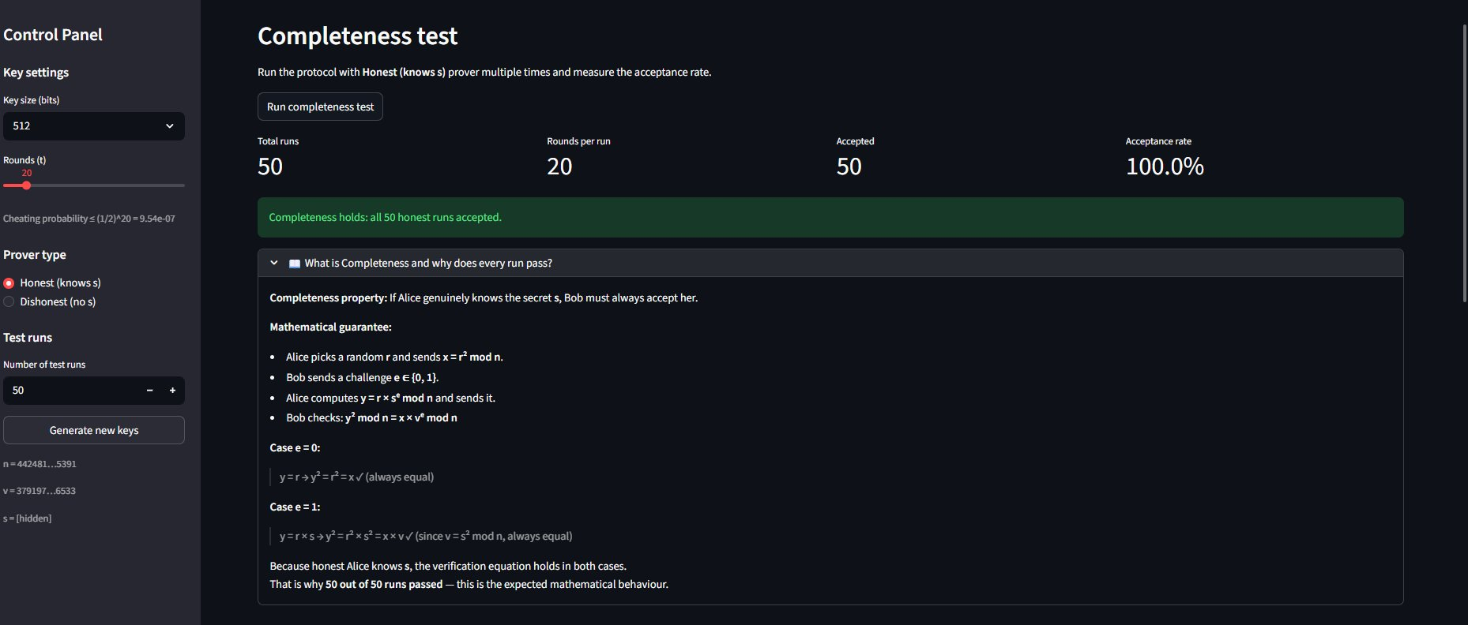
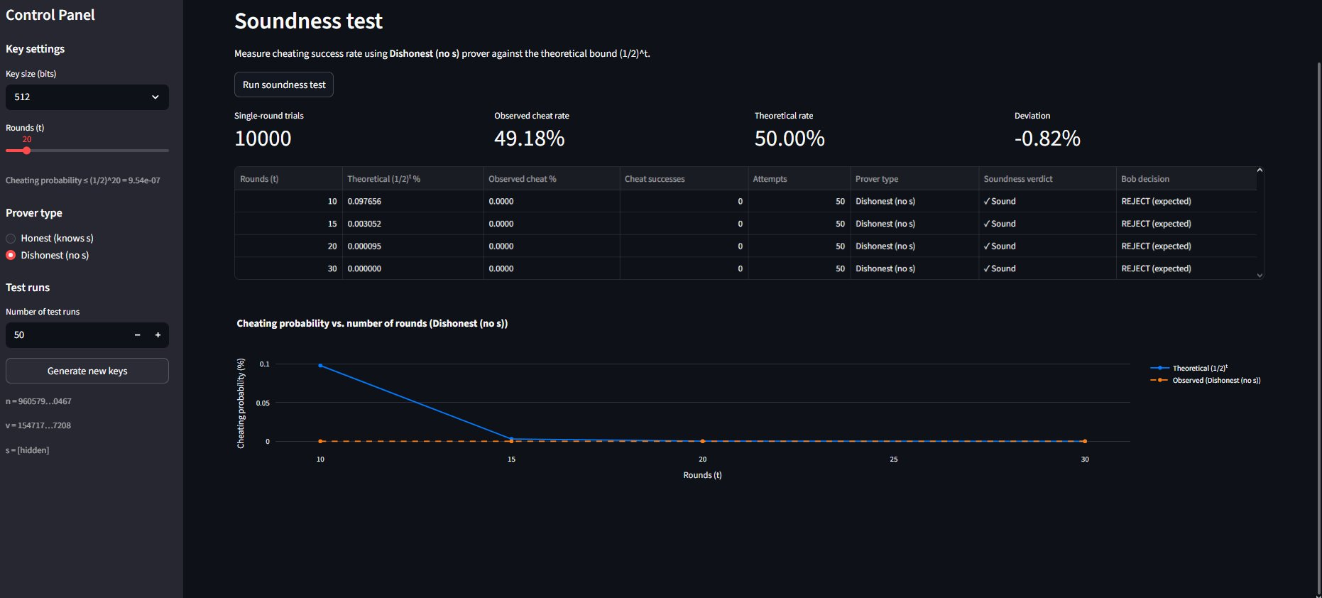
Simulator App — Completeness & Soundness
Completeness test: honest prover accepted in 50/50 runs (100%) — property confirmed
Soundness test: dishonest prover cheating rate matches (1/2)^t bound; 0 successes at t=20

Slide 18
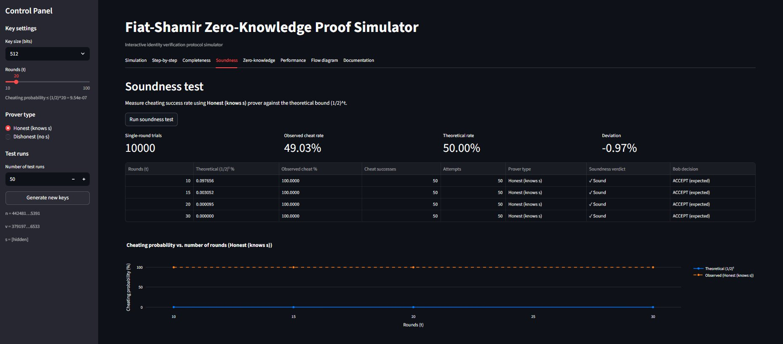
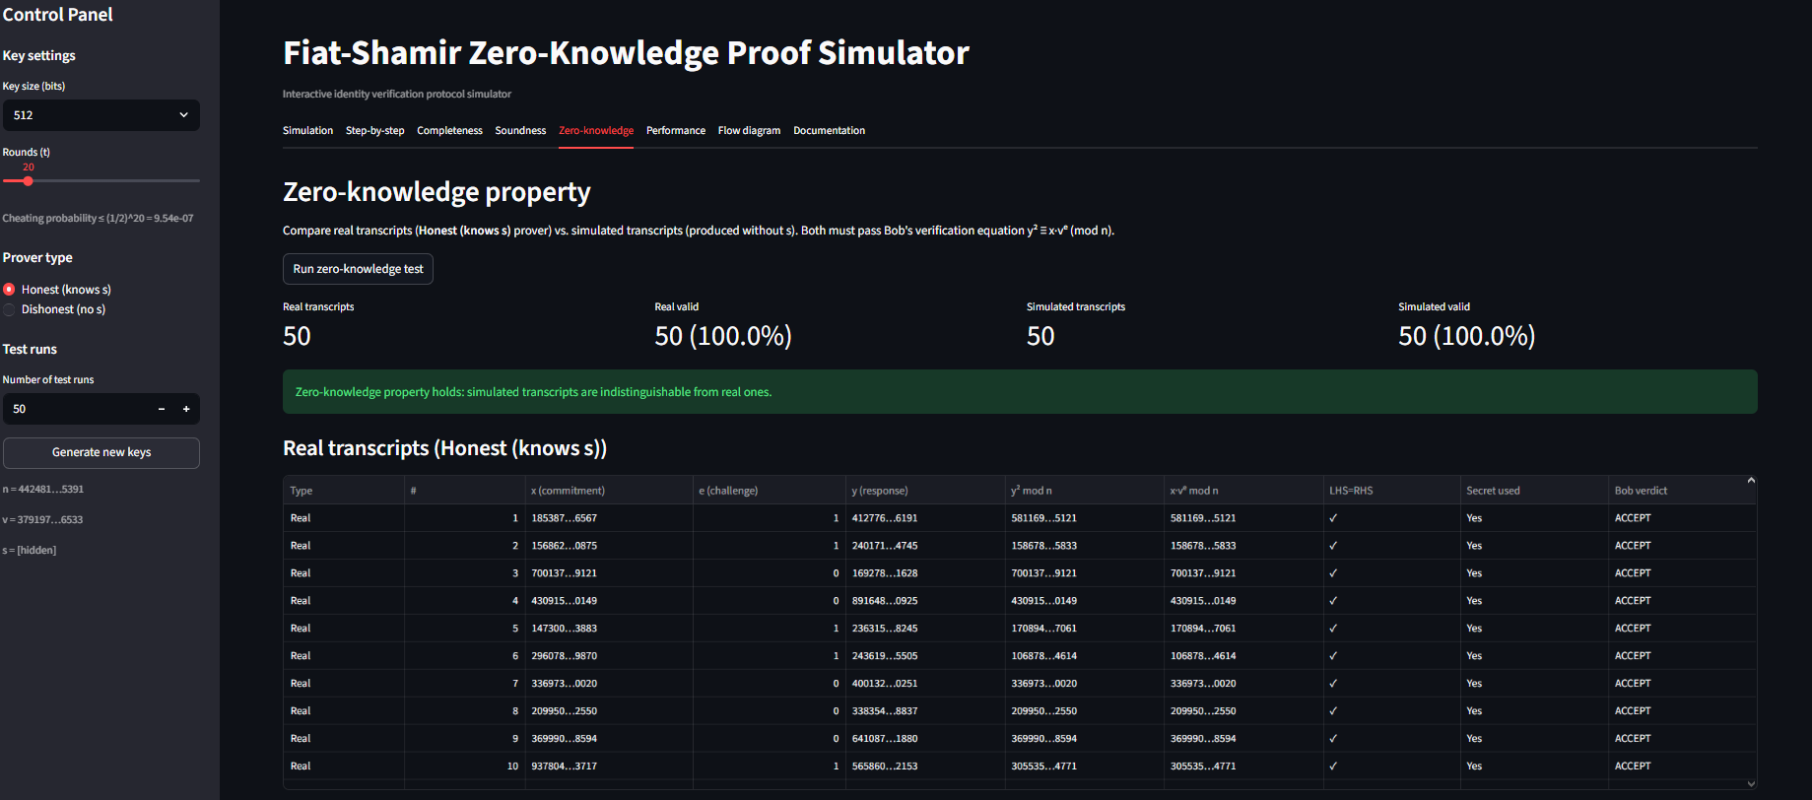
Simulator App — Soundness & Zero-Knowledge Simulation
Soundness test: honest prover cheating rate
Zero-Knowledge: round-by-round transcript table with r, x, e, y values and Bob's verdict

