Slide 1

IMADVENTIST · GETTING STARTED
Follow a club through a real task
IMAdventist
Events & Club Ministry
For club directors, deputies and Area Coordinators
Fictional training records · November 2026
Notes:
SAY
Today we follow two people instead of reading a list of features. Jordan Ellis directs Riverton Pathfinders. Alex Morgan is an Area Coordinator. We will watch Jordan update the roster, file the October Monthly Record and register the club for Winter Camporee. Then we will see how Alex uses those same saved records to offer help. Every person, club and record on these slides is invented for training. Your own tools depend on the role the conference office has given you.
POINT TO
Point to the two role labels: Club portal for Jordan and Club coordination for Alex.

Slide 2
BEFORE WE START
Slide 2
What works the same on every page
What IMAdventist is
Where to find your work
Safer everyday work
• IMAdventist: Events & Club Ministry keeps club records and event registrations together.
• Start at events.imsda.org.
• Questions go to the conference office or support@imsda.org.
• Directors and deputies: My club in the account menu.
• Area Coordinators: Club coordination in the account menu.
• Help has step-by-step picture guides for directors and coordinators.
• Leaving a form with unsaved changes asks: Leave without saving?
• Search boxes filter as you type. Column headers sort tables.
• Statuses use the same words everywhere: Draft, Submitted, Confirmed, Waitlisted, Cancelled.
Notes:
SAY
Before we look at any one task, here is what works the same on every page. The system is called IMAdventist: Events & Club Ministry. It keeps club records and event registrations together, and you start at events.imsda.org. Questions go to the conference office or support@imsda.org. Directors and deputies open My club in the account menu. Area Coordinators open Club coordination. Help has step-by-step picture guides. The app is also careful with your work. If you start typing in a form and try to leave, it asks before throwing your changes away. Search boxes filter as you type, and table headers sort.
POINT TO
Keep this short. Each habit comes up again during the story.

Slide 3
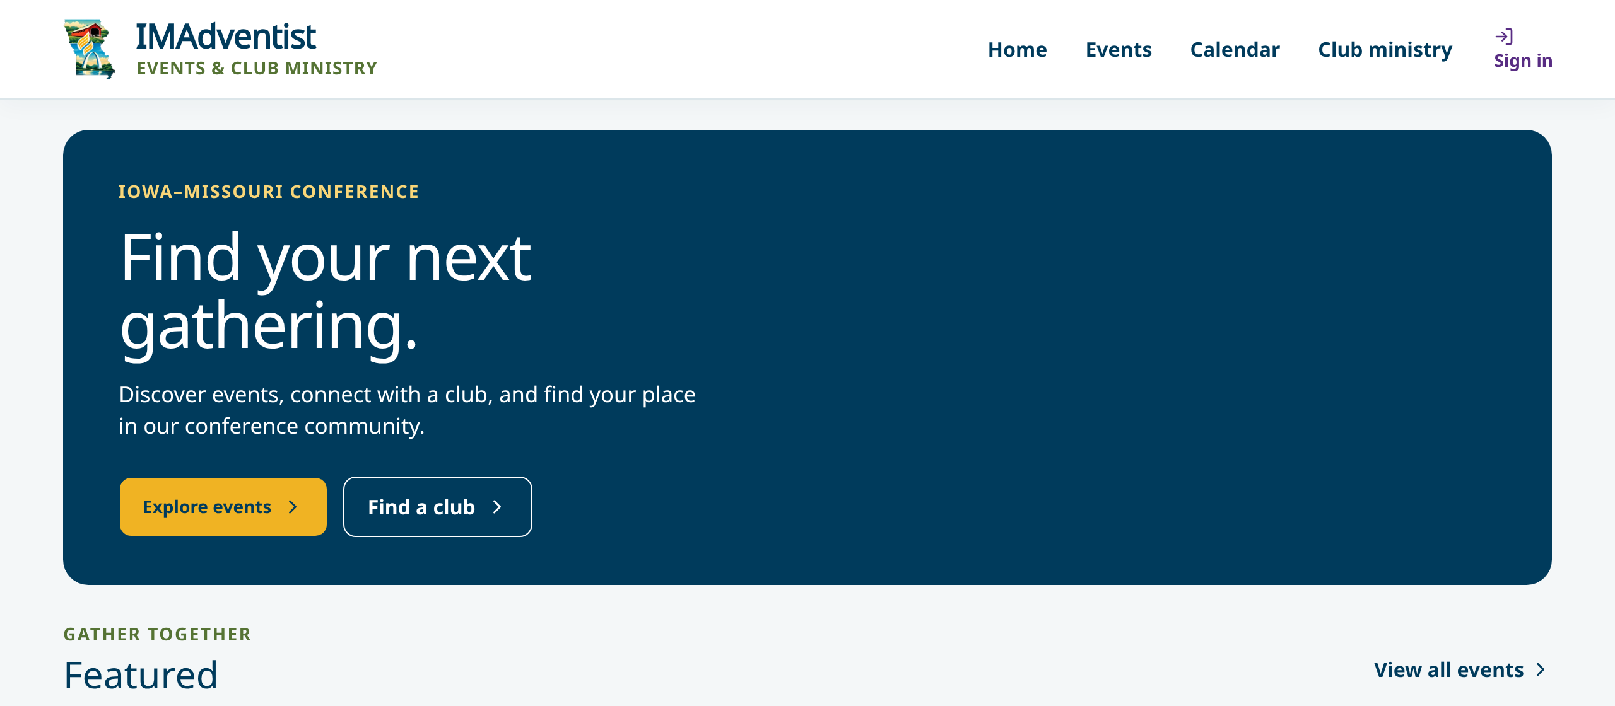
BEFORE SIGN-IN
Slide 3 · part 1 of 2
Start from the public site
• Anyone can browse events, the calendar and Club ministry without signing in.
• Sign in when you need your club's records or your registrations.
Home: Find your next gathering
Notes:
SAY
The public site is the front door. Anyone can look at events, the calendar and the Club ministry page without an account. You only need to sign in when you work with your club's records or your own registrations. The header links are Home, Events, Calendar and Club ministry, and Sign in is at the top right.
POINT TO
Point to Sign in at the top right of either screen.

Slide 4
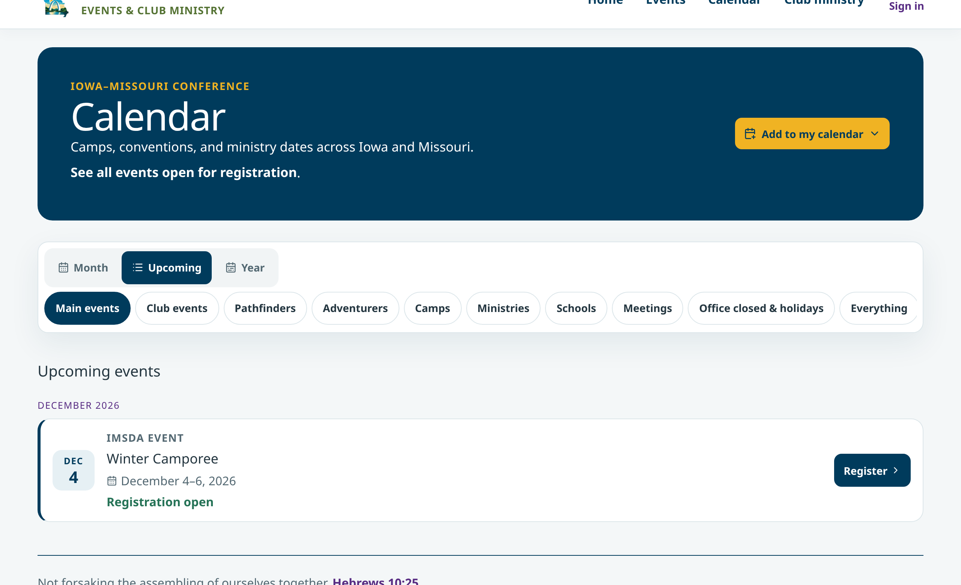
BEFORE SIGN-IN
Slide 3 · part 2 of 2
Start from the public site
• Anyone can browse events, the calendar and Club ministry without signing in.
• Sign in when you need your club's records or your registrations.
Calendar: upcoming events
Notes:
Slide 3, part 2 of 2. Notes are on part 1.

Slide 5
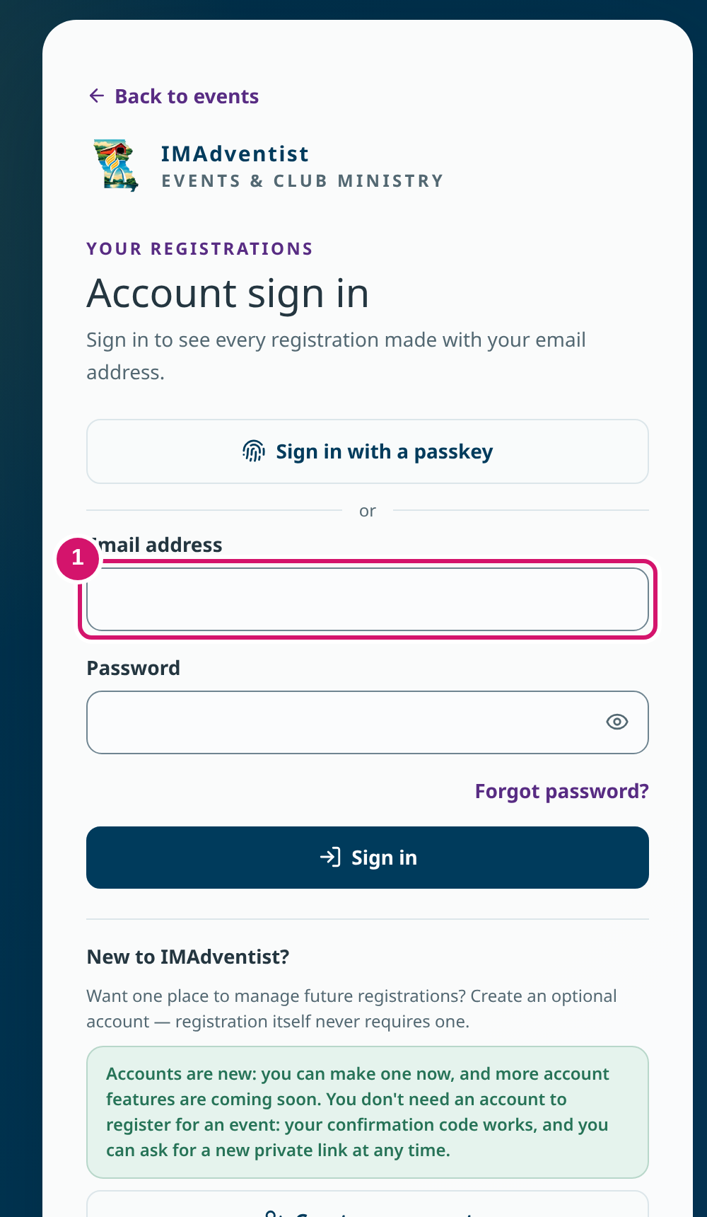
SIGNING IN
Slide 4
Use the account you already have
① Enter your email address and password, or use a passkey.
• A Security check may appear. If it is blocked, choose Email me a code instead.
• Back to events returns you to the public site.
Account sign in
Notes:
SAY
Use the same email address the conference office used for your club invitation. Enter your email and password, or choose the passkey option if you set one up. Some browsers show a short Security check. If a privacy setting blocks it, the page offers Email me a code instead. Please do not create a second account to get around a problem; ask the office instead.
POINT TO
Point to the email field (1), then to Sign in with a passkey.

Slide 6
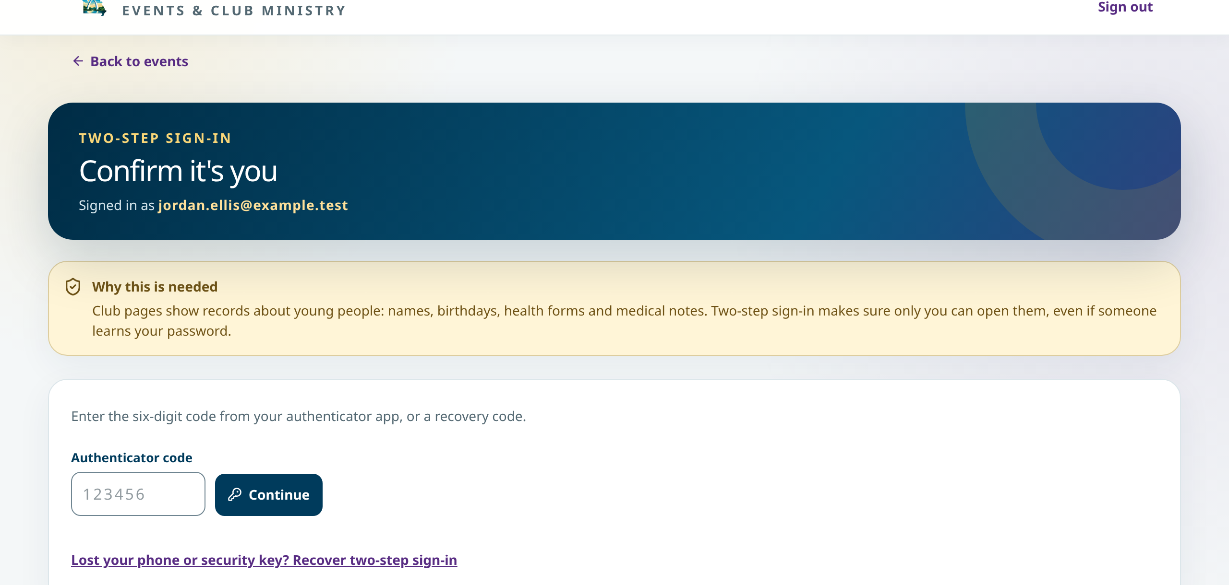
TWO-STEP SIGN-IN
Slide 5
The extra step protects young people's records
• Club pages hold names, birthdays, health forms and medical notes.
• Enter the six-digit code from your authenticator app, or use a passkey.
• Lost your phone? Use Recover two-step sign-in.
Confirm it's you
Notes:
SAY
Club pages show records about young people, so the system asks for a second step. The page is called Confirm it's you. Enter the six-digit code from your authenticator app or a recovery code, or use your passkey. If you lose your phone, the link Recover two-step sign-in emails you a code. You only set this up once.
POINT TO
Read the yellow 'Why this is needed' box aloud.

Slide 7
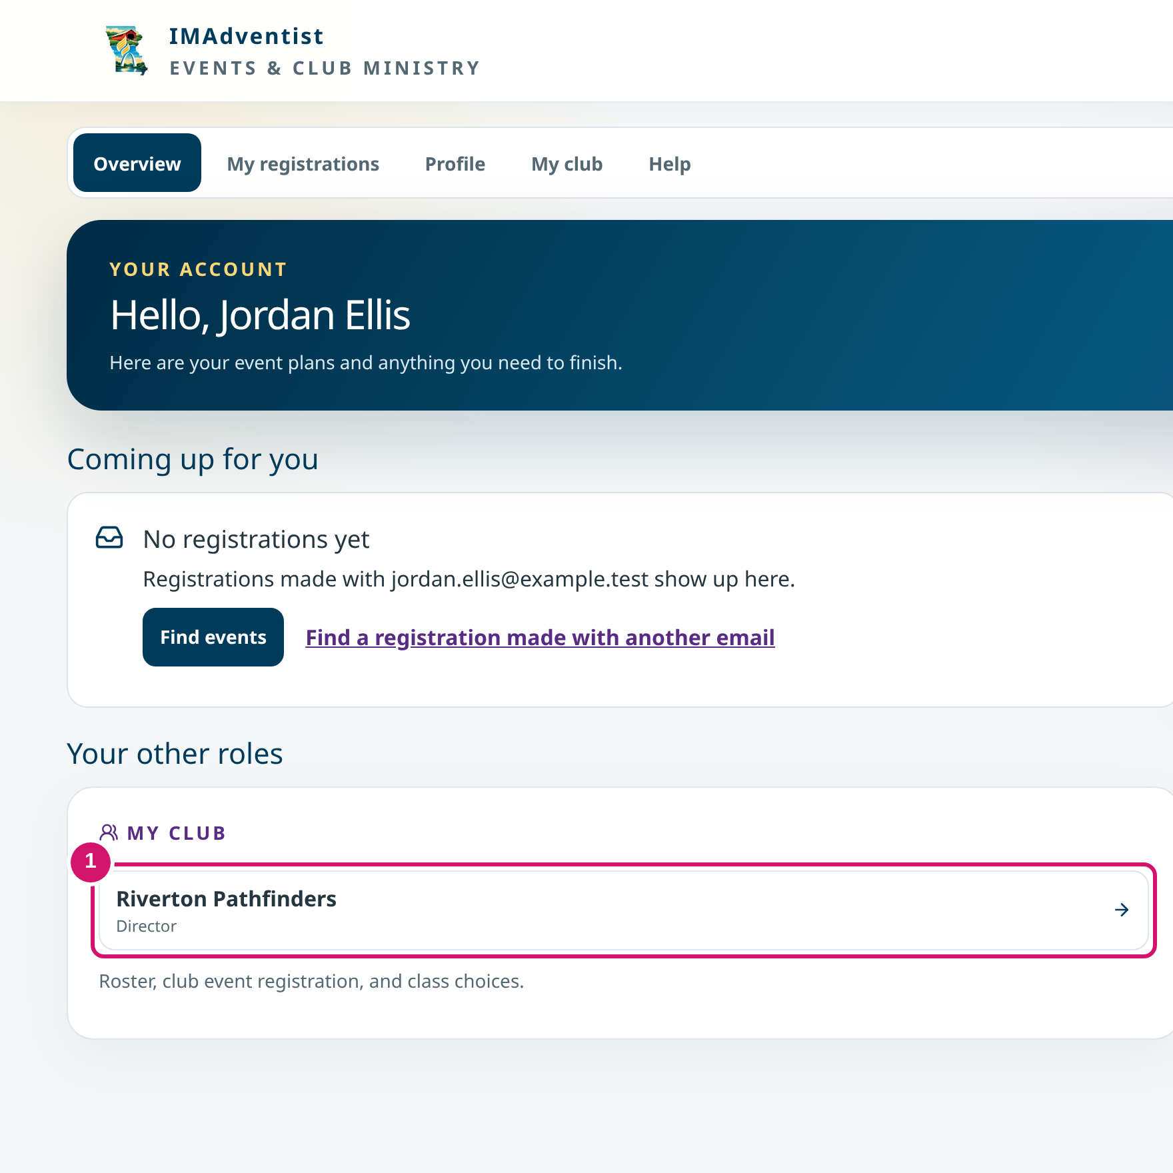
AFTER SIGN-IN
Slide 6
Your account page shows your roles
• Account menu: Overview, My registrations, Profile, My club, Help.
① Under Your other roles, open your club.
• Coordinators see Club coordination instead of My club.
Jordan's account
Notes:
SAY
After you sign in you land on your account page. The top menu reads Overview, My registrations, Profile, My club and Help. Jordan's club appears under Your other roles. Choose the club name to open the Club portal. If you help more than one club, the menu says My clubs and you pick the right one.
POINT TO
Point to the Riverton Pathfinders card (1).

Slide 8
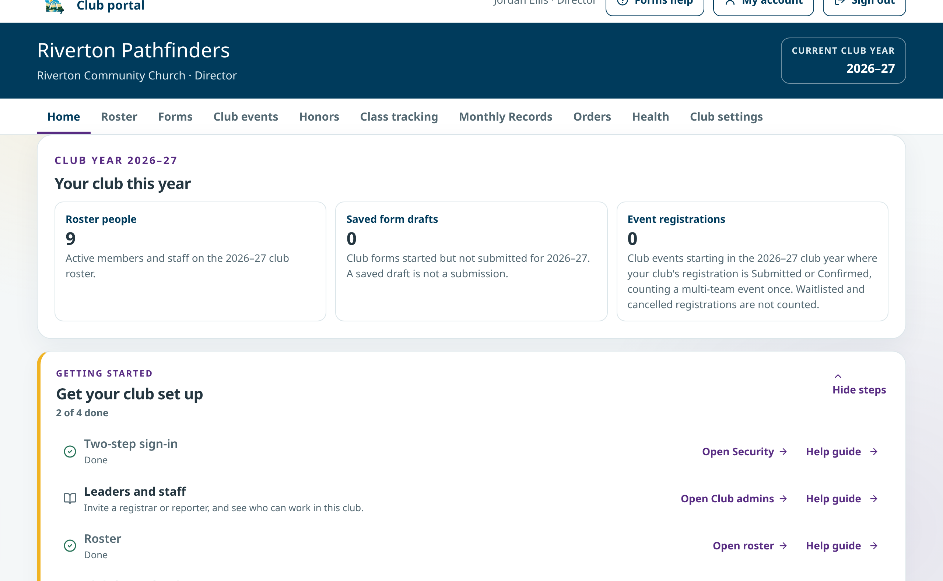
DIRECTOR · CLUB HOME
Slide 7
Jordan starts with the next task
• Tabs: Home, Roster, Forms, Club events, Honors, Class tracking, Monthly Records, Orders, Health, Club settings.
• Your club this year: roster people, saved form drafts, event registrations.
• Getting started lists set-up steps, each with a Help guide.
Riverton Pathfinders Home
Notes:
SAY
This is the Club portal. Check the club name and the current club year at the top before you change anything. The tabs across the page are where the work lives. Home summarizes the year and shows a Getting started list. Each step has an Open link and a Help guide with pictures.
POINT TO
Point to the club year box, then the tab row.

Slide 9
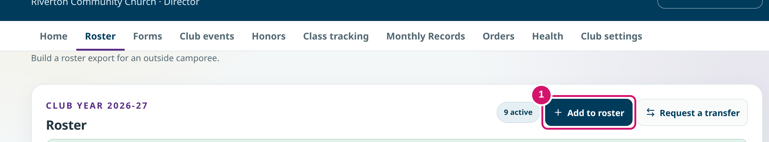
DIRECTOR · ROSTER
Slide 8 · part 1 of 2
Add Morgan once
• Search the roster first so you don't add someone twice.
• First name, last name, birth date, type, current class, gender. Emergency contacts are optional.
① Add to roster
Notes:
SAY
Morgan Reed is joining Riverton. Jordan searches the roster first to make sure Morgan is not already there, then chooses Add to roster. The form asks for first and last name, birth date, type, current class and gender. Birth dates are encrypted and only the director and deputy see them. Adding someone to the roster does not register them for an event.
POINT TO
Point to Add to roster, then the First name field.

Slide 10
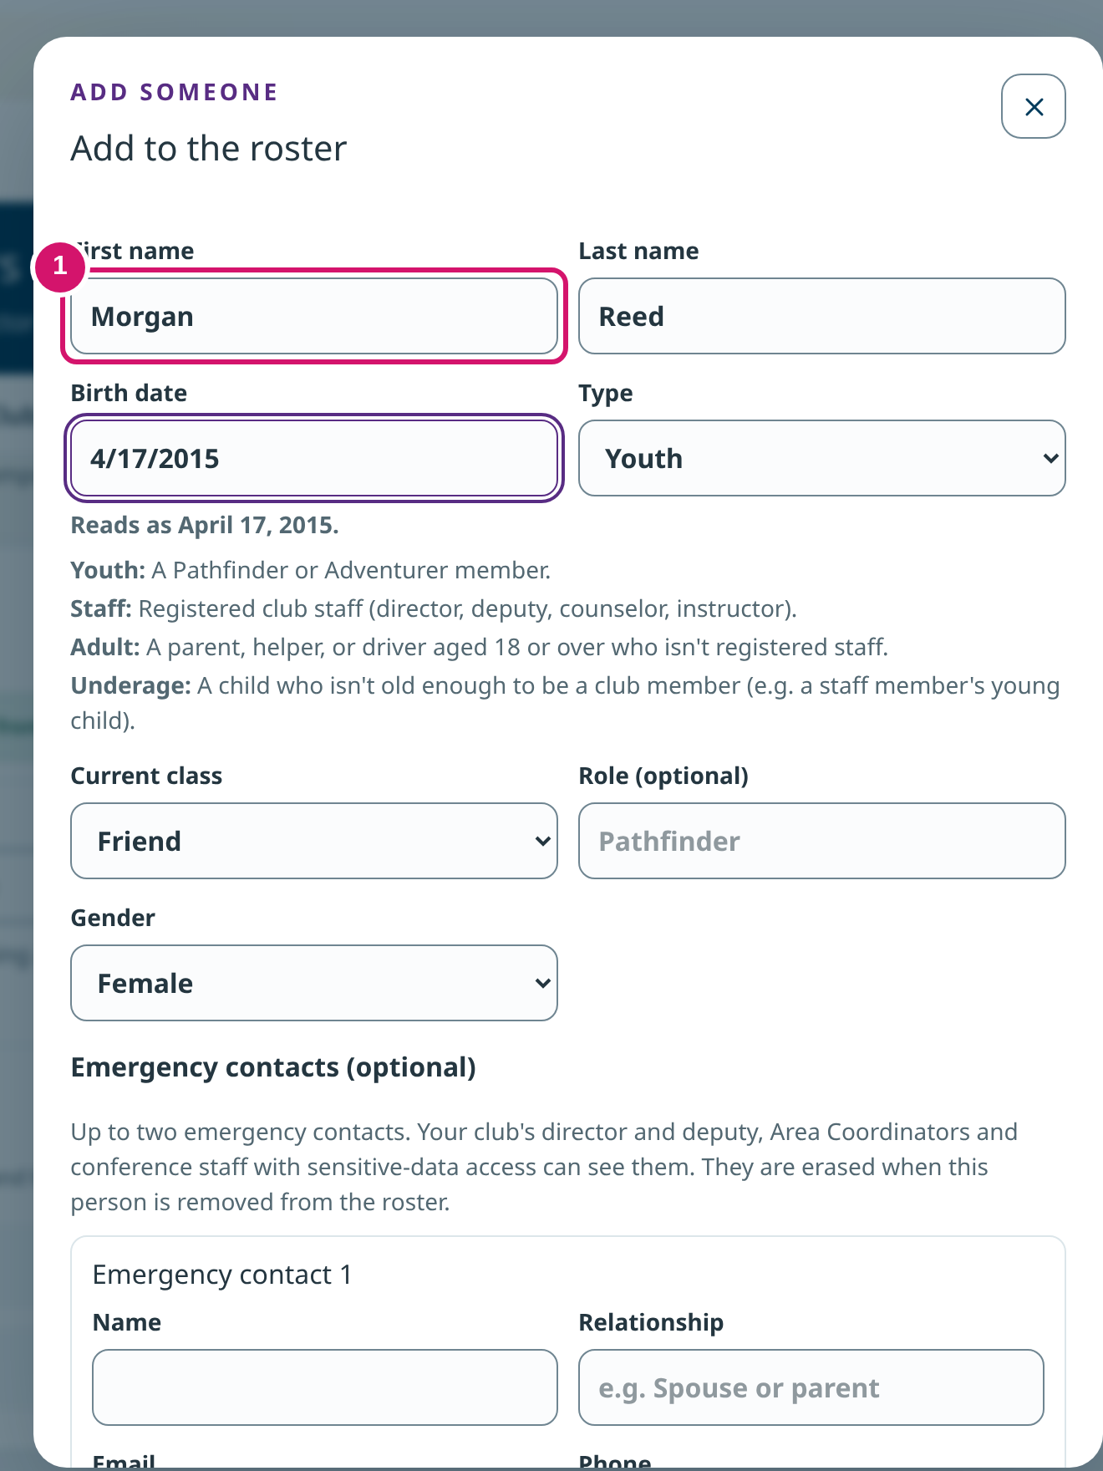
DIRECTOR · ROSTER
Slide 8 · part 2 of 2
Add Morgan once
• Search the roster first so you don't add someone twice.
• First name, last name, birth date, type, current class, gender. Emergency contacts are optional.
① Enter the details
Notes:
Slide 8, part 2 of 2. Notes are on part 1.

Slide 11
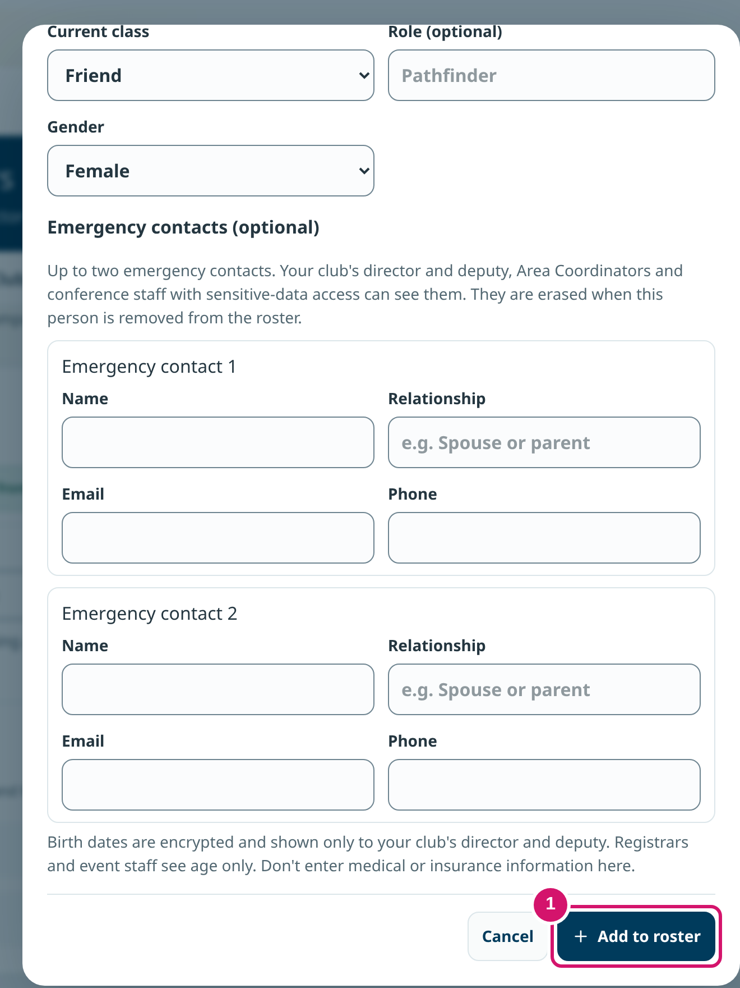
DIRECTOR · ROSTER
Slide 9 · part 1 of 2
Save, then check the saved row
• The roster now shows 10 people.
• Use Edit to correct a person and Actions for deactivate or remove.
① Add to roster saves
Notes:
SAY
Jordan chooses Add to roster at the bottom of the dialog. The dialog closes and Morgan's row appears in the Members list. Always look for the saved row before moving on. To fix a mistake later, use Edit beside the name. Actions holds Deactivate and Remove. Remove erases roster details and cannot be undone, so read it carefully.
POINT TO
Point to Morgan's row (1).

Slide 12
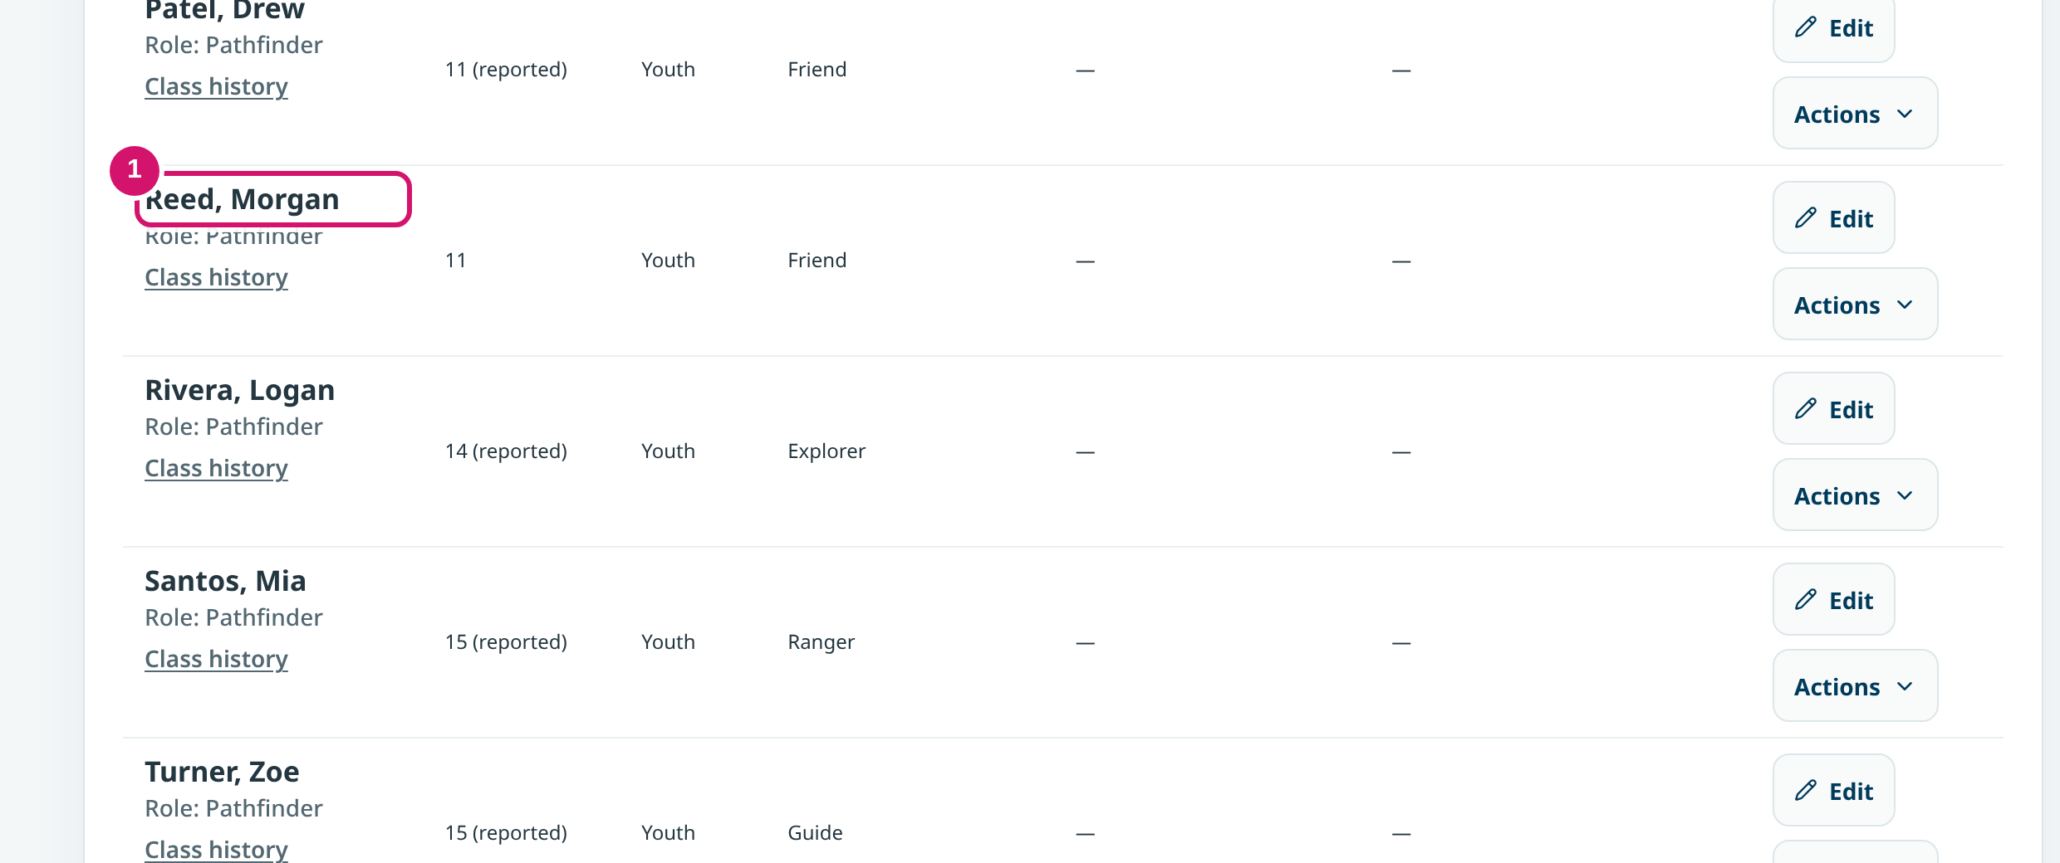
DIRECTOR · ROSTER
Slide 9 · part 2 of 2
Save, then check the saved row
• The roster now shows 10 people.
• Use Edit to correct a person and Actions for deactivate or remove.
① Morgan Reed on the roster
Notes:
Slide 9, part 2 of 2. Notes are on part 1.

Slide 13
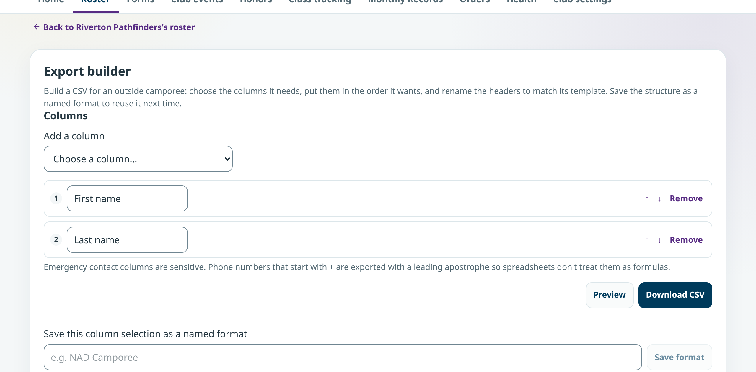
DIRECTOR · ROSTER
Slide 10
Build a roster file for another event
• Choose and order the columns another event needs.
• Preview, then Download CSV.
• Save the column choice as a named format for next time.
Export builder
Notes:
SAY
Some outside events want the roster in their own layout. The Export builder lets you pick columns, put them in order, rename headers, preview and download a CSV file. You can save the layout with a name, for example for a union camporee, so next year it is one click.

Slide 14
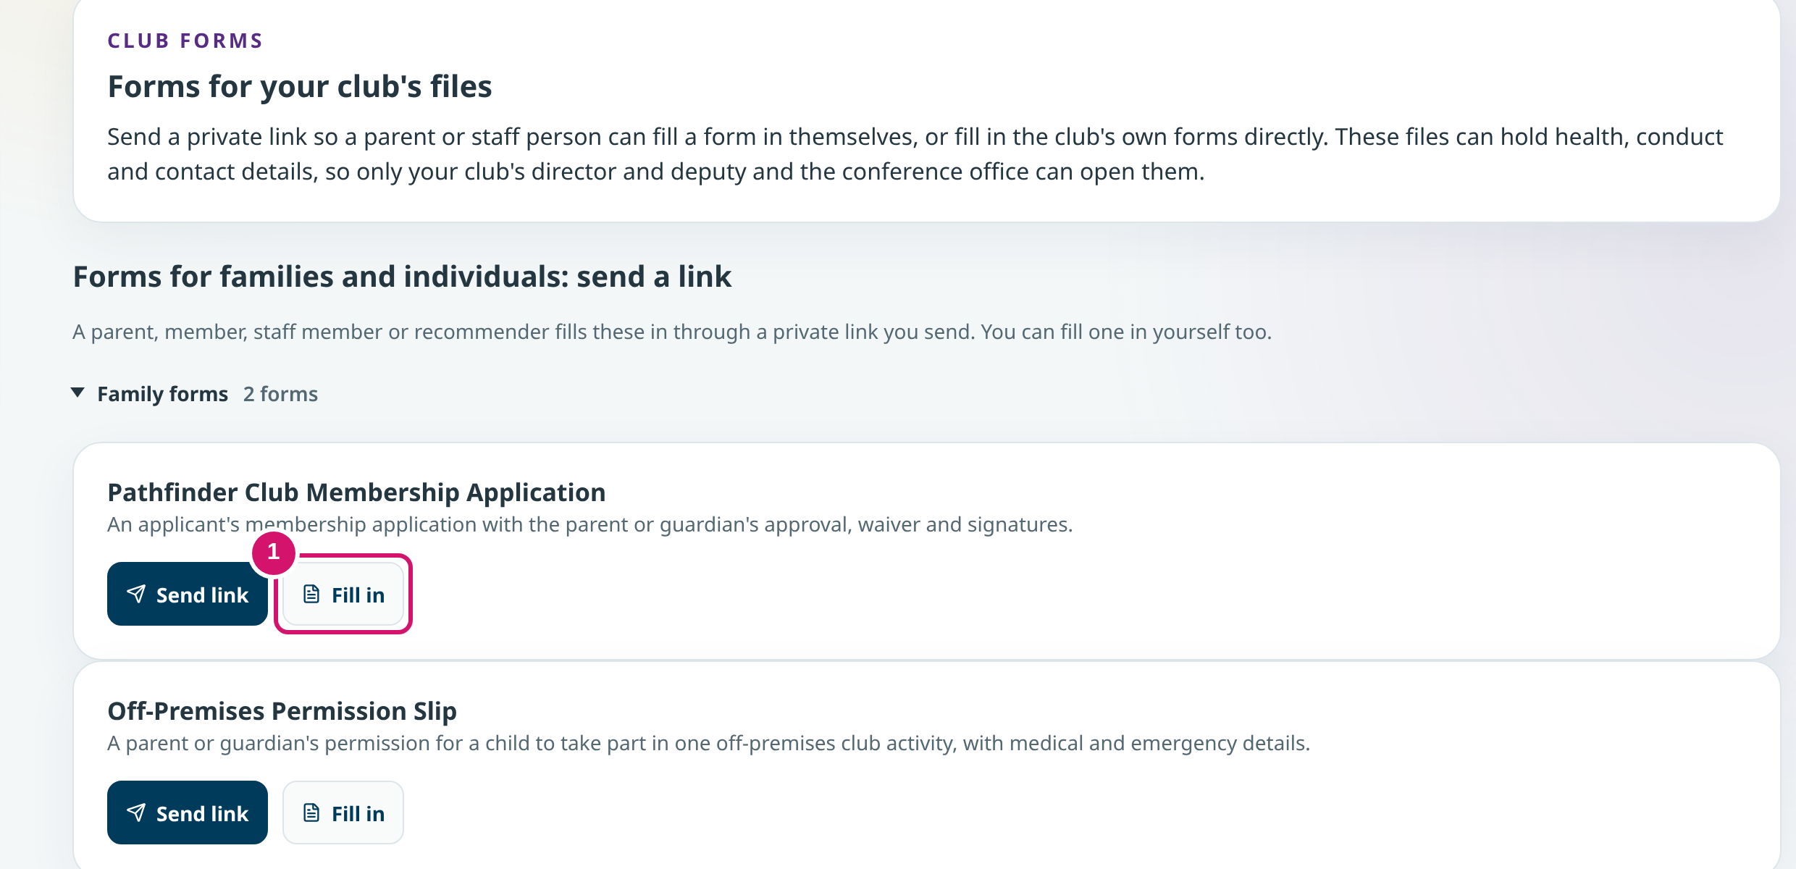
DIRECTOR & DEPUTY · FORMS
Slide 11
Fill in a form or send a private link
• Family forms: ① Fill in yourself, or Send link to a parent.
• Club forms: the club fills these in itself.
• A saved draft is not a submitted form.
Forms for your club's files
Notes:
SAY
The Forms tab holds the yearly forms. For family forms such as the membership application or a permission slip, you can fill it in yourself or send a private link so a parent fills it in. Club forms, like the transportation passenger list, are filled in by the club. Only the director, deputy and conference office can open these files, because they can hold health and contact details.
POINT TO
Point to Fill in (1) and Send link.

Slide 15
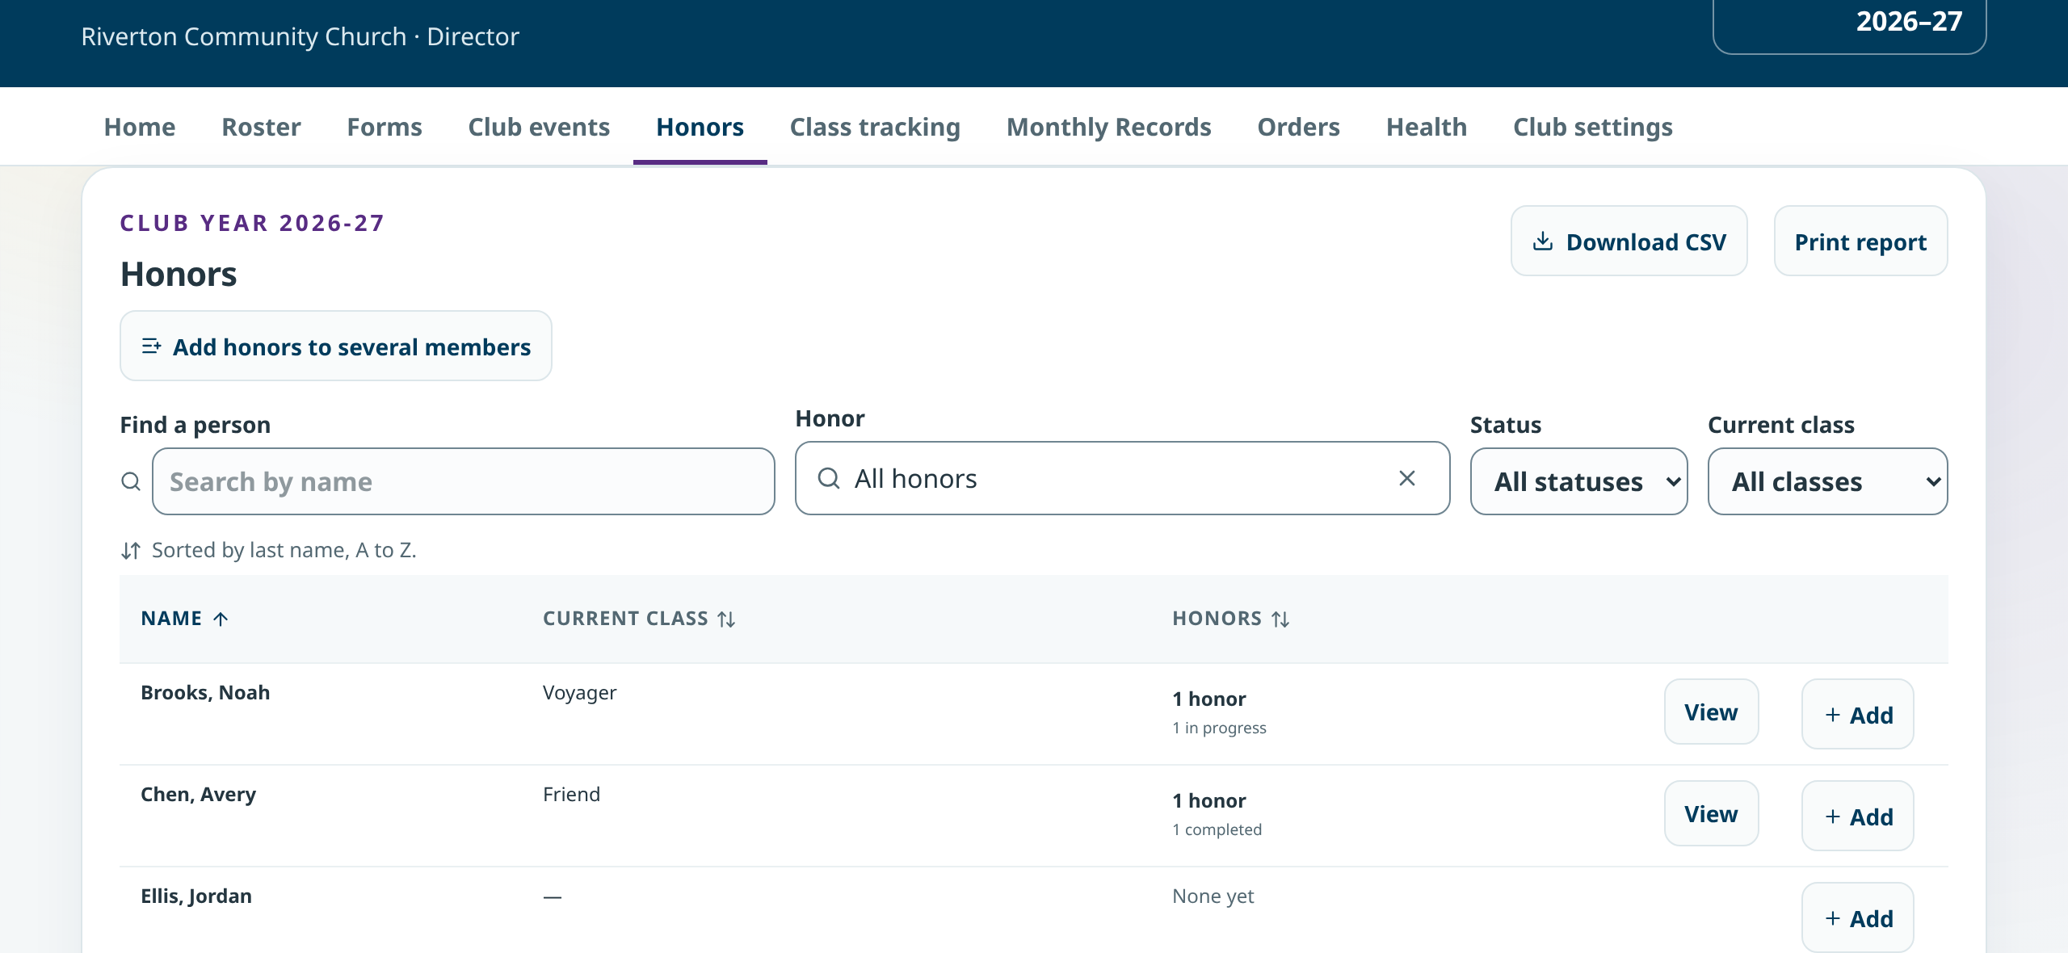
DIRECTOR · HONORS
Slide 12
Record honors as they are earned
• Find a person, then + Add or View.
• Add honors to several members at once.
• Riverton: 4 completed, 4 in progress.
Honors
Notes:
SAY
Honors keeps each member's honor records. Use Add beside a name, or Add honors to several members after a group finishes the same honor. You can filter by honor, status and class, and download or print the list.

Slide 16
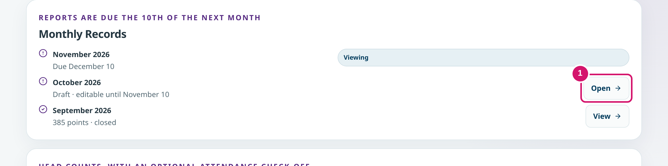
DIRECTOR · MONTHLY RECORDS
Slide 13 · part 1 of 2
Capture the meetings while they are fresh
• Reports are due the 10th of the next month.
• Add meeting note after each meeting; the record can pull counts from your notes.
① Open a month
Notes:
SAY
Monthly Records lists each month with its due date. September is closed. October is a draft that Jordan can still change until November 10. Under each month, Add meeting note records the date, head counts and what you did. Notes taken during the month make the report quicker at the end.
POINT TO
Point to the October row and the Add meeting note button.

Slide 17
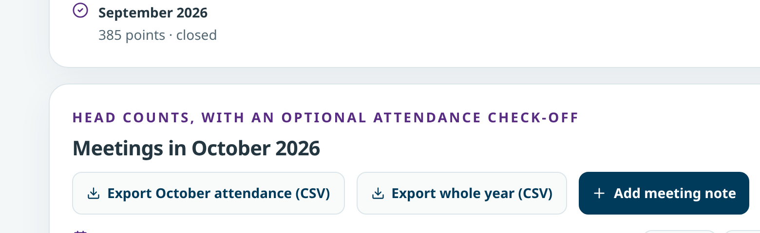
DIRECTOR · MONTHLY RECORDS
Slide 13 · part 2 of 2
Capture the meetings while they are fresh
• Reports are due the 10th of the next month.
• Add meeting note after each meeting; the record can pull counts from your notes.
October meetings
Notes:
Slide 13, part 2 of 2. Notes are on part 1.

Slide 18
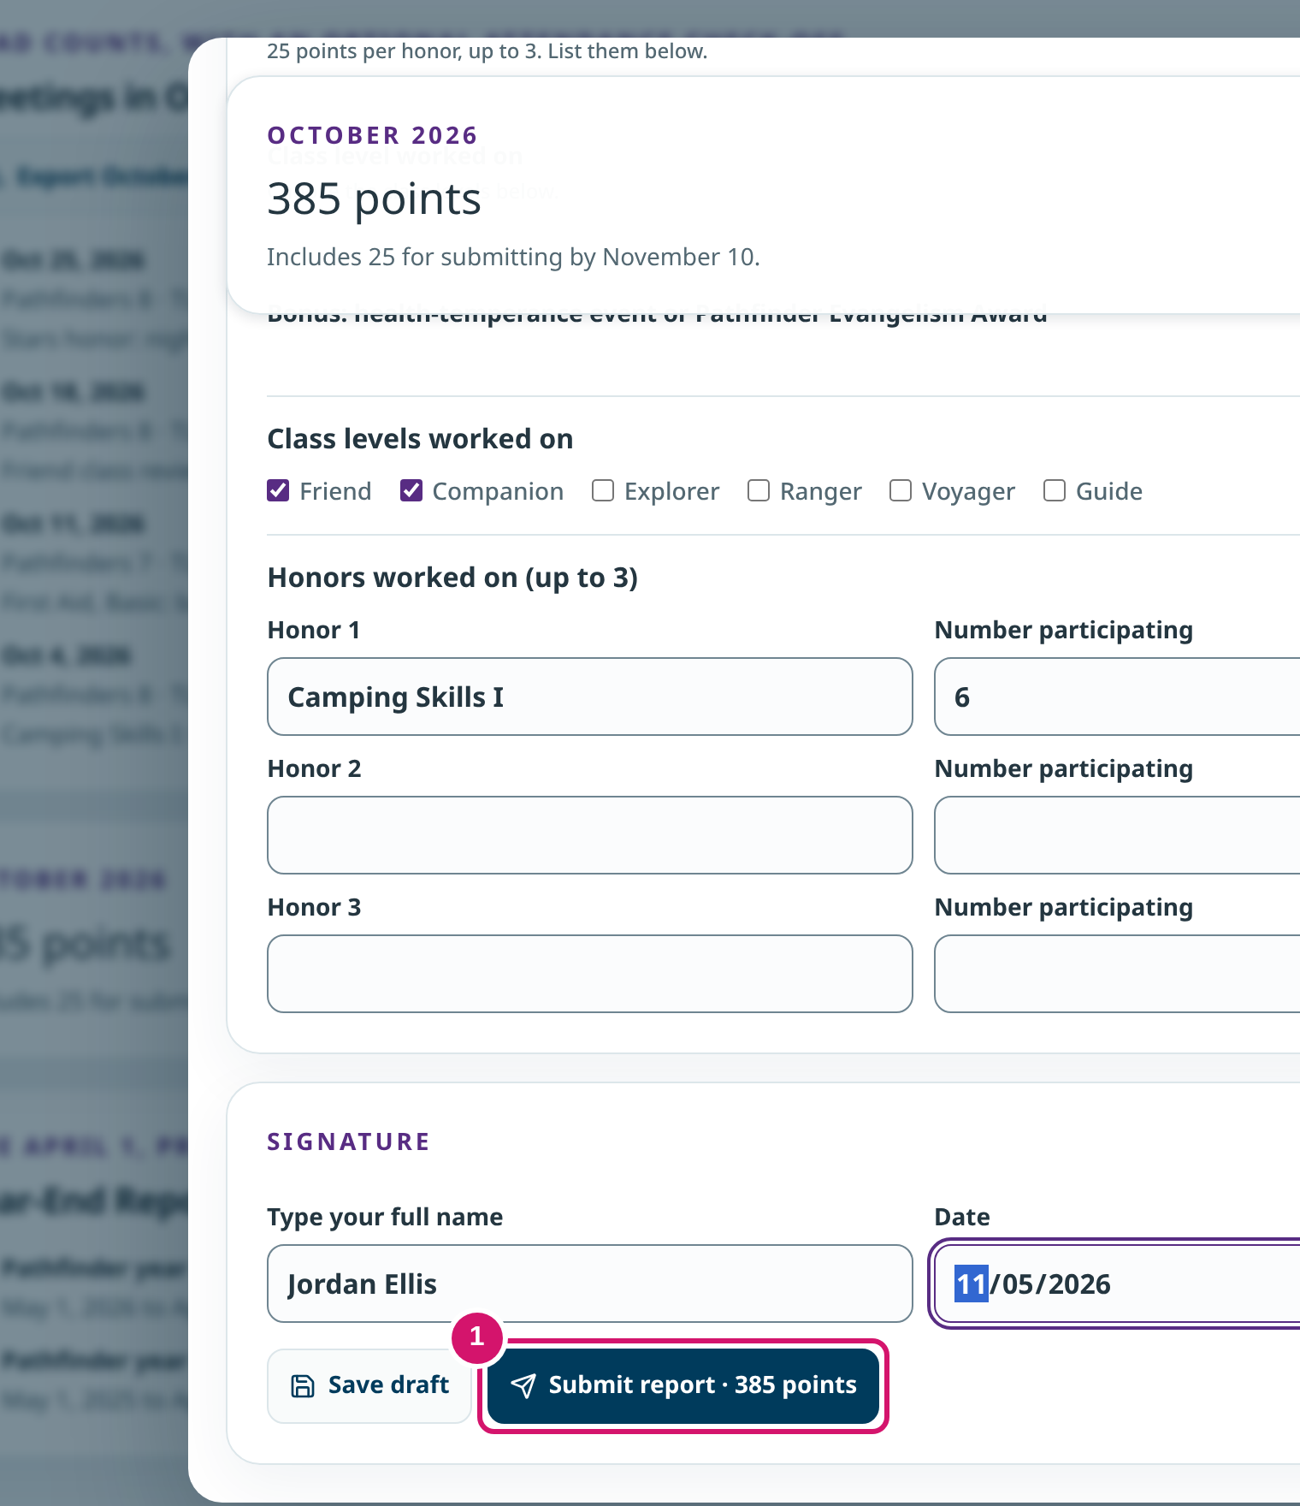
DIRECTOR · MONTHLY RECORDS
Slide 14 · part 1 of 2
Sign, then Submit report
• Save draft keeps your work but does not file the report.
• Submit report files it; the points show on the card.
① Type your name and date
Notes:
SAY
Jordan opens October with Continue report, checks the counts, types a full name and the date under Signature, and chooses Submit report. Save draft would only keep the work for later. After submitting, the card says Submitted with the date. If something needs changing before the deadline, Reopen as draft is there.
POINT TO
Point to Submit report (1), then the Submitted label.

Slide 19
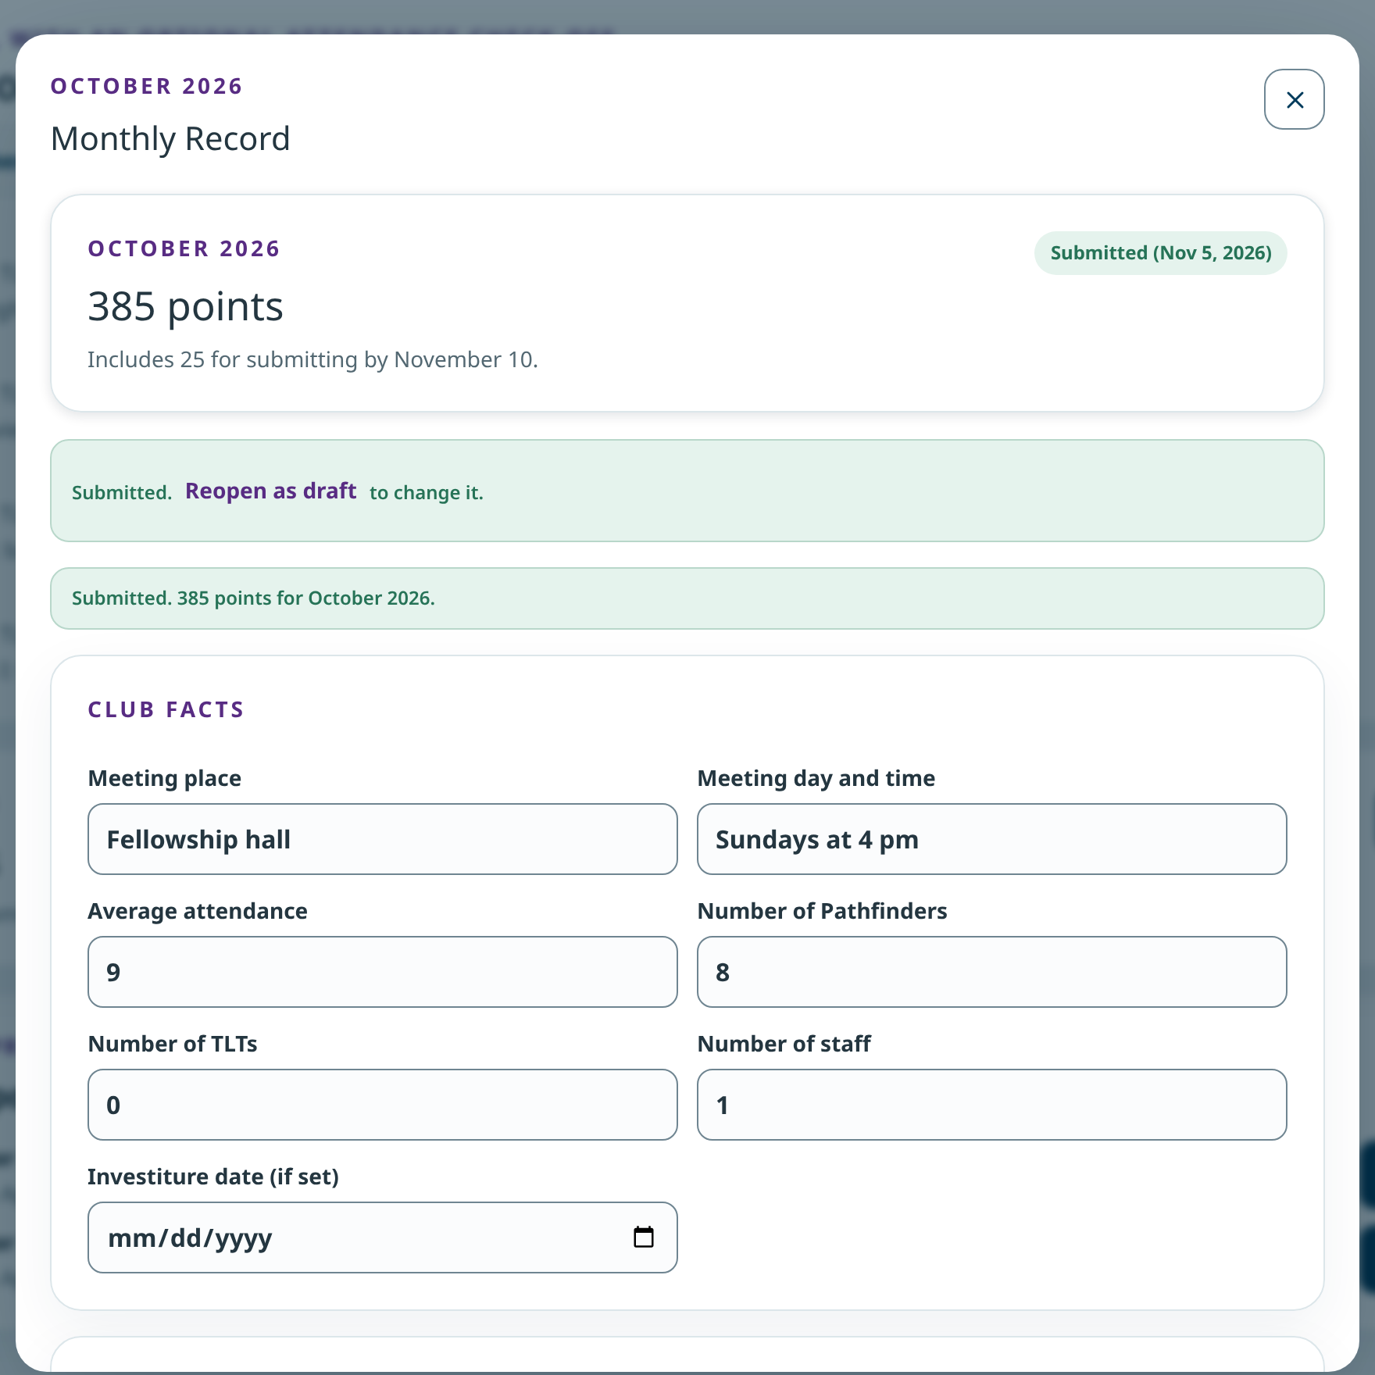
DIRECTOR · MONTHLY RECORDS
Slide 14 · part 2 of 2
Sign, then Submit report
• Save draft keeps your work but does not file the report.
• Submit report files it; the points show on the card.
Submitted
Notes:
Slide 14, part 2 of 2. Notes are on part 1.

Slide 20
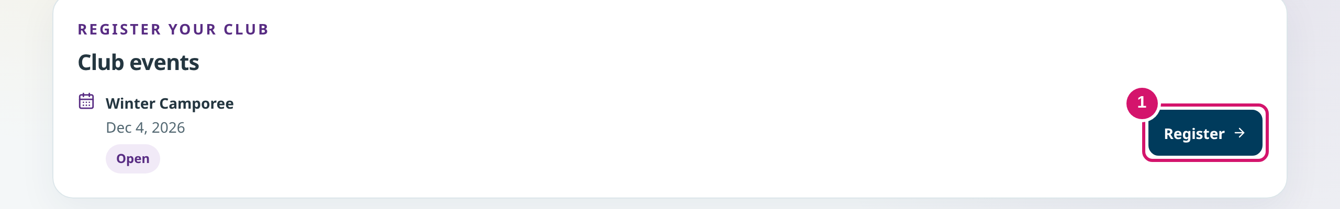
DIRECTOR · CLUB EVENTS
Slide 15 · part 1 of 2
Choose who is going
• Club events lists events open to your club.
• Select everyone or tick people one by one. Add a person who is not on the roster.
① Register
Notes:
SAY
Winter Camporee is open. Jordan chooses Register, then picks who is going. Select everyone ticks the whole roster; you can also tick people one at a time, or add a visitor who is not on your roster. The button counts the people you chose.
POINT TO
Point to Register, then the Continue button.

Slide 21
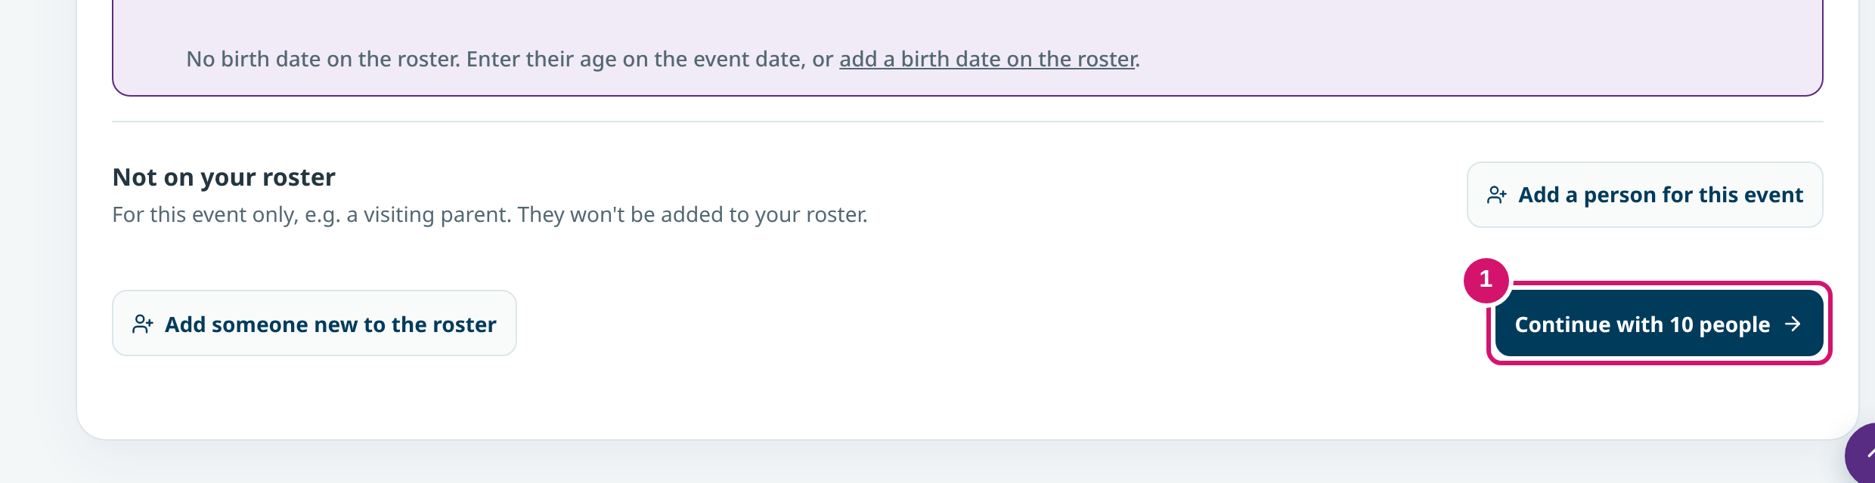
DIRECTOR · CLUB EVENTS
Slide 15 · part 2 of 2
Choose who is going
• Club events lists events open to your club.
• Select everyone or tick people one by one. Add a person who is not on the roster.
① Continue with 10 people
Notes:
Slide 15, part 2 of 2. Notes are on part 1.

Slide 22
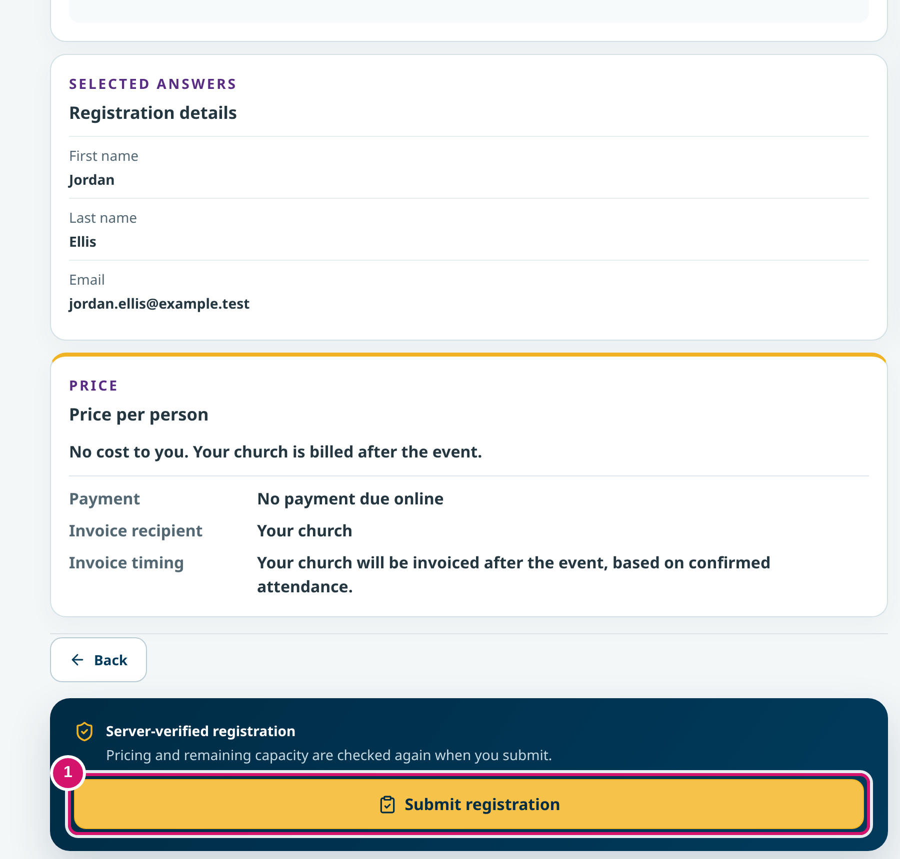
DIRECTOR · CLUB EVENTS
Slide 16 · part 1 of 2
Review, submit, and check the result
• Review shows the contact, people and price before you submit.
• After submitting: a confirmation number, the people going and a check-in code.
① Submit registration
Notes:
SAY
Before submitting, the review page shows the contact details, the people and the price. For a church-billed event there is nothing to pay online; the church is billed after the event. After Submit registration, the event page says Your club is registered, with a confirmation number and a code to show at check-in. A saved draft or a waitlist place is not a confirmed registration.
POINT TO
Point to the confirmation number.

Slide 23
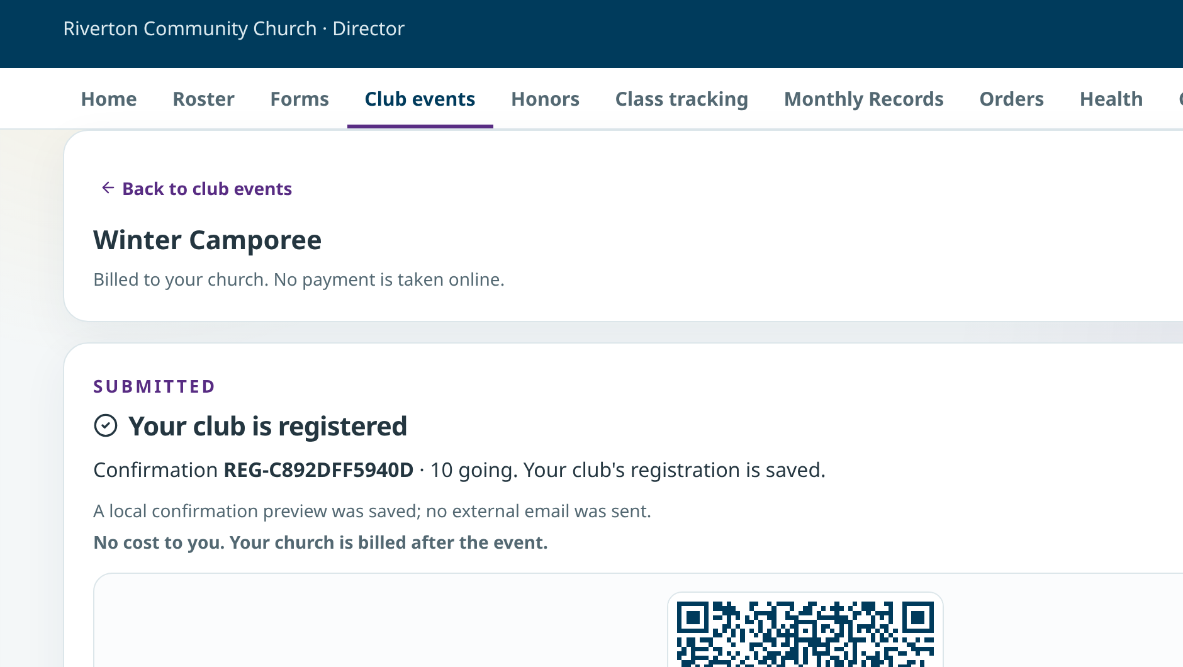
DIRECTOR · CLUB EVENTS
Slide 16 · part 2 of 2
Review, submit, and check the result
• Review shows the contact, people and price before you submit.
• After submitting: a confirmation number, the people going and a check-in code.
Your club is registered
Notes:
Slide 16, part 2 of 2. Notes are on part 1.

Slide 24
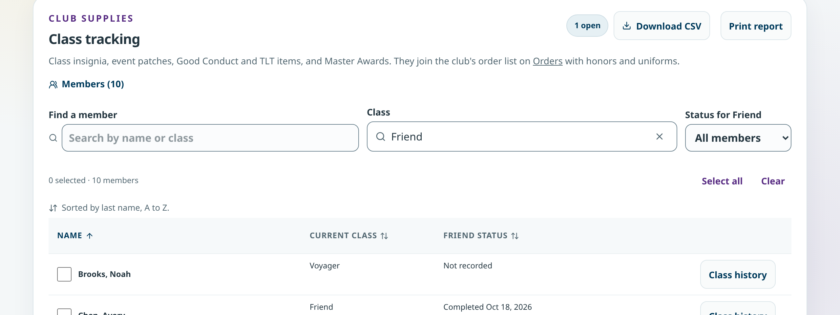
DIRECTOR · CLASS TRACKING
Slide 17 · part 1 of 2
Record a class, then confirm the insignia
• Avery finished Friend on October 18.
• Suggested items join the order list only when you choose Add to order list.
Class tracking
Notes:
SAY
Class tracking shows each member's class status. When members finish a class, select them and choose Mark completed. The page then suggests that class's insignia: name strip, chevron, pin and ribbon bar. Nothing is ordered until you choose Add to order list, and you can untick anything a member already has.
POINT TO
Point to Avery's suggested items and Add to order list.

Slide 25
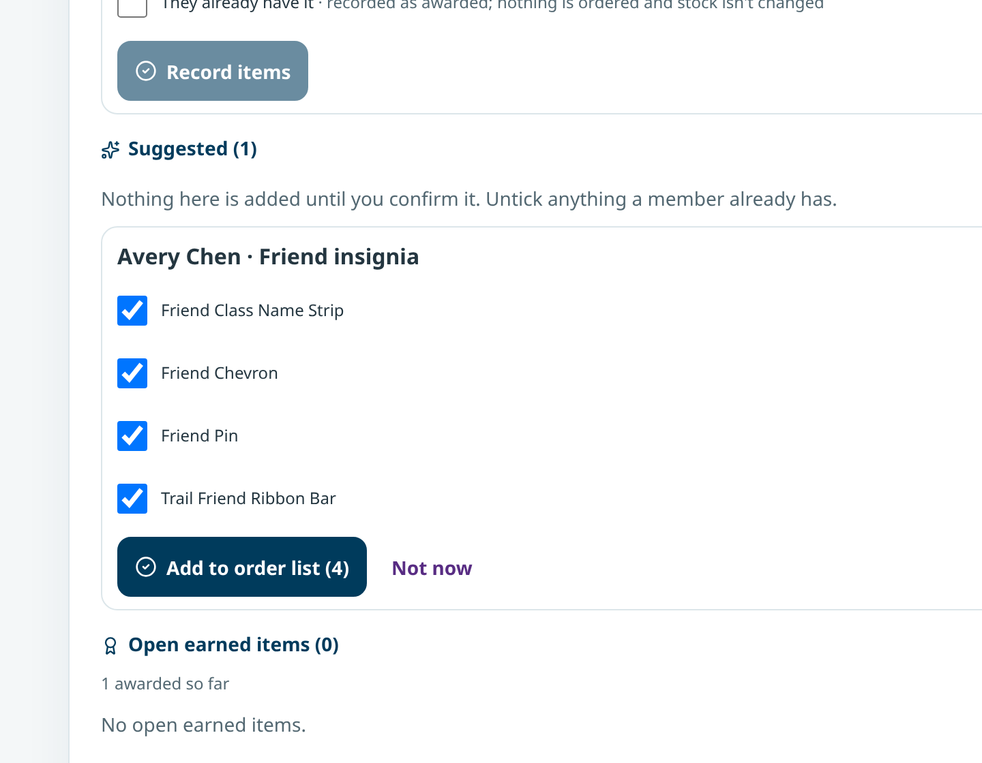
DIRECTOR · CLASS TRACKING
Slide 17 · part 2 of 2
Record a class, then confirm the insignia
• Avery finished Friend on October 18.
• Suggested items join the order list only when you choose Add to order list.
Suggested insignia
Notes:
Slide 17, part 2 of 2. Notes are on part 1.

Slide 26
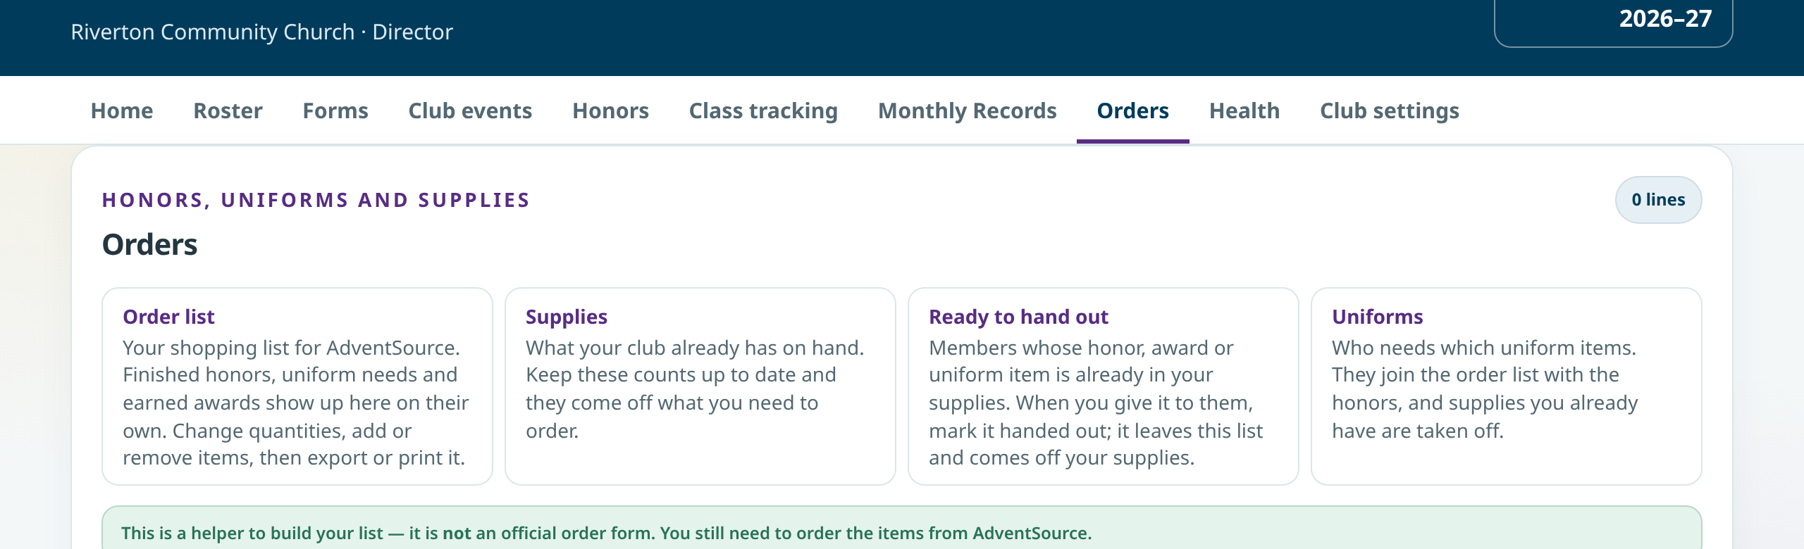
DIRECTOR · ORDERS
Slide 18 · part 1 of 2
One list for honors, uniforms and supplies
• The order list is a helper, not an official order form.
• Stock on hand comes off what you need to order.
Orders
Notes:
SAY
Orders brings honors, uniform needs and earned awards into one list. It is a helper: you still order from AdventSource. Keep your supplies on hand up to date, and the list subtracts them. Ready to hand out shows items that are already in your supplies for a member.

Slide 27
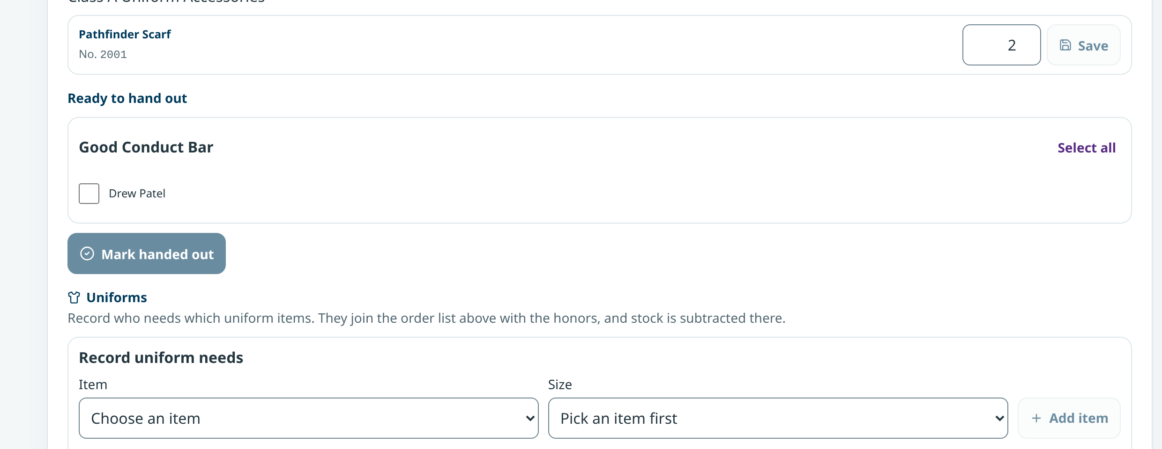
DIRECTOR · ORDERS
Slide 18 · part 2 of 2
One list for honors, uniforms and supplies
• The order list is a helper, not an official order form.
• Stock on hand comes off what you need to order.
Ready to hand out
Notes:
Slide 18, part 2 of 2. Notes are on part 1.

Slide 28
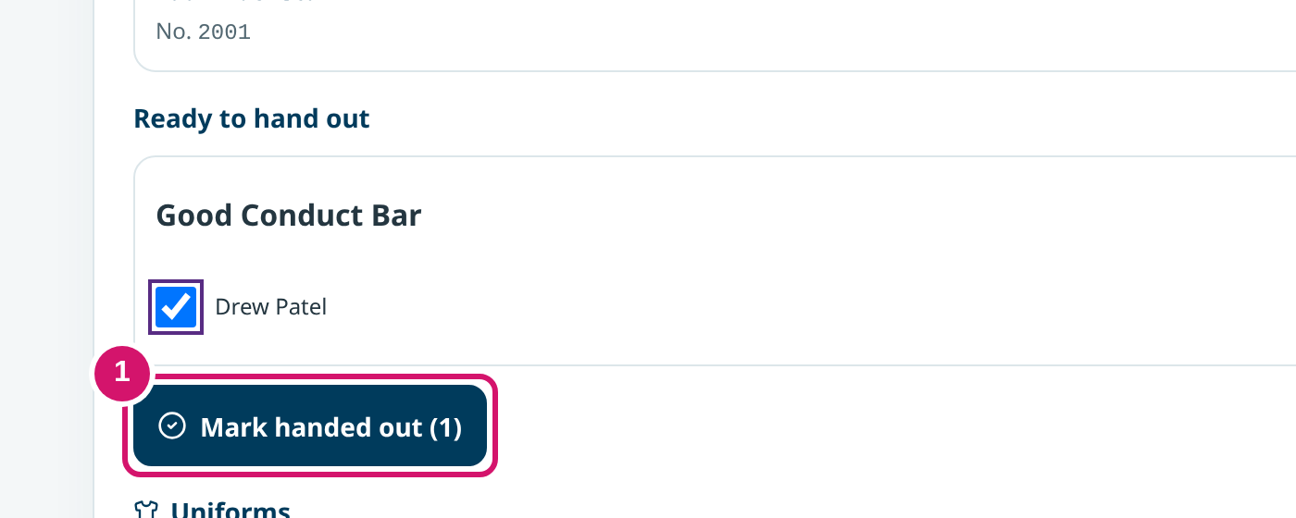
DIRECTOR · ORDERS
Slide 19 · part 1 of 2
Mark it handed out; stock goes down
• Drew's Good Conduct Bar: 3 on hand before.
• The app takes it off your supplies. Don't subtract it again by hand.
① Mark handed out
Notes:
SAY
Drew earned a Good Conduct Bar and the club has three. Jordan ticks Drew and chooses Mark handed out. The item leaves the list and the supply count drops to two on its own, so don't change the count by hand as well.
POINT TO
Point to Mark handed out, then the stock of 2.

Slide 29
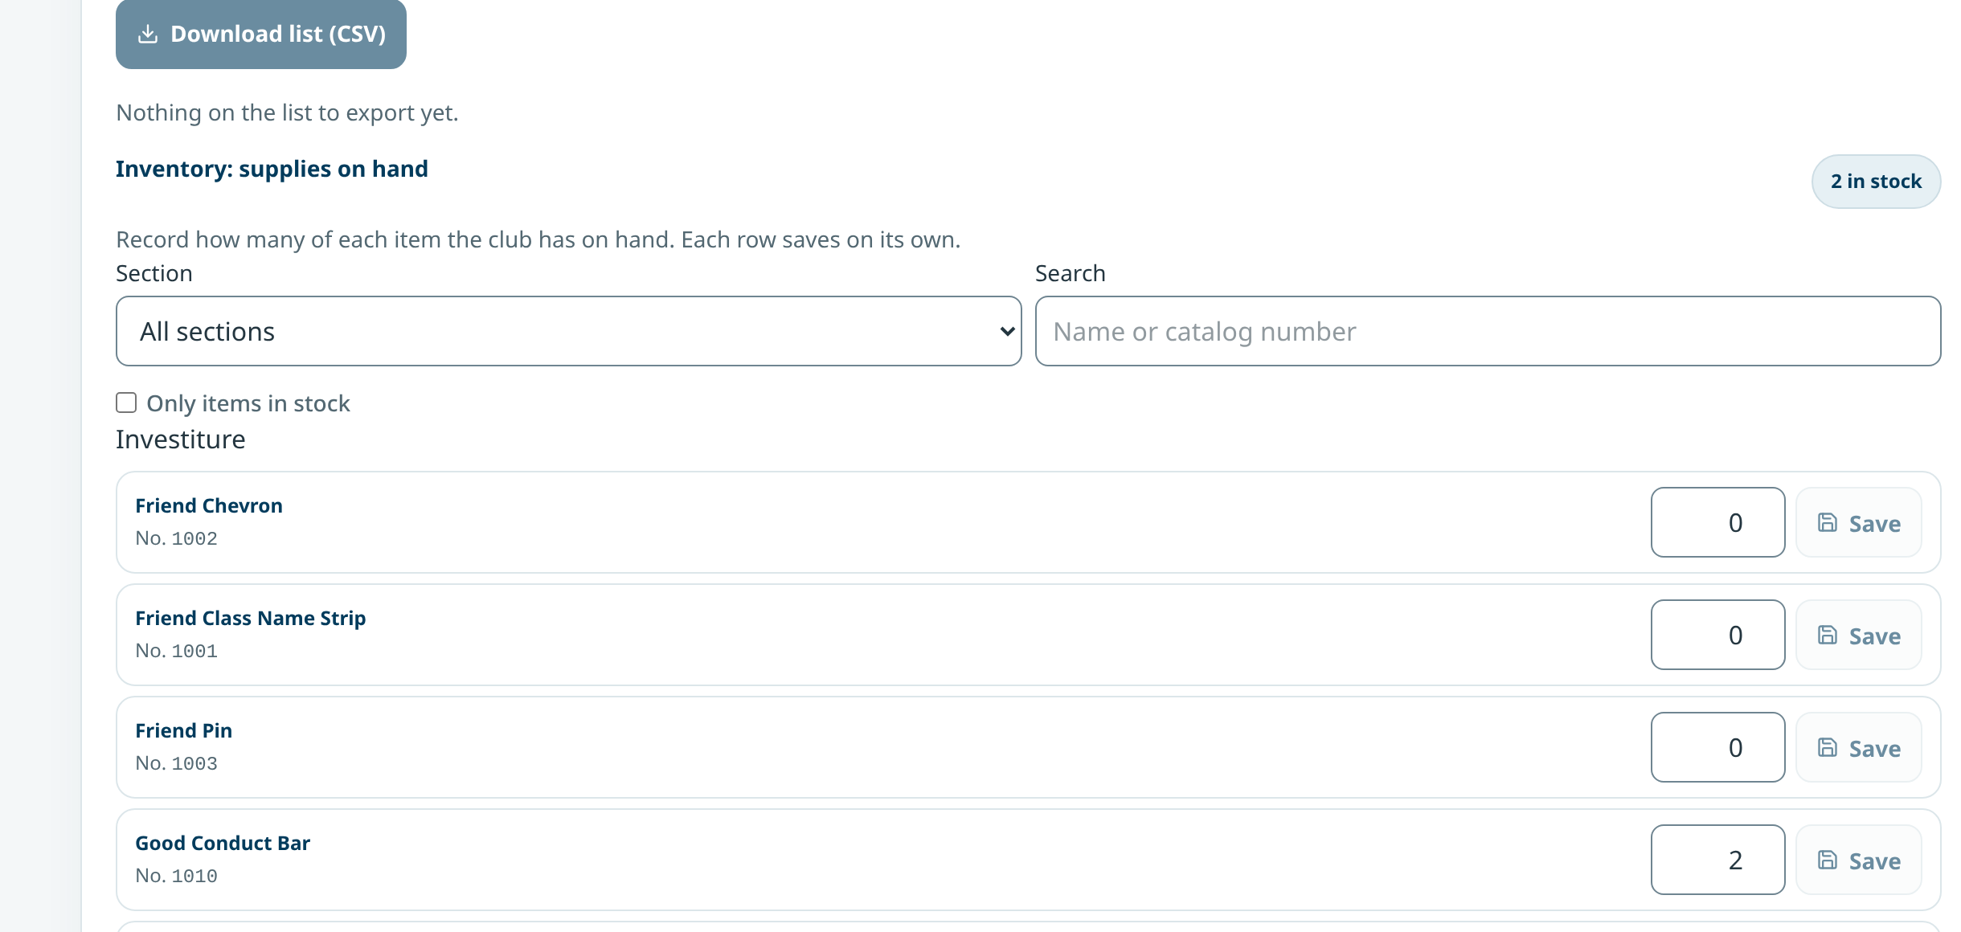
DIRECTOR · ORDERS
Slide 19 · part 2 of 2
Mark it handed out; stock goes down
• Drew's Good Conduct Bar: 3 on hand before.
• The app takes it off your supplies. Don't subtract it again by hand.
Good Conduct Bar: 2 on hand
Notes:
Slide 19, part 2 of 2. Notes are on part 1.

Slide 30
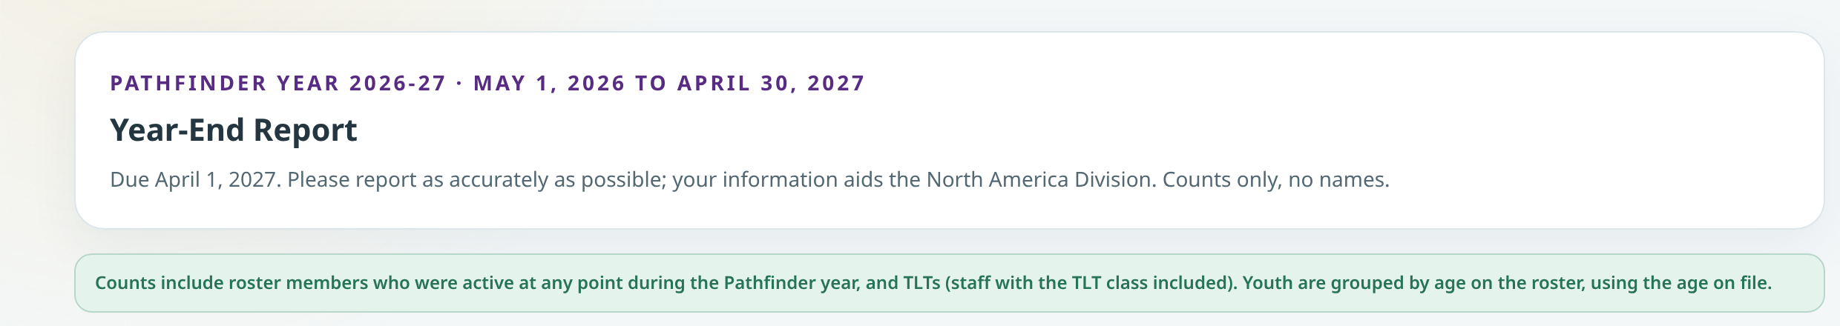
DIRECTOR · YEAR-END REPORT
Slide 20 · part 1 of 3
Most of the Year-End Report fills itself
• Due April 1, 2027. Counts only, no names.
• Save draft keeps it open. Submit report locks it until staff reopen it.
Pathfinder year May 1–April 30
Notes:
SAY
The Year-End Report covers the Pathfinder year, May 1 to April 30, which is different from the September club year. It is due April 1. Your roster, honors and classes fill in most of the counts. Check them, add the few things only you know, and use Save draft until you are ready. Submitting locks it until conference staff reopen it.
POINT TO
Point to Membership total, then Save draft.

Slide 31
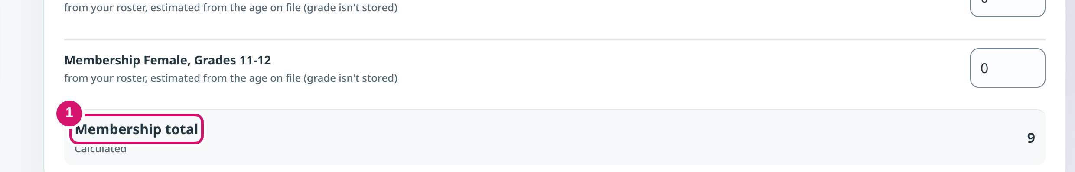
DIRECTOR · YEAR-END REPORT
Slide 20 · part 2 of 3
Most of the Year-End Report fills itself
• Due April 1, 2027. Counts only, no names.
• Save draft keeps it open. Submit report locks it until staff reopen it.
① Counts from the roster
Notes:
Slide 20, part 2 of 3. Notes are on part 1.

Slide 32
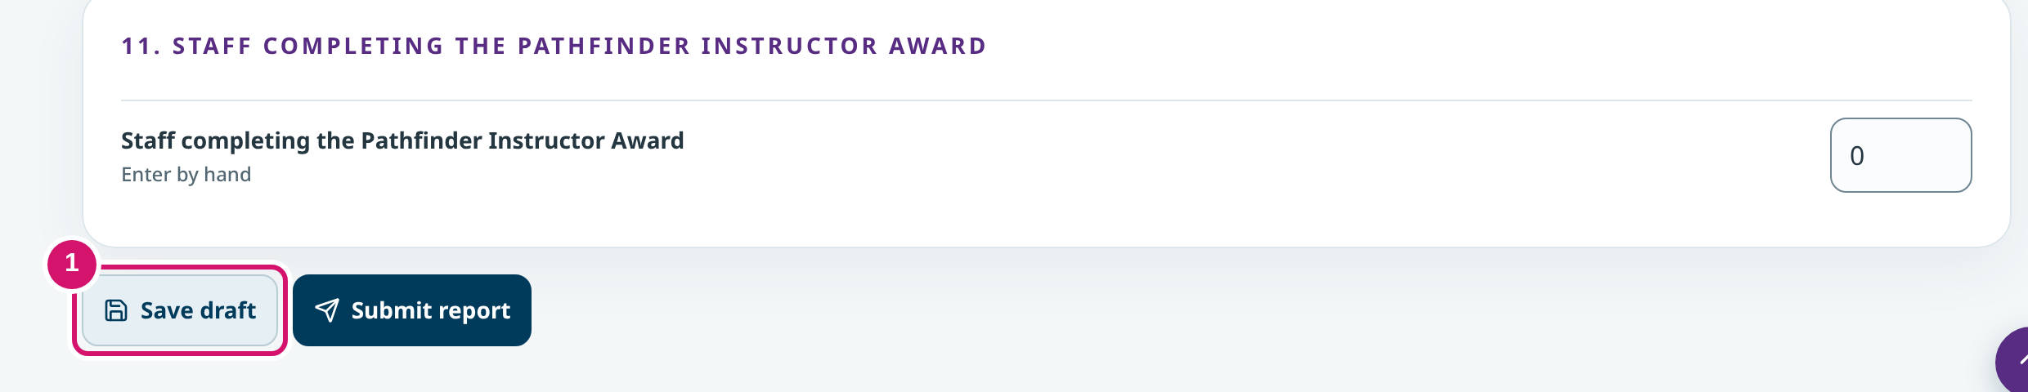
DIRECTOR · YEAR-END REPORT
Slide 20 · part 3 of 3
Most of the Year-End Report fills itself
• Due April 1, 2027. Counts only, no names.
• Save draft keeps it open. Submit report locks it until staff reopen it.
① Save draft
Notes:
Slide 20, part 3 of 3. Notes are on part 1.

Slide 33
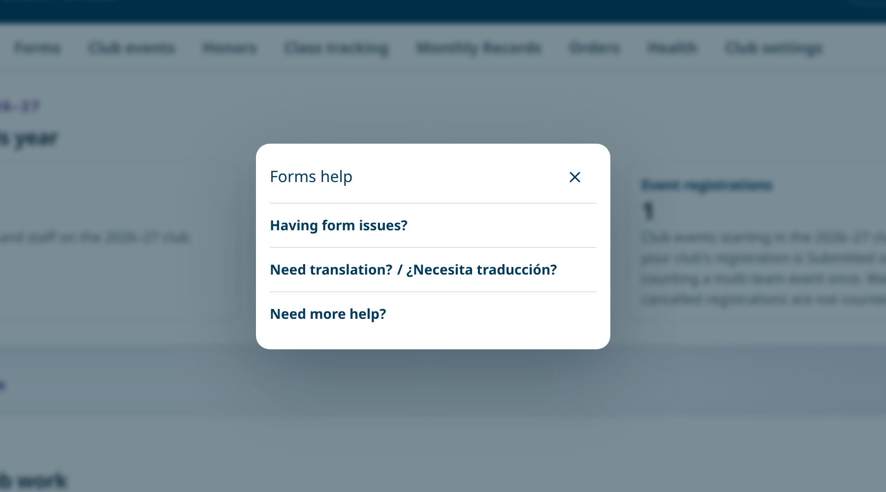
GETTING HELP
Slide 21 · part 1 of 2
Help is one click away
• Forms help: form issues, translation, and how to reach the office.
• Help → Step by step: guides with a picture of every step.
Forms help in the club portal
Notes:
SAY
Every club page has Forms help at the top. It covers common form problems, translation, and how to reach the conference office. The Help page in your account menu has short guides and Step by step guides, with a picture of the real screen for each step. Reading a guide doesn't finish a task; the work happens on the working pages.

Slide 34
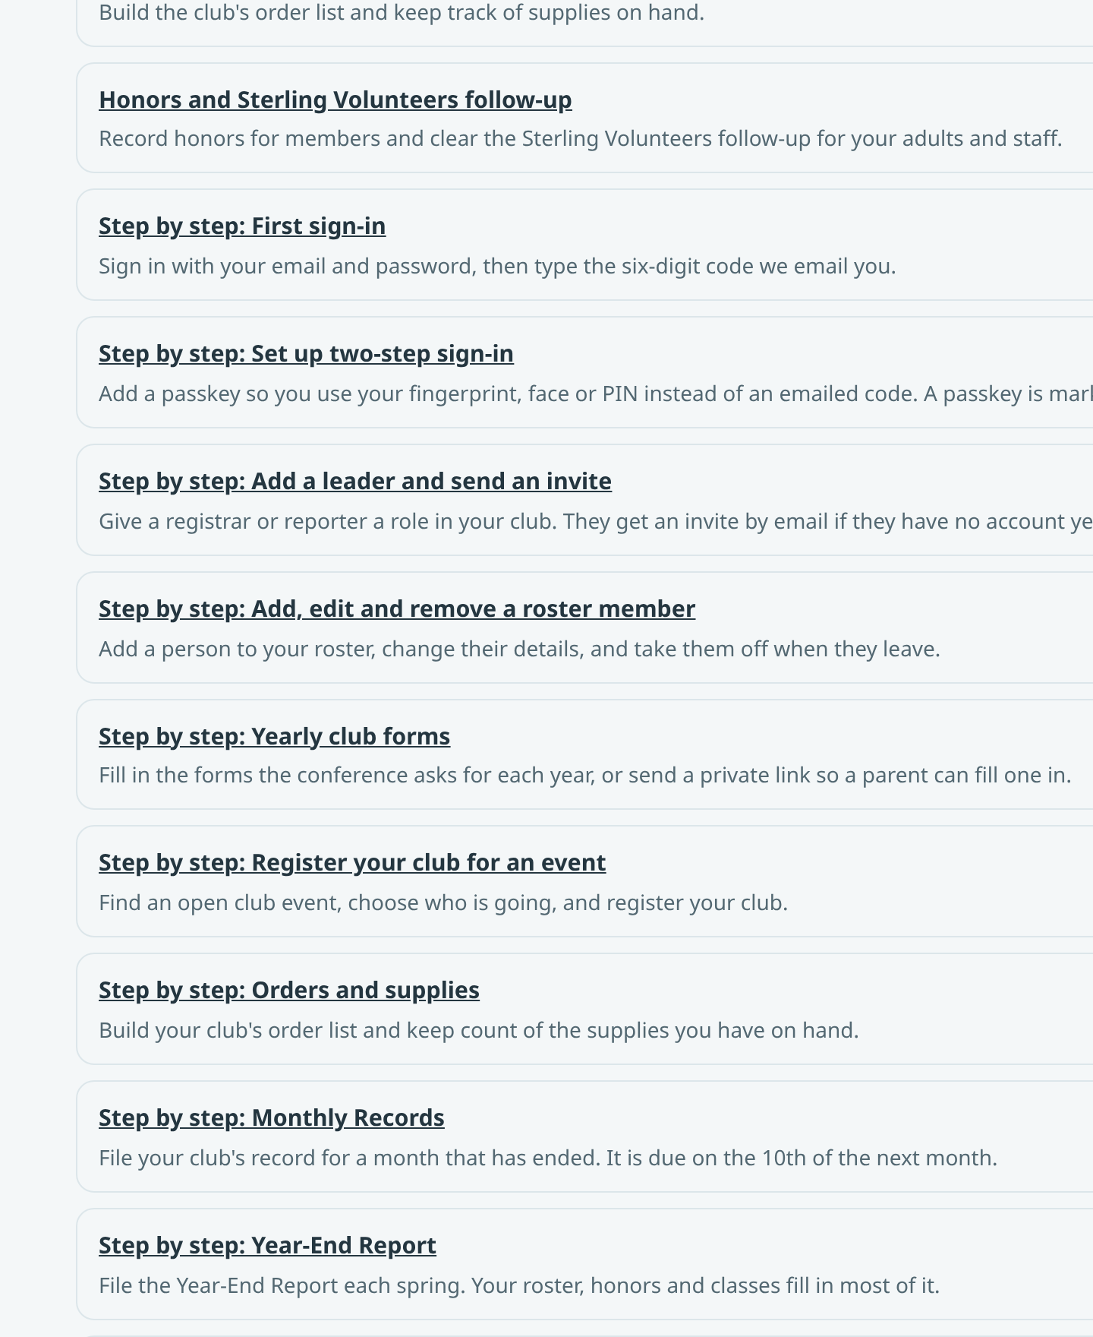
GETTING HELP
Slide 21 · part 2 of 2
Help is one click away
• Forms help: form issues, translation, and how to reach the office.
• Help → Step by step: guides with a picture of every step.
Step-by-step guides
Notes:
Slide 21, part 2 of 2. Notes are on part 1.

Slide 35
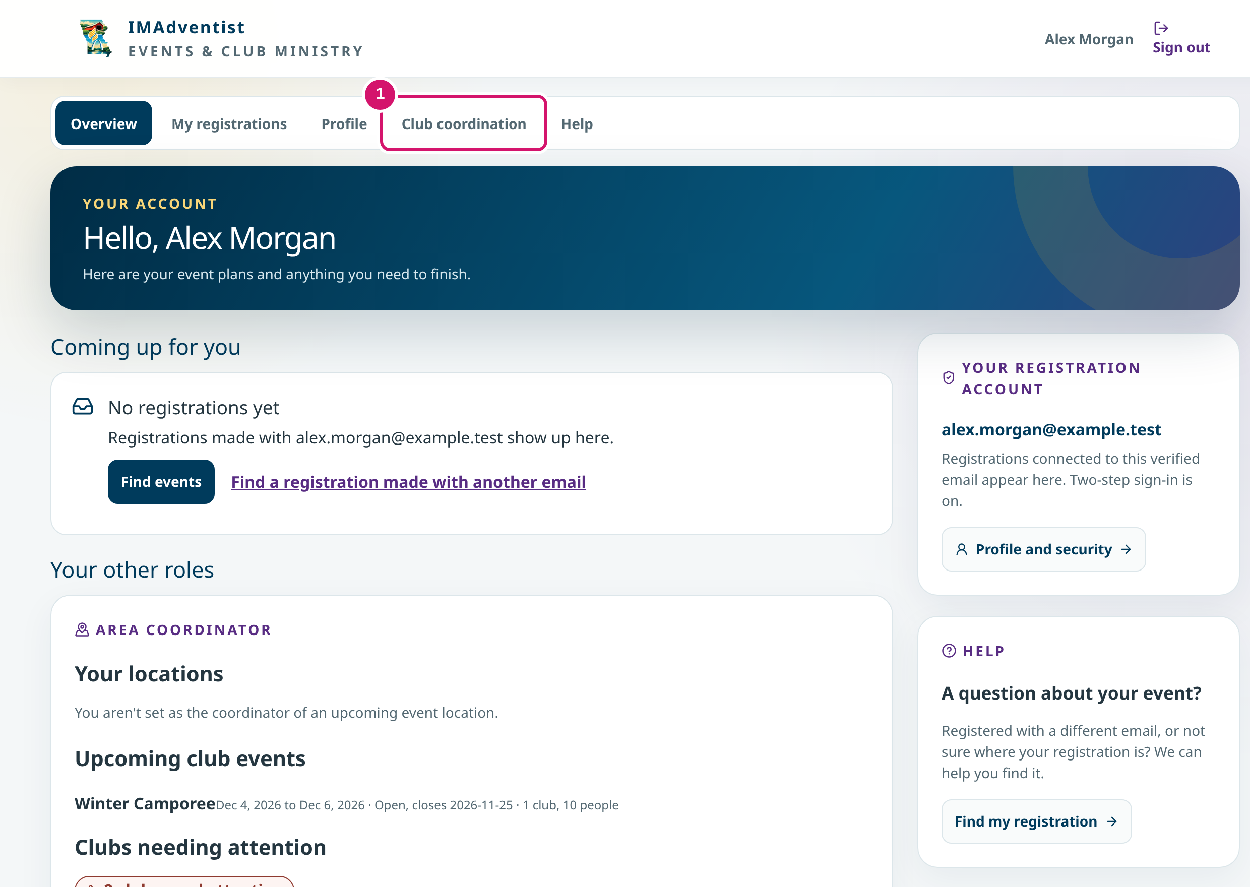
AREA COORDINATOR
Slide 22
Alex opens Club coordination
• Account menu: Overview, My registrations, Profile, Club coordination, Help.
• The Area Coordinator card shows upcoming club events and clubs needing attention.
① Club coordination
Notes:
SAY
Now we switch to Alex. Alex's account page has an Area Coordinator card with upcoming club events and clubs that need attention. Everything for coordinators lives under Club coordination in the account menu.
POINT TO
Point to Club coordination (1).

Slide 36
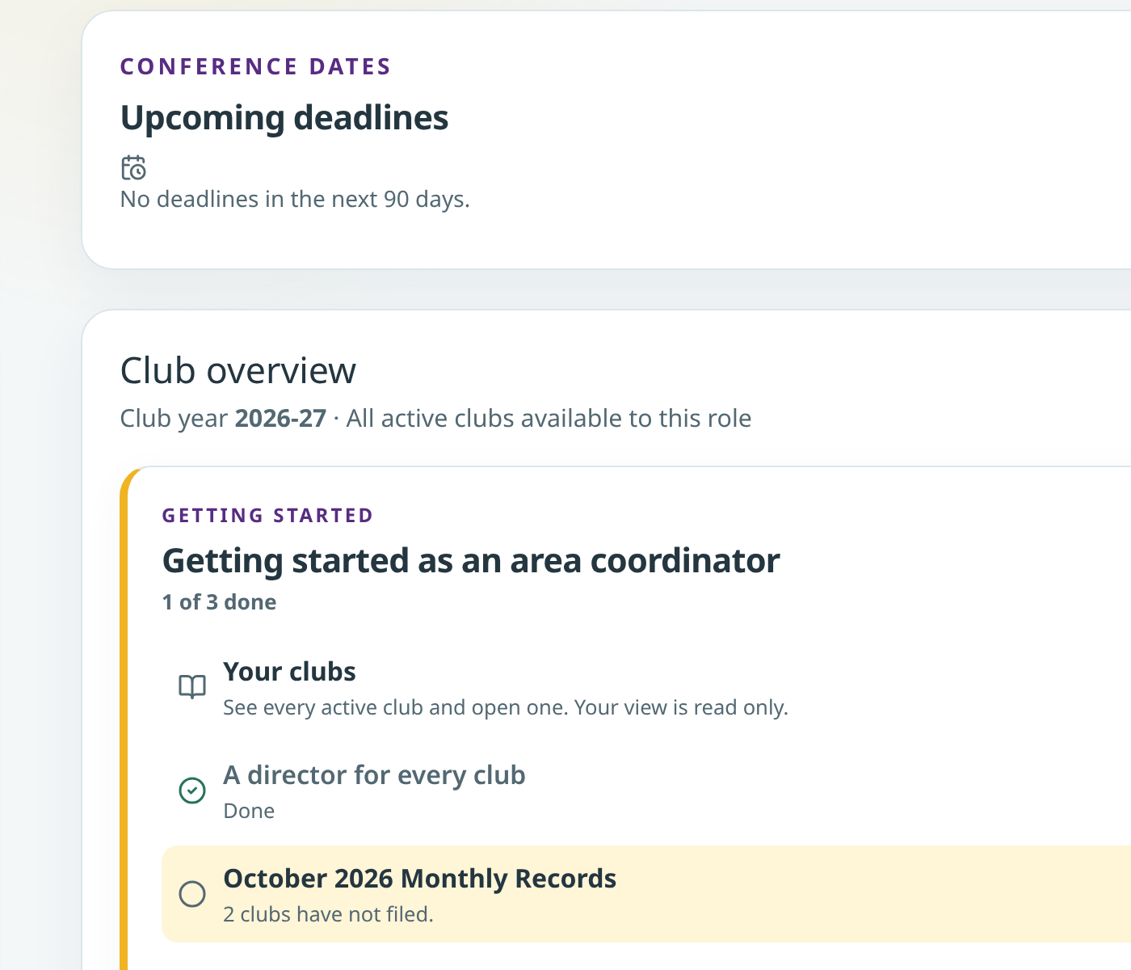
AREA COORDINATOR · OVERVIEW
Slide 23 · part 1 of 2
Start with who is missing what
• Tabs: Overview, Monthly Records, Points, Club events, Team approvals, New clubs, Waitlists.
• Each club that is behind shows one next step.
Overview and Getting started
Notes:
SAY
The Overview tab shows upcoming deadlines, a Getting started list and a summary for the year. Who's missing what lists each club that is behind, with one next step. For Lakeview and Pine Grove the next step is to contact the director about the Monthly Record. The app does not send that message for you.
POINT TO
Point to the Next step column.

Slide 37
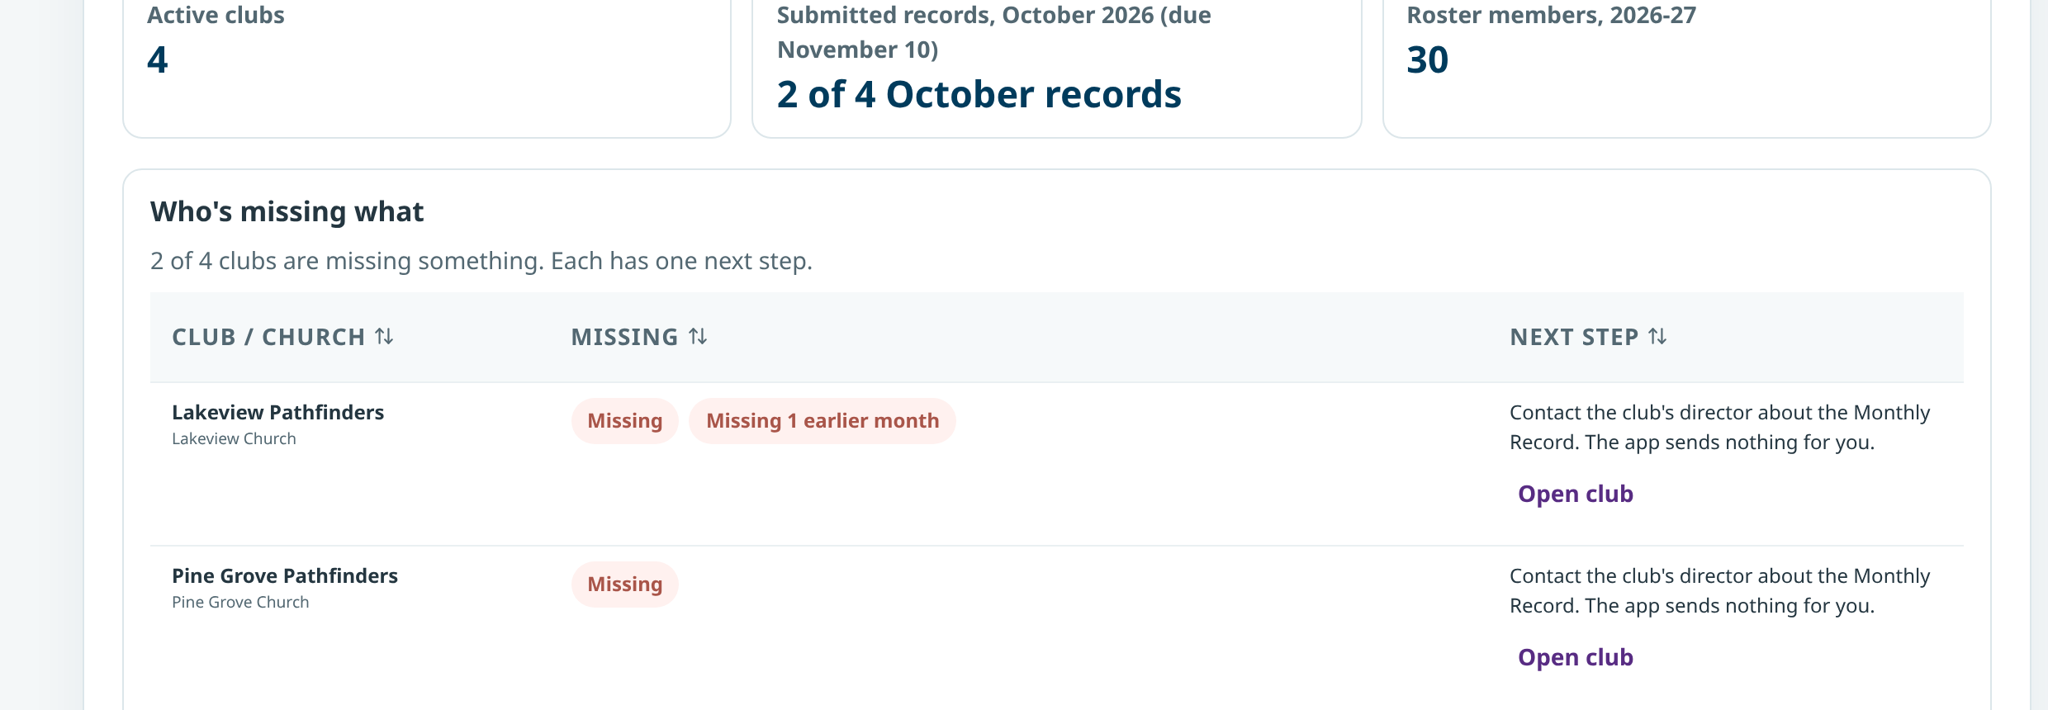
AREA COORDINATOR · OVERVIEW
Slide 23 · part 2 of 2
Start with who is missing what
• Tabs: Overview, Monthly Records, Points, Club events, Team approvals, New clubs, Waitlists.
• Each club that is behind shows one next step.
Who's missing what
Notes:
Slide 23, part 2 of 2. Notes are on part 1.

Slide 38
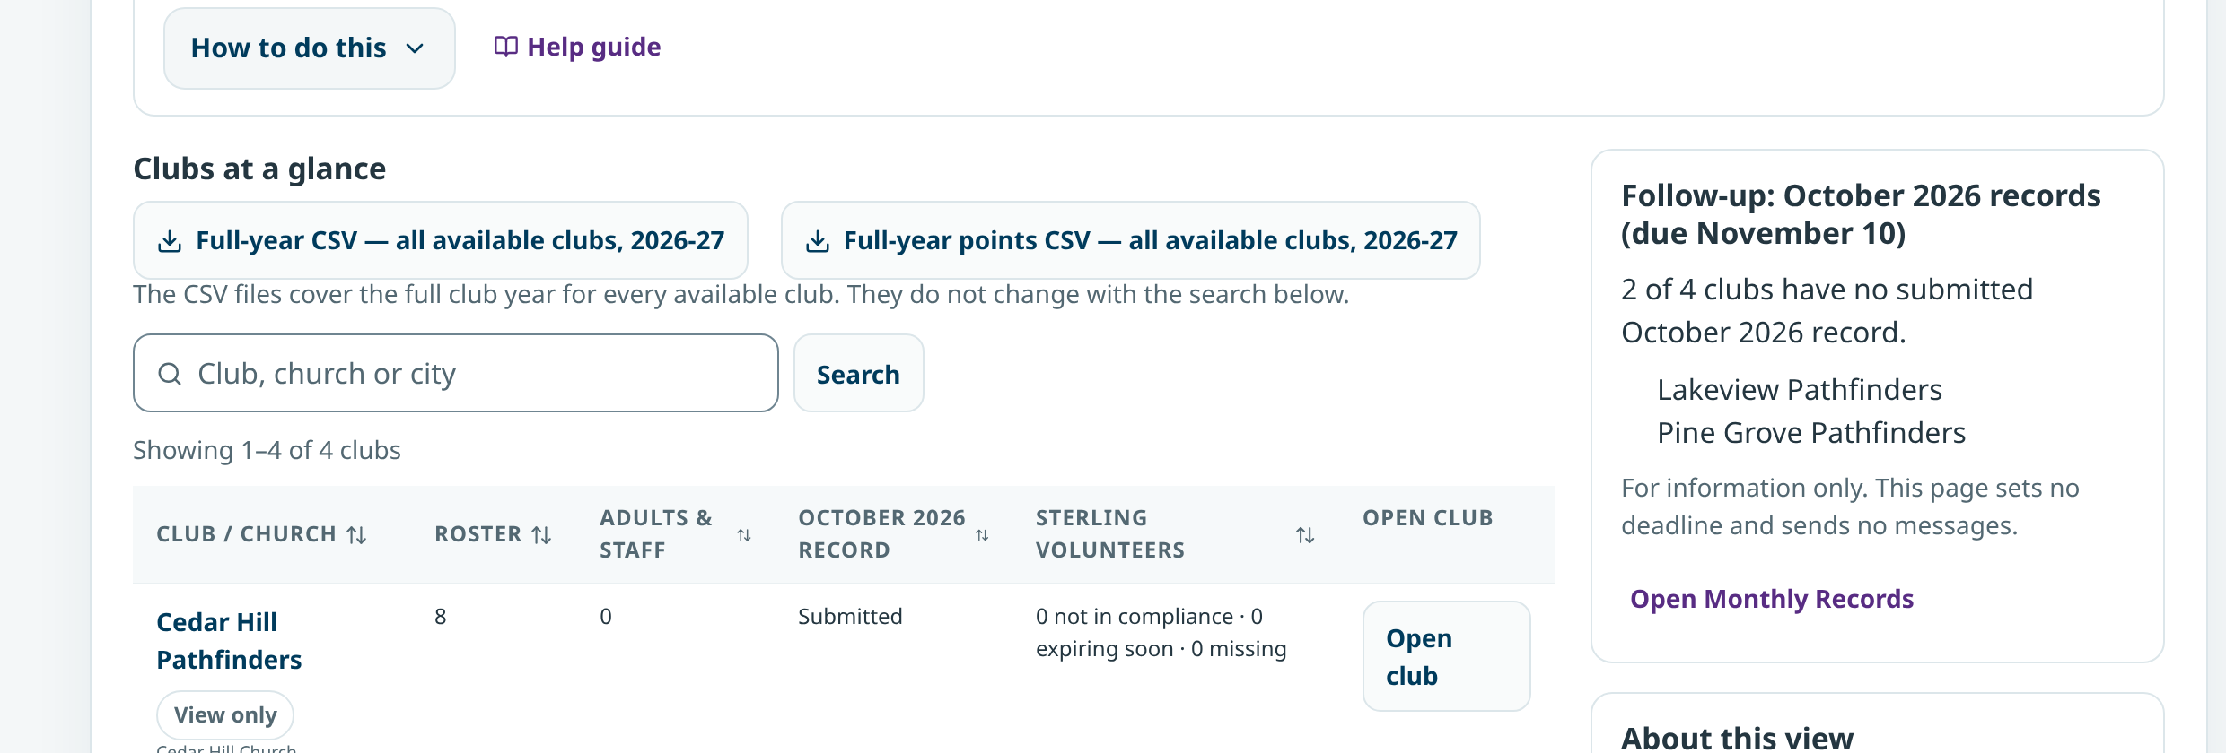
AREA COORDINATOR · CLUBS AT A GLANCE
Slide 24 · part 1 of 2
Every club, view only
• Search by club, church or city; download the full-year CSV.
• Open club shows the club's pages without editing controls.
Clubs at a glance
Notes:
SAY
Clubs at a glance is the club list. It shows roster size, adults and staff, the current month's record and Sterling Volunteers screening counts. Open club shows the club's own pages in view-only mode. The director keeps the roster and settings, so ask the director for any change.
POINT TO
Point to View only on each row.

Slide 39
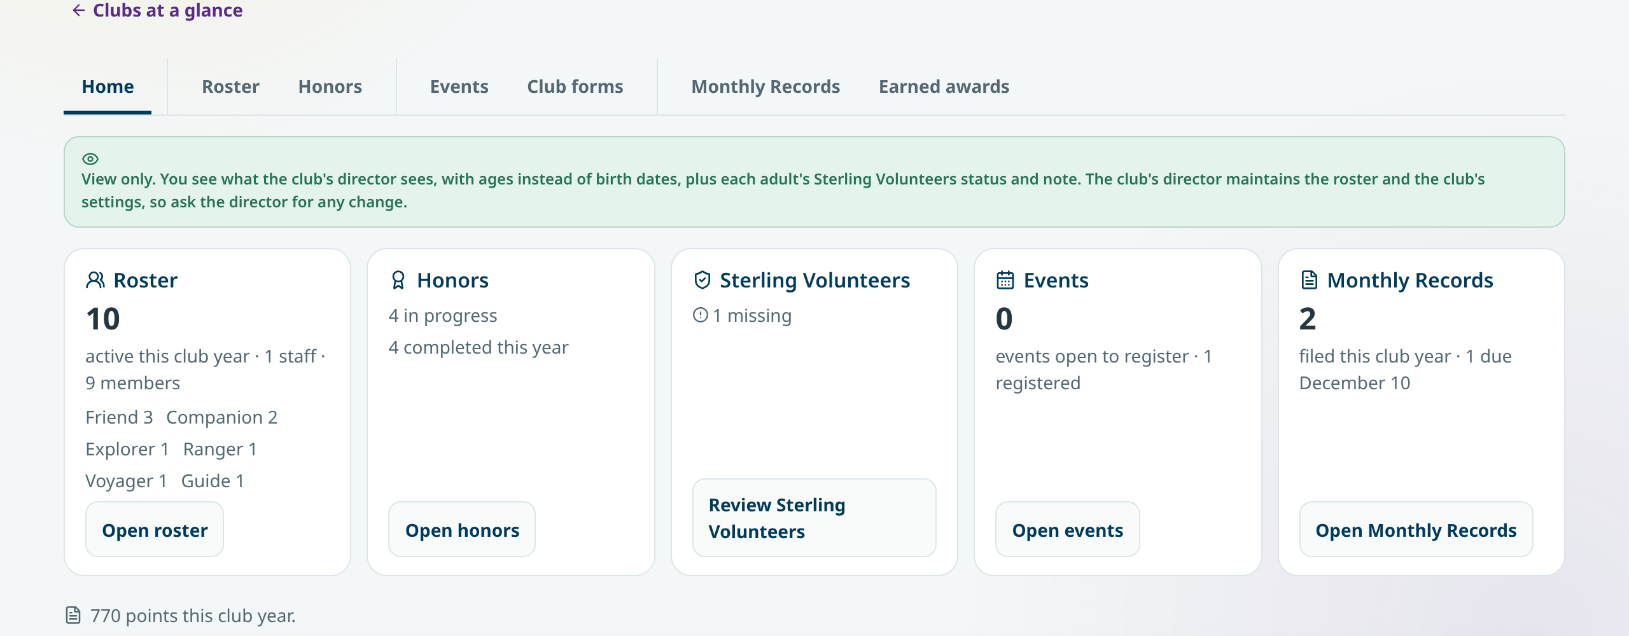
AREA COORDINATOR · CLUBS AT A GLANCE
Slide 24 · part 2 of 2
Every club, view only
• Search by club, church or city; download the full-year CSV.
• Open club shows the club's pages without editing controls.
Riverton, view only
Notes:
Slide 24, part 2 of 2. Notes are on part 1.

Slide 40
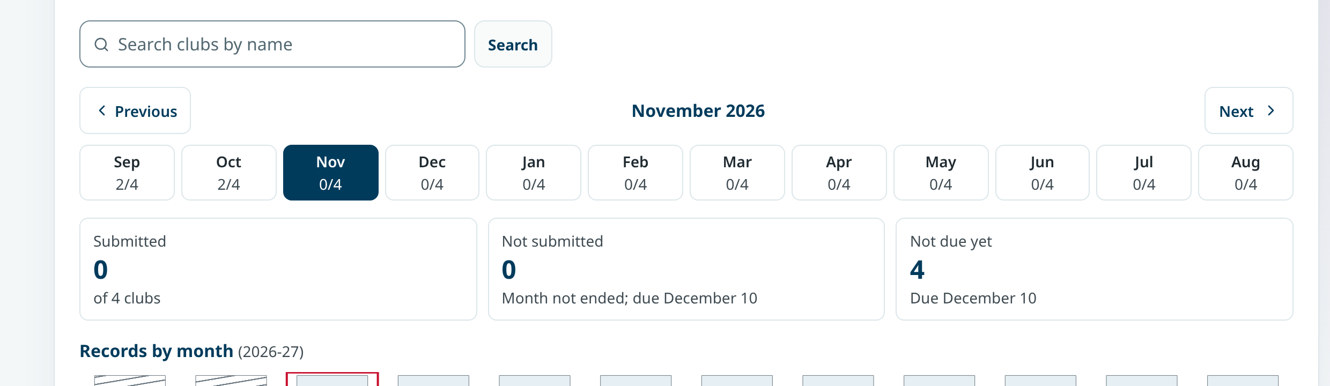
AREA COORDINATOR · MONTHLY RECORDS
Slide 25 · part 1 of 2
Read the month across clubs
• Pick a month to see Submitted, Not submitted and Not due yet.
• Open a submitted record to read it.
Monthly Records by month
Notes:
SAY
Monthly Records shows every club for a month. Submitted means the club filed it. Not submitted means the month ended without a filed record. Open a submitted record to read it; coordinators read reports but do not change them.

Slide 41
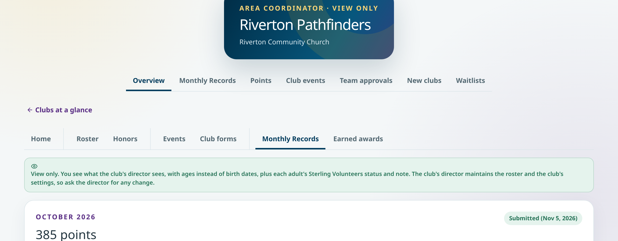
AREA COORDINATOR · MONTHLY RECORDS
Slide 25 · part 2 of 2
Read the month across clubs
• Pick a month to see Submitted, Not submitted and Not due yet.
• Open a submitted record to read it.
Riverton October, read only
Notes:
Slide 25, part 2 of 2. Notes are on part 1.

Slide 42
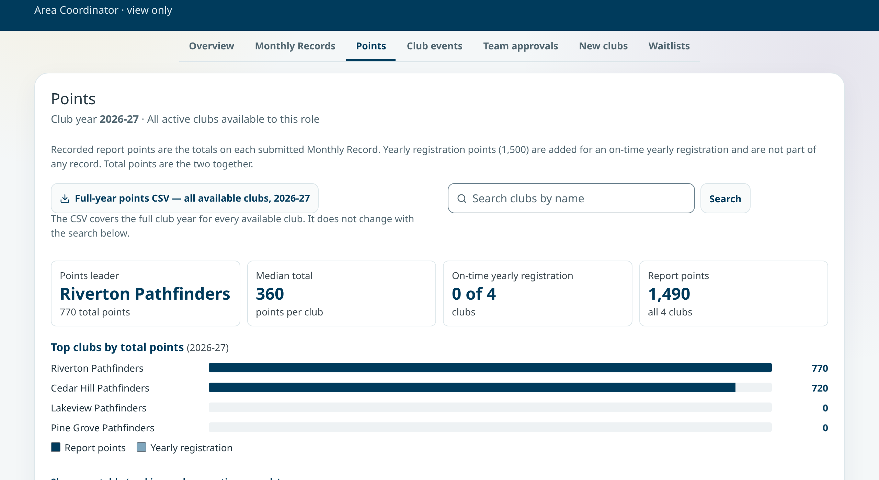
AREA COORDINATOR · POINTS
Slide 26
See how points add up
• Report points plus on-time yearly registration points.
• Riverton leads with 770 after two submitted records.
• Full-year points CSV covers every available club.
Points
Notes:
SAY
Points adds up each club's Monthly Record points and the on-time yearly registration points. Riverton has 770 after two submitted records. Show as a table gives the ranking with supporting records, and the CSV covers the full year for every club.

Slide 43
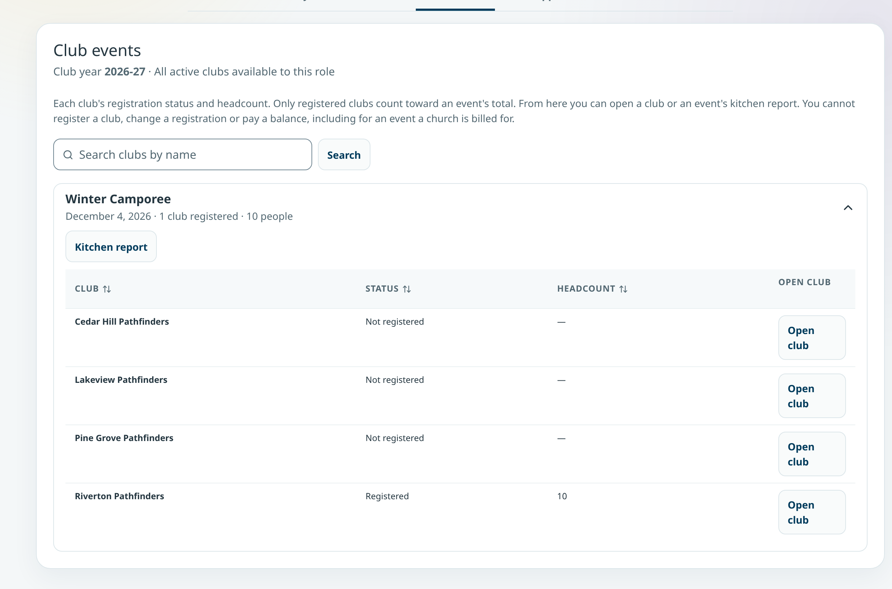
AREA COORDINATOR · CLUB EVENTS
Slide 27
Who is registered for each event
• Riverton: Registered, 10 people. Other clubs: Not registered.
• Only registered clubs count toward the event total.
• Coordinators can't register a club or change a registration.
Winter Camporee
Notes:
SAY
Club events shows each club's registration status and headcount for every club event. Winter Camporee has one club registered with ten people. Only registered clubs count toward the total. If a club hasn't registered, the follow-up is a conversation with the director.

Slide 44
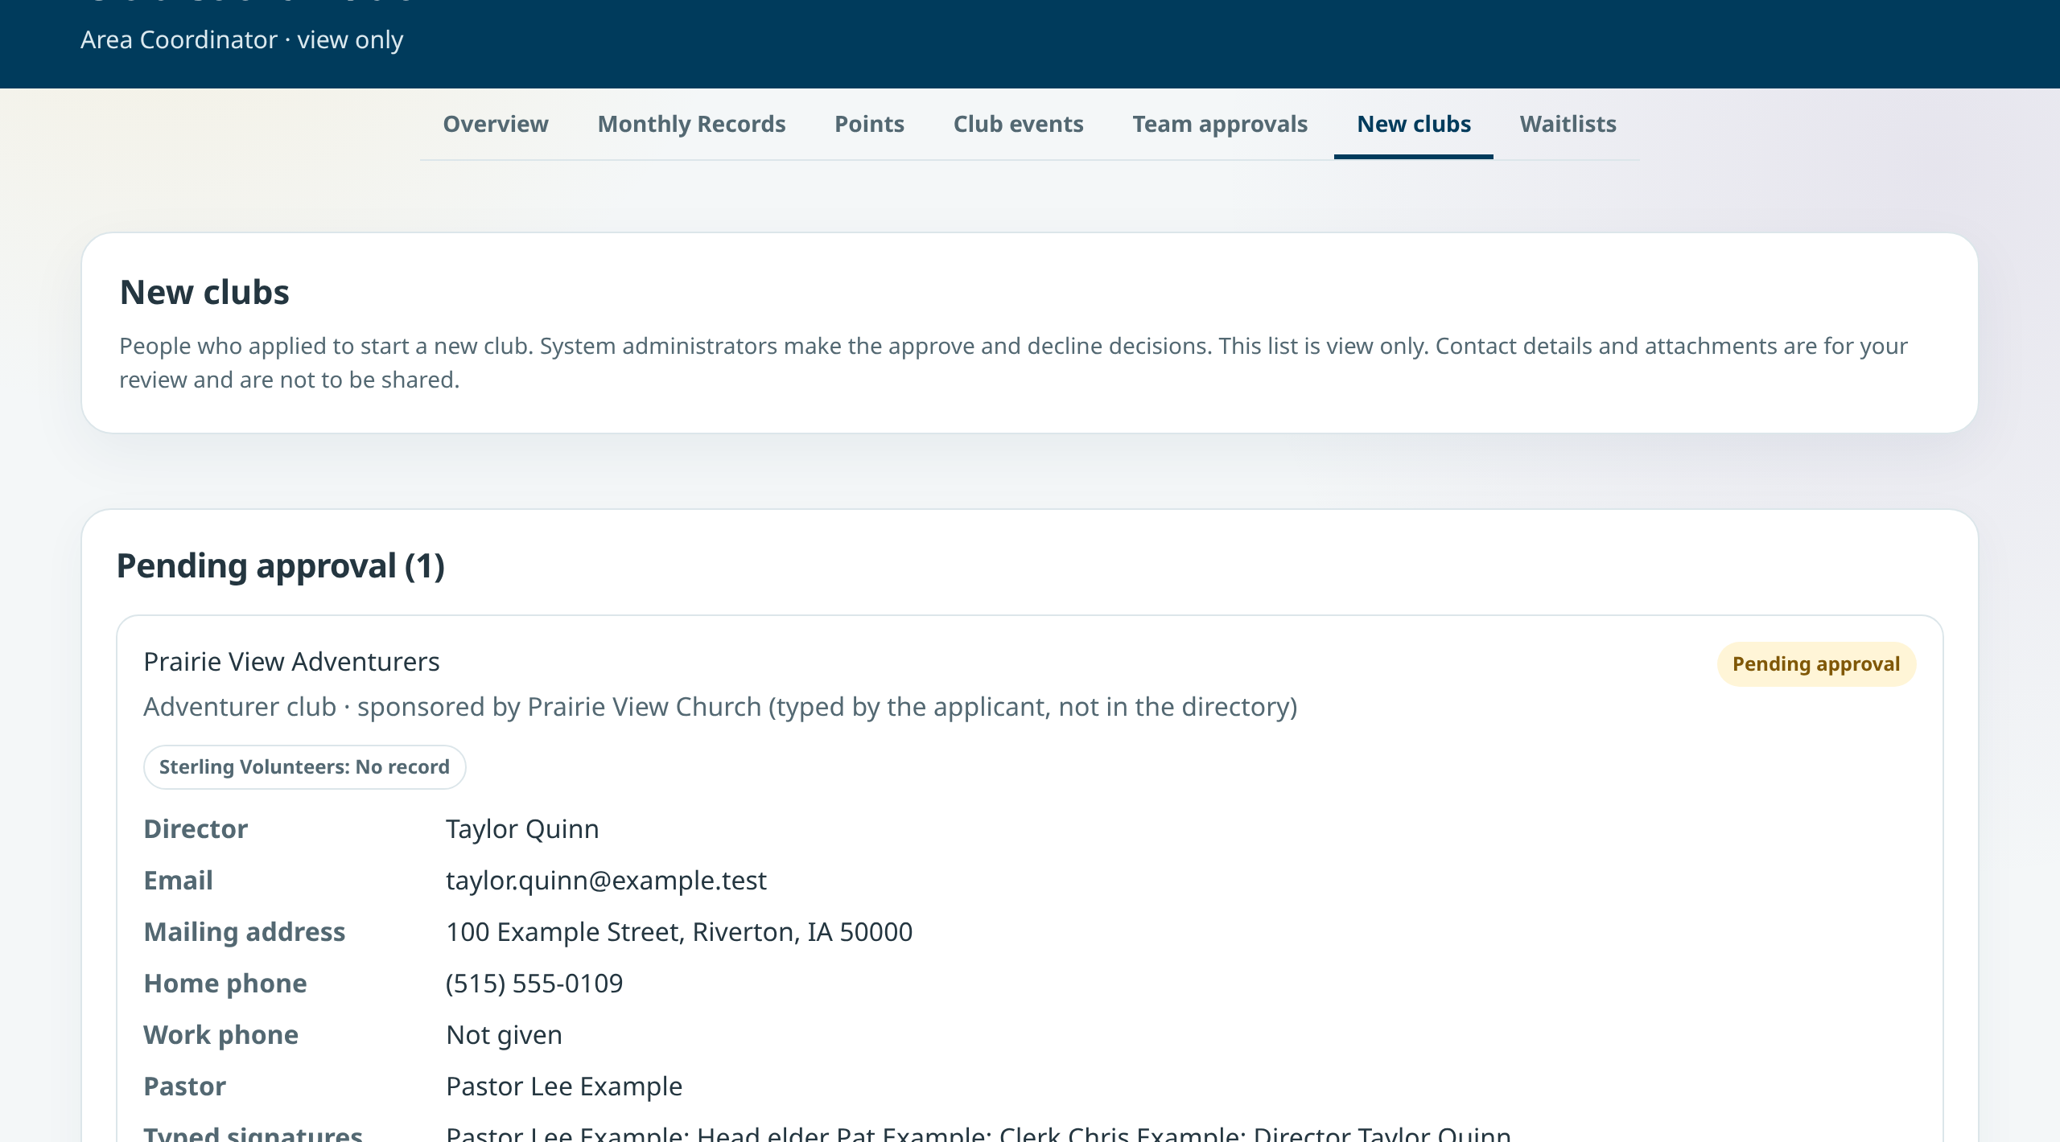
AREA COORDINATOR · NEW CLUBS
Slide 28
Read new club applications
• Coordinators read the application.
• A system administrator approves or declines it.
• Cancelled applications are collapsed out of the way.
Pending approval
Notes:
SAY
New clubs shows applications from people who want to start a club. Coordinators can read the details, but a system administrator makes the decision. Team approvals is the one place where a coordinator decides something: adult team members of 18 or older when a club asks.

Slide 45
EVERYDAY HABITS
Slide 29
Small changes that protect your work
Before you leave a page
Finding things
Reading status
• Search boxes filter as you type. No Enter needed.
• Select a column header to sort a table. Clear filters brings everything back.
• Lists use one Download CSV link.
• Draft: started, not submitted.
• Submitted, Confirmed, Waitlisted, Cancelled mean the same thing on every page.
• Saving… shows while a button works; Saved. confirms it.
• If you changed something and didn't save, the app asks: Leave without saving?
• Choose Keep editing to go back, or Leave without saving.
Notes:
SAY
A few small changes apply everywhere. If you start editing and try to leave, the app asks before discarding your changes. Searches update as you type. Table headers sort. And the status words are the same on every page, so Draft always means started but not submitted.

Slide 46
LOOKING AHEAD
Slide 30
What is done and what is still planned
Already built
Planned (not yet built)
Possible later
• Event form builder: templates, a question library, phone editing and All/Any rules.
• Redesigned public home, events, calendar, event and club ministry pages.
• Step-by-step Help guides with pictures.
• Public merchandise.
• Full residential camp registration.
• Returning profiles and a wallet; partner connections such as eAdventist and UltraCamp.
• Saved views for staff lists.
• Adventurer ministry and YMMS move.
• Shared ledger with held credits and installments.
Notes:
SAY
Some of what you see today was finished recently: the event form builder improvements, the public site redesign and the picture guides. Other items are still planned or are longer-term possibilities. Planned means tracked work that has not been built. Possible means an idea that still needs decisions. None of the planned or possible items are in the app today.
POINT TO
Keep the three labels distinct. Don't promise dates.

Slide 47
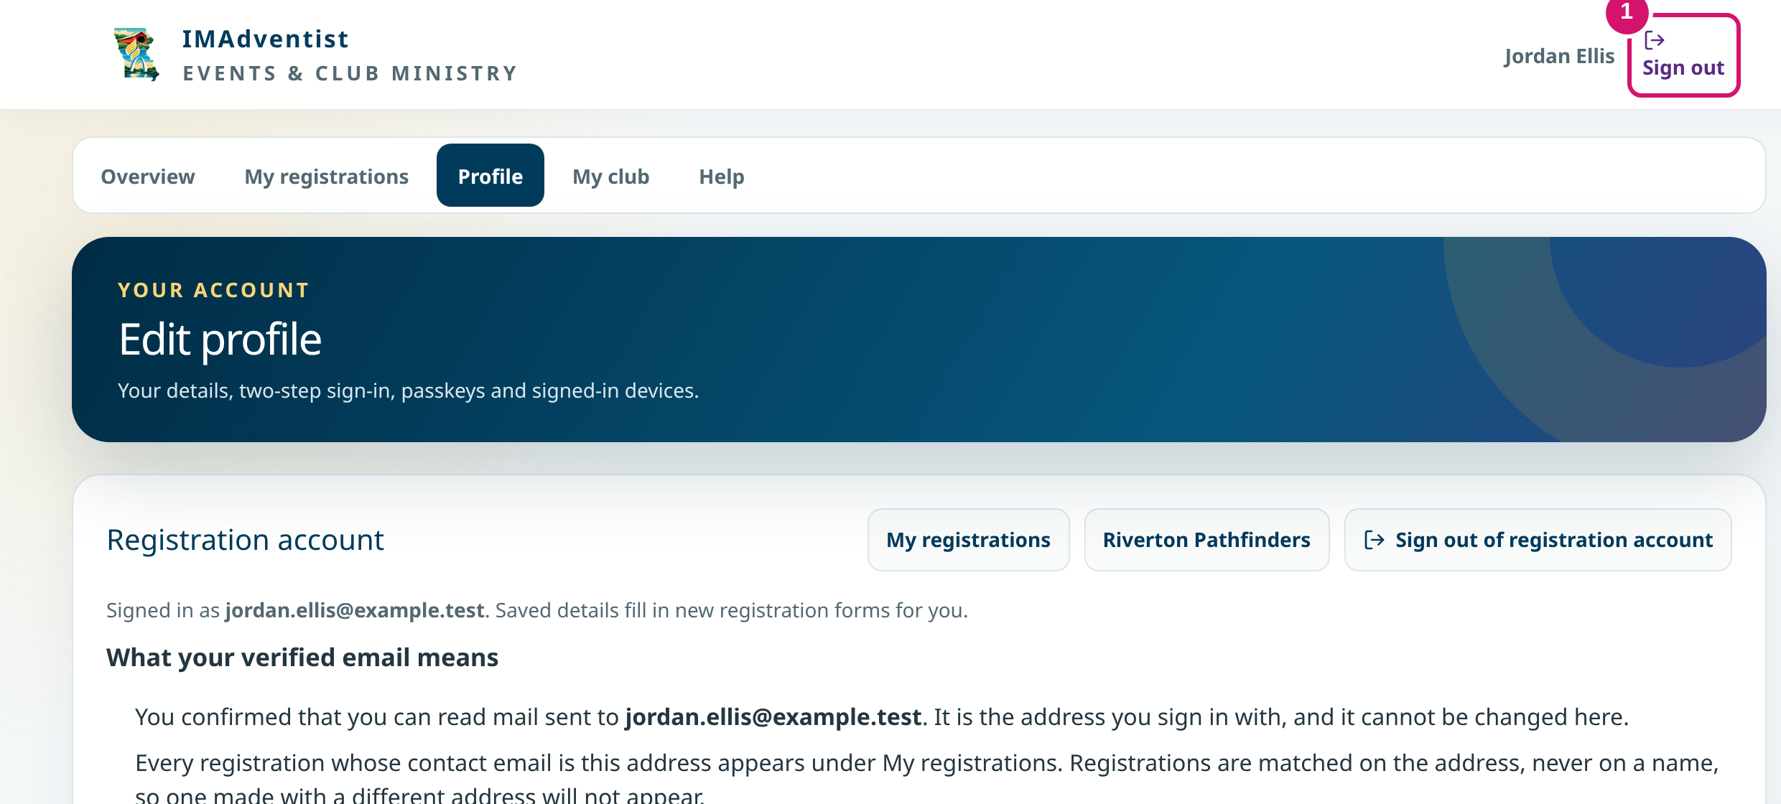
READY TO USE IT
Slide 31
Finish safely
• Check the saved result of your task before you leave.
• Choose Sign out, especially on a shared computer.
• Questions: support@imsda.org · (515) 223-1197
① Sign out
Notes:
SAY
Before you close the browser, check that your task saved: a row on the roster, a Submitted label, a confirmation number. Then sign out, especially on a shared computer. If something doesn't work, contact the conference office and tell them the club, the page, what you were trying to do and any message you saw. Please leave passwords, codes and health details out of the message.
POINT TO
Point to Sign out (1).

