Slide 1
Correlation-aware anonymization of high-dimensional data (CAHD)
Fabrizio Durante
Luca Repetto
Matteo Salvatore

Slide 2
introduction
CAHD is an effective anonymization technique for sparse, high-dimensional data, it relies on a novel data representation, in the form of a band matrix, which captures the correlation within the data.
CAHD achieves superior data utility compared to existing state-of-the-art, and it also yields reduced computational overhead.

Slide 3
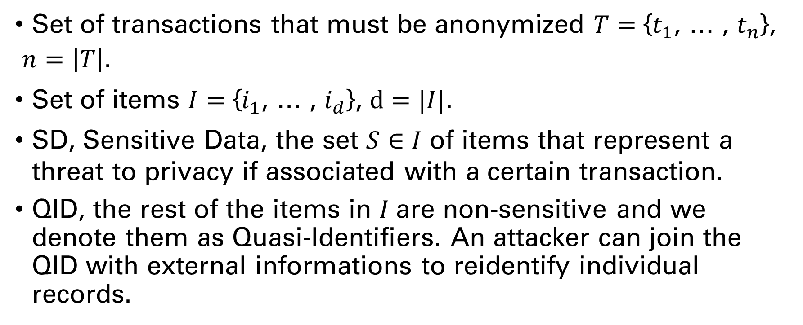
definitions
Set of transactions that must be anonymized $T$ $=$ {$t_{1}$, … , $t_{n}$},
$n=\left|T\right|$.
Set of items $I=$ {$i_{1}$, … , $i_{d}$}, $d=|I|$.
SD, Sensitive Data, the set $S∈I$ of items that represent a threat to privacy if associated with a certain transaction.
QID, the rest of the items in $I$are non-sensitive and we denote them as Quasi-Identifiers. An attacker can join the QID with external informations to reidentify individual records.

Slide 4
requirements
The Anonymized Transaction data should satisfy two requirements:
Privacy requirements
Utility requirements

Slide 5
behaviour
The CAHD algorithm is based on two steps:
Create Band Matrix using Reverse Cuthill-McKee Algorithm (RCM) to fulfill utility requirement.
Create Anonymized Groups to fulfill privacy requirement.

Slide 6
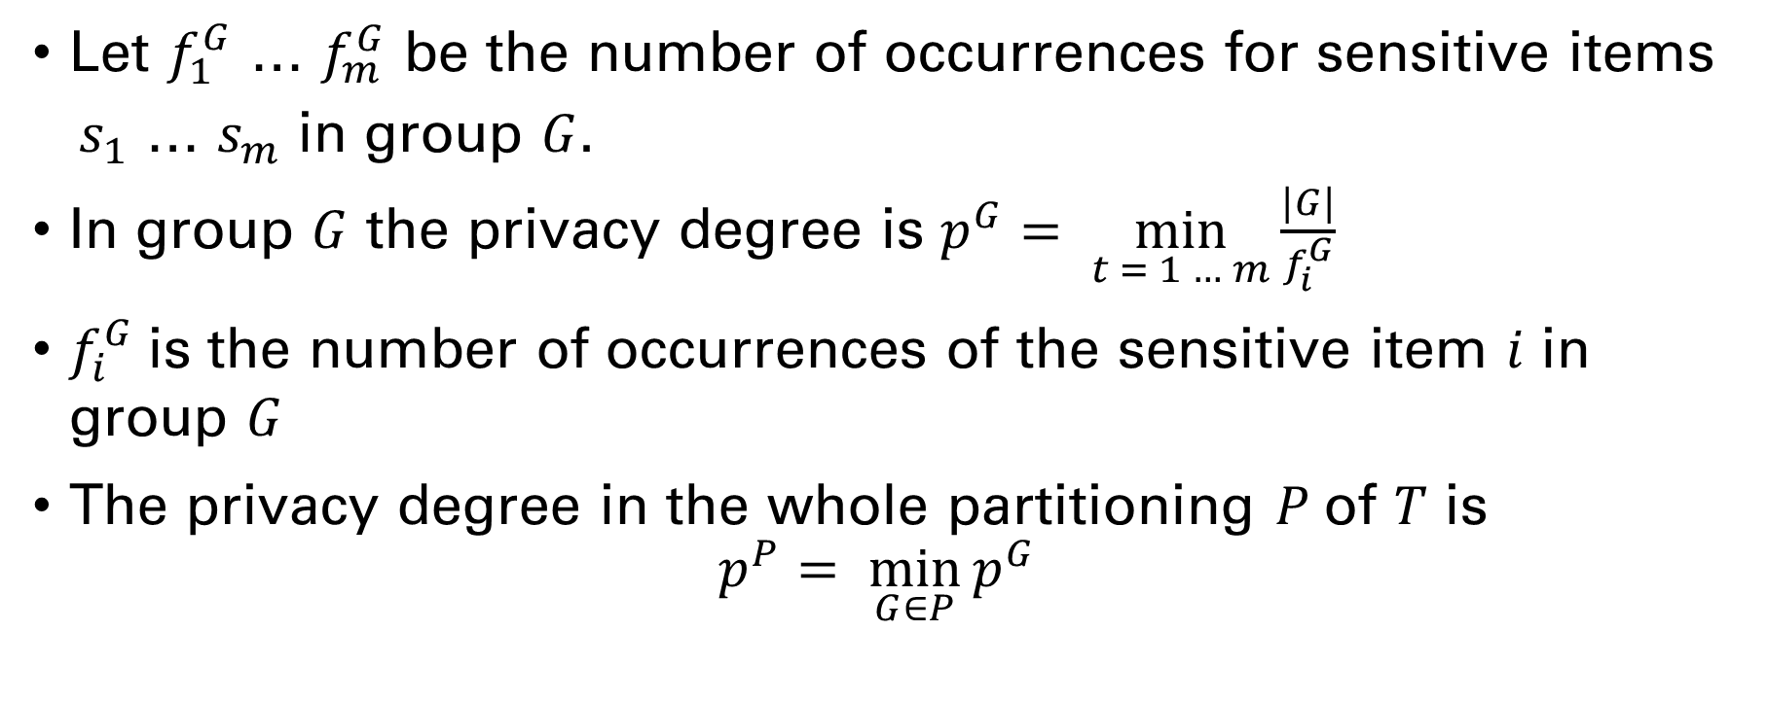
Privacy requirements
Let $f_{1}^{G}$ … $f_{m}^{G}$ be the number of occurrences for sensitive items
$s_{1}$ … $s_{m}$ in group $G$.
In group $G$ the privacy degree is $p^{G}= \min_{t = 1 … m}{\frac{|G|}{f_{i}^{G}}}$
$f_{i}^{G}$is the number of occurrences of the sensitive item $i$ in group $G$
The privacy degree in the whole partitioning $P$of $T$ is
$$p^{P}= \min_{G∈P}{p^{G}}$$

Slide 7
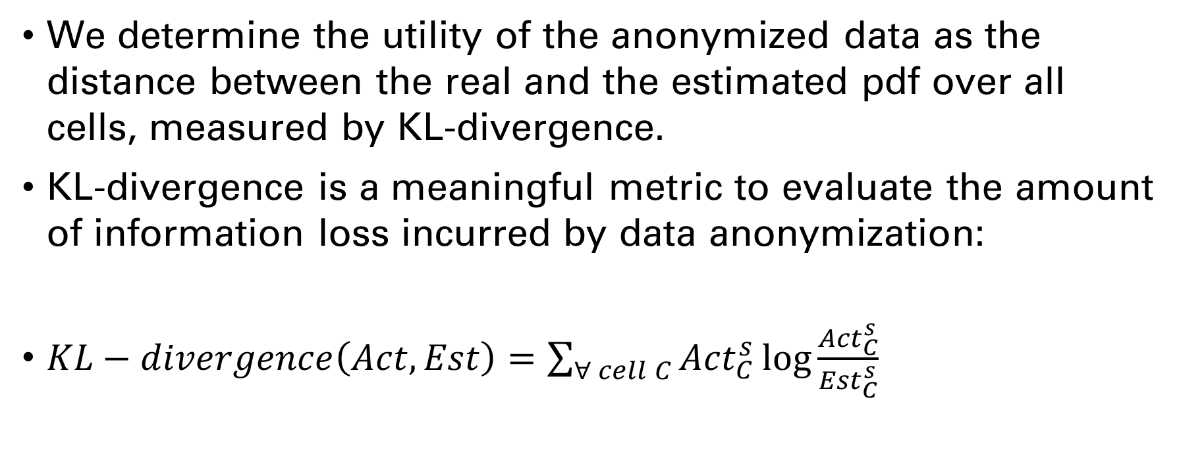
Utility requirements
We determine the utility of the anonymized data as the distance between the real and the estimated pdf over all cells, measured by KL-divergence.
KL-divergence is a meaningful metric to evaluate the amount of information loss incurred by data anonymization:
$KL−divergence\left(Act,Est\right)=\sum_{∀ cell C}{{Act}_{C}^{s}\log{\frac{{Act}_{C}^{s}}{{Est}_{C}^{s}}} }$

Slide 8
TESting
We have evaluated our implementation of the CAHD algorithm with two differents datasets, BMSWebView1 (BMS1) and BMSWebView2 (BMS2), using a thousand items.
We have organized the data as a band matrix, so that consecutive rows are likely to share a large number of common items. Band matrix organization has been acknowledged as a beneficial mode to represent sparse data in various scientific applications.
The differences between the initial dataset and the band matrix are:

Slide 9
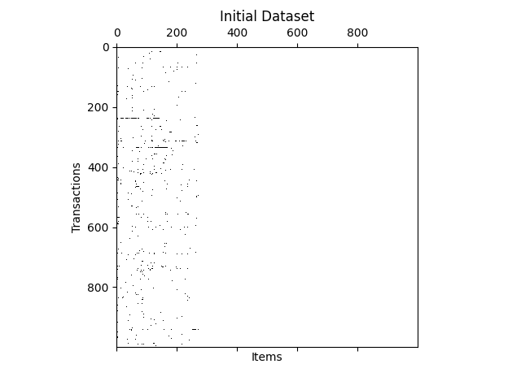
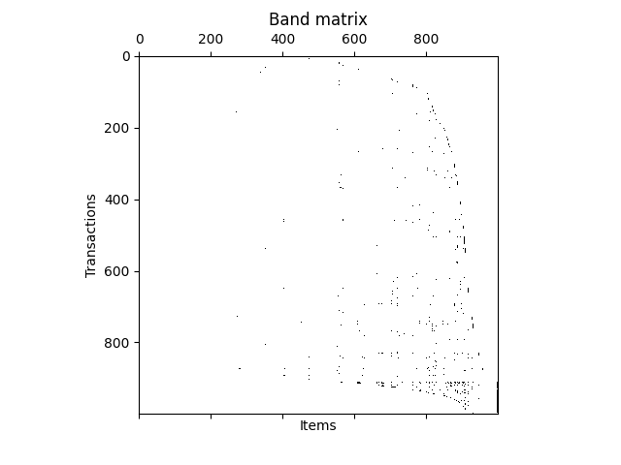
DIFFERENCES ON BMS1

Slide 10
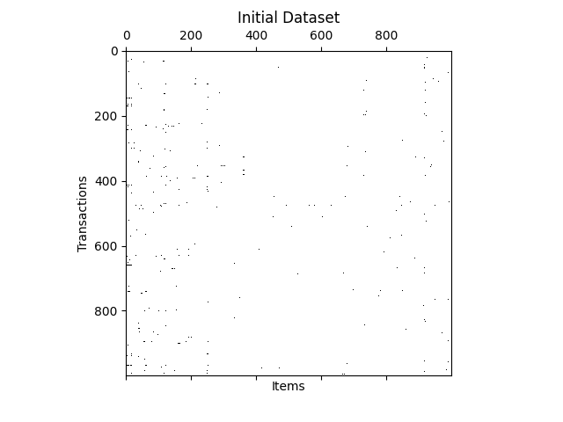
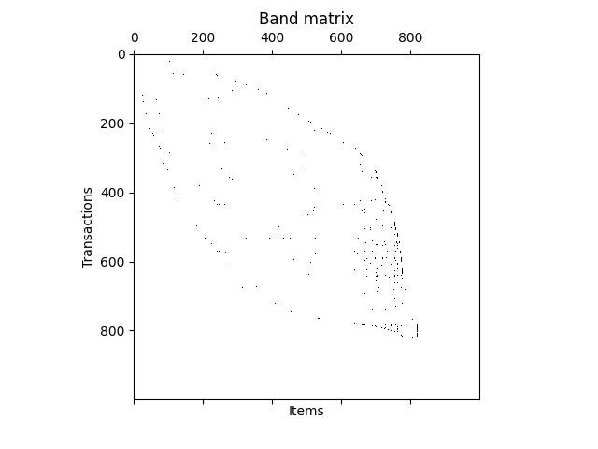
DIFFERENCES ON BMS2

Slide 11
TESting
To evaluate the reconstruction error and the execution time we have varied the privacy degree p in the range 4 - 20.
We have used a number of m sensitive items that in the first iteration is 10 and in the second is 20.
CAHD is time-efficient, with completion time of at most 5.5 and 4 seconds for the BMS1 and BMS2 datasets, respectively.

Slide 12
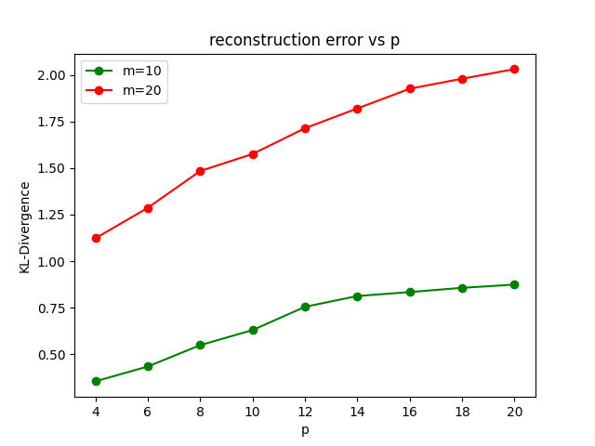
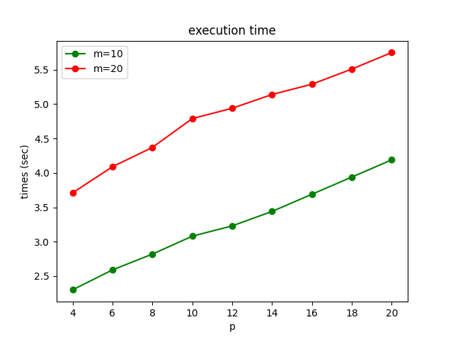
DIFFERENCES ON BMS1

Slide 13
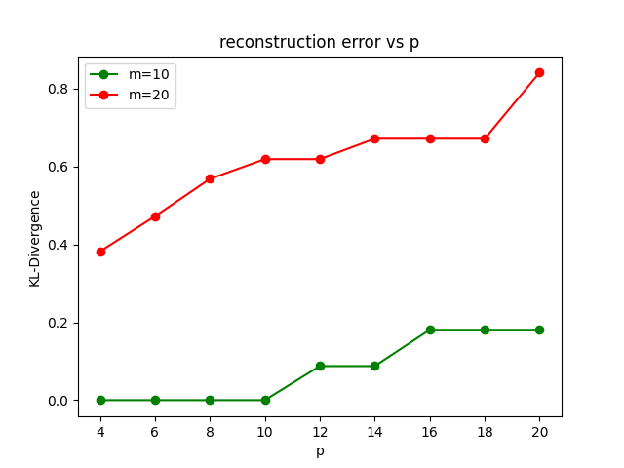
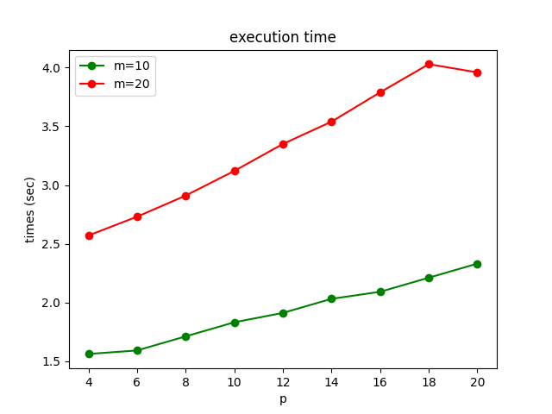
DIFFERENCES ON BMS2

Slide 14
Evaluation of rcm
To evaluate the Reverse Cuthill-McKee algorithm that we have implemented to simplify the grouping operations we have plotted the differences in terms of execution time and reconstruction error between the usage of RCM and without using it.
To have an idea on the impact on the resources of our implementation we have used two different setups, an AMD Ryzen 9 3900x @ 4.6 GHz with 16 GB DDR4 @ 3200 MHz and a Broadcom BCM2711 @ 1.5 GHz with 8 GB LPDDR4 @ 3200 MHz.

Slide 15
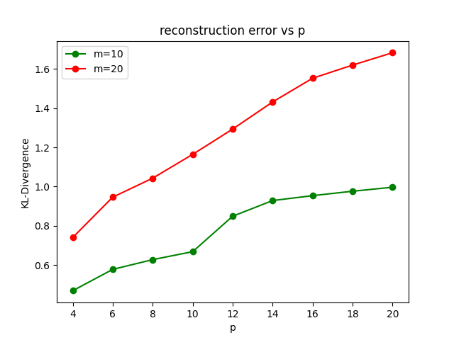
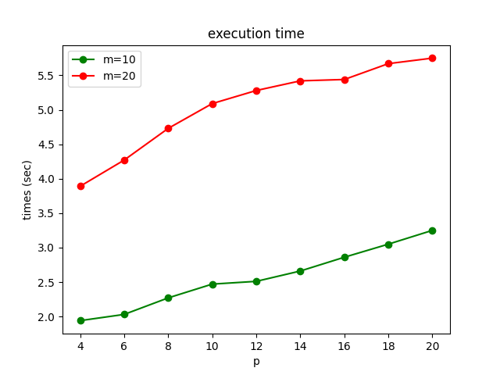
Test without rcm 3900x

Slide 16
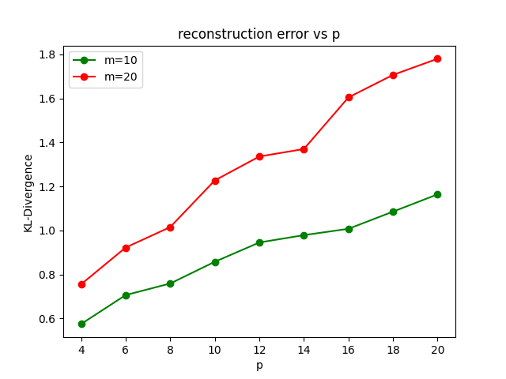
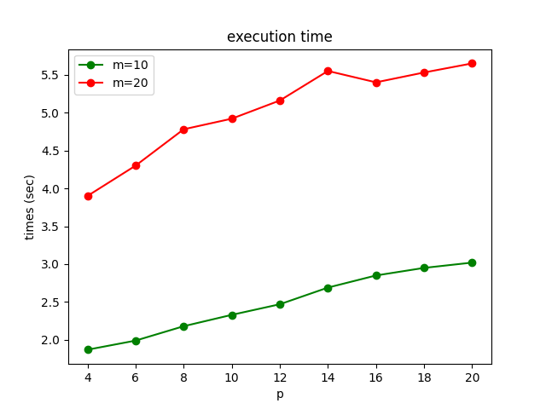
Test with rcm 3900x

Slide 17
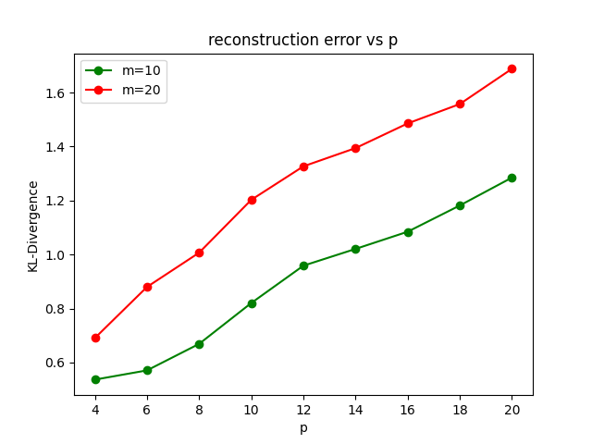
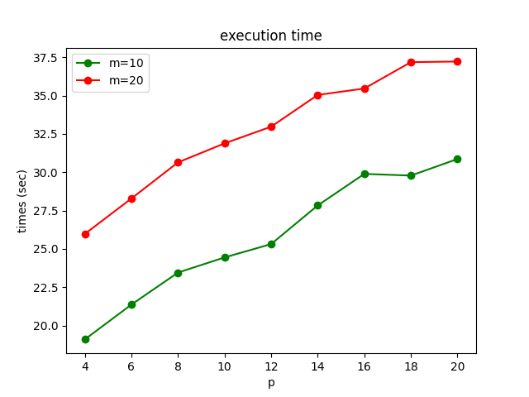
Test without rcm bcm2711

Slide 18
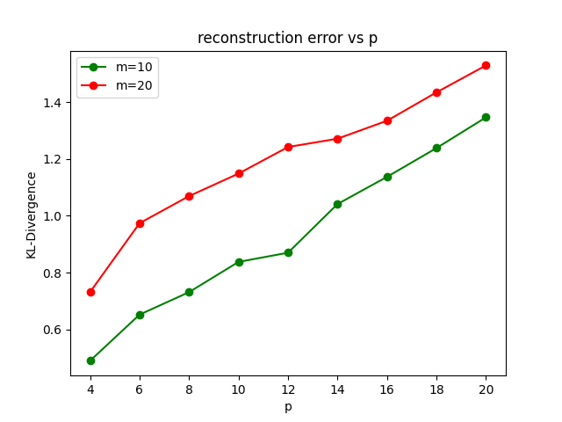
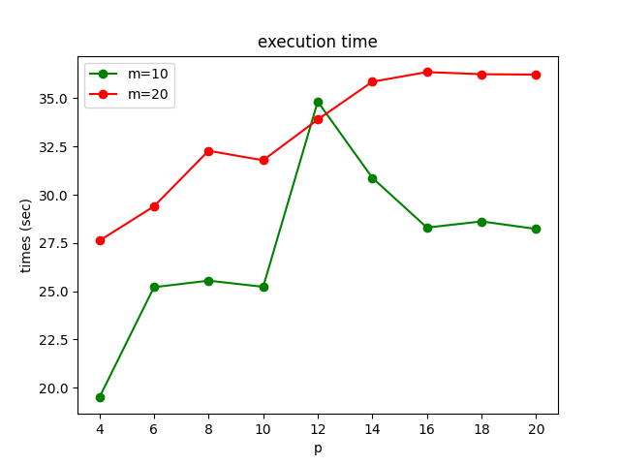
Test with rcm bcm2711

Slide 19
Conclusions
As we can see from the plots, testing the code on the 3900x gives comparable values running the CAHD algorithm with and without the RCM, instead with a setup that isn’t as much performing, the difference in terms of execution time can be of some seconds.
We also have to take into account that Python on the Broadcom CPU that is installed on a Rapberry Pi 4 runs in single core, altough it has four cores, meaning that the performance have a bottleneck.

