Slide 1
Correlation-aware anonymization of high-dimensional data (CAHD)
Fabrizio Durante
Luca Repetto
Matteo Salvatore

Slide 2
introduction
CAHD is an effective anonymization technique for sparse, high-dimensional data, it relies on a novel data representation, in the form of a band matrix, which captures the correlation within the data.
CAHD achieves superior data utility compared to existing state-of-the-art, and it also yields reduced computational overhead.

Slide 3
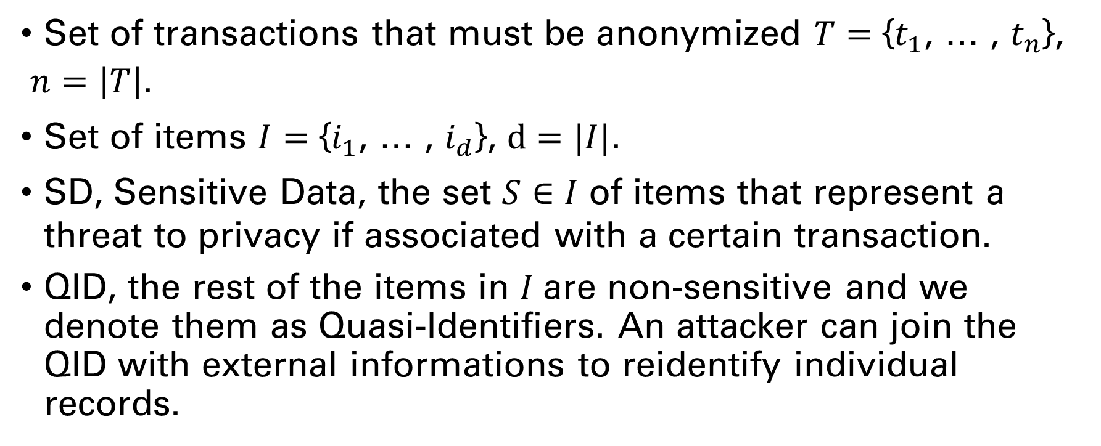
definitions
Set of transactions that must be anonymized $T$ $=$ {$t_{1}$, … , $t_{n}$},
$n=\left|T\right|$.
Set of items $I=$ {$i_{1}$, … , $i_{d}$}, $d=|I|$.
SD, Sensitive Data, the set $S∈I$ of items that represent a threat to privacy if associated with a certain transaction.
QID, the rest of the items in $I$are non-sensitive and we denote them as Quasi-Identifiers. An attacker can join the QID with external informations to reidentify individual records.

Slide 4
requirements
The Anonymized Transaction data should satisfy two requirements:
Privacy requirements
Utility requirements

Slide 5
behaviour
The CAHD algorithm is based on two steps:
Create Band Matrix using Reverse Cuthill-McKee Algorithm (RCM) to fulfill utility requirement.
Create Anonymized Groups to fulfill privacy requirement.

Slide 6
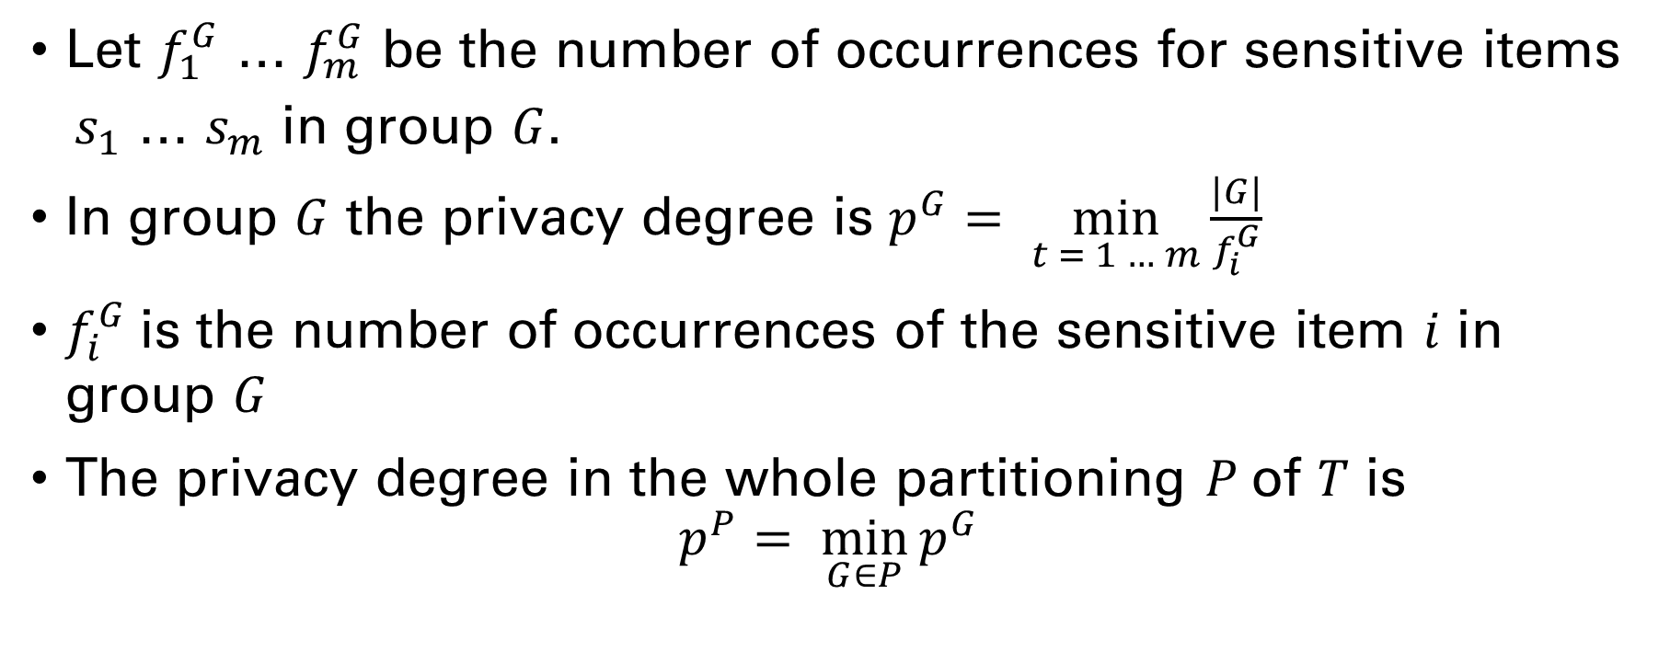
Privacy requirements
Let $f_{1}^{G}$ … $f_{m}^{G}$ be the number of occurrences for sensitive items
$s_{1}$ … $s_{m}$ in group $G$.
In group $G$ the privacy degree is $p^{G}= \min_{t = 1 … m}{\frac{|G|}{f_{i}^{G}}}$
$f_{i}^{G}$is the number of occurrences of the sensitive item $i$ in group $G$
The privacy degree in the whole partitioning $P$of $T$ is
$$p^{P}= \min_{G∈P}{p^{G}}$$

Slide 7
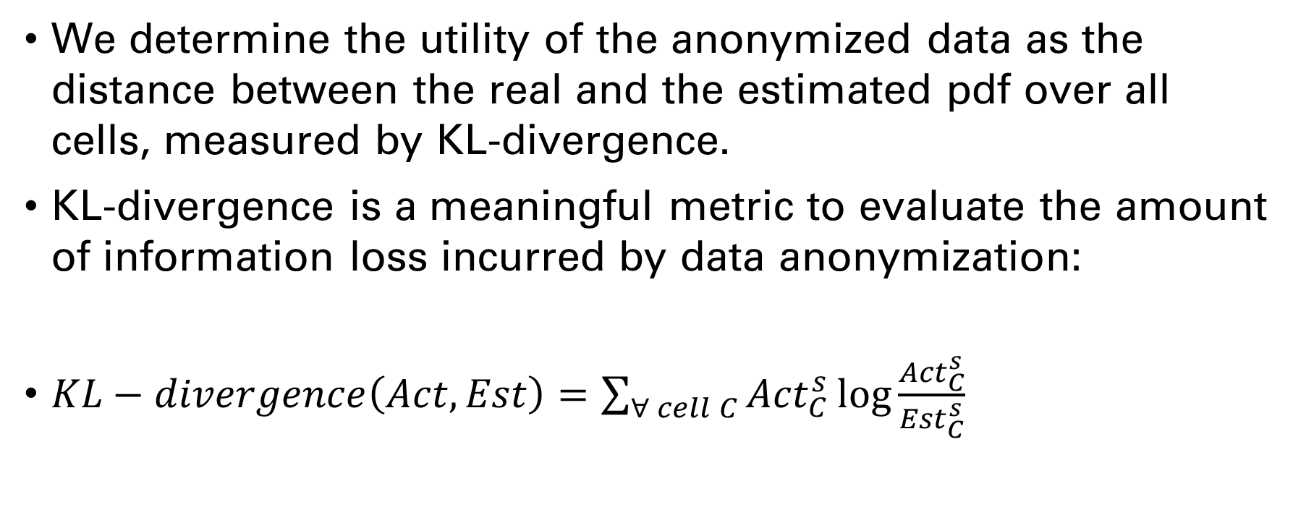
Utility requirements
We determine the utility of the anonymized data as the distance between the real and the estimated pdf over all cells, measured by KL-divergence.
KL-divergence is a meaningful metric to evaluate the amount of information loss incurred by data anonymization:
$KL−divergence\left(Act,Est\right)=\sum_{∀ cell C}{{Act}_{C}^{s}\log{\frac{{Act}_{C}^{s}}{{Est}_{C}^{s}}} }$

Slide 8
TESting
We have evaluated our implementation of the CAHD algorithm with two differents datasets, BMSWebView1 (BMS1) and BMSWebView2 (BMS2), using a thousand items.
We have organized the data as a band matrix, so that consecutive rows are likely to share a large number of common items. Band matrix organization has been acknowledged as a beneficial mode to represent sparse data in various scientific applications.
The differences between the initial dataset and the band matrix are:

Slide 9
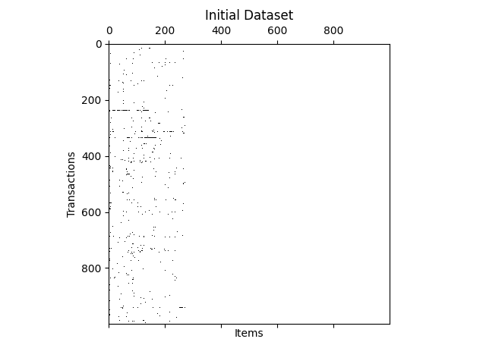
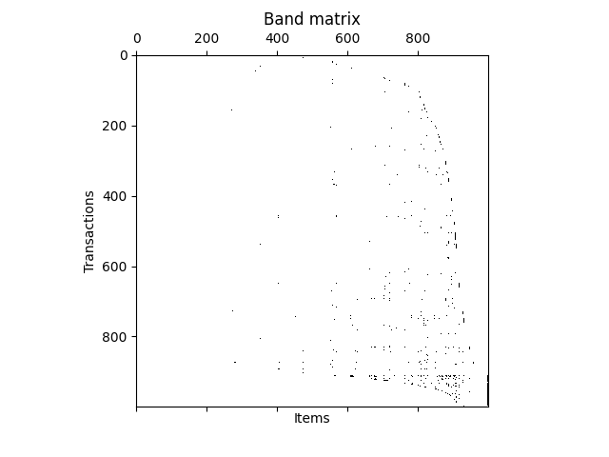
DIFFERENCES ON BMS1

Slide 10
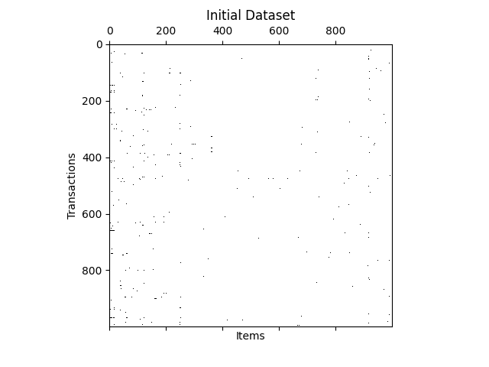
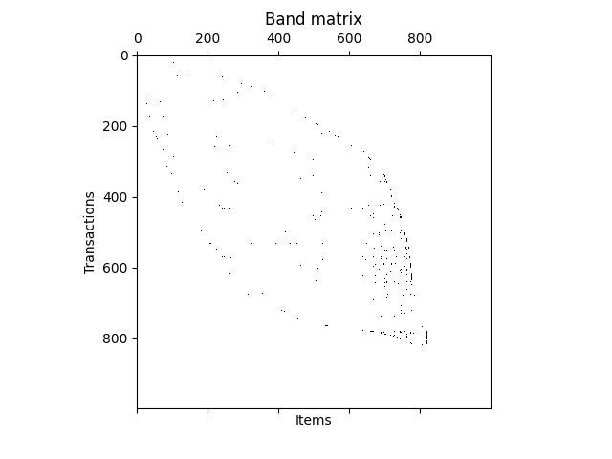
DIFFERENCES ON BMS2

Slide 11
TESting
To evaluate the reconstruction error and the execution time we have varied the privacy degree p in the range 4 - 20.
We have used a number of m sensitive items that in the first iteration is 10 and in the second is 20.
CAHD is time-efficient, with completion time of at most 5.5 and 4 seconds for the BMS1 and BMS2 datasets, respectively.

Slide 12
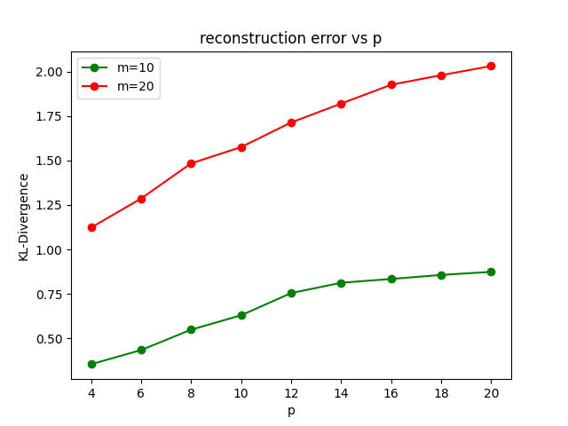
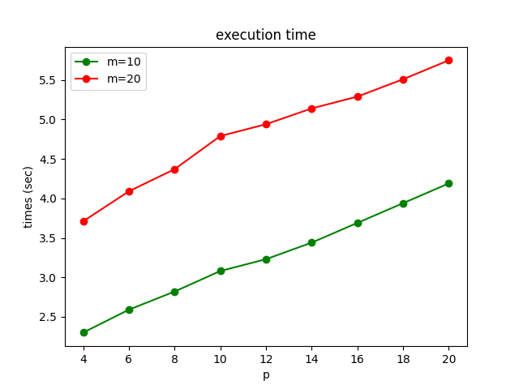
DIFFERENCES ON BMS1

Slide 13
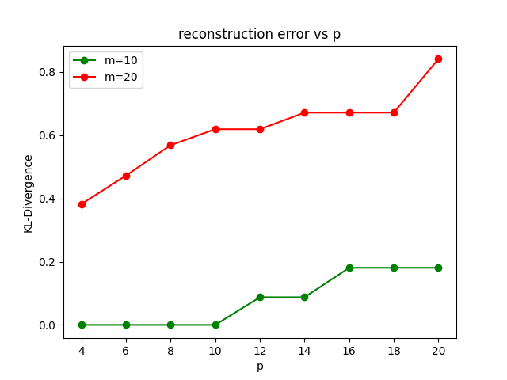
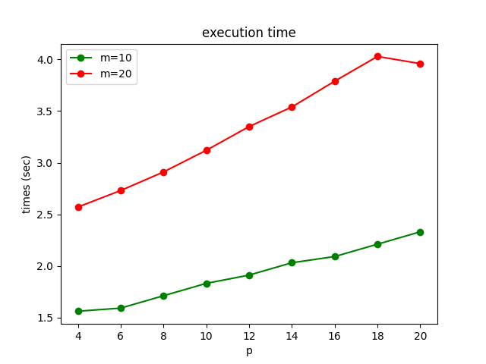
DIFFERENCES ON BMS2

Slide 14
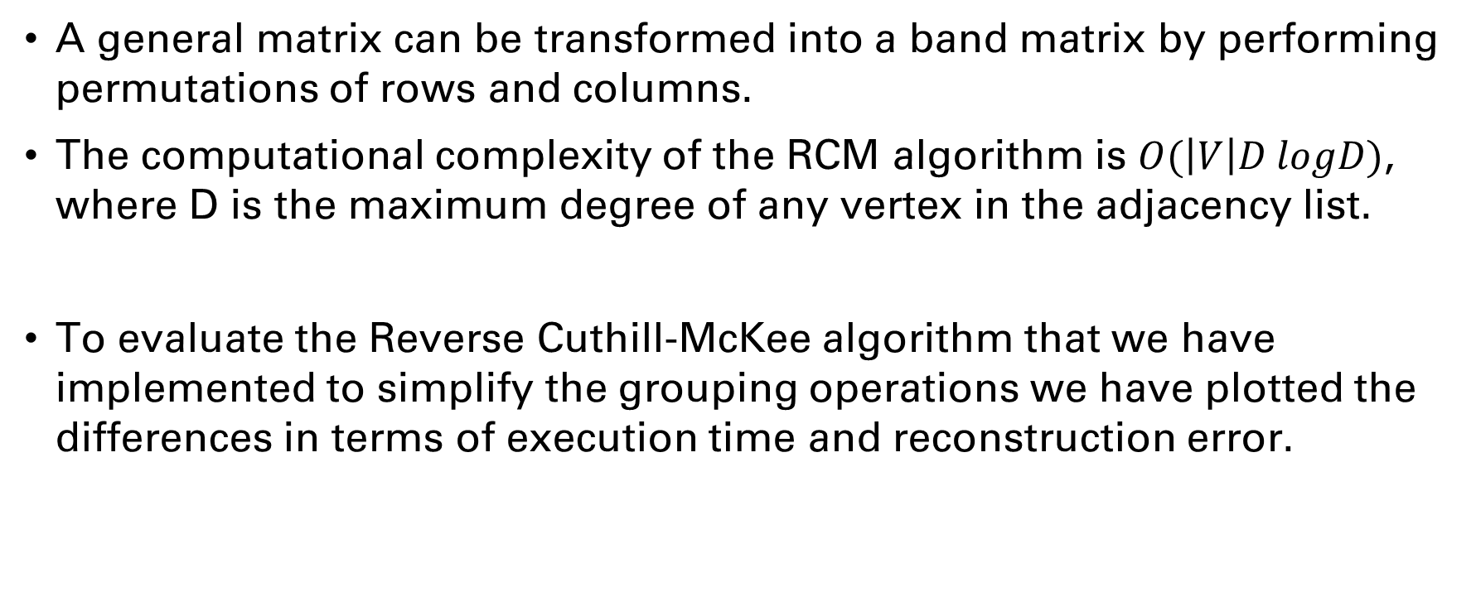
Evaluation of rcm
A general matrix can be transformed into a band matrix by performing permutations of rows and columns.
The computational complexity of the RCM algorithm is $O(\left|V\right|D logD)$, where D is the maximum degree of any vertex in the adjacency list.
To evaluate the Reverse Cuthill-McKee algorithm that we have implemented to simplify the grouping operations we have plotted the differences in terms of execution time and reconstruction error.

