Slide 1
Correlation-aware anonymization of high-dimensional data (CAHD)
Fabrizio Durante
Luca Repetto
Matteo Salvatore

Slide 2
introduction
CAHD is an effective anonymization technique for sparse, high-dimensional data, it relies on a novel data representation, in the form of a band matrix, which captures the correlation within the data.
CAHD achieves superior data utility compared to existing state-of-the-art, and it also yields reduced computational overhead.

Slide 3
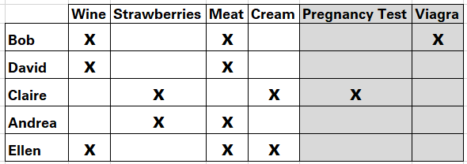
motivation
This example shows the contents of five purchase transactions.
If an attacker learns about some of the items purchased by
someone on a certain day, it can lead to a privacy breach.

Slide 4
behaviour
The CAHD algorithm is based on two steps:
Create Band Matrix using Reverse Cuthill-McKee Algorithm (RCM) to fulfill utility requirement.
Create Anonymized Groups to fulfill privacy requirement.

Slide 5
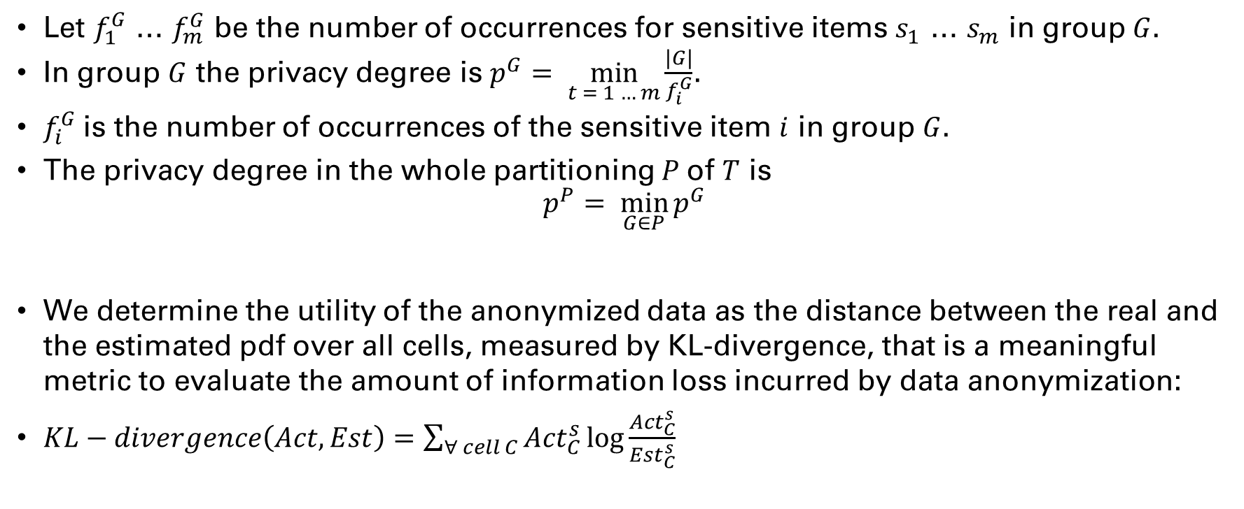
requirements
Let $f_{1}^{G}$ … $f_{m}^{G}$ be the number of occurrences for sensitive items $s_{1}$ … $s_{m}$ in group $G$.
In group $G$ the privacy degree is $p^{G}= \min_{t = 1 … m}{\frac{|G|}{f_{i}^{G}}}$.
$f_{i}^{G}$is the number of occurrences of the sensitive item $i$ in group $G$.
The privacy degree in the whole partitioning $P$of $T$ is
$$p^{P}= \min_{G∈P}{p^{G}}$$
We determine the utility of the anonymized data as the distance between the real and the estimated pdf over all cells, measured by KL-divergence, that is a meaningful metric to evaluate the amount of information loss incurred by data anonymization:
$KL−divergence\left(Act,Est\right)=\sum_{∀ cell C}{{Act}_{C}^{s}\log{\frac{{Act}_{C}^{s}}{{Est}_{C}^{s}}} }$

Slide 6
testing
We have evaluated our implementation of the CAHD algorithm with two differents datasets, BMSWebView1 (BMS1) and BMSWebView2 (BMS2), using a thousand items.
Both datasets were used in the KDD CUP 2000 and contain clickstream data from an e-commerce, BMS1 has 497 items and BMS2 has 3340 items.
None of the datasets has item names.

Slide 7
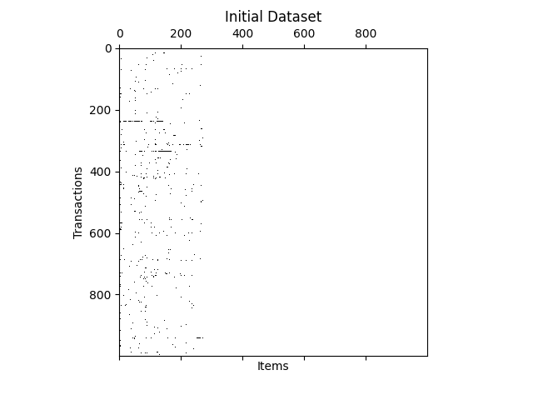
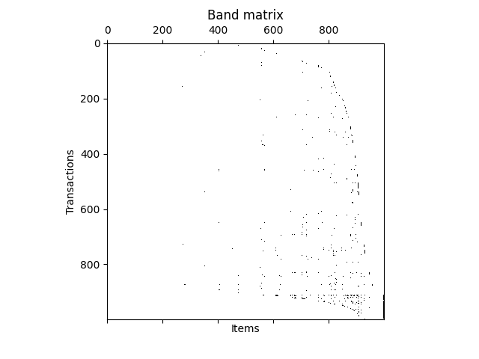
BAND matrix ON BMS1

Slide 8
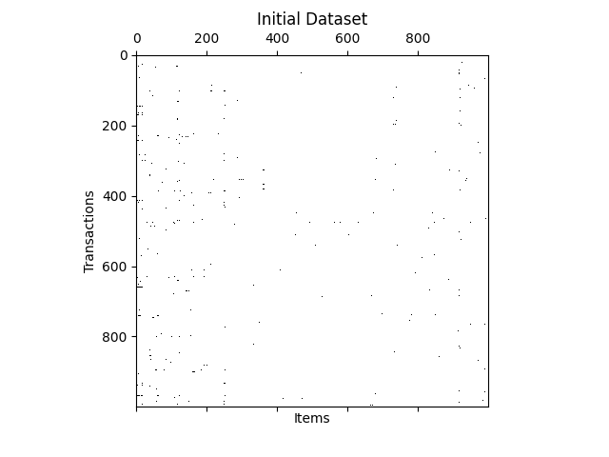
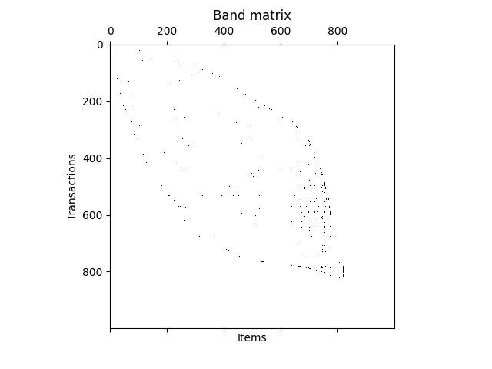
Band matrix ON BMS2

Slide 9
testing parameters
To evaluate the reconstruction error and the execution time we have varied the privacy degree p in the range 4 - 20.
We have used a number of m sensitive items that in the first iteration is 10 and in the second is 20.
CAHD is time-efficient, with completion time of at most 5.5 and 4 seconds for the BMS1 and BMS2 datasets, respectively.

Slide 10
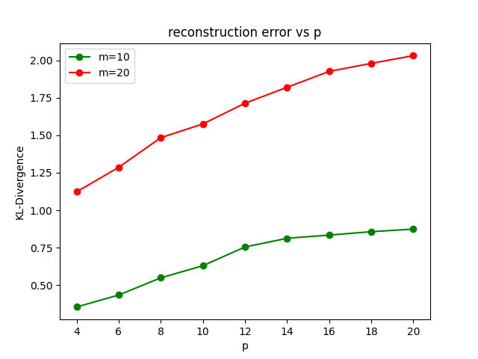
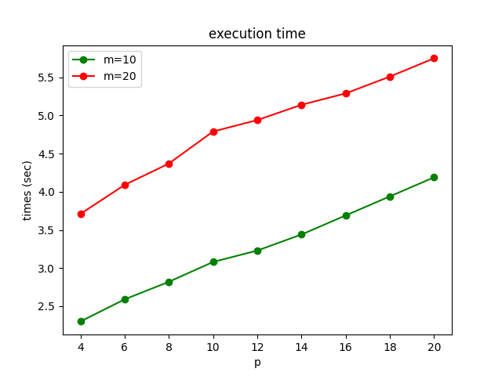
DIFFERENCES ON BMS1

Slide 11
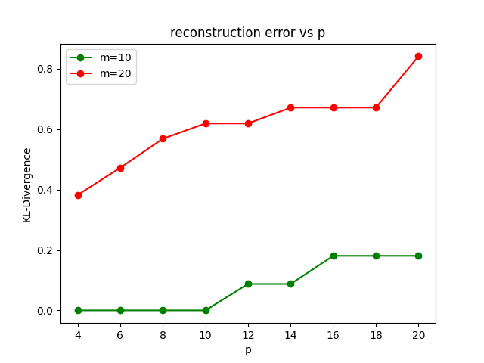
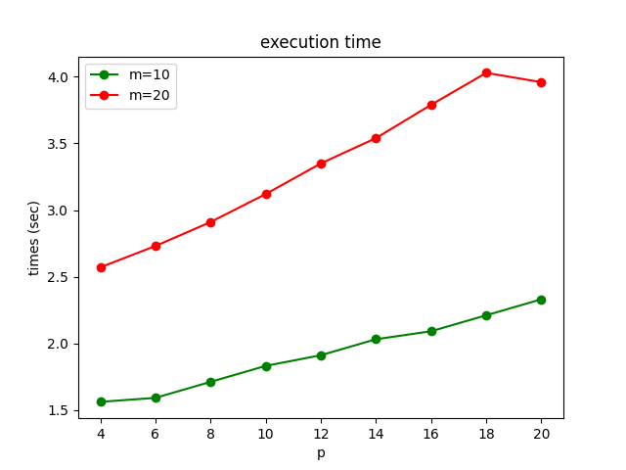
DIFFERENCES ON BMS2

Slide 12
Evaluation of rcm
To evaluate the Reverse Cuthill-McKee algorithm that we have implemented to simplify the grouping operations we have plotted the differences in terms of execution time and reconstruction error between the usage of RCM and without using it.
To have an idea on the impact on the resources of our implementation we have used two different setups, an AMD Ryzen 9 3900x @ 4.6 GHz with 16 GB DDR4 @ 3200 MHz and a Broadcom BCM2711 @ 1.5 GHz with 4 GB LPDDR4 @ 3200 MHz.

Slide 13
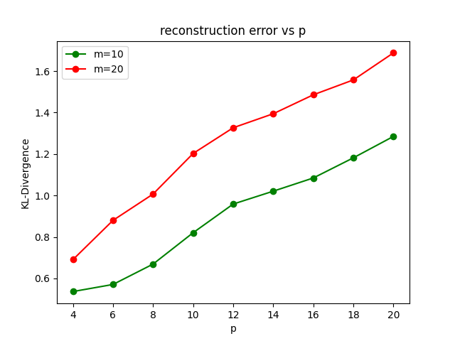
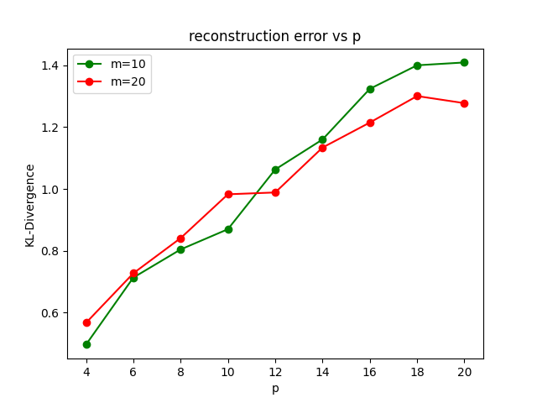
kl-divergence w/o rcm
BCM2711
3900x

Slide 14
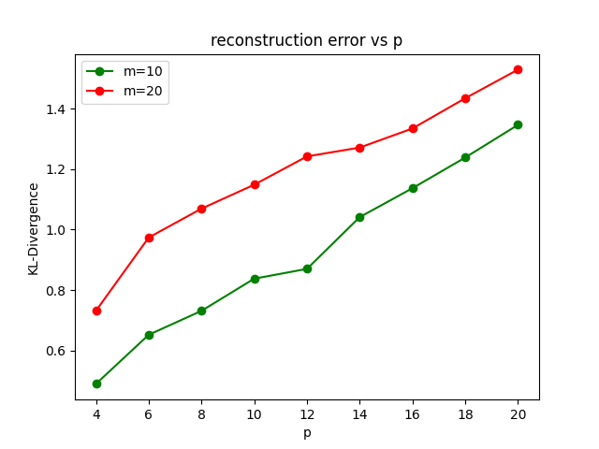
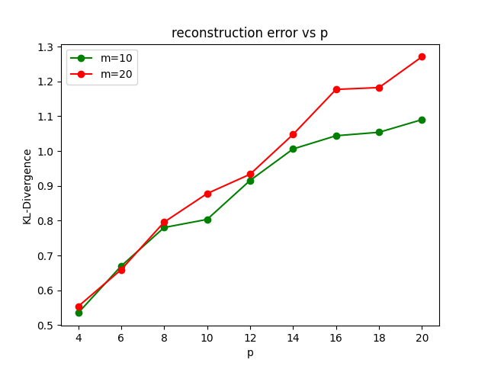
Kl-divergence with rcM
BCM2711
3900x

Slide 15
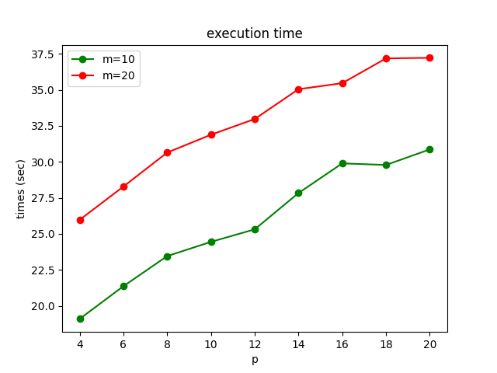
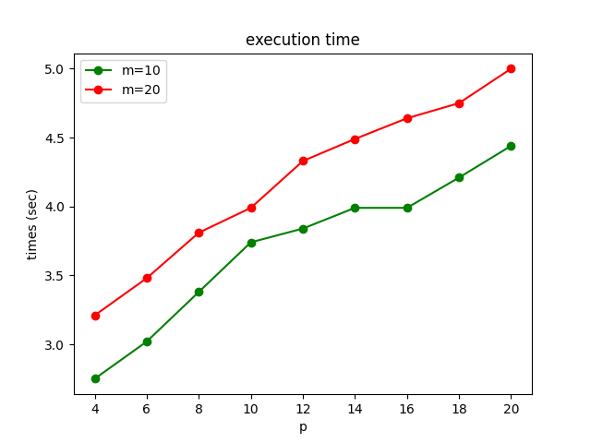
Execution time w/o rcm
BCM2711, AVG m10: 25.7 s, AVG m20: 32.9 s
3900x, AVG m10: 2.6 s, AVG m20: 5 s

Slide 16
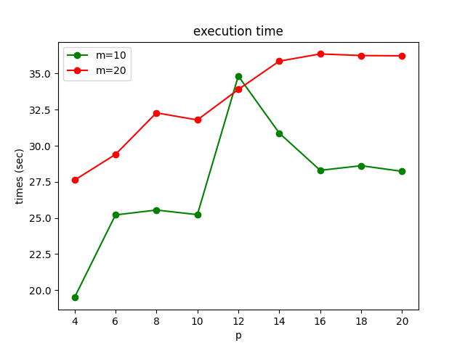
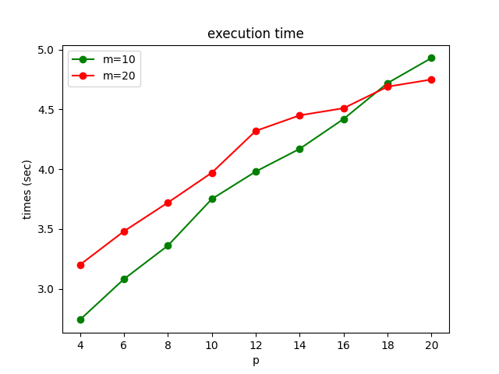
Execution time with rcm
BCM2711, AVG m10: 27.5 s, AVG m20: 33.4 s
3900x, AVG m10: 2.6 s, AVG m20: 5.1 s

Slide 17
Conclusions
As we can see from the plots, testing the code on the 3900x gives comparable values running the CAHD algorithm with and without the RCM, instead with a setup that isn’t as much performing, the difference in terms of execution time can be of some seconds.
We also have to take into account that Python on the Broadcom CPU that is installed on a Rapberry Pi 4 runs in single core, altough it has four cores, meaning that the performance have a bottleneck.

