Slide 1


Design and Development of a Web Application
in a Containerized Environment
Supervisor:
Prof. Pierpaolo Baglietto
Cosupervisor:
Dott. Marco Risso
Candidate:
Fabrizio Durante
Student ID n. 3941665
Examine the popularity of disassemblers
METHODOLOGY

Slide 2
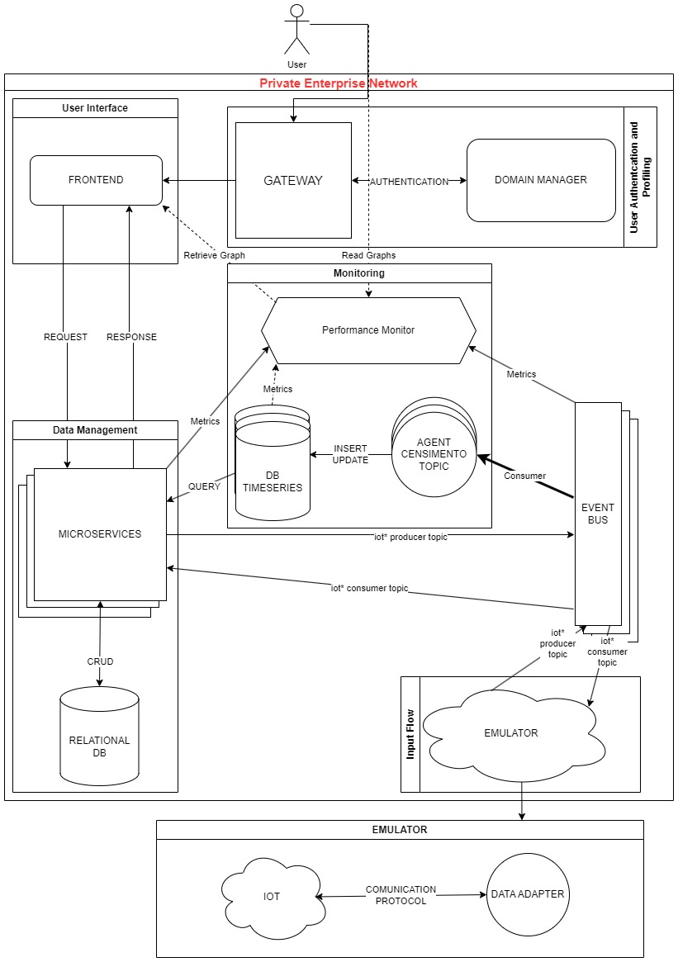
architecture

