Slide 1
Predicting SQL Execution Time
Using Linear Regression

Slide 2
Background and motivation
Create a statistical model of throughput in a transactional system to predict execution time of new SQL workload during development cycle.
The execution time would depend on the actual SQL and the workload on the system before execution.
We expect the execution time to vary depending on the time of day.

Slide 3
Data collection and preparation
Snapshot of the SQL cache in the production system is taken every one hour and stored in splunk -- A No-SQL storage engine for machine logs.
This snapshot includes the SQL text and the execution time along with other metrics.
The SQL metrics in the snapshot are cumulative from the start of the RDBMS engine to the time of the snapshot.

Slide 4
Data collection and preparation (Continued …)
Workload metrics from the production system are collected every five minutes and stored in splunk.
All metrics are cumulative and hence difference between two snapshots is computed to capture the values of the metrics in a given time period
Python splunk API is used to pull the data from splunk and it is loaded into a pandas data frame for analysis.

Slide 5
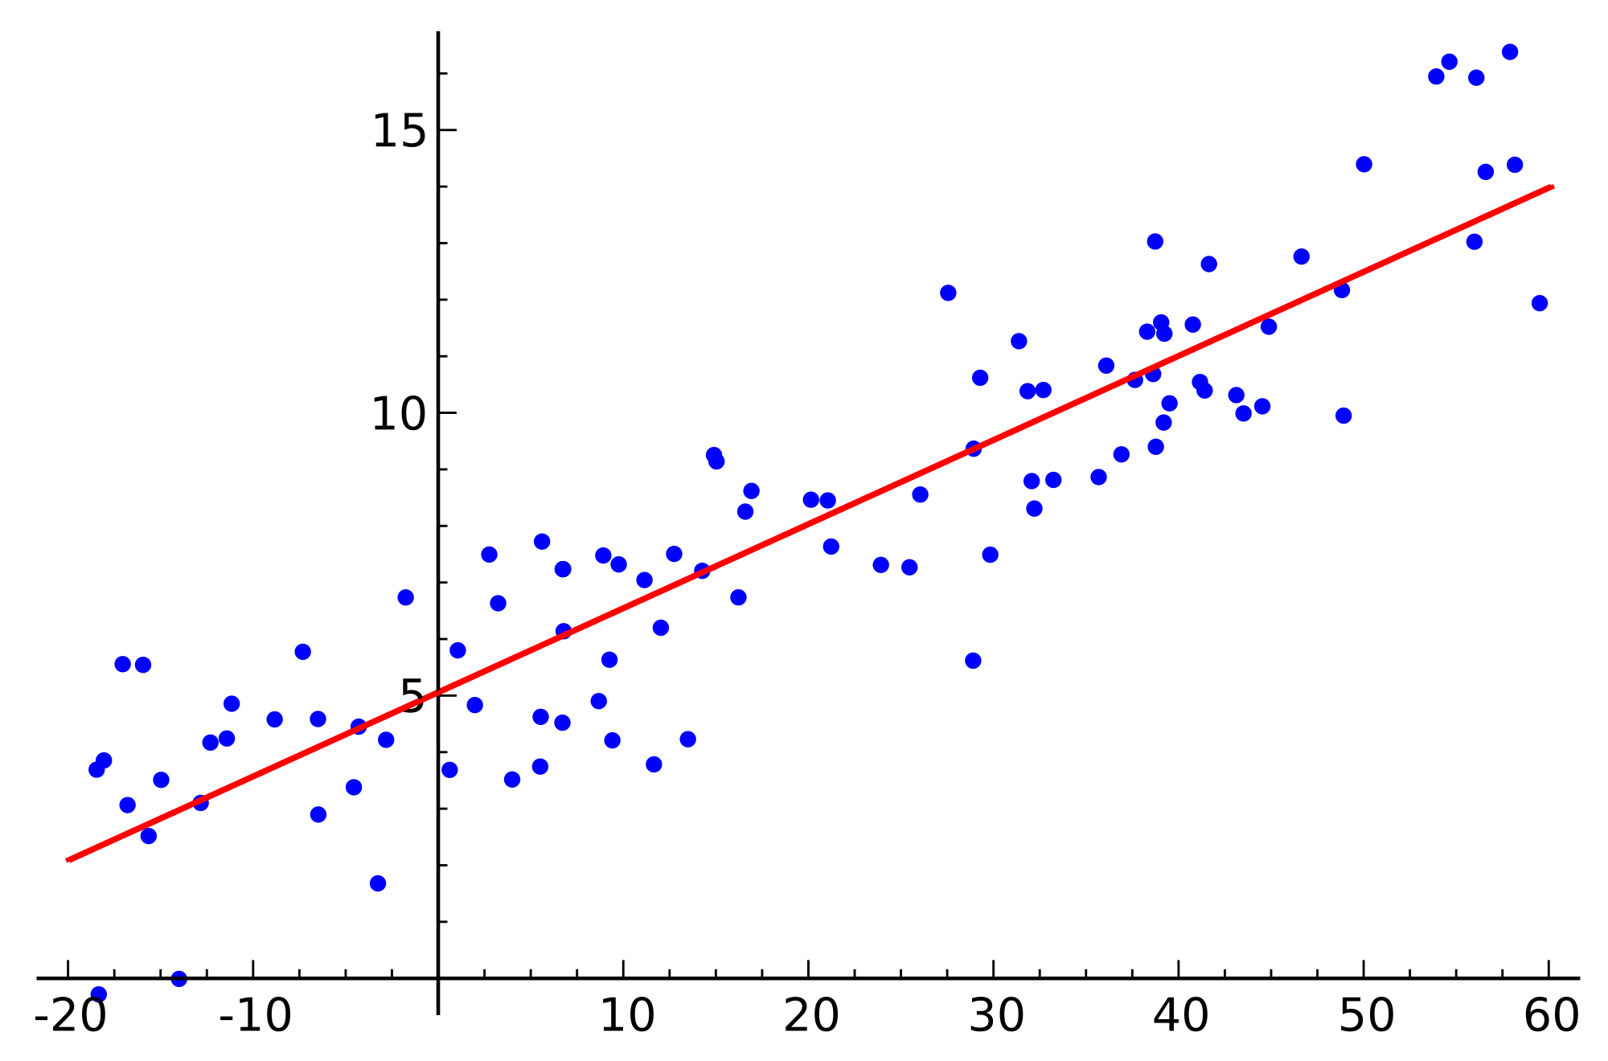
Linear regression (Ordinary Least Squares)

Slide 6
Feature selection - SQL features
Using domain expertise the following SQL features were identified:
Number of filters - fields in the ‘where clause’ of SQL.
Number of tables.
Size of the tables being addressed in the SQL.
Size of the indexes on tables.
Query depth.

Slide 7
Feature selection - Workload features
Similarly, the following workload features were identified:
Time spent by the RDBMS engine on:
Waiting for locks.
Sorting.
Writing diagnostic logs.
Reading data directly from disk
Writing data directly to disk
Waiting for log buffers to be flushed
Waiting for disk I/O

Slide 8
Feature selection - Workload features (Continued…)
Time spent by the RDBMS engine on:
Reading data from buffer pool
Writing data to buffer pool
Prefetching data
Aggregate time spent by RDBMS engine:
Total activity
Total CPU

Slide 9
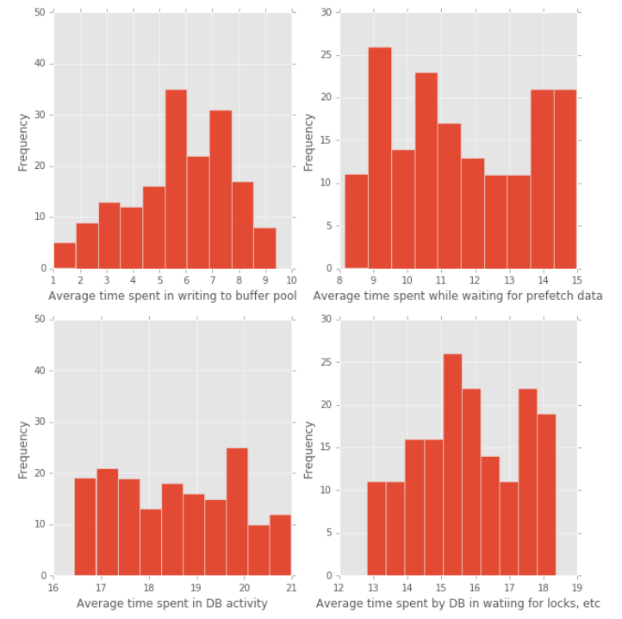
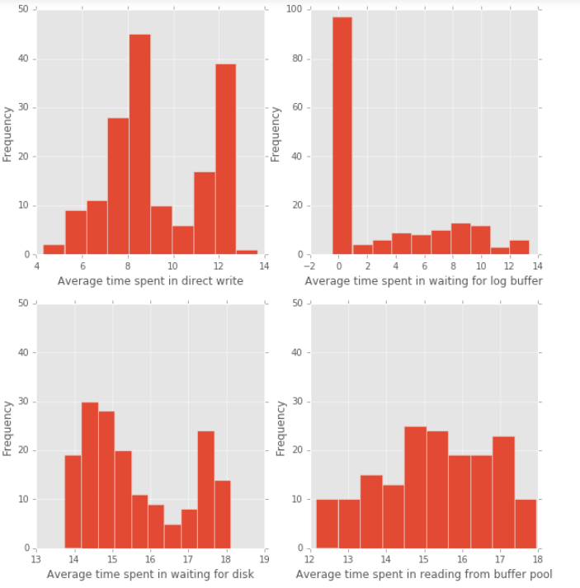
Exploratory Data Analysis - Distribution of features

Slide 10
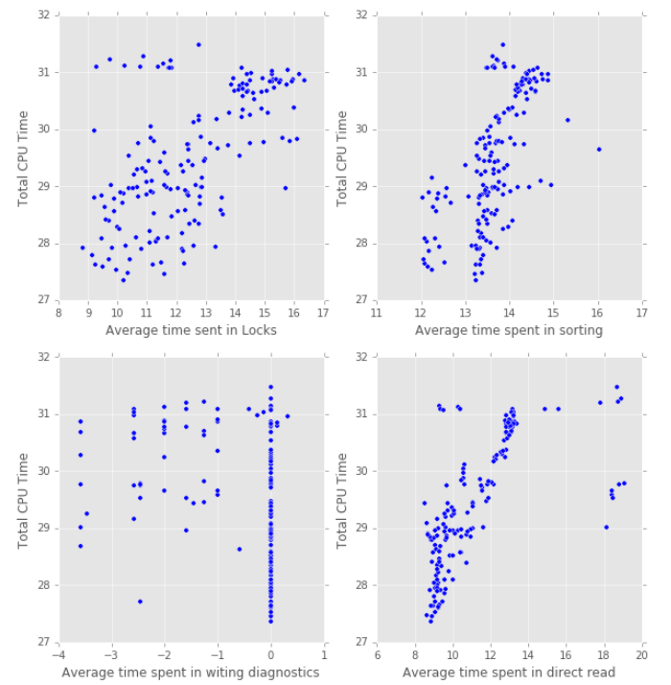
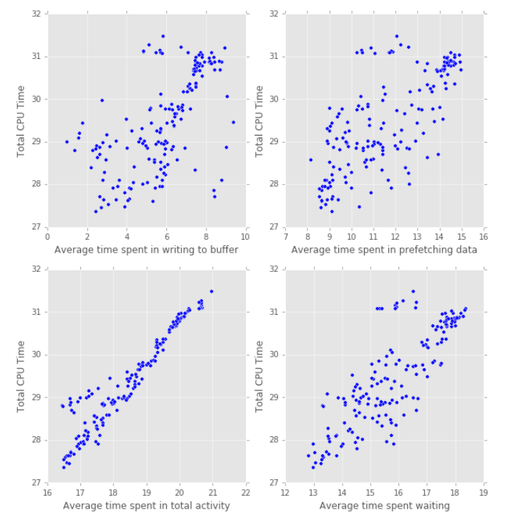
Exploratory data analysis - Collinearity

Slide 11
Stepwise regression
Forward regression using Adjusted R-squared
Variables were tested in various random orders.
Significance of the variables was measured using p-value of the t-statistic.
Overall significance of the model was tested using the p-value of F-statistic.
This method resulted in the following features for the model:
Average CPU time spent by the RDBMS
Table Size
Number of filters
Number of operations

Slide 12
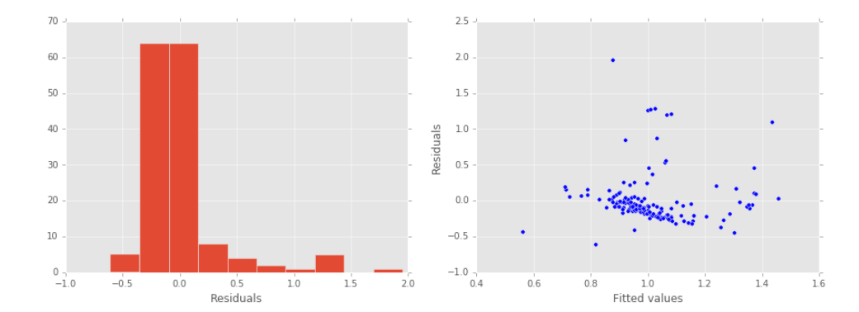
Residual Plot and Distribution

Slide 13
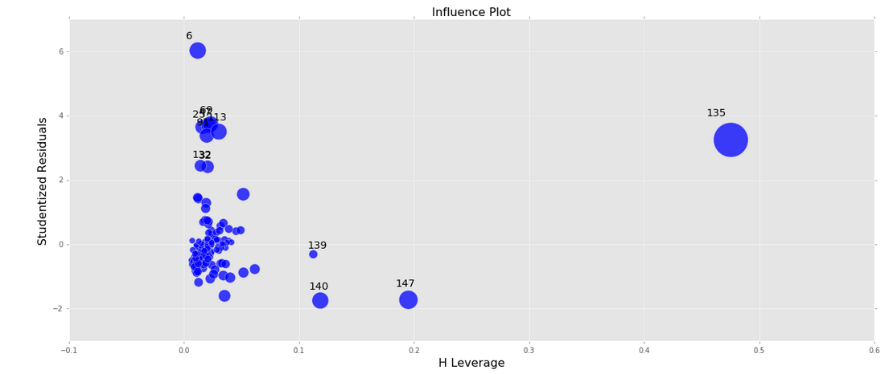
High influence data points and outliers

Slide 14
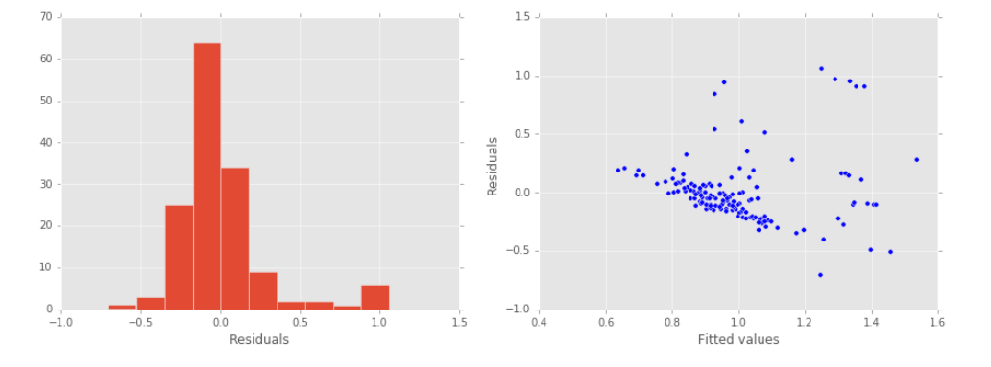
Residual plots after Removing high influence points

Slide 15
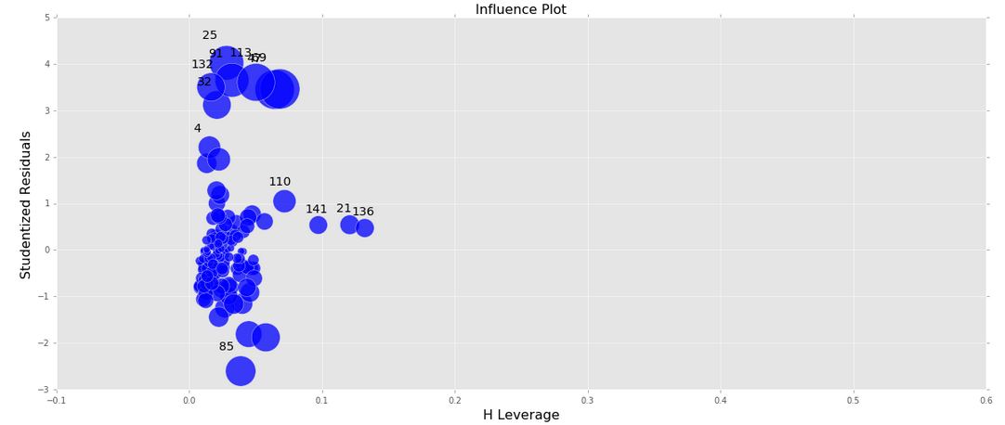
Influence plot after removing high influence points

Slide 16
Regression coefficient estimates
The relationship between SQL metrics and workload with execution time was estimated to be: Execution time = 0.1127 x (average CPU time) + 0.2458 x (Table size) – 4.0137 x (Number of Filters)+ 2.5848 x (Number of operations)
Regression coefficients represent the mean change in the execution time for one unit of change in the predictor variable while holding other predictors in the model constant
CPU time was log (base 2) transformed . So the coefficient for average cpu time represents the mean change in the execution time for every doubling of the CPU time

Slide 17
Conclusion
Above analysis made it clear that the effect of workload on the execution time can be captured in the average CPU time consumed by the RDBMS in the prior hour. The other workload metrics were not improving the fit of the model.
Number of Filters is inversely proportional to the execution time, which is expected as the total number of filters increase the amount of data on which the operations have to be performed decreases, hence decreasing the execution time of the query.
The average CPU time further away (2,3,4 hours) from the execution window was also used to see if it would make a difference, but it did not. This was due to the fact that the average CPU load was pretty consistent across the working day

