Slide 1
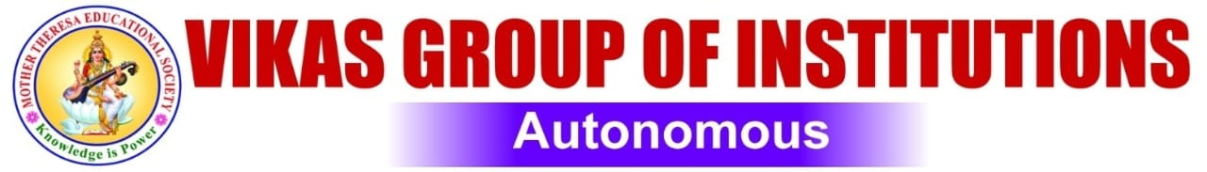

Reference Model For Sentiment Analysis Based On Customer Reviews Using AI
Submitted By :
G. Durga Chenna Kesava Reddy 219T1A0518
V. Naga Siva Manikanteswari 219T1A0575
BV. Nagarjuna Reddy 219T1A0509
Ch. Suresh 209T1A0515
Under the Guidance of
Mr. M. Naresh
Assistant Professor

Slide 2

Reference Model For Sentiment Analysis Based On Customer Reviews Using AI
REFERENCE MODEL FOR SENTIMENT ANALYSIS USING AI

Slide 3

Overview
Topics:
Objective
Abstract
S/W and H/W Requirements
Exist System
Proposed System
Functional Requirements
Non-Functional Requirements
Block Diagram
Class Diagram
Sequence Diagram
Use Case Diagram
Collaboration Diagram
Activity Diagram
Data Flow Diagram
Code
Confusion Matrix
Conclusion
Future Scope And Enhancement

Slide 4
Objective
Objective of this project is to develop a Reference Model For Sentiment Analysis is to determine the emotional tone or opinion expressed in text, classifying it as positive or negative.
The model aims to accurately analyze and classify customer sentiments (positive or negative) by using Machine Learning (ML) and Natural Language Processing (NLP) techniques.
REFERENCE MODEL FOR SENTIMENT ANALYSIS USING AI

Slide 5
abstract
This project addresses the problem of sentiment analysis or opinion mining in social media platforms like Facebook and Twitter, that is classifying the tweets or people opinions according to the sentiment expressed in them as: Positive or Negative.
In social media, the information is present in large amount and providing number of benefits such as knowledge about the latest technology and also updates of current situation in several fields.
In this project we are using NLP for processing the data and Deep Learning algorithms and Machine Learning algorithms to build a model.

Slide 6
requirements
Software
Hardware
Programming Language : Python
Technology : PyCharm
Processor : Intel(R) Core(TM)
Installed RAM : 8.00 GB
System type : 64-bit operating system
Edition : Windows 11 Pro

Slide 7
Exist system
Existing approaches to Sentiment Analysis:
Knowledge-Based Techniques(lexical-based approach)
Statistical Methods
Hybrid Approach
Knowledge-based techniques make use of pre-build model and lexicon sources containing polarity of sentiment words.
Lexicon based approach suffers from poor recognition of sentiment.
Statistical methods involve machine learning (SVM) and deep learning approaches, both approaches require Label data for polarity detection.
Hybrid approach It is both statistical and knowledge-based methods for polarity detection. It inherits high accuracy from machine learning (statistical methods) and stability from the lexicon-based approach
Reference Model For Sentiment Analysis Using AI

Slide 8
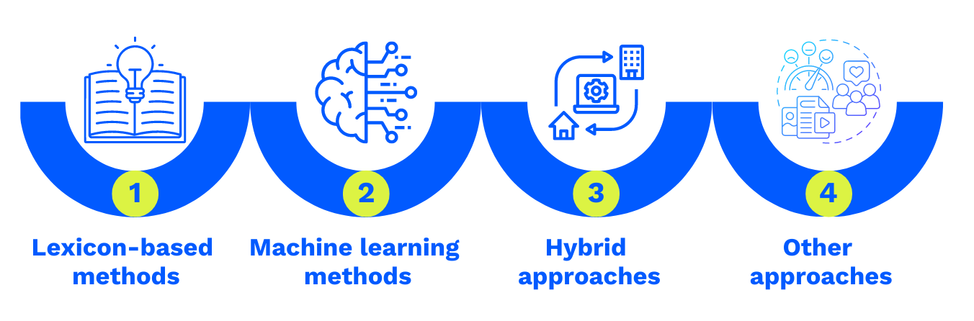
Proposed system
By using Natural Language Processing, which defines a relation between user posted tweet and suggestions of people.
NLP defines a relation between user posted tweet and opinion and in additional suggestions of people.
NLP makes speech analysis easier and makes this project very accurate.

Slide 9

Functional requirements
Functional requirements:
Text Input: The system should accept text input from various sources (opinions, reviews)
Sentiment Detection: The system should detect the sentiment (positive, negative) of the input text.
Emotion Identification: The system should identify the emotions (happy, unhappy) expressed in the text.
Aspect Extraction: The system should extract the specific aspects or features of the entity being discussed.
Opinion Mining: The system should extract the opinions or sentiments expressed about the entity.

Slide 10
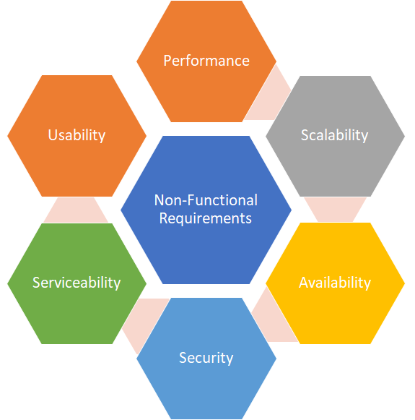
Non-functional requirements
Maintainability:
It is used to make future maintenance easier and meet new requirements.
Robustness:
Robustness is the quality of being able to withstand stress, pressures or changes in procedure or circumstance.
Reliability:
Reliability is an ability of a person or system to perform and maintain its functions in circumstances.
Size:
The size of a particular application play a major role, if the size is less then efficiency will be high.

Slide 11
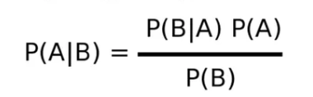
Naive Bayes Algorithm
It is Supervised Machine Learning Model based on Bayes Theorem and used for Classification problem
Text Classification: Sentiment Analysis, Spam Detection…….
Where : P(A/B) = Posterior Probability
P(B/A) = Likelihood Probability
P(A) = Prior Probability
P(B) = Marginal Probability

Slide 12
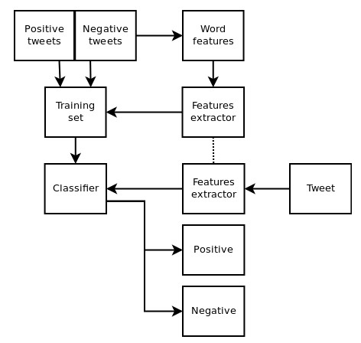
Block Diagram
A block diagram for sentiment analysis visually represents the process, showing data collection, processing, analysis, and visualization, with each stage represented as a block and their relationships as arrows.
Naive Bayes
REFERENCE MODEL FOR SENTIMENT ANALYSIS USING AI

Slide 13
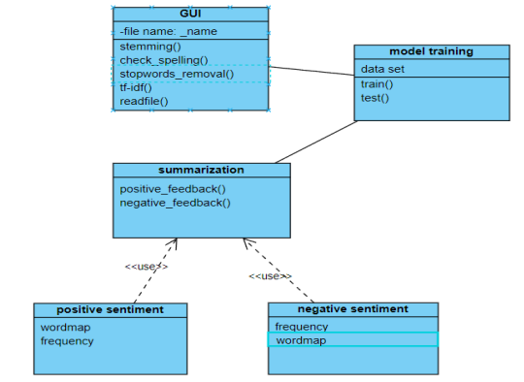
Class Diagram
A class diagram for sentiment analysis, using the Unified Modeling Language (UML), visually represents the classes, attributes, operations (methods), and relationships within a sentiment analysis system, aiding in understanding and documenting its structure.

Slide 14
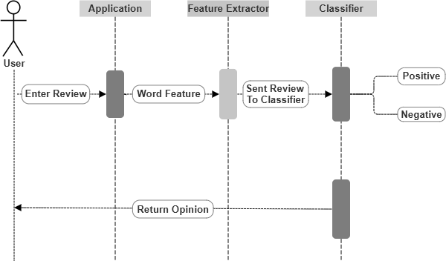
Sequence Diagram
A sequence diagram, in the context of sentiment analysis, visually illustrates the sequence of interactions and messages exchanged between different objects or components involved in analyzing text for sentiment, showing the flow of data and operations.

Slide 15
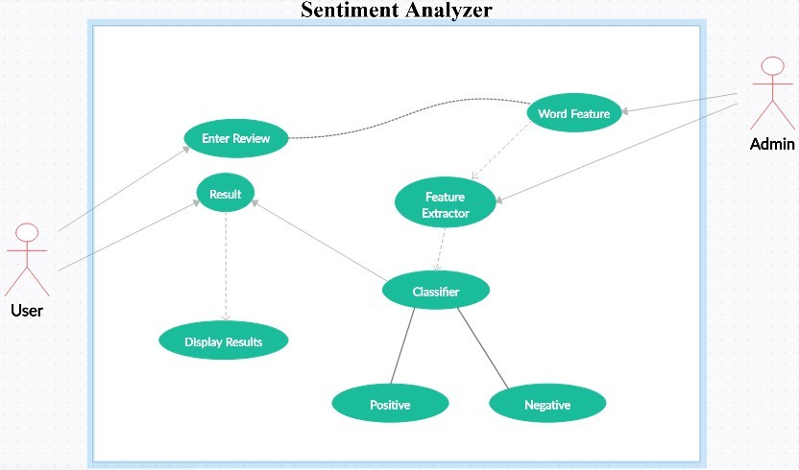
Use Case Diagram
A use case diagram for sentiment analysis visualizes how users (actors) interact with the system to achieve specific goals related to sentiment analysis, such as analyzing text for sentiment or identifying specific emotions.
Reference Model For Sentiment Analysis Using AI

Slide 16
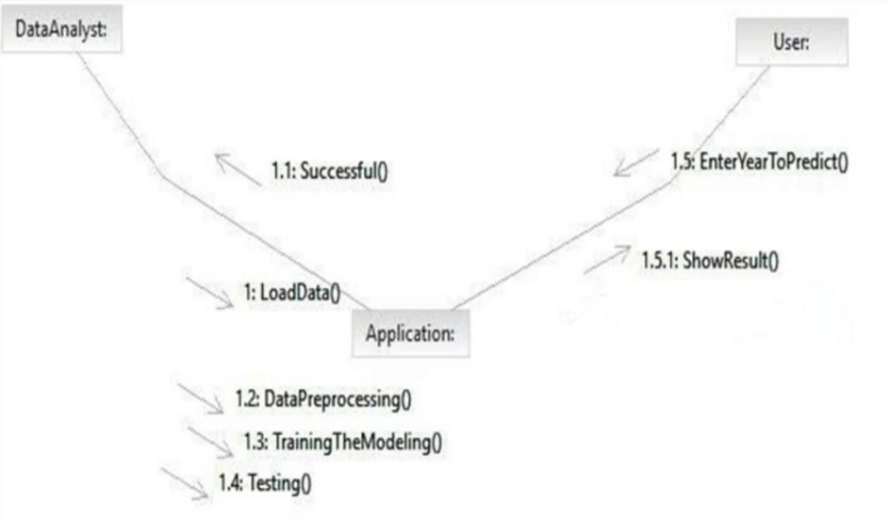
Collaboration Diagram
Collaboration Diagram(communication diagram) visually illustrates how different objects or components interact and exchange information to achieve a specific task, like analyzing sentiment from text.

Slide 17
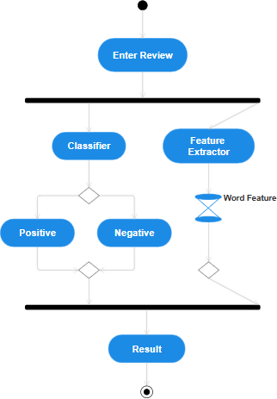
Activity Diagram
An activity diagram for sentiment analysis visually represents the workflow and actions involved in analyzing text for sentiment, showing the flow of control and decision points in a system.

Slide 18
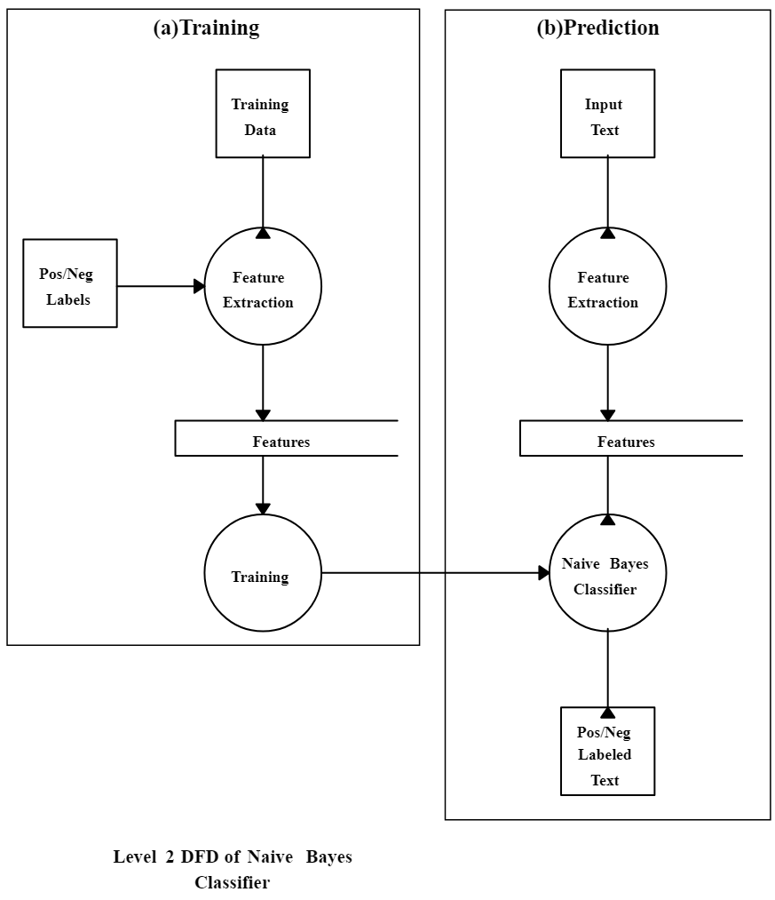
Data Flow Diagram
A Data Flow Diagram (DFD) for sentiment analysis visually maps the flow of data, showing how text data (like reviews or social media posts) is processed to determine sentiment, including input, processing steps, and output.

Slide 19
Code
model.py
# Importing Dataset
df=pd.read_csv('reviews.csv', encoding ="ISO-8859-1")
df = df.drop(columns=["Restaurant","Reviewer","Metadata","Time","Pictures"])
# Transforming & Cleaning Data
y = df["Rating"]
X = df.drop(columns=["Rating"]) y = y.replace({'Like':3})
y = y.fillna(y.median()) y = pd.to_numeric(y) for i in range(0,len(y)):
y.iloc[i] = round(y.iloc[i],0)
for i in range(0,len(y)): if (y[i]>=3):
y[i] = "Positive"
else:
y[i] = "Negative"

Slide 20
# Applying Stemming with excluding StopWords
ps = PorterStemmer() corpus = []
for i in range(0, len(X)):
review = re.sub('[^a-zA-Z]',' ', str(X['Review'][i])) review = review.lower()
review = review.split()
review = [ps.stem(word) for word in review if not word in stopwords.words('english')]
review = ' '.join(review) corpus.append(review)
# Creating Matrix of CountVectorizer
from sklearn.feature_extraction.text import CountVectorizer cv = CountVectorizer(max_features=9000)
X = cv.fit_transform(corpus).toarray()

Slide 21
# Train-Test Split
from sklearn.model_selection import train_test_split
X_train, X_test, y_train, y_test = train_test_split(X, y, test_size=0.25)
# Applying MultinomialNB
from sklearn.naive_bayes import MultinomialNB classifier = MultinomialNB().fit(X_train, y_train)
# Making Predictions
y_pred = classifier.predict(X_test)
# Creating Consusion Matrix
from sklearn.metrics import confusion_matrix confusion_m = confusion_matrix(y_test, y_pred) print(confusion_m)
# Getting the Accuracy
from sklearn.metrics import accuracy_score accuracy = accuracy_score(y_test, y_pred) print(accuracy)
# Dumping Models
import pickle pickle.dump(classifier,open('model.pkl','wb')) pickle.dump(cv,open('cv-model.pkl','wb'))

Slide 22
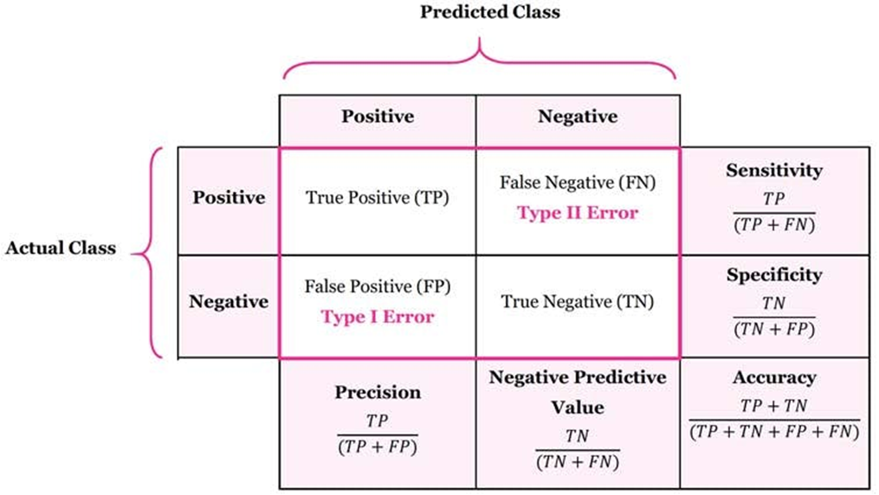
Confusion Matrix
To evaluate the performance of a classification model by comparing its predicted values with the actual values, showing the counts of :
True Positives (TP)
True Negatives (TN)
False Positives (FP)
False Negatives (FN)

Slide 23
Conclusion
Project demonstrates the potential of artificial intelligence in analyzing customer sentiment from online reviews.
By leveraging machine learning algorithms and natural language processing techniques, we were able to accurately classify customer sentiment as positive or negative.
The insights gained from this analysis can be invaluable for businesses, enabling them to identify areas of improvement, track brand reputation, and make data-driven decisions. With the increasing volume of online reviews.
Project showcases the importance of automated sentiment analysis in unlocking the value of customer feedback. The results of project can be extended to various industries, providing a foundation for more advanced applications of artificial intelligence in customer experience management

Slide 24
FUTURE SCOPE AND ENHANCEMENT
Future Scope:
Multilingual Support: Expand the project to support multiple languages, enabling analysis of reviews from diverse geographical locations.
Real-time Analysis: Develop a real-time sentiment analysis system that can process and analyze customer reviews as they are posted.
Visual Analytics: Develop a visual analytics dashboard to provide interactive and intuitive insights into customer sentiment.
Enhancements:
Improved Accuracy: Continuously update and refine the machine learning models to improve the accuracy of sentiment analysis.
Sentiment Analysis of Images and Videos: Explore the possibility of extending sentiment analysis to images and videos, which can provide additional insights into customer opinions.

Slide 25

Thank you
Vikas Group Of Institutions

