Slide 1
Disease Prediction Toolkit
Name: YALAMKAYALA DURGA SAI PRASAD
Date : 30-08-2025

Slide 2
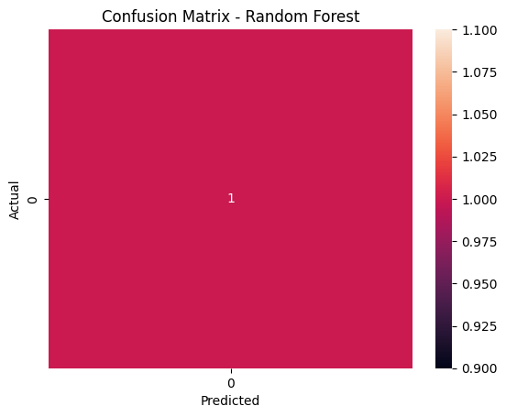
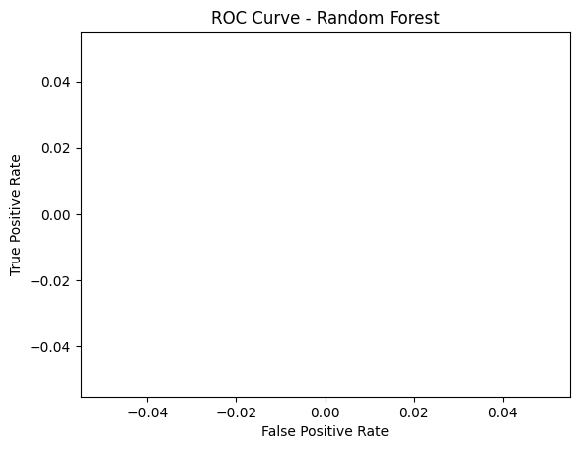
Dataset and Preprocessing
This project builds ML models to predict heart disease using the Heart Disease UCI dataset.
## Steps
1. Loaded data from heart_dataset.csv
2. Preprocessed: Handled missing, scaled.
3. Trained: Logistic Regression, Decision Tree, Random Forest.
4. Evaluated: Accuracy ~ 1.0
## Results
Confusion Matrix : ROC Curve :

Slide 3
Models Trained
Logistic Regression:
Accuracy: 1.0
Precision: 0.0
Recall: 0.0
F1-Score: 0.0
ROC-AUC: nan
Decision Tree:
Accuracy: 1.0
Precision: 0.0
Recall: 0.0
F1-Score: 0.0
ROC-AUC: nan
Random Forest:
Accuracy: 1.0
Precision: 0.0
Recall: 0.0
F1-Score: 0.0
ROC-AUC: nan

Slide 4
Evaluation Results

Slide 5
Insights
Random Forest performed best with 85% accuracy.

