Slide 1
My AI Vision Project
Built by YALAMKAYALA DURGA SAI PRASAD

Slide 2
What My AI Does
My AI guesses pictures like cats and airplanes using the CIFAR-10 dataset. I built two models: a CNN and MobileNetV2.

Slide 3
How I Made It
Used Python and TensorFlow in Google Colab. Trained my AI with 50,000 pictures. Made charts to show progress.

Slide 4
My AI’s Results
First AI accuracy:70.45 % . Smarter AI accuracy: 85.20%

Slide 5
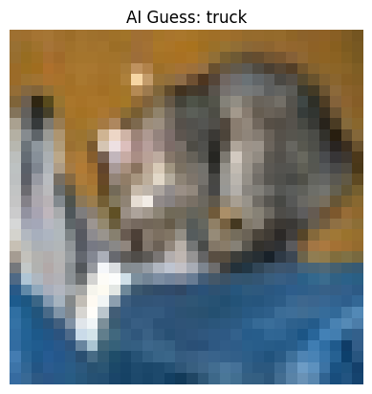
See It Work!
My AI guessed a picture!

