Slide 1
Heart Stroke Prediction using Machine Learning

Slide 2
Problem Statement
Analyze a dataset to predict heart stroke occurrences based on patient features
The aim is to use machine learning to predict strokes with high accuracy, helping in early diagnosis and prevention.

Slide 3
Dataset Overview
The dataset consists of a total of 5110 rows and 12 columns.
Key Features: id, gender,age, hypertension, heart_disease, ever_married,work_type,Residence_type,avg_glucose_level,bmi,smoking_status
Target Variable: stroke (1 for stroke, 0 for no stroke)

Slide 4
Basic Data Exploration
df.head()-Returns first few rows
df.shape()-Returns a tuple consisting number of rows and colums
df.info()-Returns summary of dataframe
df.describe()-Provides statistical summary for numerical columns
df.describe(include=object)-Provides statistical summary for categorical columns

Slide 5
Finding unique values and null values
df.nunique()-Returns count of unique values in each column
df.isnull().sum()-Returns number of null values in each column
df.isnull().sum() / len(df) * 100 –Returns percentage of null values in each column

Slide 6
Data Cleaning and Preprocessing Handing missing values
For numerical columns like BMI, handle missing values by replacing them with the column's mean,median or mode
Ensures that the missing data is filled in with a value representative of the dataset without introducing bias.
df['bmi'].fillna(df['bmi'].mean(), inplace=True)

Slide 7
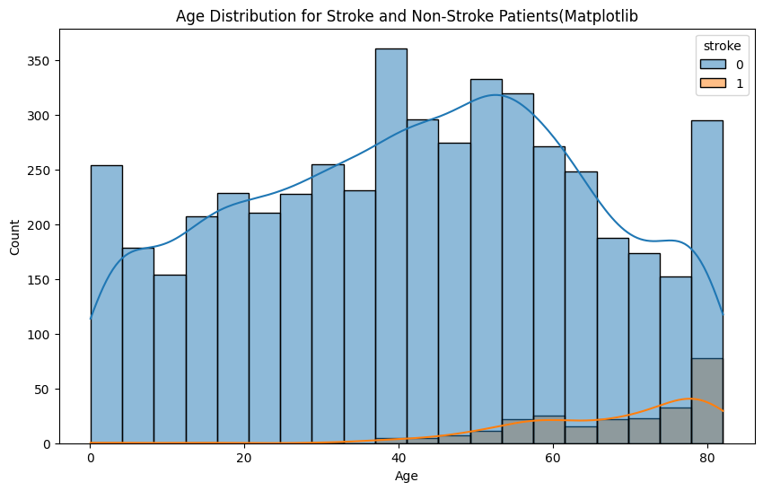
Data Visualization
How does age relate to the likelihood of stroke?
Histogram showing distribution of age with likelihood of stroke
Stroke risk increases significantly after age 40
Elderly individuals (ages 60–80) show the highest stroke occurrences
Younger individuals (under 40) dominate the non-stroke group, showing lower stroke risk.

Slide 8
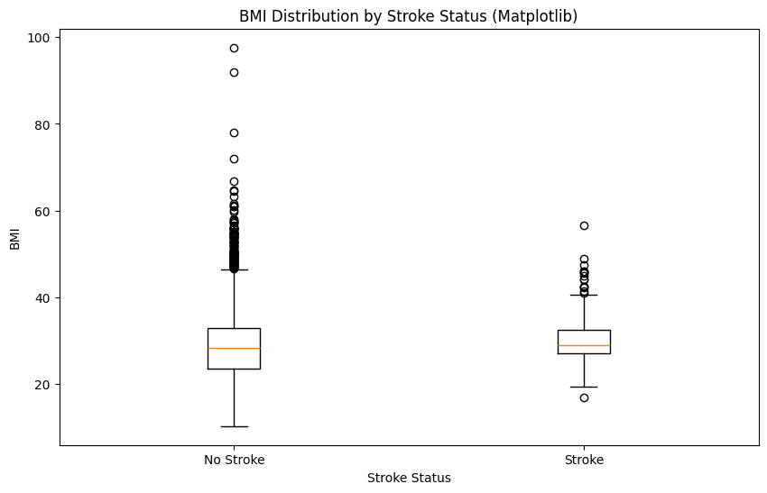
Is there any correlation between BMI and stroke incidence or risk? Stroke and non-stroke groups have similar median BMI values Non-stroke cases show a wider BMI range Both groups have outliers with high BMI BMI does not show a clear relationship with stroke incidence

Slide 9
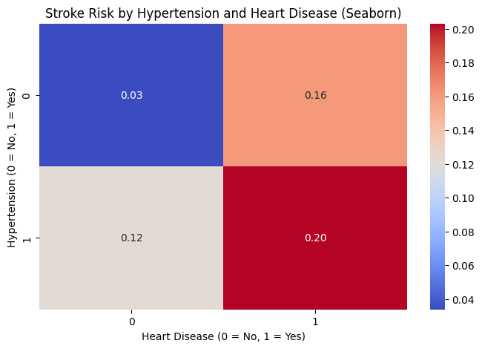
How do hypertension and heart disease jointly affect stroke risk?
Risk of stroke is highest when both hypertension and heart disease are present (1,1)
Risk is significantly lower when only one condition is present (1,0 or 0,1)
The lowest risk is observed when neither condition is present (0,0)

Slide 10
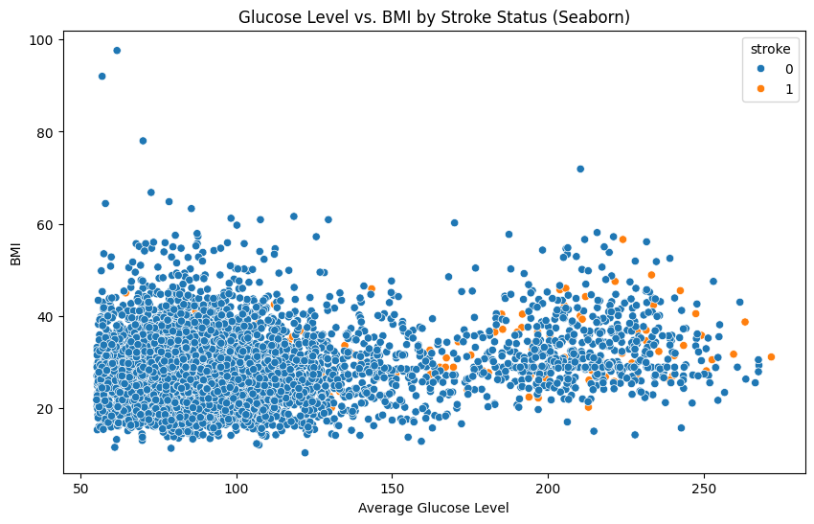
How does glucose level impact stroke risk?
Elevated glucose levels are found in both stroke and non-stroke cases
Stroke cases occur across all BMI ranges
A slight clustering of stroke cases is seen at higher glucose and BMI levels, but the correlation is weak.

Slide 11
Data Encoding
Converting categorical data into numerical formats
Residence_type column to Rural/Urban col (0 = rural, 1 =urban)
work_type column to multiple columns:'Private' 'Self-employed' 'Govt_job' 'children' 'Never_worked’
smoking_status column to binary columns:'formerly smoked' 'never smoked' 'smokes' 'Unknown'

Slide 12
Machine Learning Models
Models Used:
Logistic Regression
Linear Regression
Ridge Regression
Lasso Regression
Evaluation Metrics: Accuracy, RMSE, Precision, Recall, F1 Score, Confusion Matrix

Slide 13
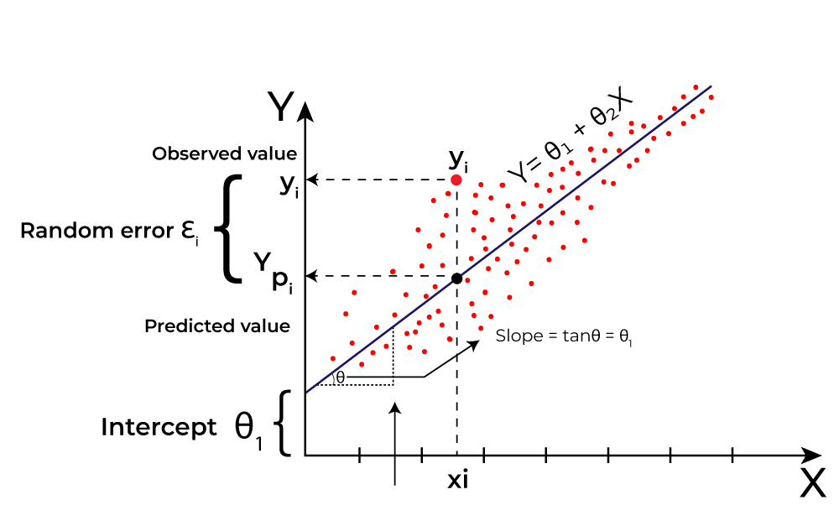
Linear Regression
Statistical method used to model the relationship between a dependent variable and one or more independent variables by fitting a linear equation to observed data.
Key Components:
Dependent Variable (Y): The outcome we want to predict.
Independent Variable(s) (X): The predictor(s) used to make predictions.
Equation: [ Y = β_0 + β_1X_1 + β_2X_2 + ... + β_nX_n + ε ] where:
(β_0) = Intercept
(β_1, β_2, ..., β_n) = Coefficients
(ε) = Error term
Assumptions:
Linearity: The relationship between X and Y is linear.
2. Independence: Observations are independent.

Slide 14
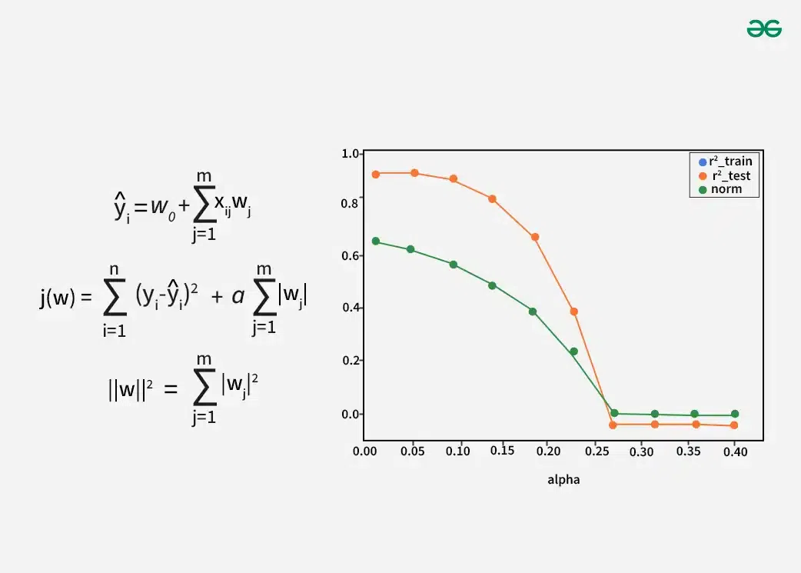
Lasso Regression
Lasso (Least Absolute Shrinkage and Selection Operator) regression is a type of linear regression
Includes a regularization term to prevent overfitting and enhance model interpretability by shrinking some coefficients to zero.composed:
Key Components:
Dependent Variable (Y): The target outcome.
Independent Variable(s) (X): Predictors used to estimate Y.
Equation: Y=β0+β1X1+β2X2+⋯+βnXn+ϵ
Regularization Term: Minimize(∑(Y−Y^)2+λ∑∣βj∣)
λ: Controls the degree of regularization; larger λ shrinks more coefficients to zero.
(λ) = Regularization parameter (controls the strength of the penalty).
(β_j) = Coefficients of the independent variables.
∑∣βj| is penalty

Slide 15
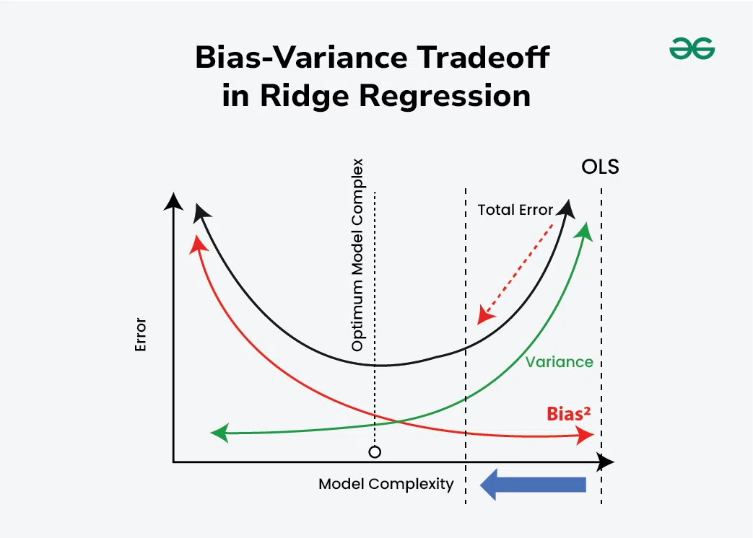
Ridge Regression
Ridge Regression minimizes the following expression: Minimize (SSE+𝜆⋅Penalty)
Sum of Squared Errors (SSE):
Measures the difference between actual (Y) and predicted (Y^ ) values: SSE=∑(𝑌−𝑌^)2
Penalty: Adds the sum of squared coefficients:
Penalty=∑𝛽𝑗2
Final Equation: Minimize (∑(𝑌−𝑌^)2+𝜆⋅∑𝛽𝑗2)
Key Components:
λ: Controls the strength of the penalty.
A higher λ shrinks coefficients more.
βj​: Coefficients assigned to independent variables
which are constrained to remain small but not
exactly zero.

Slide 16
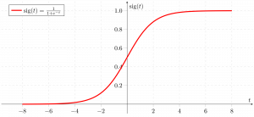
Logistic Regression
Logistic Regression is used for binary classification problems
It maximizes the likelihood of the observed data or minimizes the negative log-likelihood:
For binary classification:
Log-Likelihood=Y⋅log⁡(Y^)+(1−Y)⋅log⁡(1−Y^)
Y: Actual class label (0 or 1).
Y^: Predicted probability of the positive class
Predicted Probability: The logistic function transforms a linear combination of predictors to a probability:
Y^=1/1+e−(β0​+β1​X1​+β2​X2​+⋯+βn​Xn​)
β0​: Intercept.
βj​: Coefficients for independent variables.

Slide 17
Models Comparison:
Model | RMSE | Accuracy
Linear Regression | 22.71 | 9.47
Lasso Regression | 23.75 | 0.94
Ridge Regression | 22.71 | 9.47
Logistic Regression | 24.82 | 93.83
RMSE (Root Mean Squared Error)
RMSE = sqrt((Σ(actual - predicted)^2) / n)
Measures the average magnitude of error between predicted and actual values.
Lower RMSE indicates better prediction.
Accuracy
Accuracy = (TP + TN) / (TP + TN + FP + FN)
Measures the proportion of correct predictions
Higher accuracy indicates a better performing model

Slide 18
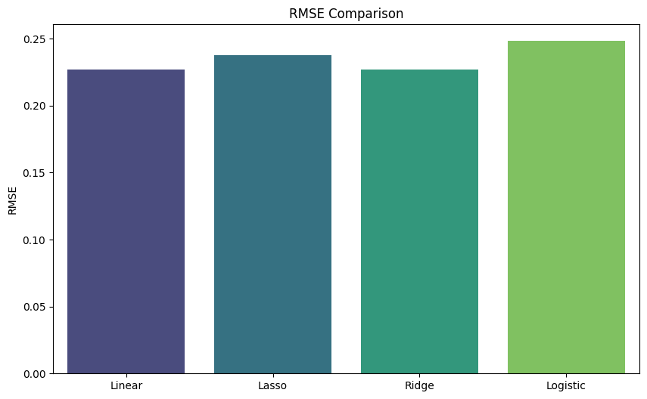
Visualizing Different Models RMSE Comparison
Linear and Ridge Regression achieve lower RMSE values but fail to perform well for classification tasks
Logistic Regression, despite a higher RMSE, provides the best classification accuracy, which is the primary focus of this analysis.

Slide 19
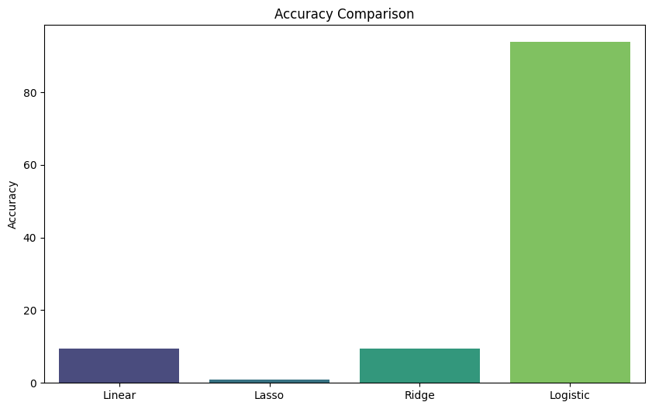
Accuracy Comparison
Linear and Ridge regression struggle in binary classification scenarios.
Logistic Regression significantly outperforms the others, making it the most reliable model for predicting heart stroke.
For accuracy, Logistic Regression is the top performer, making it the best choice for stroke prediction.
For RMSE, Linear and Ridge Regression have the lowest values, but this is not relevant to classification success, as these models yield low accuracy.

Slide 20
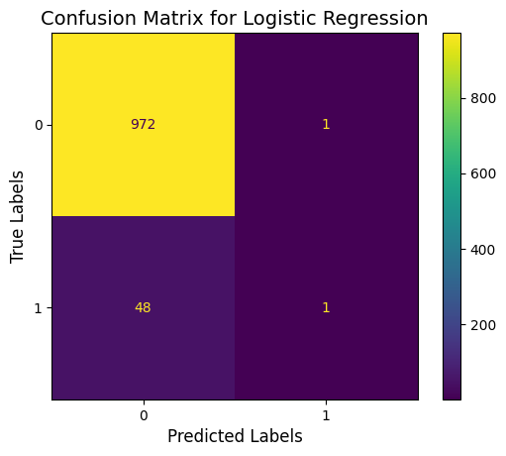
Confusion Matrix
Helps to evaluate model performance by showing counts for:
True Negatives (TN): Correctly predicted negative cases.
Predicted 0, actual 0
False Negatives (FN): Positive cases incorrectly predicted as negative.
Predicted 0, actual 1
False Positives (FP): Negative cases incorrectly predicted as positive.
Predicted 1, actual 0
True Positives (TP): Correctly predicted positive cases.
Predicted 1, actual 1
Model correctly classified 972 true negatives and 1 true positive.
There are 48 false negatives, indicating missed stroke cases, and 1 false positive.

Slide 21
Evaluation Metrics
Precision
Precision = TP / (TP + FP)
Indicates how many predicted positives are actual positives
Recall
Recall = TP / (TP + FN)
Measures how many actual positives are identified correctly.
F1-Score
F1-Score = 2 * (Precision * Recall) / (Precision + Recall)
Harmonic mean of precision and recall, balancing the trade-off between them.
Metrics | Observations
Precision: 0.5000 | Precision is decent; 50% of predicted positives are correct
Recall: 0.0204 | Extremely low recall means most positive cases are missed.
F1 Score: 0.0392 | Low F1 Score shows poor balance between precision and recall.

Slide 22
Key Observations
Model misses a majority of true stroke cases due to low recall.
High precision indicates correct positive predictions, but not enough to compensate for missed cases
Dataset imbalance likely causes the model to favor non-stroke predictions.
Recommendations
Handle Imbalanced Data: Use SMOTE or class weighting to improve recall.
Try Better Models: Test Decision Trees, Random Forests, or Gradient Boosting.
Focus on Metrics: Use F1 Score and Precision-Recall Curve for better evaluation.
Enhance Features: Add or improve features using domain knowledge for better predictions

Slide 23
Model Performance Analysis
Where the ML Model Performs Well
The model demonstrates high precision,means that when it predicts a stroke, the prediction is often correct.
It performs well in avoiding false positives, reducing unnecessary alarms for non-stroke cases.
Where the ML Model Lacks
Low Recall indicates the model fails to identify most true stroke cases, leading to a high number of false negatives.
The F1 Score is very low, reflecting an imbalance between precision and recall
Struggles with predicting minority class (stroke cases) due to the class imbalance in the dataset

Slide 24
Dataset Bias Analysis
Is the Dataset Biased?
Yes, the dataset is highly imbalanced, with significantly more non-stroke cases than stroke cases.
This imbalance skews the model toward predicting the majority class (non-stroke), making it biased against minority cases (stroke).
How to Address Dataset Bias?
Oversampling Techniques
Undersampling Techniques
Class Weights
Alternative Metrics

Slide 25
Conclusion
While the model demonstrates strong overall accuracy, its limited ability to identify stroke cases highlights the importance of addressing dataset imbalance and refining predictive features.
This project provides a solid foundation for future work in improving stroke prediction models and supports the development of data-driven healthcare solutions.

Slide 26
Thank you

