Slide 1
Heart Stroke Prediction using Machine Learning

Slide 2
Problem Statement
Analyze a dataset to predict heart stroke occurrences based on patient features
The main objective of this project is to build machine learning models that can effectively predict the risk of a heart stroke
The aim is to use machine learning to predict strokes with high accuracy, helping in early diagnosis and prevention.

Slide 3
Steps involved:
Dataset Overview
Data preprocessing and visualization
Model building using different regression models
Model evaluation using metrics
Model performance analysis
Insights into dataset bias

Slide 4
Dataset Overview
The dataset consists of a total of 5110 rows and 12 columns.
Key Features: id, gender,age, hypertension, heart_disease, ever_married,work_type,Residence_type,avg_glucose_level,bmi,smoking_status
Target Variable: stroke (1 for stroke, 0 for no stroke)

Slide 5
Basic Data Exploration
df.head()-Returns first few rows
df.shape()-Returns a tuple consisting number of rows and colums
df.info()-Returns summary of dataframe
df.describe()-Provides statistical summary for numerical columns
df.describe(include=object)-Provides statistical summary for categorical columns

Slide 6
Finding unique values and null values
df.nunique()-Returns count of unique values in each column
df.isnull().sum()-Returns number of null values in each column
df.isnull().sum() / len(df) * 100 –Returns percentage of null values in each column

Slide 7
Data Cleaning and Preprocessing Handing missing values
For numerical columns like BMI(3.93% missing values),we can handle missing values by replacing them with the column's mean,median or mode
Ensures that the missing data is filled in with a value representative of the dataset without introducing bias.
df['bmi'].fillna(df['bmi'].mean(), inplace=True)

Slide 8
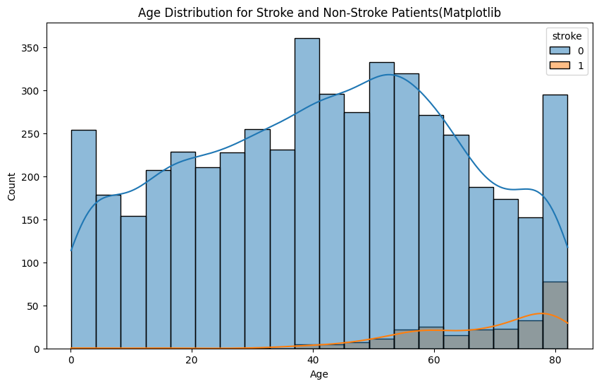
Data Visualization
How does age relate to the likelihood of stroke?
Histogram showing distribution of age with likelihood of stroke
Stroke risk increases significantly after age 40
Elderly individuals (ages 60–80) show the highest stroke occurrences
Younger individuals (under 40) dominate the non-stroke group, showing lower stroke risk.

Slide 9
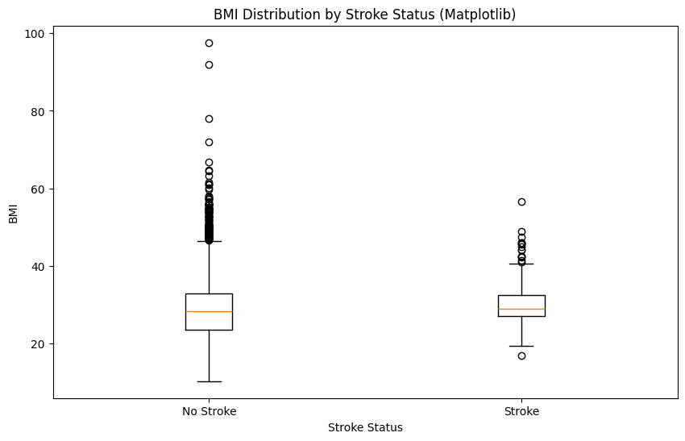
Is there any correlation between BMI and stroke incidence or risk? -Boxplot showing BMI distribution with stroke status -Stroke and non-stroke groups have similar median BMI values -Non-stroke cases show a wider BMI range Both groups have outliers with high BMI -BMI does not show a clear relationship with stroke incidence

Slide 10
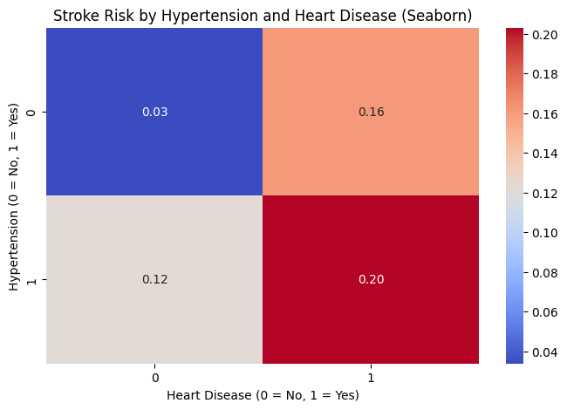
How do hypertension and heart disease jointly affect stroke risk?
Heatmap showing risk of stroke with hypertension and heart disease
Risk of stroke is highest when both hypertension and heart disease are present (1,1)
Risk is significantly lower when only one condition is present (1,0 or 0,1)
The lowest risk is observed when neither condition is present (0,0)

Slide 11
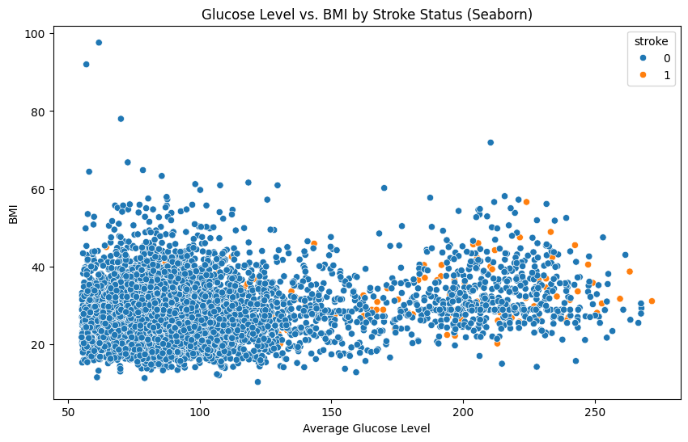
How does glucose level impact stroke risk?
Scatterplot showing impact of glucose level and BMI on stroke
Elevated glucose levels are found in both stroke and non-stroke cases
Stroke cases occur across all BMI ranges
A slight clustering of stroke cases is seen at higher glucose and BMI levels, but the correlation is weak.

Slide 12
Data Encoding
Converting categorical data into numerical formats
Residence_type column to Rural/Urban col (0 = rural, 1 =urban)
work_type column to multiple columns:'Private' 'Self-employed' 'Govt_job' 'children' 'Never_worked’
smoking_status column to binary columns:'formerly smoked' 'never smoked' 'smokes' 'Unknown'

Slide 13
Machine Learning Models
Models Used:
Logistic Regression
Linear Regression
Ridge Regression
Lasso Regression
Evaluation Metrics: Accuracy, RMSE, Precision, Recall, F1 Score, Confusion Matrix

Slide 14
Model Building
A Machine Learning (ML) Model is a mathematical representation of a real-world process or pattern learned from data.
Uses input features to predict outcomes by recognizing patterns and relationships in the data.
Key Points:
It is built using training data and evaluated on test data
Types of ML models include:
Regression Models: Predict continuous values
E.g., Linear, Lasso, Ridge Regression
Classification Models: Predict categorical outcomes
E.g., Logistic Regression

Slide 15
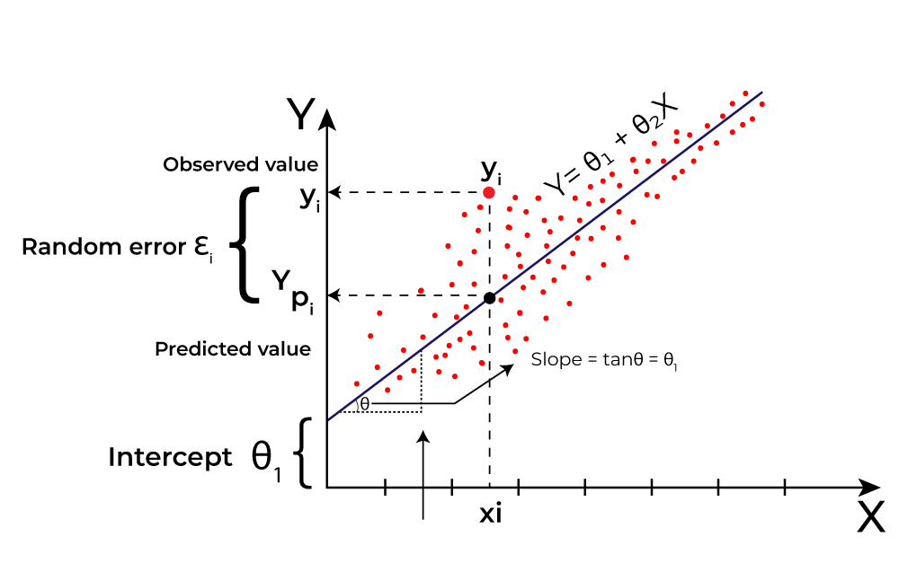
Linear Regression
Statistical method used to model the relationship between a dependent variable and one or more independent variables by fitting a linear equation to observed data.
Key Components:
Dependent Variable (Y): The outcome we want to predict.
Independent Variable(s) (X): The predictor(s) used to make predictions.
Equation: [ Y = β_0 + β_1X_1 + β_2X_2 + ... + β_nX_n + ε ] where:
(β_0) = Intercept
(β_1, β_2, ..., β_n) = Coefficients
(ε) = Error term
Assumptions:
Linearity: The relationship between X and Y is linear.
2. Independence: Observations are independent.

Slide 16
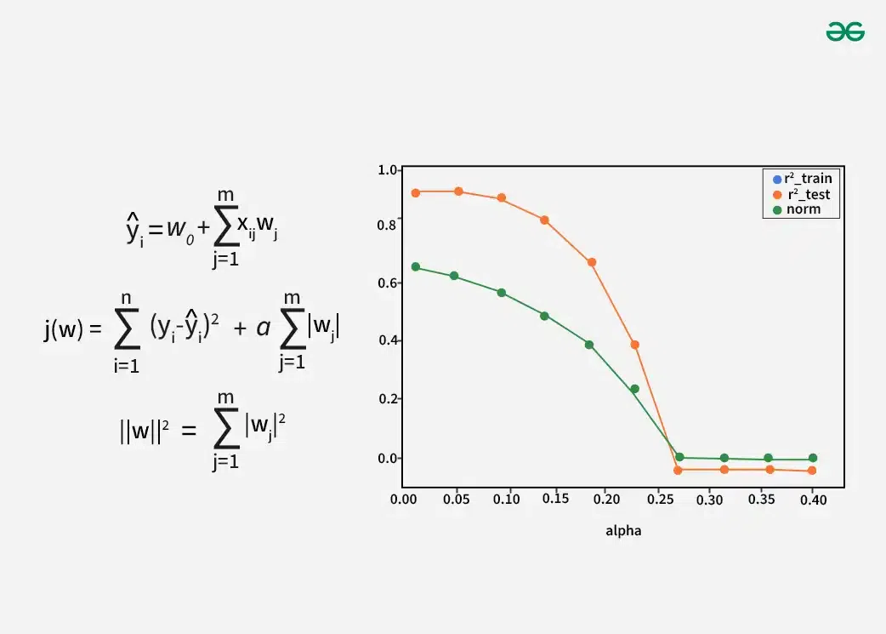
Lasso Regression
Lasso (Least Absolute Shrinkage and Selection Operator) regression is a type of linear regression
Includes a regularization term to prevent overfitting and enhance model interpretability by shrinking some coefficients to zero.composed:
Key Components:
Dependent Variable (Y): The target outcome.
Independent Variable(s) (X): Predictors used to estimate Y.
Equation: Y=β0+β1X1+β2X2+⋯+βnXn+ϵ
Regularization Term: Minimize(∑(Y−Y^)2+λ∑∣βj∣)
λ: Controls the degree of regularization; larger λ shrinks more coefficients to zero.
(λ) = Regularization parameter (controls the strength of the penalty).
(β_j) = Coefficients of the independent variables.
∑∣βj| is penalty

Slide 17
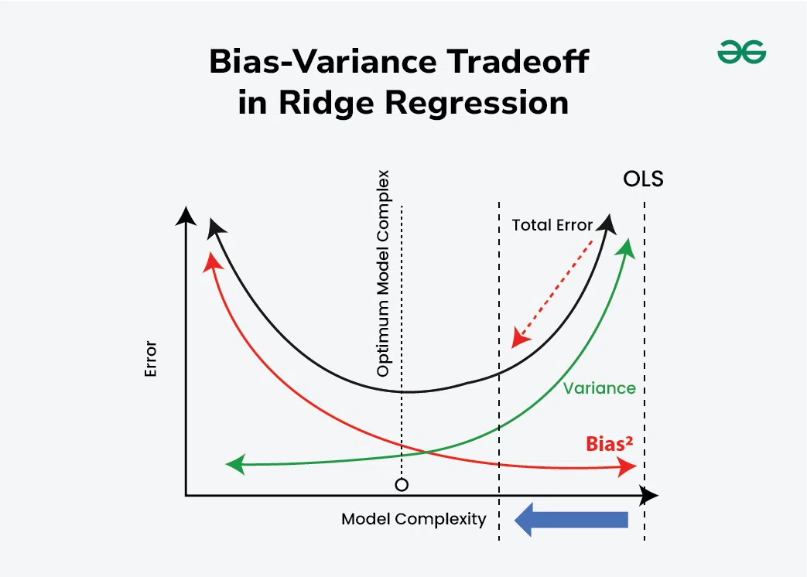
Ridge Regression
Ridge Regression minimizes the following expression: Minimize (SSE+𝜆⋅Penalty)
Sum of Squared Errors (SSE):
Measures the difference between actual (Y) and predicted (Y^ ) values: SSE=∑(𝑌−𝑌^)2
Penalty: Adds the sum of squared coefficients:
Penalty=∑𝛽𝑗2
Final Equation: Minimize (∑(𝑌−𝑌^)2+𝜆⋅∑𝛽𝑗2)
Key Components:
λ: Controls the strength of the penalty.
A higher λ shrinks coefficients more.
βj​: Coefficients assigned to independent variables
which are constrained to remain small but not
exactly zero.

Slide 18
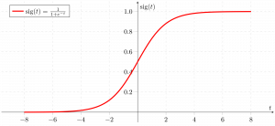
Logistic Regression
Logistic Regression is used for binary classification problems
It maximizes the likelihood of the observed data or minimizes the negative log-likelihood:
For binary classification:
Log-Likelihood=Y⋅log⁡(Y^)+(1−Y)⋅log⁡(1−Y^)
Y: Actual class label (0 or 1).
Y^: Predicted probability of the positive class
Predicted Probability: The logistic function transforms a linear combination of predictors to a probability:
Y^=1/1+e−(β0​+β1​X1​+β2​X2​+⋯+βn​Xn​)
β0​: Intercept.
βj​: Coefficients for independent variables.

Slide 19
Models Comparison:
Model | RMSE | Accuracy
Linear Regression | 22.75 | 6.06
Lasso Regression | 23.76 | 0.94
Ridge Regression | 22.71 | 9.47
Logistic Regression | 24.63 | 93.93
RMSE (Root Mean Squared Error)
RMSE = sqrt((Σ(actual - predicted)^2) / n)
Measures the average magnitude of error between predicted and actual values.
Lower RMSE indicates better prediction.
Accuracy
Accuracy = (TP + TN) / (TP + TN + FP + FN)
Measures the proportion of correct predictions
Higher accuracy indicates a better performing model

Slide 20
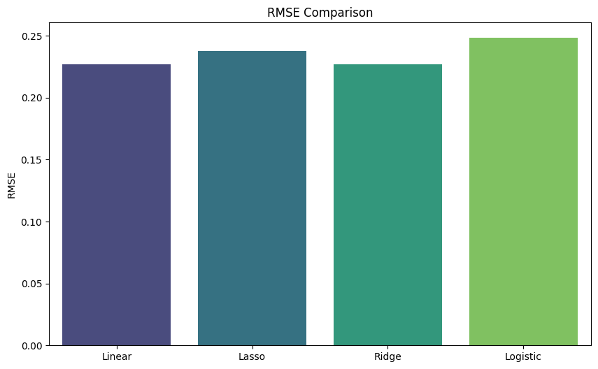
Visualizing Different Models RMSE Comparison
Linear and Ridge Regression achieve lower RMSE values but fail to perform well for classification tasks
Logistic Regression, despite a higher RMSE, provides the best classification accuracy, which is the primary focus of this analysis.

Slide 21
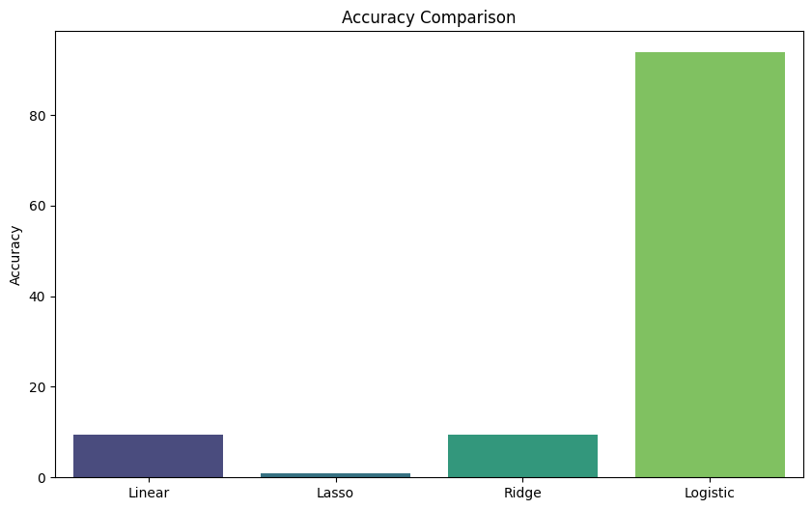
Accuracy Comparison
Linear and Ridge regression struggle in binary classification scenarios.
Logistic Regression significantly outperforms the others, making it the most reliable model for predicting heart stroke.

Slide 22
Observations (Comparing All Models)
Logistic Regression achieves the highest accuracy (93.93%), making it the most effective model for heart stroke prediction in this dataset.
Linear Regression performs poorly in classification tasks, showing low accuracy (6.06%) despite having a lower RMSE.
Lasso Regression struggles to identify relevant patterns in the dataset, resulting in low accuracy (0.94%) and a relatively high RMSE.
Ridge Regressionis not suited for classification tasks, providing low accuracy (9.47%) even with a lower RMSE.
Logistic Regression is the optimal choice, while the other models fail to deliver satisfactory classification performance.

Slide 23
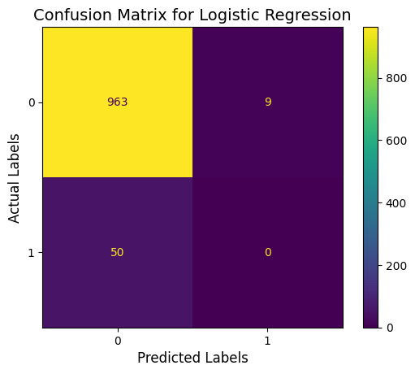
Confusion Matrix
Helps to evaluate model performance by showing counts for:
True Negatives (TN): Correctly predicted negative cases.
Predicted 0, actual 0
False Negatives (FN): Positive cases incorrectly predicted as negative.
Predicted 0, actual 1
False Positives (FP): Negative cases incorrectly predicted as positive.
Predicted 1, actual 0
True Positives (TP): Correctly predicted positive cases.
Predicted 1, actual 1.

Slide 24
Observations from Confusion Matrix
The model correctly classified 963 non-stroke cases.
incorrectly classified 50 stroke cases as non-stroke, indicates the model's inability to detect positive cases (strokes)
Incorrectly predicted 9 non-stroke cases as strokes, false positives can lead to unnecessary interventions.
Failed to identify any true stroke cases
Improvements can include handling class imbalance using oversampling (e.g., SMOTE) or trying different algorithms.

Slide 25
Model Evaluation using Metrics
Precision
Precision = TP / (TP + FP)
Indicates how many predicted positives are actual positives
Recall
Recall = TP / (TP + FN)
Measures how many actual positives are identified correctly.
F1-Score
F1-Score = 2 * (Precision * Recall) / (Precision + Recall)
Harmonic mean of precision and recall, balancing the trade-off between them.
Metrics | Observations
Precision: 0.9041 | High precision shows that 90.41% of predicted positives are correct.
Recall: 0.9423 | High recall suggests the model identifies 94.23% of actual positive cases accurately.
F1 Score: 0.9228 | A high F1 Score indicates a strong balance between precision and recall.

Slide 26
Key Observations
Model demonstrates excellent performance, with a near-perfect balance between precision and recall.
High precision ensures the majority of positive predictions are accurate, with few false positives.
High recall indicates the model effectively minimizes false negatives, capturing most true stroke cases.
High F1 Score reflects that the model performs well across both positive and negative cases.
Recommendations
Handle Imbalanced Data
Try Better Models
Focus on Metrics
Enhance Features

Slide 27
Model Performance Analysis
Where the ML Model Performs Well
The model demonstrates high precision,means that when it predicts a stroke, the prediction is often correct.
It performs well in avoiding false positives, reducing unnecessary alarms for non-stroke cases.
The high accuracy indicates the model's capability to classify most cases correctly,
Where the ML Model Lacks
While the recall value is high, it may over-represent the majority class's contribution to correct predictions
The RMSE reflects errors in numeric evaluation and highlights areas where predictions can be more precise.
Struggles with predicting minority class (stroke cases) due to the class imbalance in the dataset

Slide 28
Dataset Bias Analysis
Is the Dataset Biased?
Yes, the dataset is highly imbalanced, with significantly more non-stroke cases than stroke cases.
This imbalance skews the model toward predicting the majority class (non-stroke), making it biased against minority cases (stroke).
How to Address Dataset Bias?
Oversampling Techniques
Undersampling Techniques
Class Weights
Alternative Metrics

Slide 29
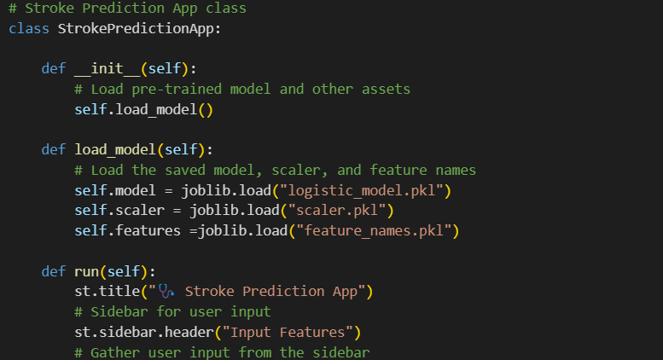
Streamlit
Streamlit is an open-source Python framework that simplifies the creation of interactive, data-driven web applications.
It is particularly designed for machine learning (ML) and data science projects, allowing developers and data scientists to turn their Python scripts into fully interactive web apps with minimal effort.

Slide 30
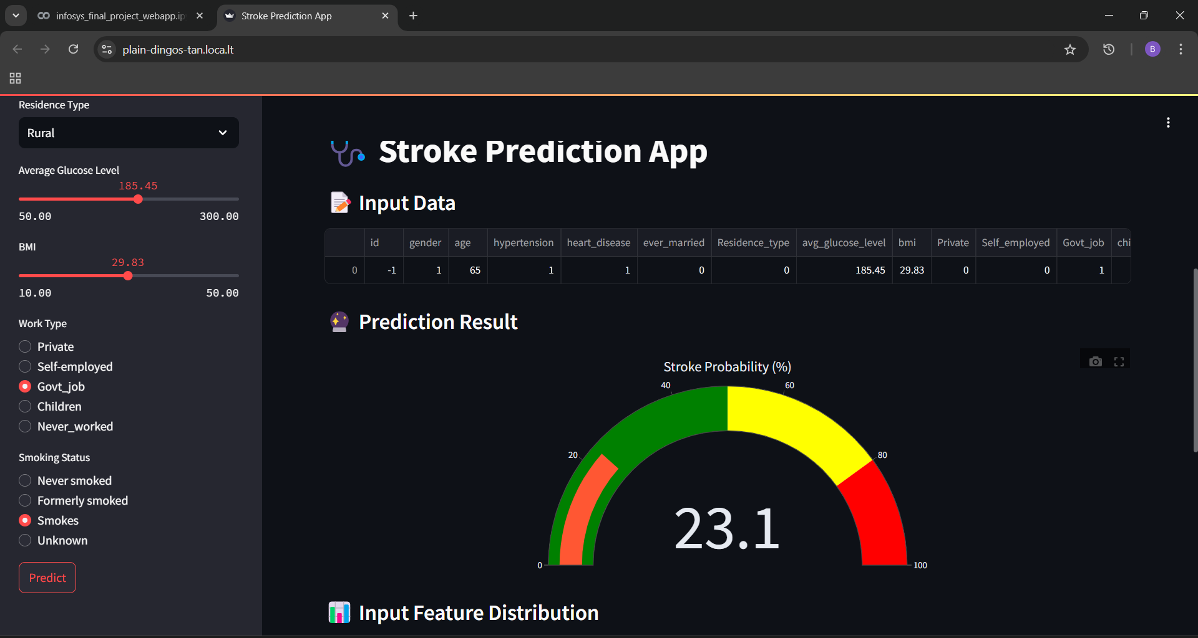
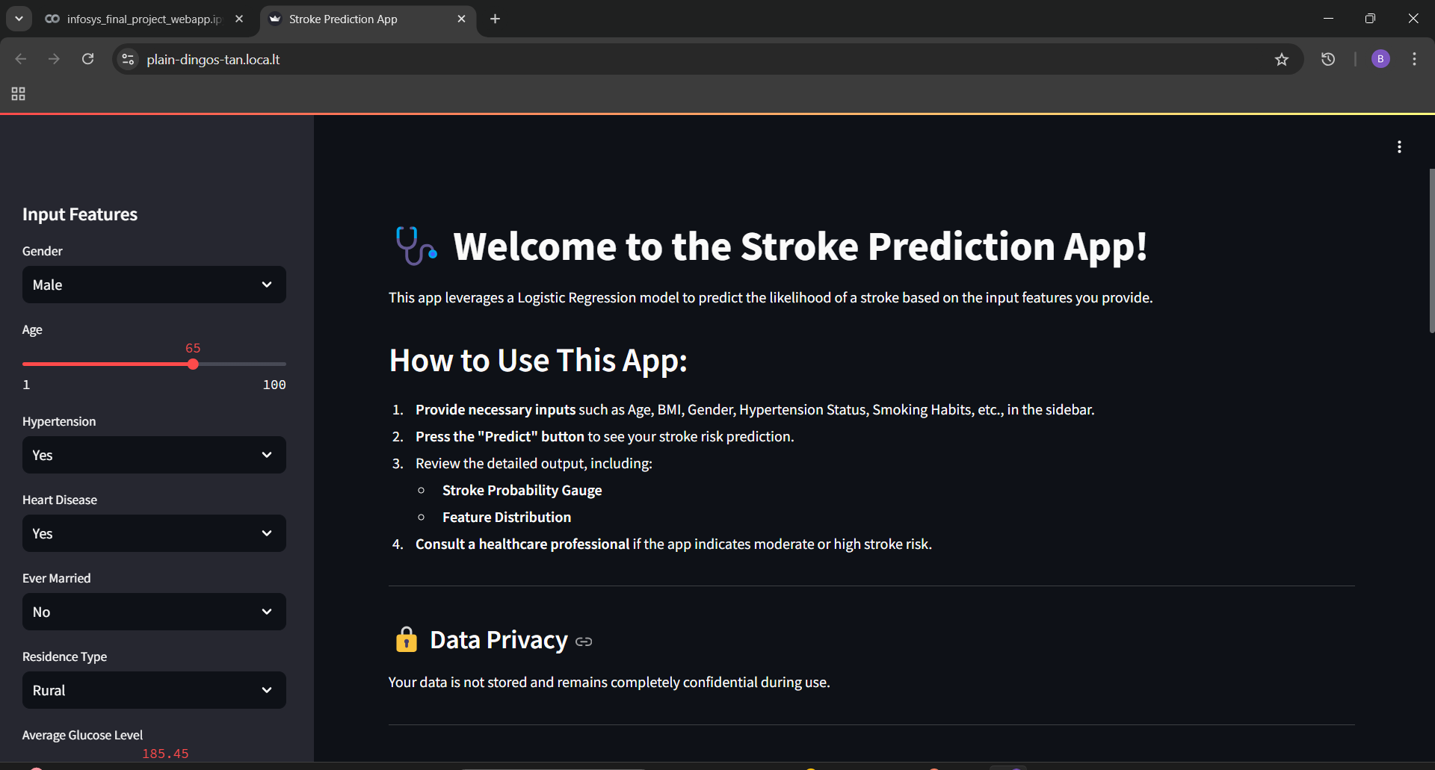
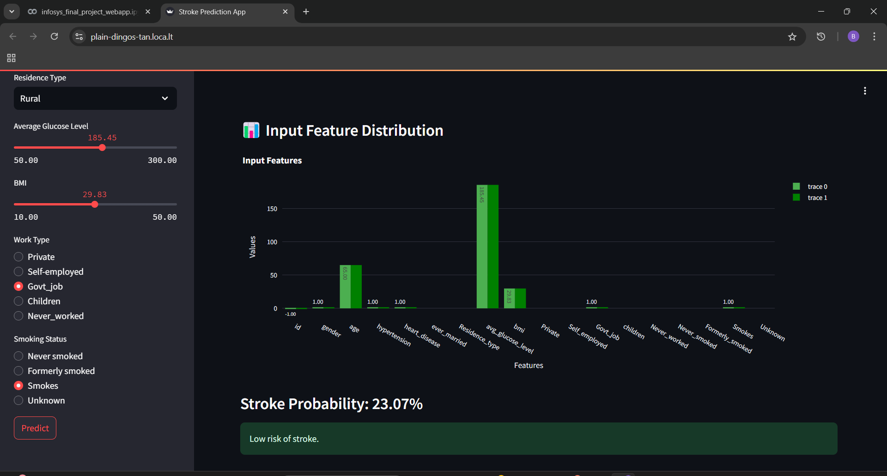
Webpage

Slide 31
Project Summary
The Heart Stroke Prediction project aimed to analyze health-related data, preprocess it for modeling, and evaluate machine learning models to predict stroke occurrence.
Logistic Regression emerged as the most suitable model for this task.
Strengths of the Model
The model excels in identifying non-stroke cases accurately, as evidenced by its high accuracy and precision.
Logistic Regression, being interpretable and computationally efficient, is well-suited for this dataset.

Slide 32
Limitations:
The dataset's class imbalance limits the model's ability to generalize well for minority class predictions.
Despite strong metrics, the model may still miss critical stroke cases, which is significant for medical applications.
Recommendations:
Address Dataset Imbalance: Use techniques like oversampling, undersampling, or class weighting to improve recall and F1 scores.
Feature Engineering: Introduce or enhance features that can better distinguish between stroke and non-stroke cases.
Advanced Models: Explore other models, such as Random Forest or Decision Tree, which can handle imbalanced datasets better.
Evaluation Metrics: Focus on metrics like F1 score, precision-recall curve, and ROC-AUC for a comprehensive evaluation.

Slide 33
Conclusion
While the model shows strong accuracy and precision, its ability to identify stroke cases remains limited.
Addressing the dataset imbalance and refining predictive features, will improve the model's predictive power and practical utility in healthcare applications.
This project provides a solid foundation for future work in improving stroke prediction models and supports the development of data-driven healthcare solutions.

Slide 34
Thank you

