Slide 1
Concept Learning

Slide 2
Concept Learning
Learning involves acquiring general concepts from specific training examples.
Alternatively, each concept can be thought of as a Boolean-valued function defined over this larger set. (Example: A function defined over all animals, whose value is true for birds and false for other animals).
Concept learning can be formulated as a problem of searching through a predefined space of potential hypotheses for the hypothesis that best fits the training examples
Concept learning - Inferring a Boolean-valued function from training examples of its input and output

Slide 3
A Concept Learning Task
Consider the example task of learning the target concept
"Days on which Aldo enjoys his favorite water sport."
Example | Sky | AirTemp | Humidity | Wind | Water | Forecast | EnjoySport
1 | Sunny | Warm | Normal | Strong | Warm | Same | Yes
2 | Sunny | Warm | High | Strong | Warm | Same | Yes
3 | Rainy | Cold | High | Strong | Warm | Change | No
4 | Sunny | Warm | High | Strong | Cool | Change | Yes
Positive and negative training examples for the target concept EnjoySport

Slide 4
The attribute EnjoySport indicates whether a Person enjoys his favorite water sport on this day.
The task is to learn to predict the value of EnjoySport for an arbitrary day, based on the values of its other attributes ?
What hypothesis representation is provided to the learner?
Let’s consider a simple representation in which each hypothesis consists of a conjunction of constraints on the instance attributes.
Let each hypothesis be a vector of six constraints, specifying the values of the six attributes Sky, AirTemp, Humidity, Wind, Water, and Forecast.
For each attribute, the hypothesis will either
Indicate by a "?' that any value is acceptable for this attribute,
Specify a single required value (e.g., Warm) for the attribute, or
Indicate by a "Φ" that no value is acceptable

Slide 5
The hypothesis that PERSON enjoys his favorite sport only on cold days with high humidity (independent of the values of the other attributes) is represented by the expression
(?, Cold, High, ?, ?, ?)
(?, Warm,?, ?, ?, ?)
If some instance x satisfies all the constraints of hypothesis h, then h classifies x as a positive example (h(x) = 1).
The most general hypothesis-that every day is a positive example-is represented by
(?, ?, ?, ?, ?, ?)
The most specific possible hypothesis-that no represented by
(Φ , Φ, Φ, Φ, Φ, Φ)
day is a positive example-is

Slide 6
Notation
The set of items over which the concept is defined is called the set of instances, denoted by X.
Example: X is the set of all possible days, each represented by the attributes: Sky, AirTemp, Humidity, Wind, Water, and Forecast
The concept or function to be learned is called the target concept, denoted by c.
c can be any Boolean valued function defined over the instances X;
c : X→{O, 1}
The target concept corresponds to the value of the attribute EnjoySport
(i.e., c(x) = 1 if EnjoySport = Yes, and c(x) = 0 if EnjoySport = No).

Slide 7
Instances for which c(x) = 1 are called positive examples, or members of the target concept.
Instances for which c(x) = 0 are called negative examples, or non-members of the target concept.
The ordered pair (x, c(x)) to describe the training example consisting of the instance x and its target concept value c(x).
D to denote the set of available training examples
The symbol H to denote the set of all possible hypotheses that the learner may consider regarding the identity of the target concept. Each hypothesis h in H represents a Boolean-valued function defined over X
h : X→{O, 1}
The goal of the learner is to find a hypothesis h such that h(x) = c(x) for all x in X.

Slide 8
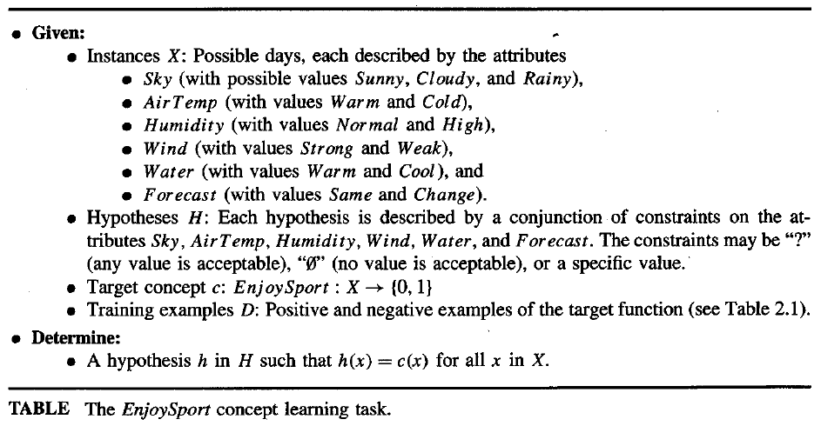

Slide 9
Inductive Learning Hypothesis
Definition: Any hypothesis found to approximate the target function well over a sufficiently large set of training examples will also approximate the target function well over other unobserved examples.

Slide 10
Concept Learning as Search
Concept learning can be viewed as the task of searching through a large space of hypotheses implicitly defined by the hypothesis representation.
The goal of this search is to find the hypothesis that best fits the training
examples.
Example, the instances X and hypotheses H in the EnjoySport learning task.
The attribute Sky has three possible values, and AirTemp, Humidity, Wind, Water Forecast each have two possible values
The instance space X contains exactly
3.2.2.2.2.2 = 96 (Distinct instances)

Slide 11
If we add the other two values tha attribute can take, then
The instance space X contains exactly
5.4.4.4.4.4 = 5120
(Syntactically distinct hypotheses within H.)
Every hypothesis containing one or more " Φ" symbols represents the empty set of instances; that is, it classifies every instance as negative.
Hence, the instance space X contains
1 + (4.3.3.3.3.3) = 973
(Semantically distinct hypotheses)

Slide 12
General-to-Specific Ordering of Hypotheses
Many algorithms for concept learning organize the search through the hypothesis space by relying on a very useful structure that exists for any concept learning problem: a general-to-specific ordering of hypotheses.
By taking advantage of this naturally occurring structure over the hypothesis space, we can design learning algorithms that exhaustively search even infinite hypothesis spaces without explicitly enumerating every hypothesis.

Slide 13
To illustrate the general-to-specific ordering, consider the two hypotheses
h₁ = (Sunny, ?, ?, Strong, ?, ?)
h₂ = (Sunny, ?, ?, ?, ?, ?)
Consider the sets of instances that are classified positive by h_{l} and by h₂.
h₂ imposes fewer constraints on the instance, it classifies more instances as positive. So, any instance classified positive by h_{l} will also be classified positive by h₂. Therefore, h₂ is more general than h_{l}.
Given hypotheses h_{j} and h_{k},
h_{j} is more-general-than or- equal to h_{k} if and only if any instance that satisfies h_{k} also satisfies h_{j}
Definition: Let h_{j} and h_{k} be Boolean-valued functions defined over X. Then h_{j} is
more_general_than_or_equal_to h_{k} (written h_{j} ≥ h_{k}) if and only if

Slide 14
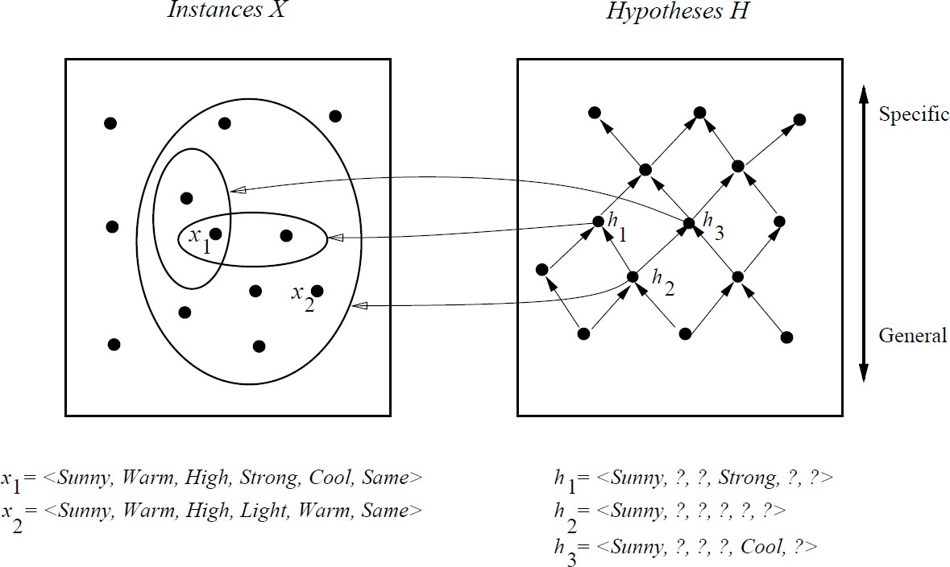
In the figure, the box on the left represents the set X of all instances, the box on the right the set H of all hypotheses.
Each hypothesis corresponds to some subset of X-the subset of instances that it classifies positive.
The arrows connecting hypotheses represent the more_general_than relation, with the arrow pointing toward the less general hypothesis.
Note the subset of instances characterized by h₂ subsumes the subset characterized by h _{l} , hence h₂ is more - general– than h₁

Slide 15
FIND-S: Finding a Maximally Specific Hypothesis
FIND-S Algorithm
Initialize h to the most specific hypothesis in H
For each positive training instance x
For each attribute constraint a_{i} in h
If the constraint a_{i} is satisfied by x
Then do nothing
Else replace a_{i} in h by the next more general constraint that is satisfied by x
Output hypothesis h

Slide 16
To illustrate this algorithm, assume the learner is given the sequence of training examples from the EnjoySport task
Example | Sky | AirTemp | Humidity | Wind | Water | Forecast | EnjoySport
1 | Sunny | Warm | Normal | Strong | Warm | Same | Yes
2 | Sunny | Warm | High | Strong | Warm | Same | Yes
3 | Rainy | Cold | High | Strong | Warm | Change | No
4 | Sunny | Warm | High | Strong | Cool | Change | Yes
The first step of FIND-S is to initialize h to the most specific hypothesis in H
H← (Ø, Ø, Ø, Ø, Ø, Ø)

Slide 17
x₁ = <Sunny, Warm,Normal, Strong, Warm, Same>, +
Observing the first training example, it is clear that our hypothesis is too specific. In particular, none of the "Ø" constraints in h are satisfied by this example, so each is replaced by the next more general constraint that fits the example
h₁ = <Sunny, Warm, Normal, Strong,Warm, Same>
This h is still very specific; it asserts that all instances are negative except for the single positive training example
x₂ = <Sunny, Warm, High, Strong, Warm, Same>, +
The second training example forces the algorithm to further generalize h, this time substituting a "?' in place of any attribute value in h that is not satisfied by the new example
h₂ = <Sunny, Warm, ? ,Strong, Warm, Same>

Slide 18
x3 = <Rainy, Cold, High, Strong, Warm, Change>, -
Upon encountering the third training the algorithm makes no change to h. The FIND-S algorithm simply ignores every negative example.
h3 = < Sunny,Warm ? Strong, Warm, Same>
x4 = <Sunny, Warm, High, Strong, Cool, Change>, +
The fourth example leads to a further generalization of h
h4 = < Sunny, Warm, ?, Strong, ?,? >

Slide 19
Training example 1
Example | Time of day | Weather | Temp | Company | Humidity | Wind | Play Tennis
1 | Morning | Sunny | Warm | Yes | Mild | Strong | Yes
2 | Evening | Rainy | Cold | No | Mild | Normal | No
3 | Morning | Sunny | Moderate | Yes | Normal | Normal | Yes
4 | Evening | Sunny | Cold | Yes | High | Strong | Yes

Slide 20
Training Example 2
Example | Toothed | Legs | Species
1 | True | True | Mammal
2 | True | False | Reptile
3 | False | True | Mammal
4 | False | True | Reptile

Slide 21
Training Example 3
Example | Body Temp | Gives Birth | Four Legged | Hibernates | Class label
1 | Warm | Yes | Yes | Yes | Yes
2 | Warm | Yes | Yes | No | Yes
3 | Warm | No | No | No | No
4 | Cold | No | No | No | No
5 | Cold | Yes | No | No | No
6 | Warm | Yes | No | Yes | Yes
7 | Warm | Yes | No | No | Yes

Slide 22
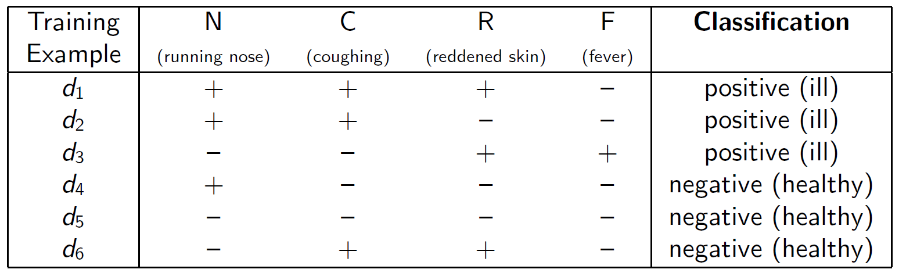
Training Example 4

Slide 23
Find-S: Key properties
FIND-S is guaranteed to output the most specific hypothesis within H that is consistent with the positive training examples
FIND-S algorithm’s final hypothesis will also be consistent with the negative examples provided
  the correct target concept is contained in H,
  the training examples are correct.
  Yet there are several which are unanswered

Slide 24
Unanswered Questions by Find-S
Has the learner converged to the correct target concept?
  It is not clear whether the hypothesis found is the only hypothesis consistent with the data
Why prefer the most specific hypothesis?
  In case there are multiple hypotheses consistent with the training examples, FIND-S will find the most specific.
  It is unclear whether we should prefer this hypothesis over, say, the most general, or some other hypothesis of intermediate generality
  3. Are the training examples consistent?
the training examples may contain at least some errors or noise. Such inconsistent sets of training examples can severely mislead FIND-S, given the fact that it ignores negative examples. We would prefer an algorithm that could at least detect when the training data is inconsistent and, preferably, accommodate such errors.
  4. What if there are several maximally specific consistent hypotheses?
there can be several maximally specific hypotheses consistent with the data.

Slide 25
Version Spaces and the Candidate Elimination Algorithm
Consistent Hypothesis
Definition: A hypothesis h is consistent with a set of training examples D if and only if h(x) = c(x) for each example (x, c(x)) in D.
Consistent(h, D) ≡ (∀ ⟨x, c(x)⟩ ∈ D) h(x) = c(x))
Example | Sky | AirTemp | Humidity | Wind | Water | Forecast | EnjoySport
1 | Sunny | Warm | Normal | Strong | Warm | Same | Yes
2 | Sunny | Warm | High | Strong | Warm | Same | Yes
3 | Rainy | Cold | High | Strong | Warm | Change | No
4 | Sunny | Warm | High | Strong | Cool | Change | Yes
1. <?, Warm, ?, Strong, ?, ?>
<?, ?, ?, ?, ?, ?>
<Sunny, ?, ?, Strong, ?, ?>
<Sunny, Warm, ?, Strong, ?, ?>

Slide 26
Version Space
A representation of the set of all hypotheses which are consistent with D
Definition: The version space, denoted VS_{H,D} with respect to hypothesis space H and training examples D, is the subset of hypotheses from H consistent with the training examples in D
VS_{H,D} ≡{h ∈ H | Consistent(h, D)}

Slide 27
The LIST-THEN-ELIMINATE Algorithm
VersionSpace c a list containing every hypothesis in H
For each training example, (x, c(x))
remove from VersionSpace any hypothesis h for which h(x) ≠ c(x)
Output the list of hypotheses in VersionSpace
List-Then-Eliminate works in principle, so long as version space is finite.
However, since it requires exhaustive enumeration of all hypotheses in practice it is not feasible.

Slide 28
The Candidate Elimination Algorithm
Initialize G to the set of maximally general hypotheses in H Initialize S to the set of maximally specific hypotheses in H For each training example d, do
If d is a positive example
  Remove from G any hypothesis inconsistent with d
  For each hypothesis s in S that is not consistent with d
    Remove s from S
    Add to S all minimal generalizations h of s such that
      h is consistent with d, and some member of G is more general than h
    Remove from S any hypothesis that is more general than another hypothesis in S
If d is a negative example
  Remove from S any hypothesis inconsistent with d
  For each hypothesis g in G that is not consistent with d
    Remove g from G
    Add to G all minimal specializations h of g such that
      h is consistent with d, and some member of S is more specific than h
    Remove from G any hypothesis that is less general than another hypothesis in G

Slide 29
Definition: The general boundary G, with respect to hypothesis space H and training data D, is the set of maximally general members of H consistent with D
G ≡{g ∈ H | Consistent(g, D)∧(¬∃g' ∈ H)[(g' >_{g} g) ∧ Consistent(g', D)]}
Definition: The specific boundary S, with respect to hypothesis space H and training data D, is the set of minimally general (i.e., maximally specific) members of H consistent with D.
S ≡{s ∈ H | Consistent(s, D)∧(¬∃s' ∈ H)[(s >_{g}s') ∧ Consistent(s', D)]}

Slide 30
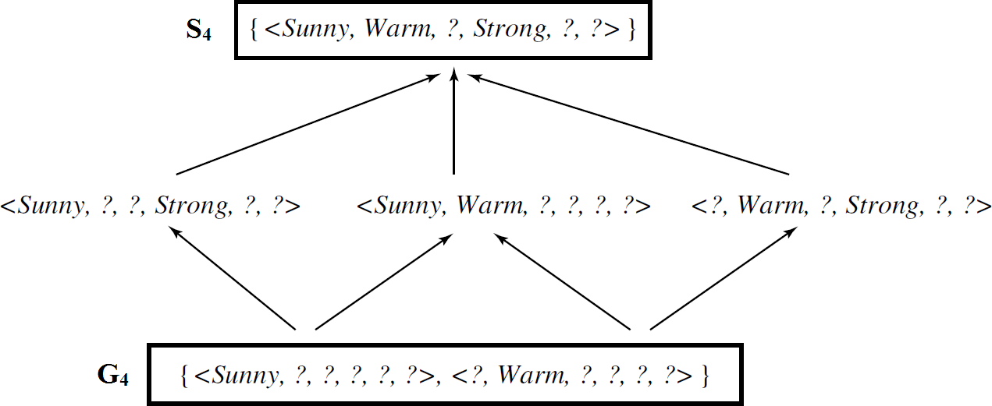
Version Space :Enjoysport
Example | Sky | AirTemp | Humidity | Wind | Water | Forecast | EnjoySport
1 | Sunny | Warm | Normal | Strong | Warm | Same | Yes
2 | Sunny | Warm | High | Strong | Warm | Same | Yes
3 | Rainy | Cold | High | Strong | Warm | Change | No
4 | Sunny | Warm | High | Strong | Cool | Change | Yes

Slide 31
Remarks on Version Space and Candidate Elimination
Will the CANDIDATE-ELIMINATION Algorithm Converge to the Correct Hypothesis?
  Yes/No based on following constraints
    there are no errors in the training examples
    there is some hypothesis in H that correctly describes the target concept
  The target concept is exactly learned when the S and G boundary sets converge to a single, identical, hypothesis
  If training data contain errors
    the algorithm is certain to remove the correct target concept from the version space
    And possibly the S and G boundary sets eventually converge to an empty version space
  A similar symptom will appear when the training examples are correct, but the target concept cannot be described in the hypothesis representation

Slide 32
Example | Toothed | Legs | Species
1 | True | True | Mammal (Y)
2 | True | False | Reptile (N)
3 | False | True | Mammal (Y)
4 | False | True | Reptile (N)
S0=< Ø, Ø>
S1=<T,T>
S2=<T,T>
S3=<?,T>
S4=< >
S4 = G4 = { }
G4= < T,?> <?, F>
G3=<?,T>
G2= <F,?> <?,T>
G1=<?,?>
G0=<?,?>
Example | Toothed | Legs | Species
1 | True | True | Mammal
2 | True | False | Reptile
3 | False | True | Mammal
4 | False | False | Reptile
S0=< Ø, Ø>
S1=<T,T>
S2=<T,T>
S3=<?,T>
S4= <?,T>
G4= <?,T>
G3= <?,T>
G2= <F,?> <?,T>
G1=<?,?>
G0=<?,?>

Slide 33
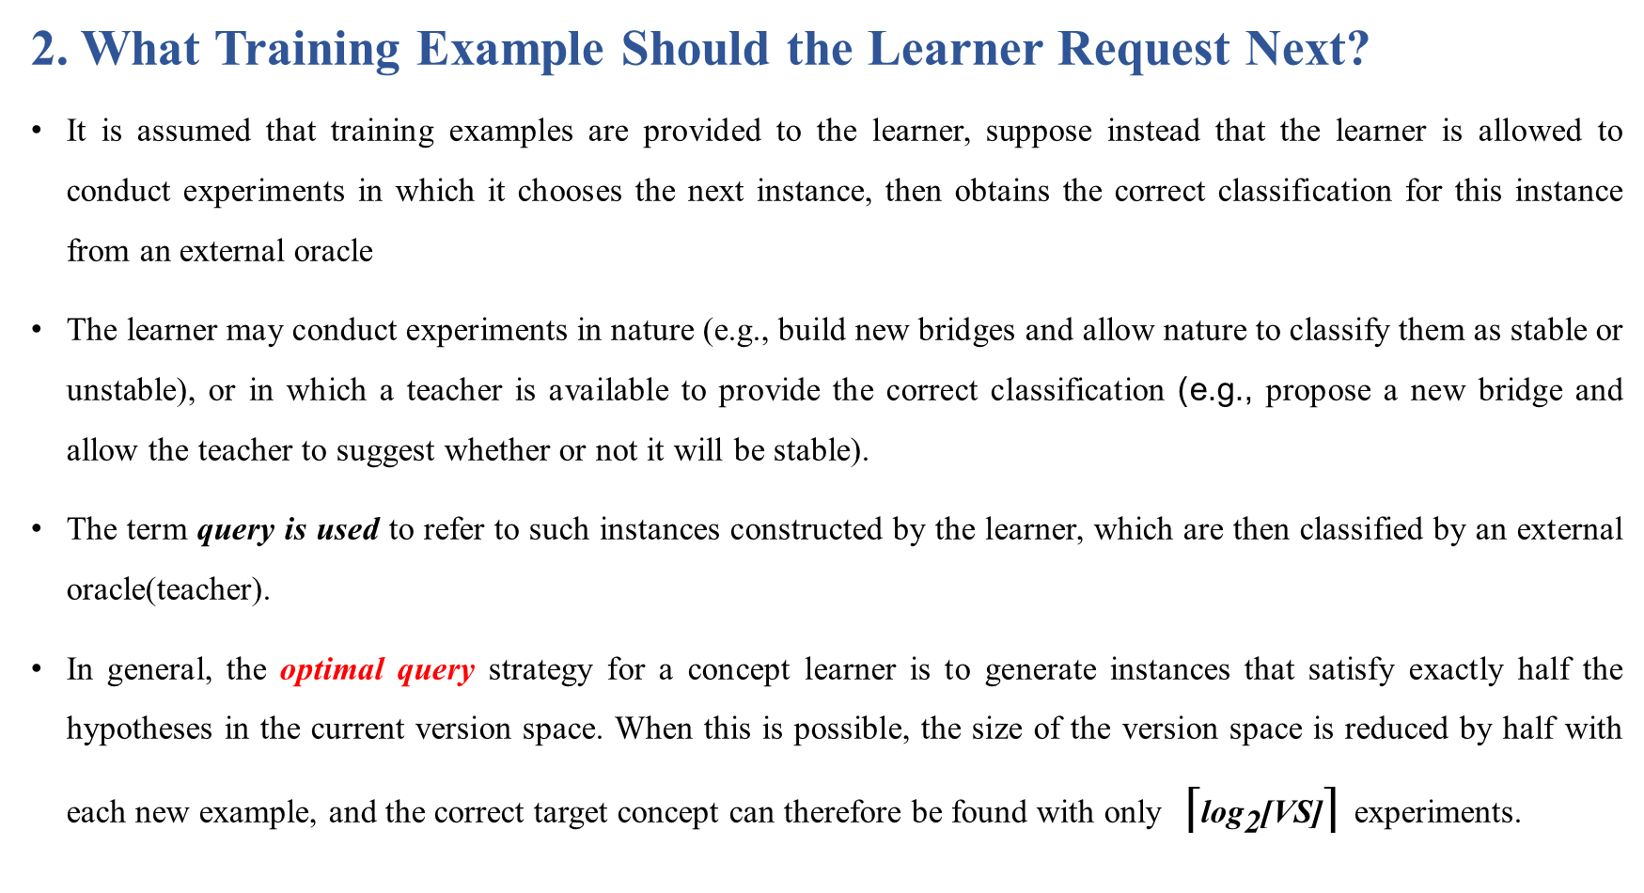
Remarks on Version Space and Candidate Elimination contd..
2. What Training Example Should the Learner Request Next?
It is assumed that training examples are provided to the learner, suppose instead that the learner is allowed to conduct experiments in which it chooses the next instance, then obtains the correct classification for this instance from an external oracle
The learner may conduct experiments in nature (e.g., build new bridges and allow nature to classify them as stable or unstable), or in which a teacher is available to provide the correct classification (e.g., propose a new bridge and allow the teacher to suggest whether or not it will be stable).
The term query is used to refer to such instances constructed by the learner, which are then classified by an external oracle(teacher).
In general, the optimal query strategy for a concept learner is to generate instances that satisfy exactly half the hypotheses in the current version space. When this is possible, the size of the version space is reduced by half with each new example, and the correct target concept can therefore be found with only ⌈${\text{log}}_{\text{2}}$[VS]⌉ experiments.

Slide 34
For example
The learner should attempt to discriminate among the alternative competing hypotheses in its current version space. Therefore, it should choose an instance that would be classified positive by some of these hypotheses, but negative by others.
Suppose the trainer will classify the following instance as positive than only 3 out 6 hypothesis will be consistent
<Sunny, Warm, Normal, Light, Warm, Same>

Slide 35
Remarks on Version Space and Candidate Elimination contd..
How Can Partially Learned Concepts Be Used?
  A learner is partially learned if it contains multiple hypotheses.
  But still it is possible to classify certain examples with the same degree of confidence as if the target concept had been uniquely identified.

Slide 36
Summary
Learning involves acquiring general concepts from specific training examples.
Concept learning can be cast as a problem of searching through a large predefined space of potential hypotheses.
The general-to-specific partial ordering of hypotheses provides a useful structure for organizing the search through the hypothesis space.
The FINDS algorithm utilizes this general-to-specific ordering, performing a specific-to-general search through the hypothesis space to find the most specific hypothesis consistent with the training examples
The CANDIDATE-ELIMINATION algorithm utilizes this general-to-specific ordering to compute the version space (the set of all hypotheses consistent with the training data) by incrementally computing the sets of maximally specific (S) and maximally general (G) hypotheses.
The target concept is exactly learned when the S and G boundary sets converge to a single, identical, hypothesis. Otherwise, the S and G sets delimit the entire set of hypotheses consistent with the data, they provide the learner with a description of its uncertainty regarding the exact identity of the target concept.
Version spaces-based CANDIDATE-ELIMINATION algorithm is not robust to noisy data or to situations in which the unknown target concept is not expressible in the provided hypothesis space.

