Slide 1
E-Commerce Database Management System
-Project by Durga Bhavani

Slide 2
Introduction
The E-Commerce Database Management System project is designed to simulate the working of an e-commerce platform using SQL. It efficiently manages information related to customers, products, orders, shippings, and payments. The project focuses on creating a structured and relational database to store and retrieve business data accurately.
Through this project, various SQL queries can be executed to analyze sales trends, customer purchases, shipping performance, and payment records. It demonstrates how relational databases ensure data consistency, accuracy, and efficient management in large-scale
e-commerce systems.

Slide 3

Tables Present in this Project
1
Customers – stores customer details like name and state.
2
Products – holds product data such as price, cost, brand, and category.
3
Sales – records each order placed, including customer ID, product ID, quantity, and order status.
3
4
Shippings – tracks shipping details like delivery status, provider, and return date.
5
Payments – manages payment information such as payment status and date.

Slide 4

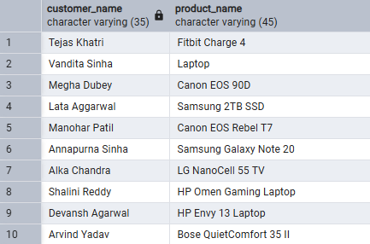
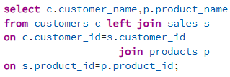
E-Commerce Database Management System
1.Retrieve a list of all customers with their corresponding product names .
Output:
About us

Slide 5
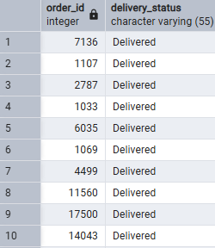

Borcelle
E-Commerce Database Management System
Output:
2.List all orders and their shipping status. Include orders that do not have any shipping records.

Slide 6
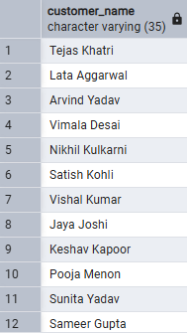
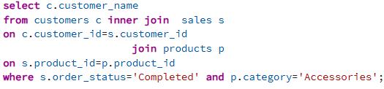
E-Commerce Database Management System
3.List all customers who have placed orders where the product category is 'Accessories' and the order status is 'Completed‘.
Output:
About us

Slide 7
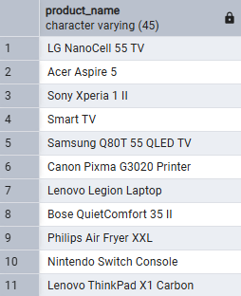
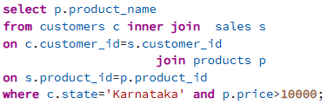
Borcelle
E-Commerce Database Management System
Output:
4. Retrieve a list of products ordered by customers from the state 'Karnataka' with price greater than 10,000.

Slide 8
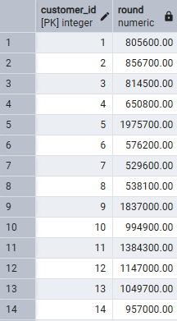
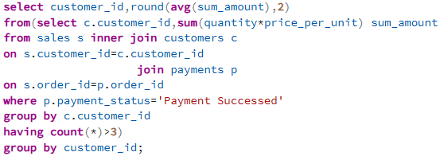
E-Commerce Database Management System
5. Get the average payment amount per customer who has placed more than 3 orders.
Output:
About us

Slide 9
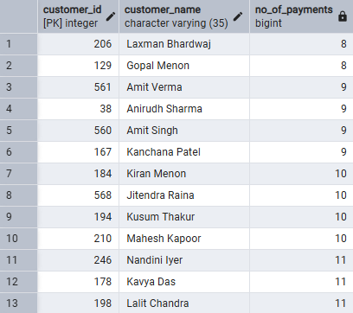
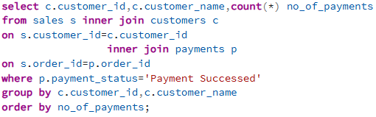
Borcelle
E-Commerce Database Management System
Output:
6.Retrieve the number of payments made per customer where the payment status is 'Payment Successed' and group by customer, ordering by payment count .

Slide 10
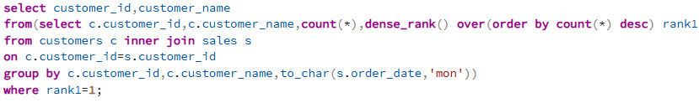

E-Commerce Database Management System
7.Find the customers who have made the most purchases in a single month.
Output:
About us

Slide 11

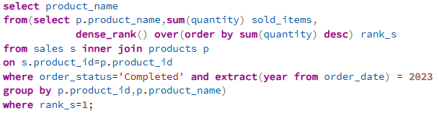
Borcelle
E-Commerce Database Management System
Output:
8.Find the most popular product based on total quantity sold in 2023.

Slide 12
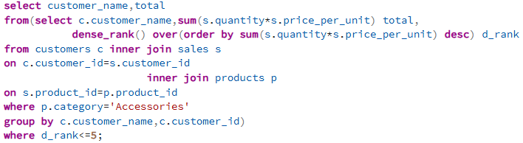
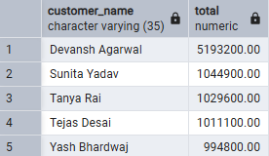
E-Commerce Database Management System
9.Get the top 5 customers by total spending on 'Accessories'.
Output:
About us

Slide 13
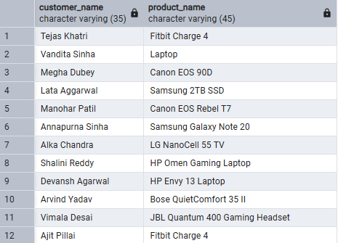
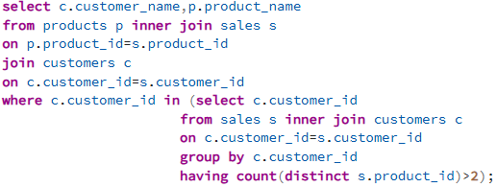
Borcelle
E-Commerce Database Management System
Output:
10. List all customers and the products they have purchased, showing only those who have ordered more than two products.

Slide 14

Conclusion
The E-Commerce Database Management System project helps manage e-commerce data efficiently using SQL. It maintains customer, product, order, shipping, and payment details with accuracy and consistency. This project shows how relational databases support smooth data handling and analysis in online shopping platforms.

