Slide 1

VELAGAPUDI RAMAKRISHNA SIDDHARTHA ENGINEERING COLLEGE
DEPT OF ELECTRONICS AND COMMUNICATION ENGINEERING
EFFICIENT DATA WIDTH CONVERSION WITH AXI STREAM DOWNSIZER USING VERILOG
GUIDE : DR.M.PADMAJA BATCH NO : A02
-Professor
S.DURGA BHAVANI 228W1A0457
Y.VARSHITHA 228W1A0465
Y.POOJITHA 228W1A0464

Slide 2
Abstract:
Efficient data width conversion is a critical requirement in modern digital systems, where high-performance interconnects like the AXI Stream protocol must handle varying data widths seamlessly.
The AXI Stream Downsizer provides a robust and efficient solution for reducing data widths while maintaining data integrity and alignment.
This explores the architecture, implementation, and benefits of the AXI Stream Downsizer in applications requiring flexible data handling.
By optimizing resource utilization and minimizing latency, the downsizer enables developers to design systems with enhanced performance, scalability, and interoperability.

Slide 3
Social Significance:
By improving the handling of high-speed data, the downsizer enables the deployment of faster and more reliable networks, such as 5G and fiber-optic systems.
Efficient designs save hardware resources and energy, lowering production costs for manufacturers.
These systems improve the efficiency and accessibility of technologies that impact daily life, such as streaming platforms, and IoT devices.

Slide 4
Literature Review:
Author(s) | Title | Year | Key Contributions | Contrasts
Jesús Lázaro, Armando Astarloa, Aitzol Zuloaga, José Ángel Araujo, Jaime Jiménez | AXI Lite Redundant On-Chip Bus Interconnect for High Reliability Systems | 2024 | The primary contribution of this paper is a triple redundant on-chip interconnect bus (AXI Lite Redundant) that enhances reliability for FPGA-based systems and focus on zero-latency. It also focuses on fault tolerance. | AXI Stream Downsizer handles data width conversion for seamless streaming. Your design prioritizes throughput in width conversion.
Jiang, Z., Audsley, N., Shill, D., Yang, K., Fisher, N., Dong, Z. | AXI-Interconnect RT: Towards a Real-Time AXI Interconnect for SoCs | 2021 | introduces enhancements to the AXI interconnect to better support real-time applications.​ | The downsizer ensures data compatibility between mismatched bus widths and Primarily deals with data slicing and control signal management to maintain AXI-Stream protocol compliance.
Zhang, Y., Cai, G., Huang, Z. | High Performance and Low Area Interconnect Structure Based on AXI | 2024 | It introduces an optimized AXI interconnect architecture designed to enhance performance while minimizing area utilization. | It provides flexibility in data width management, facilitating interoperability between components with varying data widths.
De Sio, C., Azimi, S., Sterpone, L. | On the Evaluation of SEU Effects on AXI Interconnect within AP-SoCs | 2020 | Evaluated Single-Event Upsets (SEU) in AXI interconnects, addressing reliability in radiation-prone environments. | The downsizer ensures standardized data transfer between components with different bus widths.
Emil, D., Hamdy, M., Nagib, G. | Development of an Efficient AXI-Interconnect Unit Between a Set of Customized Peripheral Devices and an Implemented Dual-Core RISC-V Processor | 2023 | Designed a custom AXI interconnect for RISC-V processor-based systems to improve peripheral communication. | It focuses on data width conversion in AXI streams, independent of the specific processor or peripherals.

Slide 5
Problem Statement:
In high-speed digital systems, data width mismatches between different modules can cause inefficiencies, data loss, and increased latency. The Advanced extensible Interface (AXI) Stream protocol is widely used for high-performance data streaming but when interfacing components with different data widths, proper conversion mechanisms are required. Traditional data width conversion methods introduce unnecessary overhead, increase power consumption and affect system performance. This project focuses on designing an efficient AXI Stream downsizer in Verilog to optimize data width conversion while maintaining low latency and high throughput.

Slide 6
Objectives:
Achieve Seamless Data Width Conversion:
Enable reliable downscaling of AXI Stream data widths while preserving data integrity and alignment.
Provide Design Flexibility:
Allow customization for different data width reduction ratios, error checking mechanisms and control signals.
Improving System Modularity and Reusability:
Design a downsizer that can be easily reused across multiple projects and hardware setups. Simplify hardware integration between modern and legacy IP cores.

Slide 7
Proposed Methodology:
Study of AXI stream protocol
Declared ports following AXI Stream protocol
Width Handling and Ratio Calculation
Buffering the Input Data
Output Chunking Logic(Use chunk_counter to slice the correct chunk from the buffer)
TLAST Handling
Post-Chunk Reset and Readiness
Run Simulation
Creating IP module

Slide 8
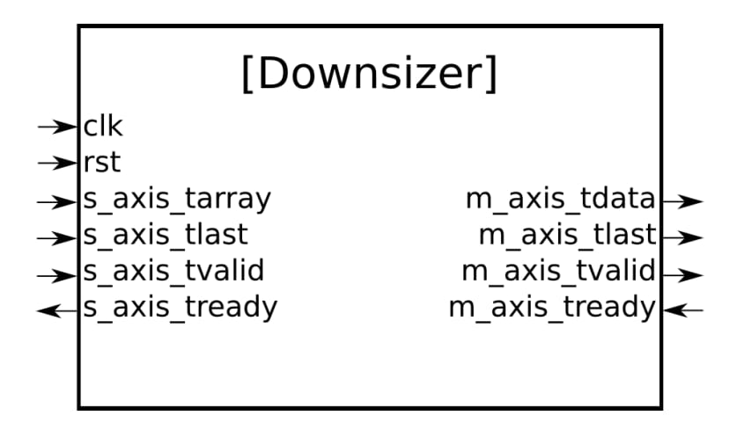

Block Diagram:

Slide 9
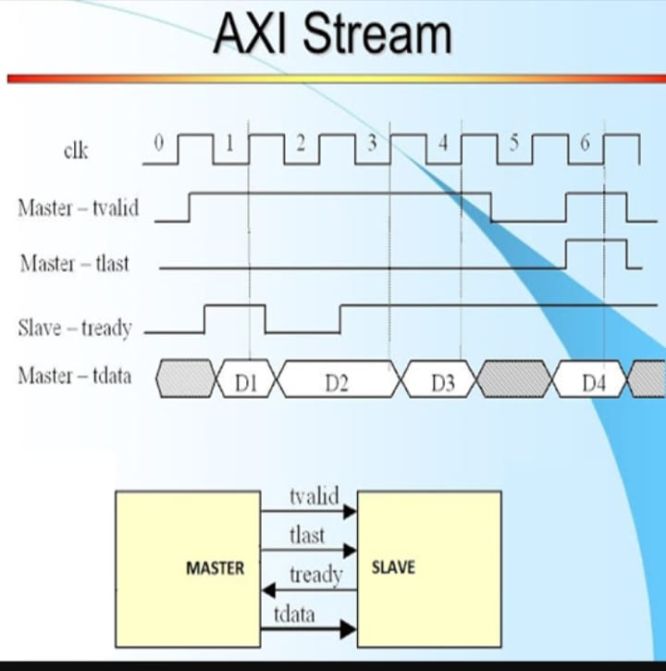
AXI Stream Protocol:

Slide 10
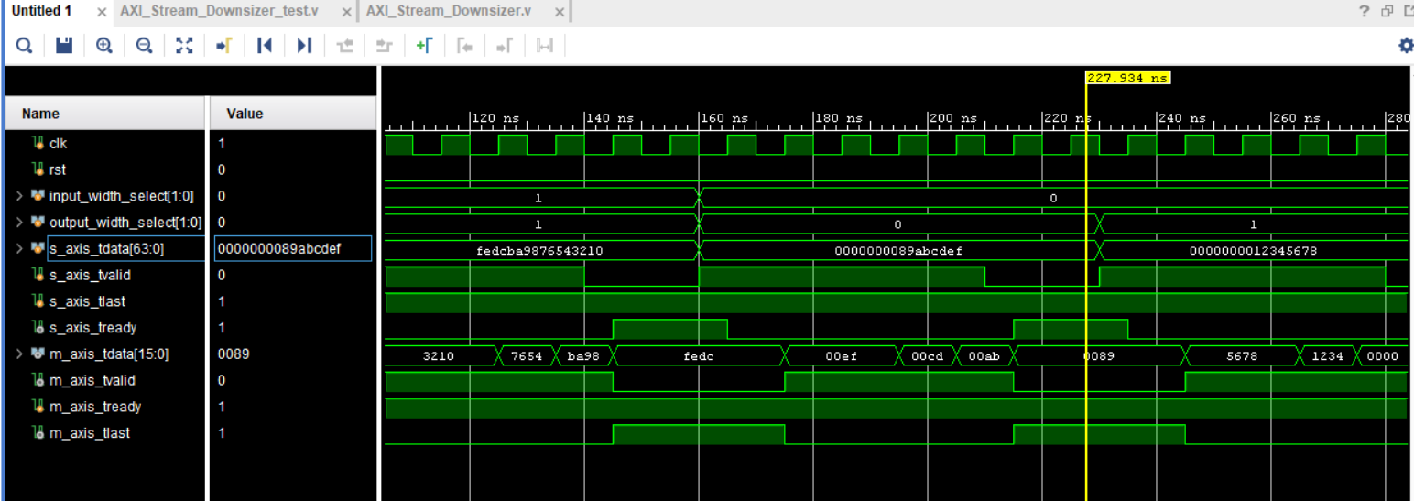
Simulation Results:
89abcdef(32-bit)
Test case 1 :0000000089abcdef which is 32 bits that breaks into 8 bits

Slide 11
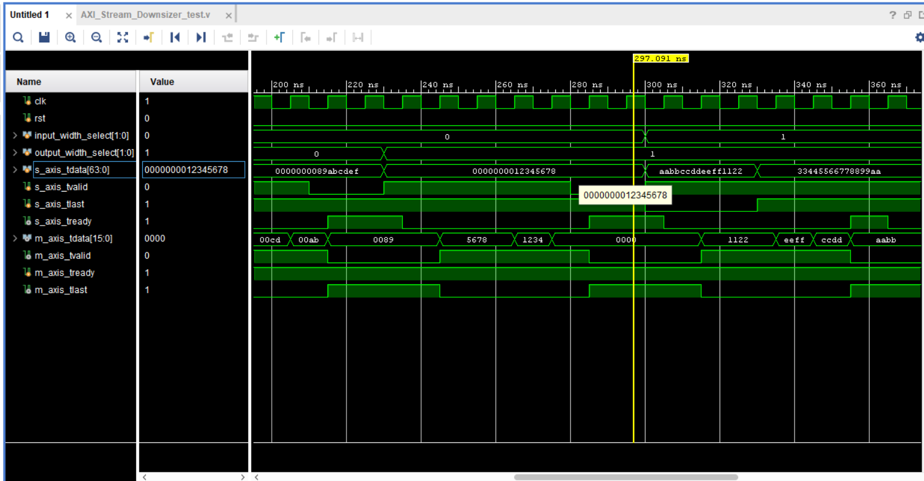
Test case 2:0000000012345678 is a 32 bit breaks in 16 bit
12345678(32-bit)

Slide 12
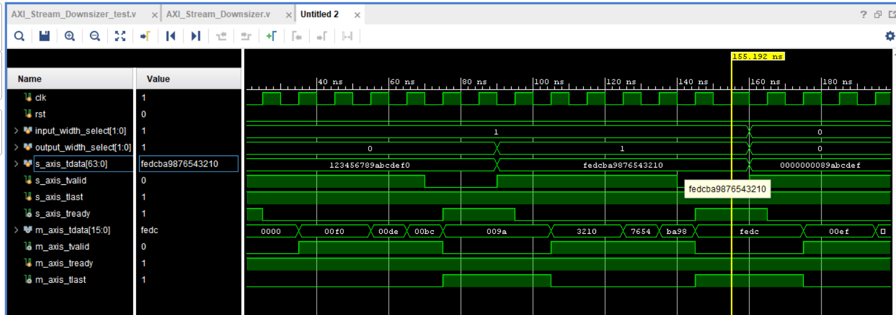
Test Case 3: fedcba9876543210 which is a 64 bit data breaks into 16 bit
FEDCBA9876543210(64 bit)

Slide 13
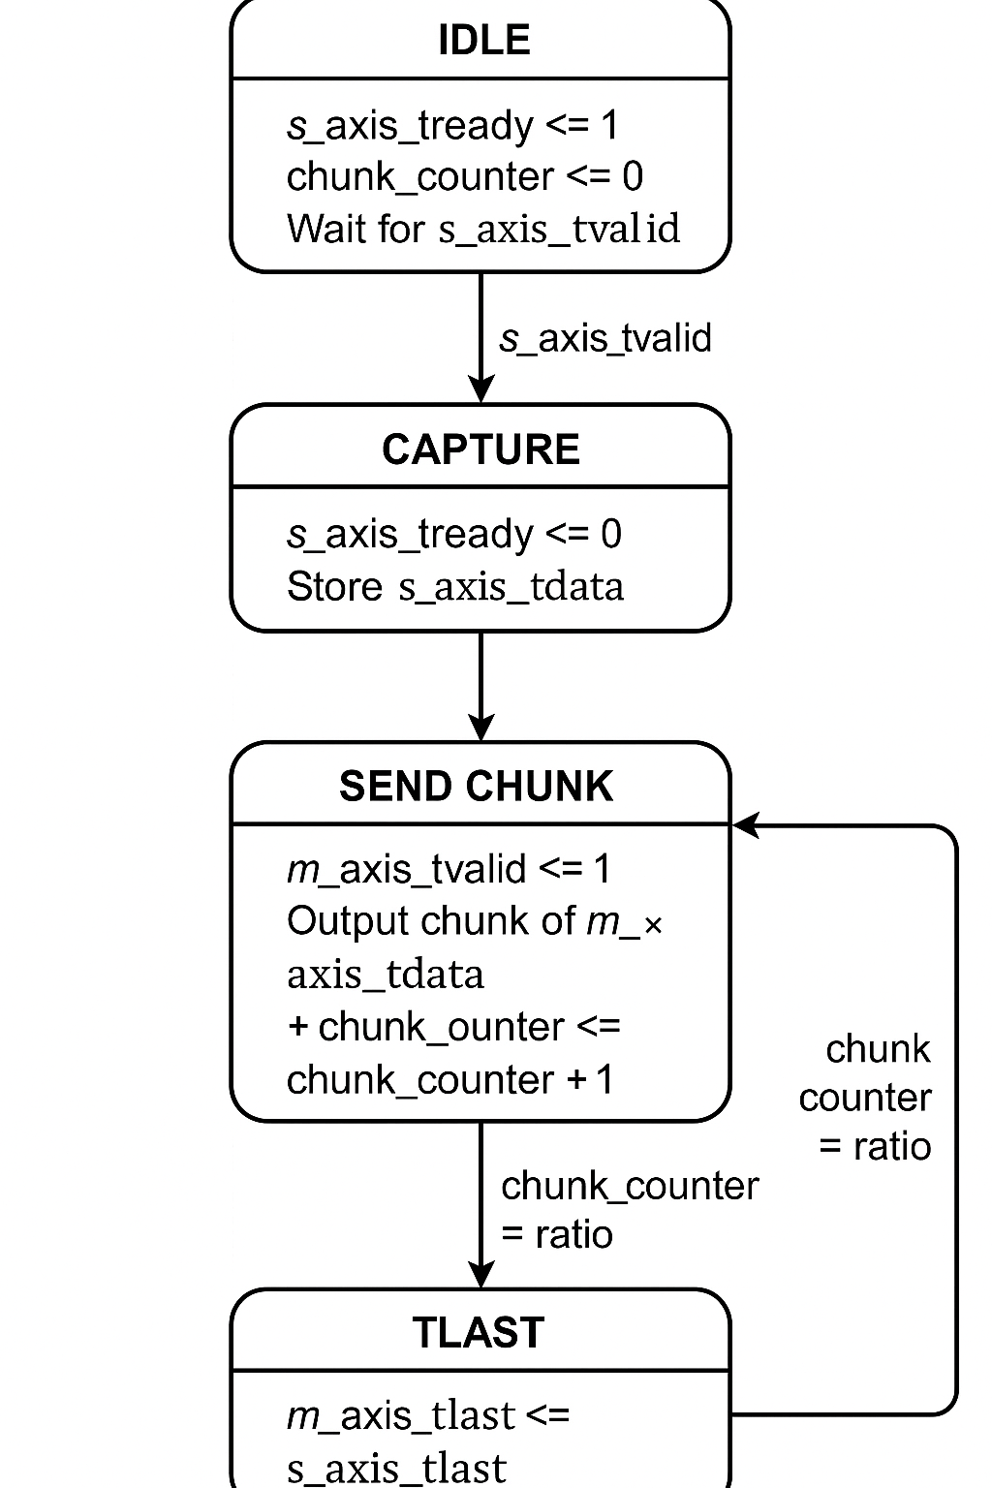
-1
-1

Slide 14
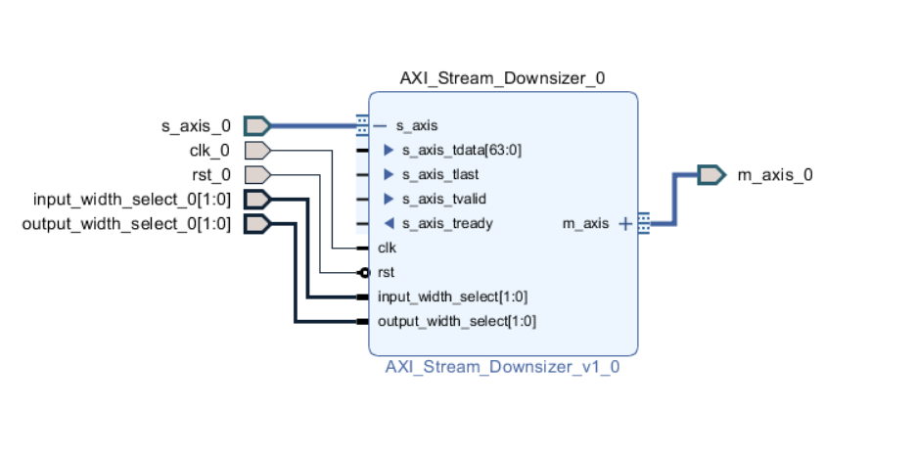
IP Module:

Slide 15
Result Analysis:
Data Width Flexibility: Our design allows dynamic width selection on both input and output (32/64 input to 8/16 output), offering versatile configuration without re-synthesis.
Lightweight and Modular: Compared to system-wide AXI interconnects, the downsizer is minimal in area and can be reused in larger data systems.
Stream-Oriented Design: Unlike general-purpose interconnects, this module is specifically optimized for AXI Stream interface with buffer slicing logic and TLAST handling.

Slide 16
Limitations:
Only one transaction is stored at a time using data_buffer.
Need more FPGA logic for implementation.

Slide 17
References:
Jesús Lázaro, Armando Astarloa , Aitzol Zuloaga, José Ángel Araujo, and Jaime Jiménez:AXI Lite Redundant On-Chip Bus Interconnect for High Reliability Systems: VOL. 73, NO. 1, MARCH 2024,IEEE.
Jiang, Z., Audsley, N., Shill, D., Yang, K., Fisher, N. and Dong, Z., 2021, May. Brief industry paper: AXI-interconnect RT: Towards a real time AXI interconnect for system-on-chips. In 2021 IEEE 27th Real Time and Embedded Technology and Applications Symposium (RTAS) (pp. 437-440). IEEE.
Zhang, Y., Cai, G. and Huang, Z., 2024, January. High performance and low area interconnect structure based on AXI. In Workshop on Electronics Communication Engineering (WECE 2023) (Vol. 12973, pp. 39-45).
De Sio, C., Azimi, S. and Sterpone, L., 2020. On the evaluation of SEU effects on AXI interconnect within AP-SoCs. In Architecture of Computing Systems–ARCS 2020: 33rd International Conference, Aachen, Germany, May 25–28, 2020, Proceedings 33 (pp. 215-227). Springer International Publishing.
Emil, D., Hamdy, M. and Nagib, G., 2023. Development an efficient AXI-interconnect unit between set of customized peripheral devices and an implemented dual-core RISC-V processor. The Journal of Supercomputing, 79(15), pp.17000-17019.

