Slide 1

VELAGAPUDI RAMAKRISHNA SIDDHARTHA ENGINEERING COLLEGE
DEPT OF ELECTRONICS AND COMMUNICATION ENGINEERING
CMOS HALF ADDER: VLSI DESIGN, SIMULATION, AND LAYOUT WITH DFT IN MICROWIND
NAME: SUGRIVU DURGA BHAVANI
ROLL NO: 228W1A0457
COMPANY: BIST TECHNOLOGIES PVT . LTD.
DURATION: 4 MONTHS (DEC 2024 – APR 2025)

Slide 2
Abstract:
Internship completed at BIST Technologies Pvt. Ltd. in the domain of VLSI Design for Testability (DFT)
Focus on understanding ASIC design flow and the importance of testable circuit design
Designed and simulated a CMOS Half Adder at logic and transistor levels
Implemented layout using Microwind VLSI CAD tool
Verified functionality using DRC and LVS checks
Gained hands-on experience in digital VLSI design, layout, and verification

Slide 3
Background:
Modern ICs have high complexity and integration density
Testing is critical for:
  Functional correctness
  Yield improvement
  Reliability
Design for Testability (DFT) integrates testing features at design stage
Improves:
  Controllability
  Observability
  Fault detection efficiency

Slide 4
Objectives
Understand ASIC design flow
Learn DFT methodologies
Study fault models and test generation
Implement a CMOS Half Adder
Perform layout design and verification
Analyze area and timing parameters

Slide 5
Scope of Work
Study of:
  RTL to physical design flow
  Scan-based testing
  Fault modeling
Design and simulation of Half Adder
Layout design using Microwind
Post-layout verification (DRC & LVS)

Slide 6
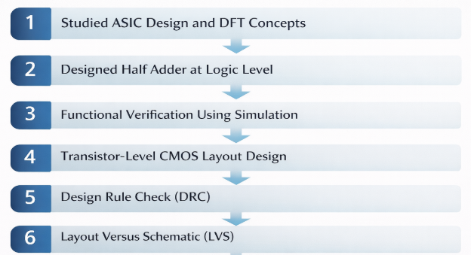
METHODOLOGY:
.

Slide 7
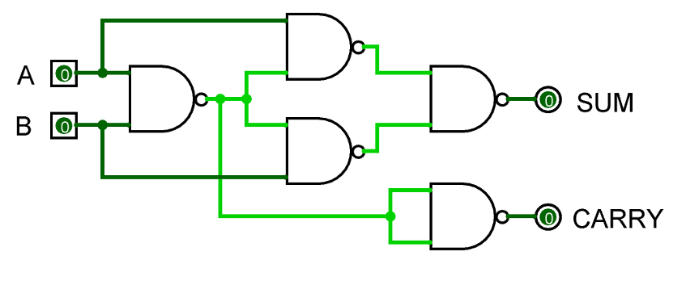
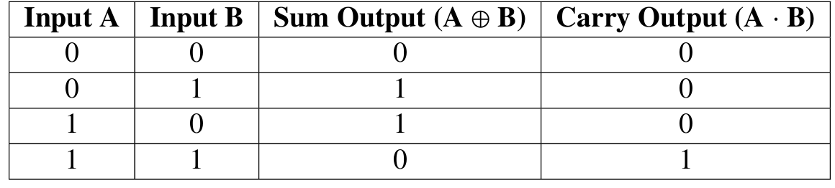
Half Adder Design:
Inputs: A, B
Outputs:
  Sum = A ⊕ B
  Carry = A · B
Implemented using:
  XOR gate for Sum
  AND gate for Carry
Half Adder using NAND Gates
Truth Table for Half Adder

Slide 8
Layout Implementation:
Transistor-level layout in Microwind
Proper NMOS & PMOS placement
Metal routing and contacts added
Layout optimized for:
  Compact area
  Reduced parasitic effects

Slide 9
CMOS Layout Design Rules (λ-Based)
  .
Layer | Design Rule | Minimum Value
Polysilicon | Minimum poly width | 2λ
Polysilicon | Poly–poly spacing | 2λ
Polysilicon | Poly overlap on diffusion | 2λ
Diffusion | Minimum diffusion width | 3λ
Diffusion | Diffusion–diffusion spacing | 3λ
Diffusion | Diffusion extension beyond gate | 2λ
Metal-1 | Minimum metal width | 3λ
Metal-1 | Metal–metal spacing | 3λ
Metal-1 | Metal overlap on contact | 1λ
Contact | Contact size | 2λ × 2λ
Contact | Contact–contact spacing | 2λ
Via | Via size | 2λ × 2λ
Via | Via spacing | 2λ
Well | Minimum well width | 12λ
Well | Well–well spacing | 6λ

Slide 10
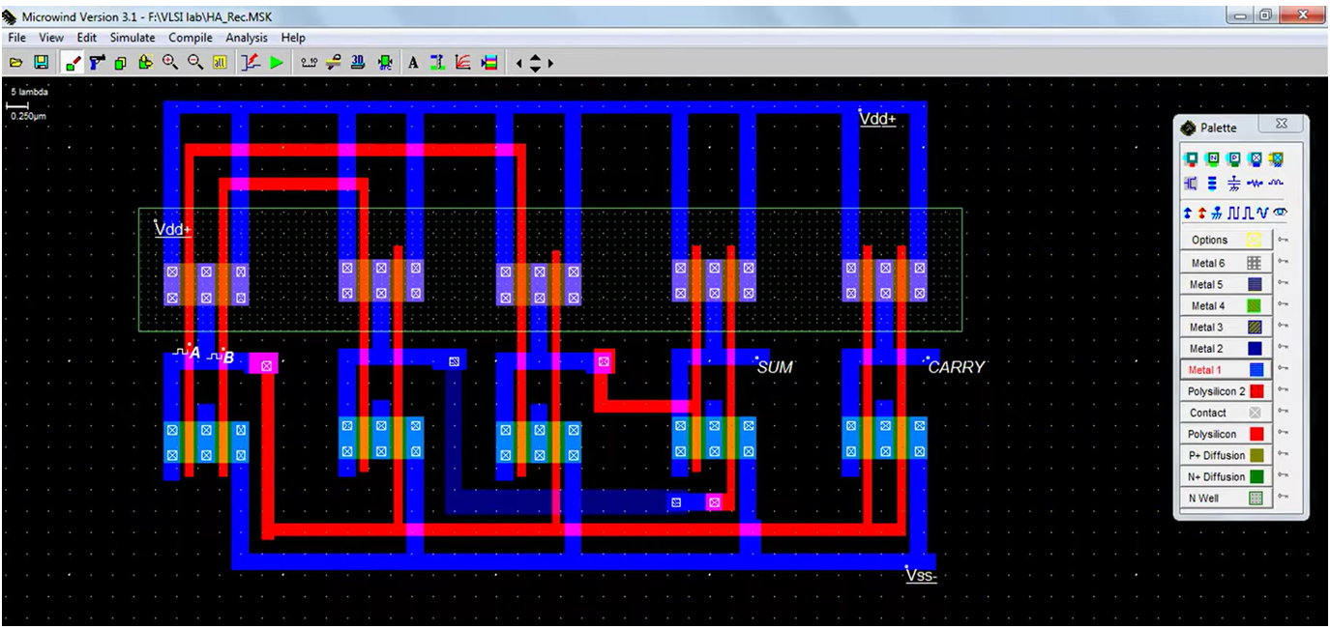
Layout Design of half Adder in Microwind
.

Slide 11
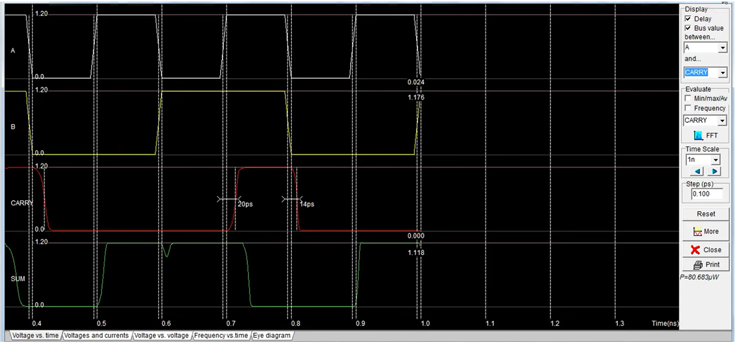
.
RESULTS AND DISCUSSIONS:
Fig 7: V_{dd} vs Delay in SRAM Cell in Write Operation
Output Waveforms of Layout Design for Half Adder

Slide 12
.
RESULTS AND DISCUSSIONS:
A | B | Sum | Carry
0 | 0 | 0 | 0
0 | 1 | 1 | 0
1 | 0 | 1 | 0
1 | 1 | 0 | 1
Table : Input–Output Verification based on Layout
Half Adder operates correctly for all input cases
Layout adheres to CMOS design rules
Functional and post-layout verification successful
Demonstrates effective application of DFT concepts

Slide 13
CONCLUSION:
The internship at BIST Technologies Pvt. Ltd. provided strong practical exposure to VLSI Design for Testability (DFT) and ASIC design flow.
A CMOS Half Adder was successfully designed, simulated, and implemented at the transistor level using the Microwind tool.
Functional correctness was verified through pre-layout and post-layout simulations, including DRC and LVS checks.
The project reinforced key concepts such as layout design rules, area optimization, timing analysis, and DFT awareness.
Overall, the internship bridged the gap between theoretical VLSI concepts and real-world IC design, providing a strong foundation for future roles in ASIC and VLSI design.

Slide 14
References:
[1] Bhattacharya, Debaprasad, Digital VLSI Design and Test, McGraw-Hill, 2008.
[2] Chandrasekaran, K., and R.S.S.Prasad, ”Design and Layout of CMOS Logic Gates and Combinational Circuits,” International Journal of Electronics and Communication Engineering, 2018.
[3] Kang, Sung-Mo, and Yusuf Leblebici, CMOS Digital Integrated Circuits: Analysis and Design, 3rd Edition, McGraw-Hill, 2003.
[4] Rabaey, Jan M., ”Digital Integrated Circuits: Design, Fabrication, and Test,” IEEE Transactions on VLSI Systems, vol. 9, no. 3, pp. 299–311, 2001.

Slide 15
THANK YOU

