Slide 1
Credit Card Fraud
Detection System
Using Machine Learning
Finex Bank | Fraud Analytics Division
1,296,675 Transactions • 7 Models Evaluated • AUC: 0.983
Notes:
Welcome everyone. Today I will walk you through our machine learning-based fraud detection system built for Finex Bank. We analyzed over 1.2 million transactions, built 7 models, and achieved an AUC of 0.983 with our best model.

Slide 2
Agenda
01
Business Problem & Objective
05
Model Evaluation
Why fraud detection matters for Finex Bank
Metrics, ROC-AUC, Precision-Recall tradeoffs
02
Data Understanding & EDA
06
Financial Impact
Dataset of 1.29M transactions, key insights
Cost-benefit analysis and business savings
03
Feature Engineering
07
Recommendations
Creating time, distance, and behavioral features
Final model choice and next steps
04
Model Building
7 models: Logistic → Random Forest → XGBoost
Notes:
Here is the agenda. We will cover the entire ML lifecycle from problem definition to financial impact.

Slide 3
Business Problem & Objective
$33B+
0.52%
1.29M
Global Card Fraud Loss
Detection Challenge
Data Size
annually worldwide
fraud rate — extreme class imbalance
transactions analyzed
Our Objectives
Accurately identify fraudulent credit card transactions from 1.29M records
Handle extreme class imbalance (99.48% non-fraud vs 0.52% fraud) using SMOTE
Engineer behavioral and temporal features to improve detection
Minimize financial losses through cost-benefit optimized model selection
Evaluate business savings via quantified financial impact analysis
Notes:
Finex Bank faces a critical challenge: detecting fraud in a dataset where only 0.52% of transactions are fraudulent. Standard accuracy metrics fail here — we need precision-recall tradeoffs and appropriate sampling techniques.

Slide 4
Data Understanding & EDA
1,296,675
23
0
0.52%
Total Records
Features
Missing Values
Fraud Rate
Key EDA Insights
Target Distribution
Class Imbalance:
99.48% legit vs 0.52% fraud — accuracy alone is misleading
Transaction Amount:
Fraud txns have significantly higher median amounts
High Skewness:
amt skewness: 40.81 → log transformation applied
City Hotspots:
Clearwater & Aurora exceed 3% fraud rate
Temporal Patterns:
Fraud peaks during certain hours and weekdays
Notes:
The dataset has 1.29M transactions with 23 features and zero missing values. The critical challenge is the extreme class imbalance: only 0.52% are fraud. We found fraud transactions tend to have higher amounts, and certain cities show higher fraud concentrations.

Slide 5
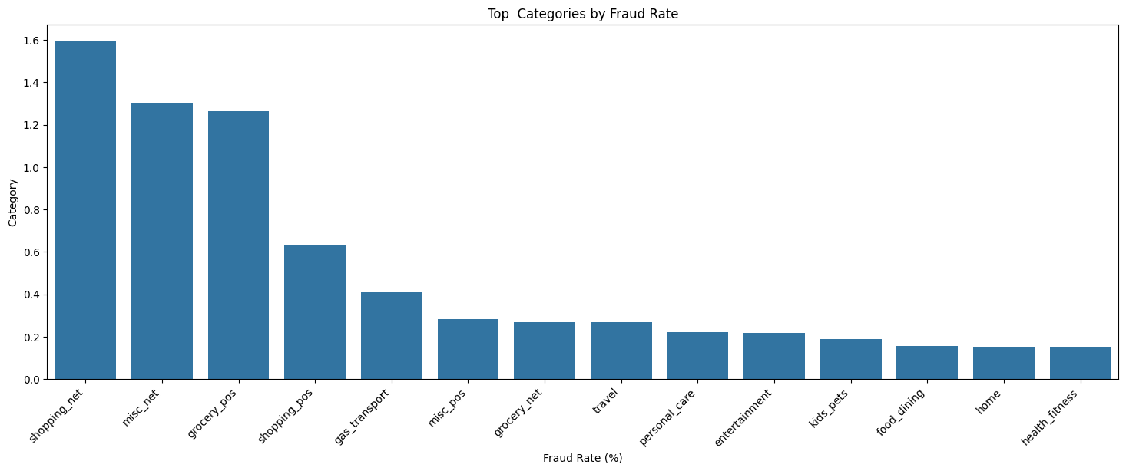
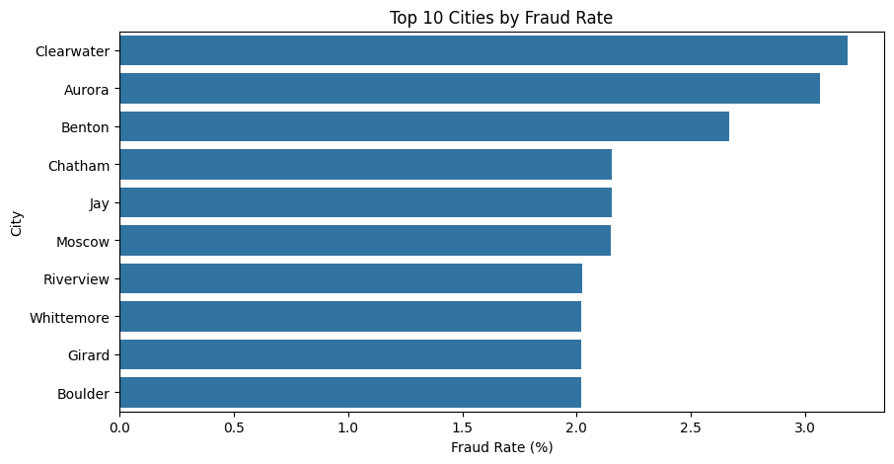
EDA — Fraud by Category & City
Top Categories by Fraud Rate
Top 10 Cities by Fraud Rate
💡 Key Insight
💡 Key Insight
shopping_net (1.6%), misc_net (1.3%) and grocery_pos (1.26%) have the highest fraud rates — online & grocery channels are primary fraud targets.
Clearwater (3.2%) and Aurora (3.1%) are fraud hotspots — geographically targeted fraud prevention can reduce losses.
Notes:
Two important EDA findings: Online shopping categories have the highest fraud rates, suggesting fraudsters prefer card-not-present transactions. Geographically, Clearwater and Aurora show 3%+ fraud rates, well above the 0.52% average.

Slide 6
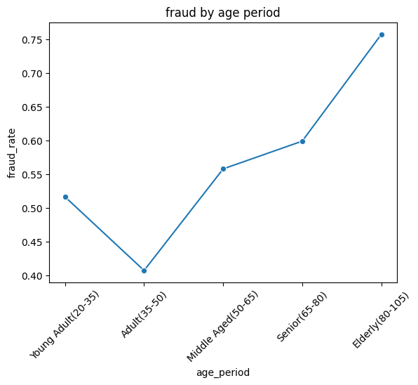
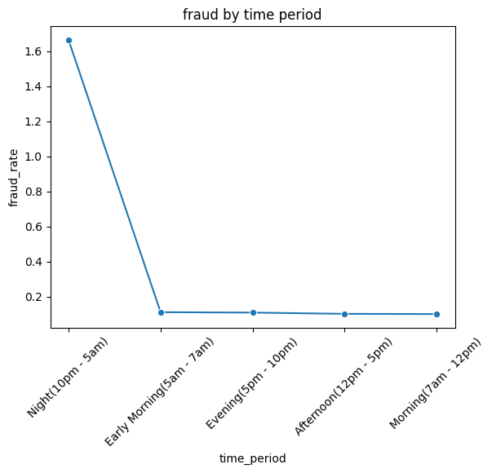
EDA — Fraud by Age, Time & Amount
Fraud Rate by Age Group
Fraud Rate by Time Period
💡 Elderly (80-105) show 0.76% fraud rate — highest of all age groups. Adults (35-50) are least targeted at 0.41%.
💡 Night (10pm–5am) has dramatically higher fraud rate (1.65%) — fraudsters operate when customers are least alert.
💳 Transaction Amount: Legitimate avg = $67.65 vs Fraud avg = $530.66 → Fraudulent transactions are 7.8× higher in value
Notes:
Three more EDA insights: Elderly customers are most vulnerable to fraud. Night-time transactions (10pm-5am) have a fraud rate of 1.65% vs 0.1% during daytime. Fraud transactions average $530.66 vs just $67.65 for legitimate ones — nearly 8x higher.

Slide 7
Feature Engineering
Columns Removed
New Features Created
first, last (PII)
Unnamed:0, unix_time (redundant)
zip, trans_num, street (non-informative)
Temporal Features
Year, Month, Weekday, Hour from transaction timestamp — captures time-based fraud patterns
Customer Age
Derived from date of birth — age groups show different fraud vulnerability
Distance (Haversine)
Geographic distance between customer and merchant — large distances flag suspicious txns
Log Transformation
log(amt) to fix extreme right skewness (40.81 → -0.45)
Removed redundant columns + Engineered 4 feature groups → Stratified 70/30 train-test split applied
Notes:
Feature engineering was critical. We removed PII and non-informative columns, then created temporal features, customer age, and geographic distance using the Haversine formula. Log transformation fixed the heavy skewness in transaction amounts.

Slide 8
Model Building Journey
Logistic Regression
XGBoost
1
5
Baseline
+ SMOTE
Class weight balanced
Linear decision boundary
Better minority class
representation
Random Forest
XGBoost
2
6
+ Class Weight
+ SMOTE + SelectFromModel
Ensemble method
Handles non-linearity
Feature selection
2193 → 184 features
Random Forest
XGBoost
3
7
+ SMOTE
+ SMOTE + SFM + RandomSearchCV
Synthetic oversampling
of minority class
Hyperparameter tuning
BEST MODEL ★
XGBoost
4
+ Class Balance
Gradient boosting
scale_pos_weight used
Notes:
We followed a systematic progression from a simple logistic regression baseline up to XGBoost with SMOTE, feature selection, and hyperparameter tuning. Each step was justified by measurable improvement in key metrics.

Slide 9
Handling Class Imbalance
Approach 1: Class Weights
Approach 2: SMOTE
Penalizes the model more heavily for misclassifying minority class. Used in Logistic Regression (class_weight='balanced') and XGBoost (scale_pos_weight).
Synthetic Minority Over-sampling Technique. Creates synthetic fraud samples by interpolating between existing fraud cases.
Advantages:
Advantages:
No data augmentation needed
Computationally efficient
Works well with imbalance ratio
Balances class distribution directly
Reduces model bias toward majority class
Improved recall for fraud class
SMOTE outperformed class weights — used in all final XGBoost models for better recall on fraud class
Notes:
We tried two main strategies for class imbalance. Class weights are simpler but SMOTE gave better results because it actually balances the training data, helping the model learn the fraud class patterns better.

Slide 10
Model Comparison Results
0.538
0.983
91.6%
Best F1
Best AUC
Feature Reduction
XGB + SMOTE + SFM + RSCV
Final tuned model
2193 → 184 features via SFM
Notes:
This slide shows the progression. F1 score jumped from 0.05 with logistic regression to 0.538 with our best XGBoost model. Feature selection alone improved F1 from 0.299 to 0.436, and hyperparameter tuning pushed it to 0.538.

Slide 11
★ Final Model: XGBoost + SMOTE + SelectFromModel + RandomSearchCV
0.538
0.983
F1 Score
ROC-AUC
Best balance of Precision & Recall
Near-perfect discrimination ability
40.2%
~85%
Precision
Recall
Of flagged txns are truly fraud
Fraud cases correctly detected
Why This Model Wins:
Feature selection reduced 2193 features to 184 (91.6% reduction) without sacrificing predictive power
RandomizedSearchCV tuned n_estimators, max_depth, and learning_rate — F1 improved from 0.436 to 0.538
AUC-ROC of 0.983 proves the model can rank-order fraud probability reliably for any threshold
Notes:
The best model achieved F1 of 0.538 and AUC of 0.983. Feature selection was key — reducing from 2193 to 184 features made the model faster and more generalizable. Hyperparameter tuning via RandomizedSearchCV delivered the final improvement.

Slide 12
Financial Impact & Cost-Benefit Analysis
Assumptions
Financial Outcomes
Avg transactions/month (a)
154,366
Cost Before Model (b × c)
$426,651/mo
Avg fraudulent transactions/month (b)
804
804 × $530.66 — full fraud loss
Avg amount per fraud transaction (c)
$530.66
Support Cost (TF × $1.50)
TF detected by model/month
200
$300/mo
200 × $1.50 — investigation cost
Support cost per flagged transaction
$1.50
Missed Fraud Cost (FN × c)
FN missed by model/month
45
$23,880/mo
45 × $530.66 — undetected fraud
NET SAVINGS/MONTH
$402,471
$426,651 − $24,180 = $402,471/month
Notes:
Translating model performance into business value: Before the model, Finex Bank lost $426,651 every month to fraud. After deployment, the total cost drops to just $24,180/month — $300 in support costs plus $23,880 in missed fraud. Net monthly savings: $402,471. That is over $4.8 million saved per year.

Slide 13
Recommendations & Next Steps
1
Deploy XGBoost Final Model
4
Add Real-Time Scoring
Use the SMOTE + SelectFromModel + RandomSearchCV pipeline in production. Set threshold at 0.9 for high precision with manageable false positives.
Integrate the model into the transaction processing pipeline for real-time fraud scoring with a sub-100ms SLA target.
2
Focus on Key Features
5
Use Threshold Tuning
Transaction amount (log_amt), geographic distance, and transaction hour are top predictors. Prioritize data quality for these fields.
At threshold 0.9: high precision, fewer false positives. At 0.3: higher recall, more fraud caught. Tune based on business tolerance.
3
Monitor & Retrain Periodically
Fraud patterns evolve. Schedule quarterly model retraining on fresh data to prevent model drift and maintain detection performance.
Notes:
Five key recommendations: deploy the best model, monitor key features, retrain quarterly, integrate real-time scoring, and use threshold tuning based on business needs. These steps will maximize the model's business impact.

Slide 14
Key Takeaways
XGBoost + SMOTE + Feature Selection + Tuning is the best model (F1: 0.538, AUC: 0.983)
Feature selection cut 91.6% of features with no AUC loss — leaner and faster model
Model saves Finex Bank $402,471/month = ~$4.83 million/year in fraud losses
Accuracy is misleading for imbalanced data — F1 and AUC are the right metrics
SMOTE consistently outperformed class weighting across all model architectures
Thank You | Questions Welcome
Notes:
Wrap up with these five key takeaways. Emphasize the business value — $402,471 in monthly savings, over $4.83 million per year — and the methodological rigor: proper handling of class imbalance, feature engineering, and iterative model improvement.

